Slide 1
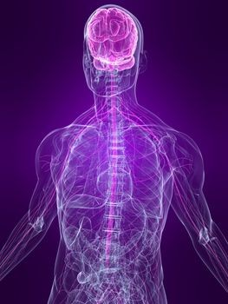
GENERAL ANAESTHETICS
Mr.Dharmendra Pradhan
SOP,CUTM,Bolangir

Slide 2
Definition
General anaesthetics are the drugs which produce reversible loss of sensation and consciousness.
Ideal anaesthetic gas-should induce unconciousness smoothly, rapidly, and prompt recovery
Balanced anaesthesia- various combinations
Monitored anaesthesia- local Ana’s +Gen Ana’s

Slide 3
Stages of Anaesthesia
Guedel described stages of ether anaesthesia
1. Stage of analgesia
-starts from beginning of anaesthetic inhalation and lasts upto loss of conciousness
2. Stage of delirium
from loss of conciousness to beginning of respiration
-apparent excitement is seen.
patient may struggle, shout, hold his breath
-micturition or defecation may occur

Slide 4
Stages of Anaesthesia
Surgical anaesthesia
Extends from onset of regular respiration to cessation of spontaneous breathing
Plane1- Rolling eye balls-till eyes become fixed
Plane2- Loss of corneal and laryngeal reflexes-
Plane3- Loss of light reflex-dilation of pupils
Plane4- Intercostal paralysis-shallow abdominal respiration
Medullary paralysis-cessation of breathing to failure of circulation and death

Slide 5
Mechanism of action
Anaesthetic gases interact with hydrophobic regions of neuronal membrane proteins that interface with membrane lipids
Inhaled Ana’s barbiturates, benzodiazepines, etomidate and propofol facilitates GABA- mediated inhibition at GABAA receptor sites and thereby increase cl flux through its channel.
Ketamine blocks the action of glutamate (an excitatory neurotransmitter) on NMDA receptor.

Slide 6
Mechanism of action
Inhalational anaesthetics like enflurane and isoflurane decrease the duration of opening of nicotinic receptors activated Na channels→ decreases the effects of Ach at cholinergic synapses
By affecting neuronal membrane proteins, general anaesthetics disrupt neuronal firing and sensory processing in the thalamus, thereby causing loss of conciousness and analgesic effects.
The motar activity is reduced because they also inhibit neuronal output from the internal pyramidal layer of cerebral cortex

Slide 7
Classification
INHALATIONAL ANAESTHETICS
Nitrous oxide, cyclopropane,xenon
VOLATILE LIQUIDS
Isoflurane, Sevoflurane
Desflurane, Halothane
(Ether), Enflurane
INTRAVENOUS ANAESTHETICS
INDUCING AGENTS Thiopentone sod.
Methohexitone sod., Propofol, Etomidate

Slide 8
Intravenous anaesthetics
SLOWER ACTING DRUGS
Benzodiazepines
Diazepam
Lorazepam
Midazolam
Dissociative anaesthesia
Ketamine
Neurolept analgesia
Fentanyl

Slide 9
Pharmacokinetics of inhalational anaesthesia
Aim is to attain rapid pp in brain-pleasant, adequate sedation, analgesia
Eqlbrium of par pr- alveoli, blood and tissues
Anesthetic uptake from the alveoli to the blood is dependant on three factors: the solubility of the anesthetic (S), the cardiac output (Q) and the alveolar to venous partial pressure (Pa-Pv):
Anaesthetic Uptake = (S) x (Q) x (Pa-Pv)
--pulmonary ventilation(A/v)
--pulmonary ventilation/perfusion ratio
--second gas and conc effect

Slide 10
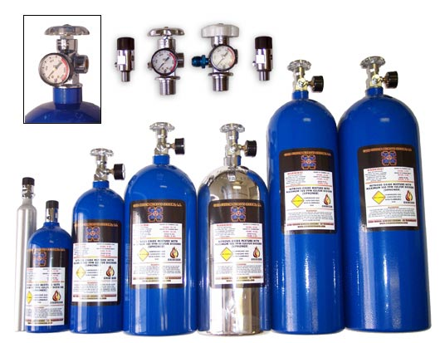
Nitrous Oxide
widely used
Potent analgesic
Produce a light anesthesia
Do not depress the respiration/vasomotor center
Used as adjunct to supplement other inhalationals
Least hepatotoxic

Slide 11
Second gas effect
It can concentrate halogenated anaesthetics in the alveoli →after concomitant administration →faster uptake from alveolar gas
Diffusion hypoxia-the solubility of nitrous oxide in blood is more than oxygen→ the speed of movement of nitrous oxide retards the oxygen uptake during recovery→ cause diffusion hypoxia→ use of 100% oxygen helps in recovery

Slide 12
Nitrous oxide- demerits and adverse effects
Within close compartment→it can increase volume→pneumothorax, sinuses pressure
No muscle relaxation
Post anaesthetic nausea and vomiting
>4hrs →megaloblastic anaemia
Abortion, birth defects

Slide 13
Ether –historical importance
Highly volatile liquid, produces irritating vapours which are inflammable and explosive
Ether is a potent anaesthetic produces good analgesia and marked muscle relaxation
Highly soluble in blood, induction is prolonged and unpleasant with struggling
Recovery is slow, post anaesthetic nausea, vomiting, and retching
Disadvantages- less used now –because of unpleasant and inflammable properties.

