Slide 1
HATCH WAXMAN ACT

Slide 2
CONTENTS
Introduction
Objectives of the Act
Provisions of the Act
Para IV Filings
Delay in generic entry(Reverse payment agreements)
Loopholes of the Act(Authorized generics)
Conclusion
1
2
3
4
5
6
7

Slide 3
INTRODUCTION
Also known as “The Drug Price Competition and Patent Term Restoration Act”
Enacted in 1984
Amended the Patent laws
Amended the Federal Food, Drug, and Cosmetic Act
Before 1962- new drug approved based on safety
alone
1962- Proof of efficacy made compulsory for
marketing approval of a new drug (Kefauver-Harris Amendments)

Slide 4
INTRODUCTION CONTD…
There was no provision for patent term extension prior to enactment of the Hatch Waxman Act, to make up for the time lost out of the total patent term during the marketing approval process
Generic companies required to submit their own comprehensive NDA
Costly
Time consuming
If drug was covered by patent
Testing could not begin until patent expired
To overcome the above problems an act was needed
to promote generic companies

Slide 5
OBJECTIVES OF THE ACT
Reducing the cost associated with the approval of a generic drug
Allowing Early-Experimental-Use
Compensating the branded drugs manufacturers for the time lost from the patent term because of the regulatory approval formality
Motivating the generic drug manufacturers
“HWA strives to strike a balance between the interests of branded drug manufacturers, generic drug manufacturers and the consumers”

Slide 6
PROVISIONS OF THE ACT
Creation of section 505(j)
Section 505(j) established the ANDA approval
process
The timing of an ANDA approval depends in part on patent protections for the innovator drug
NDA must include any patent that claims the "drug"
or a "method of using [the] drug" for which a claim of patent infringement could reasonably be asserted
On approval of NDA, FDA publishes patent
information for drug in Orange Book (“Approved Drug
Products with Therapeutic Equivalence Evaluations”)

Slide 7
PROVISIONS OF THE ACT
ORANGE BOOK
FDA publishes patent information on approved drug products in the Orange Book
An NDA applicant must submit the following information for each patent:
Patent no and date on which the patent will expire
Type of patent, i.e. drug, drug product, or method of use
Name of patent owner
The name of an agent of the patent owner or applicant
Brand drugs listed for generics to compare with their proposed products

Slide 8
PROVISIONS OF THE ACT
Four Types of Patent Certifications
When an applicant submits an ANDA to the FDA, the
applicant must certify one of four things under section 505(j)(2)(A)(vii):
that the required patent information relating to such patent has not been filed (Para I) ;
that such patent has expired (Para II) ;
that the patent will expire on a particular date ( Para III);
that such patent is invalid or will not be infringed by the drug, for which approval is being sought (Para IV – Patent Challenge)

Slide 9
PARA IV- PATENT CHALLENGE
GENERIC- PARA IV FILING
GENERIC- PROVIDE NOTICE TO BRAND WITHIN 20 DAYS OF ACCEPTANCE
BRAND- MUST BRING LAWSUIT WITHIN 45 DAYS
GENERIC- IF SUED, AUTOMATIC 30 MONTH STAY GRANTED TO BRAND

Slide 10
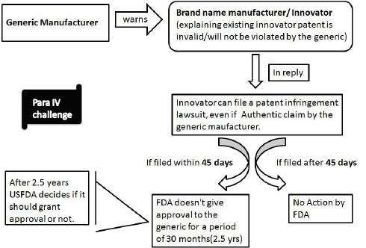
PARA IV- PATENT CHALLENGE

Slide 11
INCENTIVES AND PROTECTION
180 Day Market exclusivity
First applicant to submit a substantially complete ANDA (first-to-file)
May be shared by multiple applicants
Subject to forfeiture
30-month stay of FDA approval
If patent owner or NDA holder sues the ANDA applicant for patent infringement within 45 days of receiving notice of the Paragraph IV certification
Runs from date of notification or expiration of NCE exclusivity
May be lengthened or shortened by the court

Slide 12
PARA IV DEADLINES
NOTIFICATION LETTER: 20 DAYS
○ Upon ANDA acceptance for filing, the applicant must notify the NDA holder and patent owner of the ANDA within 20 days. The notice must include a detailed
statement of the factual and legal basis of the opinion of the applicant that the patent is invalid or will not be
infringed
LAWSUIT: 45 DAYS
○ Upon notification, the NDA holder and patent owners have 45 days in which to initiate an action for patent infringement. If such an action is brought within 45 days, the ANDA is subject to a 30-month stay of FDA
approval beginning on the date the notification letter was received

Slide 13
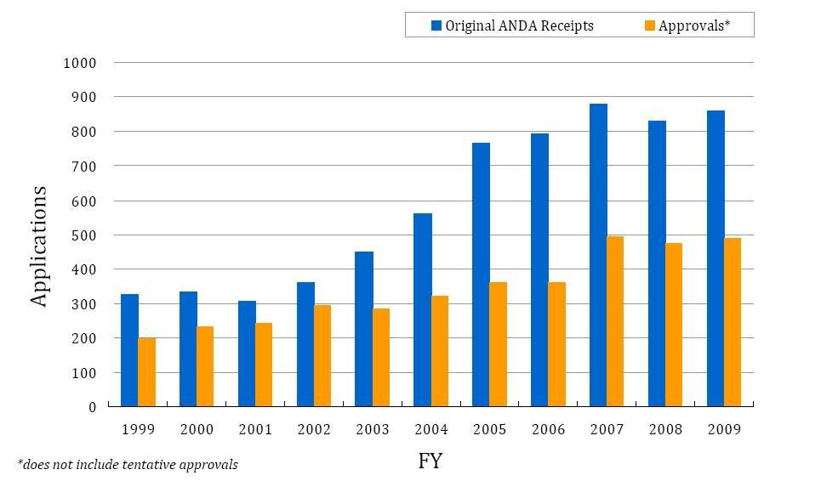
ANDA APPROVALS

Slide 14
ANDA APPROVAL & INDIAN COMPANIES
Drug approvals in US
2009 2010
19
15
18
18
17
17
11
12
11
3
Glenmark Aurobindo Sun Lupin DRL
Indian companies bagged 33.17% or 139 of 419 original ANDA approvals from US FDA in 2010
Source: http://www.business-standard.com/india/news/indian-pharma-remains- top-in-us-generics/420523/

Slide 15
EXEMPT ACTS OF PATENT INFRINGEMENT FOR FDA APPROVAL
The manufacture, use, or sale of a patented drug is not an act of infringement, to the extent it is
necessary for the preparation and submission of an ANDA
The Hatch-Waxman Act provides under 35 U.S.C. § 271(e)(1), generally that:
“It shall not be an act of infringement to make, use, or sell a patented invention … solely for uses reasonably related to the development and submission of information under a Federal law which regulates the manufacture, use, or sale of drugs.”

Slide 16
HATCH WAXMAN TRADE-OFF
BRANDS GENERICS
BRAND- 30 MONTH STAY
GENERIC- 180 DAY EXCLUSIVITY
Automatic Injunction
Notice of generic competition
Can be worth $$ mn per day
1st successful Para IV filer A big head start on others

Slide 17
HATCH WAXMAN TRADE-OFF
BENEFITS FOR BRANDED MANUFACTURERS
Orange Book provides public notice of patents
Allows for resolution of patent disputes prior to generic entry
30-month stay of FDA approval of generic drugs
Patent Term Restoration
Allows for Several Market Exclusivities:
Data Exclusivity
5 years for New Chemical Entity (NCE) Drug
3 years for non-NCE Drug
Orphan Drug (7 years)
Pediatric (PEDS) (6 months)

Slide 18
HATCH WAXMAN TRADE-OFF
BENEFITS FOR GENERIC MANUFACTURERS
180-day market exclusivity for first successful challenger to Orange Book patent
Allows generics to challenge Orange Book patents without risk
of damages
“Safe Harbor” rule allows generics to perform bioequivalence and other testing relating to regulatory approval without risk
of patent infringement
“Dr Reddy’s was the first Indian company to get the 180-day exclusivity for marketing Fluoxetine (Eli Lilly’s Prozac) 40 mg capsule in August 2001”

Slide 19
NON-PATENT EXCLUSIVITY
Types | Term
New chemical entity | 5 years
New Clinical study | 3 years
Orphan drug | 7 years
Pediatric exclusivity | 6 months
180-day generic market exclusivity | 180 days

Slide 20
NEW CHEMICAL ENTITY EXCLUSIVITY
○Hatch-Waxman Act, 1984
○Granted: to drug products containing a New Chemical Entity
○Blocks: submission of 505(b)(2) or ANDA
○Length: five years (or four years if para.
IV)

Slide 21
NEW CHEMICAL ENTITY
DEFINITIONS
New Chemical Entity : “a drug that contains no active moiety that has been approved by FDA in any other
application submitted under section 505(b) of the act”
Active Moiety: “the molecule or ion, excluding those
appended portions of the molecule that cause the drug to be an ester, salt (including a salt with hydrogen or
coordination bonds), or other noncovalent derivative (such
as a complex, chelate, or clathrate) of the
molecule, responsible for the physiological or pharmacological action of the drug substance”

Slide 22
NCE EXCLUSIVITY FOR ENANTIOMERS
Federal Drug Administration Amendments Act, 2007(“FDAAA”)
Under strict conditions, an enantiomer can qualify as a NCE:
–The single enantiomer has not been previously approved except in
the approved racemic drug
–The NDA includes full new clinical investigations
–The clinical studies were not used for the racemate
–The enantiomer indication is not in the same therapeutic category as the racemate
○ Three-year exclusivity available:
e.g., Lexapro(escitalopram); Nexium (esomeprazole)

Slide 23
NEW CLINICAL STUDY EXCLUSIVITY
○Hatch-Waxman Act, 1984
○Granted: for submission of results of new clinical studies
○Blocks: approval of 505(b)(2) or ANDA
○Length: three years

Slide 24
NEW CLINICAL STUDY EXCLUSIVITY
Granted for submission of “reports of new clinical investigations (other than biovailability studies)
essential to the approval of the application [or the supplemental application] and conducted or
sponsored by the applicant”
Examples: new or changed formulations; salts;
indications; dosing regimens; patient populations; OTC switches; or other label changes
Opana ER (immediate release →extended release)
Caduet (atorvastatin/amlodipine combination)

Slide 25
ORPHAN DRUG EXCLUSIVITY
○Orphan Drug Act, 1983
○Granted: to drugs intended for treatment of a “rare disease or condition”
Affects < 200,000 people in the U.S., or
No reasonable expectation of recouping dev. costs
○Blocks: approval of 505(b)(1), (b)(2), or ANDA directed to the same drug, for same disease
○Length: seven years
○Additional rewards: tax credits; grants; fees waived

Slide 26
PEDIATRIC EXCLUSIVITY
○Food and Drug Administration Modernization Act, 1997 (“FDAMA”)
○Granted: to applicants who successfully complete FDA-requested clinical trials of a drug in a pediatric population
○Blocks: approval of 505(b)(2) or ANDA
○Length: six months beyond any existing marketing or patent exclusivity
○gov’t funding of pediatric studies if no exclusivity

Slide 27
GENERIC DRUG EXCLUSIVITY
○Hatch-Waxman Act, 1984
○Granted: to first ANDA applicant who submits a “substantially complete” ANDA containing a paragraph IV certification
Substantially complete = sufficient to permit review
○Blocks: approval of subsequently-filed ANDA containing a paragraph IV certification
○Length: 180 days, from commercial marketing

Slide 28
180-DAY EXCLUSIVITY FORFEITURE
○Medicare Modernization Act, 2003 (“MMA”)
○Six ways to forfeit:
failure to market
withdrawal of application
amendment of certification
failure to obtain tentative approval within 30 mos.
improper agreement with another applicant, the listed drug application holder, or a patent owner
expiration of all patents

Slide 29
DELAY IN GENERIC ENTRY
Reverse Payment Agreements
Sham Litigations(30 months stay) Sham Citizen’s Petitioning
Walker Process Fraud Product Hopping

Slide 30
REVERSE PAYMENT AGREEMENTS
○Both parties decide it is in their mutual best interests to settle via a significant payment from the patent owner/branded to the generic to keep the generic drug off the market
○The generic may make more money than by rushing to market the drug
○The branded may also make more money by paying the generic to defer marketing the drug for a certain period of time

Slide 31
REVERSE PAYMENT AGREEMENTS
Intellectual property licenses
Distribution agreements
Co-promotion arrangements
Side deals
Development agreements
Supply agreements
No authorized generic

Slide 32
REVERSE PAYMENT AGREEMENTS
CASE STUDY
FTC vs. Cephalon (E.D. Pa.) (filed Feb. 13, 2008 )
Provigil - $800 million brand sales
6 years delayed entry
Complaint alleges that Cephalon unlawfully induced four first filers to refrain from marketing generic
Provigil until 2012 by entering into over 13 side deals that transferred substantial value to the
generics

Slide 33
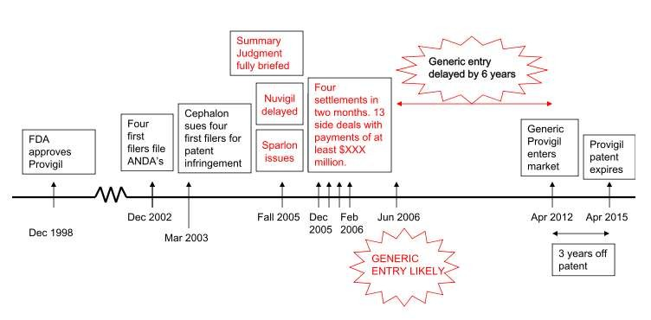
FTC V. CEPHALON, INC.
Settlements Allegedly Delay Entry By 6 Years

Slide 34
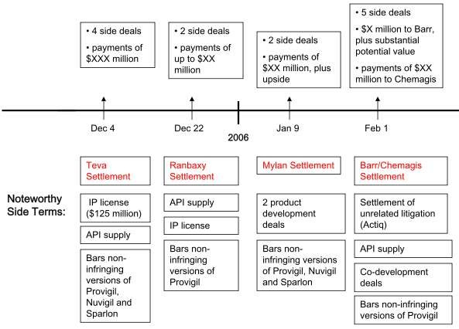
FTC V. CEPHALON, INC.
SETTLEMENT TERMS AND TIMELINE

Slide 35
REVERSE PAYMENT AGREEMENTS
MMA Patent Settlement Filing Requirements
○Pharmaceutical patent settlements required to be filed with FTC (per 2003 Medicare Modernization Amendments)
○Why Congress Enacted This Requirement
Waxman: “to re-emphasize the Hatch-Waxman Act’s original intent of enhancing competition, not collusion, between generic and name-brand drug manufacturers”

Slide 36
BMS/APOTEX SETTLEMENT ON PLAVIX
Settlements at Issue
Original Settlement – FTC did not approve because included provision that BMS
would not launch authorized generic
Revised Settlement – Did not include authorized generic provision, but BMS orally represented it would not launch authorized generic
Both Settlements Submitted to FTC
Required under prior BMS consent, which required FTC approval
Required under MMA filing requirement
Apotex submitted letter with MMA filing noting oral terms
BMS signed FTC certification confirming no oral terms
Ramifications for BMS
DOJ Criminal Investigation and Plea Agreement with BMS (two felony counts and criminal fine of $1 million)
BMS Senior VP Andrew Bodnar ($100,000 fine, one year jail time, required to write book on experience)
State Attorneys General ($1.1 million fine for misleading States regarding settlement (violation of 2003 Order with States))
FTC ($2.1 million in civil penalties for misleading FTC regarding settlement (violation of 2003 FTC Order and MMA violation))

Slide 37
SHAM LITIGATION
○Brand sues generic for patent infringement
○Court finds for generic, often on SJ, and holds patent invalid or unenforceable
○Hatch-Waxman 30-month stay allows brand to win even if they lose
○Plaintiffs must prove brand’s infringement suit is objectively and subjectively baseless

Slide 38
SHAM CITIZEN PETITIONING
○Companies can petition FDA to not approve an ANDA
Should be based on safety or formulation concerns
○Citizen’s Petitions delay approval of ANDAs
Ripe for abuse, and often abused
○Delay itself is the goal
○Same standard as Sham Litigation

Slide 39
WALKER PROCESS FRAUD
○Antitrust violation premised on fraud on the PTO
○Patent applicants have a duty of candor to PTO because applications are ex parte
○Elements track fraud claims
○Often coupled with Sham Litigation and other theories

Slide 40
PRODUCT HOPPING
○Delay sometimes allows brands to introduce new versions of the product
○Changes are often minimal but can defeat generic competition
○Brands actively convert the market
– Free samples
– Pulling the “old” product from the market

Slide 41
LOOPHOLES IN THE HATCH-WAXMAN ACT
Authorized generics
30 month stay Warehousing patents Reverse payments
Citizen’s petitions

Slide 42
AUTHORIZED GENERICS(AG)
AGs are pharmaceutical products that are approved as brand-name drugs but marketed as generic drugs
AGs do not bear the brand-name or trademark of the brand-name drug or manufacturer, but the brand-
name and AG products are manufactured to the brand’s specifications
Authorized generics have a unique impact during the first six months of generic competition
Competition from AGs during the 180 -day exclusivity period has the potential to reduce both generic drug prices and generic firm revenues

Slide 43
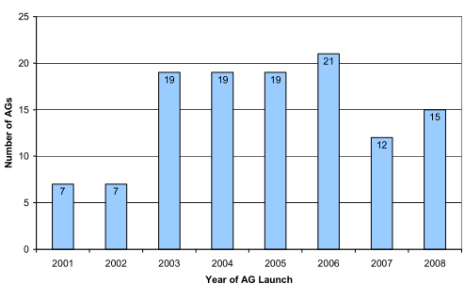
AUTHORIZED GENERICS(AG)

Slide 44
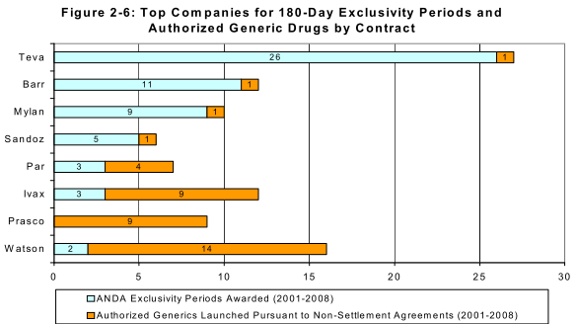
AUTHORIZED GENERICS(AG)

Slide 45
AUTHORIZED GENERICS(AG)
○Drug: Nitrofurantoin
○Innovator: P&G
○AG: Watson
○Generic: Mylan
○Mylan lost about $30 mn of the revenue it was set to realize under its 180-day exclusivity grant from FDA

Slide 46
INDIAN COMPANIES & AUTHORIZED GENERICS
Femcon Fe (Warner Chilcot)
Lupin
2011
Rocaltrol (Validus)
Ranbaxy
2009
Caduet (Pfizer)
Ranbaxy
2011
Zocor (Merck)
DRL
2006

Slide 47
WAREHOUSING PATENTS
Evergreening or warehousing of patents
An innovator may patent multiple attributes of a product (may be color, manufacturing process or the chemicals produced when the drug is
ingested in the body) and keeps on adding
patents in the Orange Book, essentially forcing the generic to hose between waiting for the patents to expire or file a Para IV certification which
brings along the risks of litigation and associated costs and delays
○ The provision of filing a patent infringement lawsuit
gives the brand name manufacturer at least an additional two and a half years of product
monopoly has resulted in a wave of such lawsuits

Slide 48
CONCLUSION
The Hatch Waxman Act
extended the life of the pharmaceutical patents up to 14 years from the time the New Drug Application is approved by the FDA,
provided additional market exclusivity for the new uses or new formulations,
allowed potential generic manufacturers to conduct work related to marketing approval of the drug without the charge of patent infringement,
permitted generic manufacturers to use safety and effectiveness research performed by the brand name pharmaceutical companies,
introduced the concept of bioequivalence to obtain the approval of generic drug, and simpliﬁed generic drug approval process by introducing ANDA, and
encouraged patent challenges by providing 180 -day market exclusivity for the ﬁrst generic manufacturer who ﬁles ANDA

Slide 49
CONCLUSION CONTD…
Hatch Waxman Act led to the birth of generic industry
It also gave protection to innovators in terms of 30 month stay, market exclusivities and patent term extensions
But, the brand companies are taking advantage of the
loopholes of HWA in the form of authorized generics and reverse payment agreements
Brand companies are also involved in sham litigations to take
advantage of 30 month stay provision
Role of both brand and generic companies are vital for US healthcare system
Maintaining the balance between these two important
contributors to health care will be essential in meeting the goals of affordable health care and innovative research

