Slide 1
Industrial Internet of things(IIOT)
Application of IOT in industry is known as IIOT or Industrial internet of things or Industry 4.0.
Industrial Internet integrates big data technologies, machine learning, sensor data, machine-to-machine (M2M) communication to architect intelligent commercial-ready industrial equipment and facilities.
Industrial IoT platform will allow you to connect and process IoT data securely at a larger scale.

Slide 2
How Industrial IoT Works
Industrial IoT (IIoT) is a network of devices which are connected through communications technologies.
These devices analyze data, collect and exchange information to provide complete operational visibility to make rapid operational decisions that can enhance your business.
Industrial IoT increases visibility, enhances operational efficiency, reduces complexities and boosts productivity in the industry.
Industrial IoT Platform makes use of modern sensor technology to architect various industrial equipments with remote monitoring and maintenance capabilities.
It helps in enhancing productivity, quality and safety and machine life.

Slide 3
Textile industry was the first to be affected by industry revolution.
John key`s Flying shuttle- weaving industry
Spinning jenny-enabling the spinning of 100 of yan together.
The power loom

Slide 4
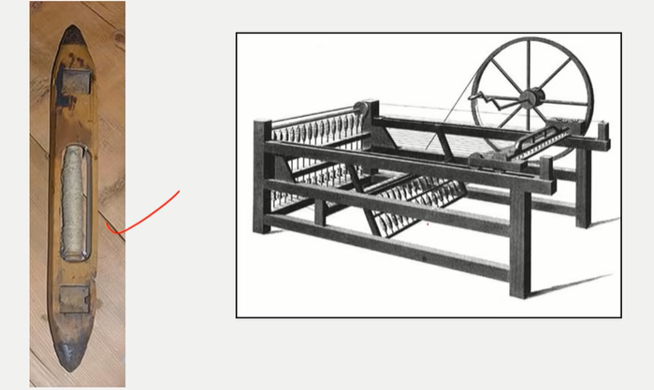
Fling shuttle ,spinning jenny

Slide 5
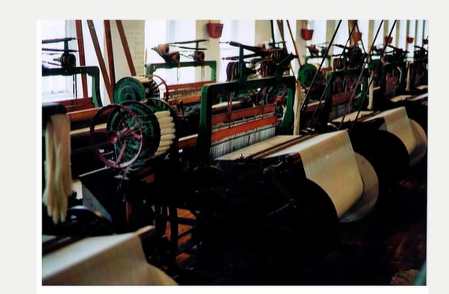
Power loom

Slide 8
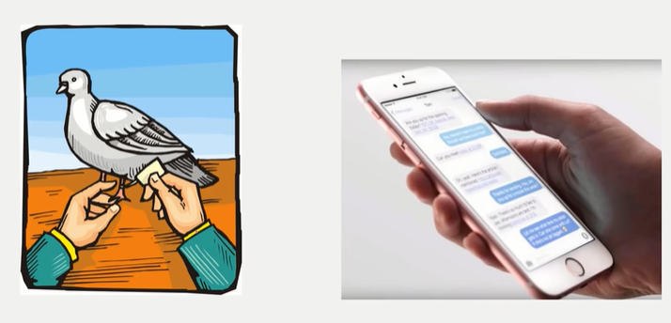

Slide 9
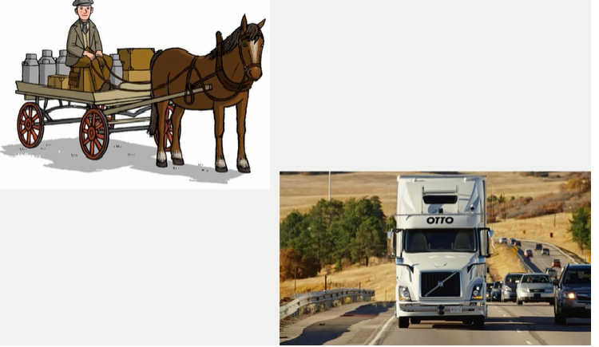

Slide 10
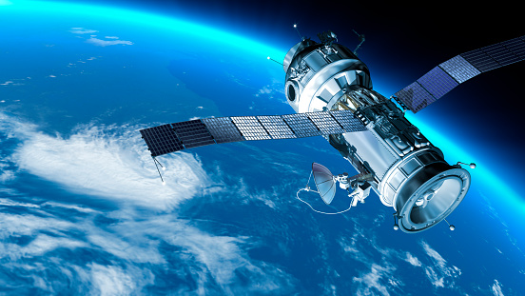

Slide 12
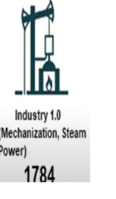
Industry 1.0
The industrial revolution started with the mechanization (water/steam power) of the production pipelines. Steam engines are used in production and transportation.

Slide 13
Industry 2.0
The second transformation has happened once the steam power is replaced with electricity and because of electricity there was mass production.

Slide 14
Industry3.0
Breakthrough in transistor and electric circuits technology produced computers which triggered the third industrial revolution.

Slide 15
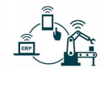
Industry4.0
Mass device connectivity pushes the fourth
industrial revolution which is enhanced with
smart devices and advanced artificial
intelligence algorithms like machine learning.

Slide 16
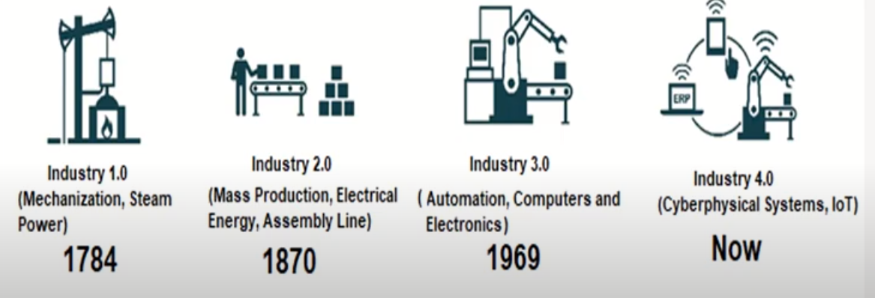

Slide 17
Industry 4.0 industry revolution basically started in German to push German economy.
This term coined in Hannover university in 2011 in germany.

Slide 18
Difference between IOT &IIOT
IoT devices are commonly used by the hobbyist or another consumer usage.
IIoT is designed for heavy-duty tasks such as manufacturing,monitoring,etc.
IIoT uses more precise and durable (heat/cold resistant) devices,actuators, sensors, etc.
Both IoT and IIoT have the same core principles such as data management, network, security, cloud, etc

Slide 19
The main differences between IoT and IIoT are scalability and the volume of generated data and how data has been handled. Since IIoT devices generate massive amount of data.
IIoT requires data streaming, big data, machine learning or artificial intelligence practices.
In a home network, loss of the generated data would be trivial but in IIoT it is vital.

Slide 20
The data in IIoT should be more precise, continuous and sensitive.
For instance, considering a monitoring system in a nuclear power plant or a manufacturing facility should be precise, continuous and sensitive to prevent hazardous events.

Slide 23
Security: As manufacturing processes are becoming smarter (with the use of SCADA Systems), the production processes are becoming more technology-driven, in terms of wireless M2M technologies. Most of the connected machines share information directly to the cloud and hence get exposed to security threats and attacks. In other words, any ‘thing’ or “device” or “asset” that is controlled by the network, or the internet is vulnerable to attacks and hacks.
Interoperability: As per IoT Nexus survey, 77% of IoT professionals saw interoperability as the biggest challenge in the Industrial Internet. The manufacturing environment is flooded with machines and protocols that are yet to be interconnected and most often not interoperable. So, connecting the legacy industrial systems and ensuring interoperability between them is a challenge.

