Slide 1
Introduction to Heat Transfer
By
GURUDUTTA

Slide 2
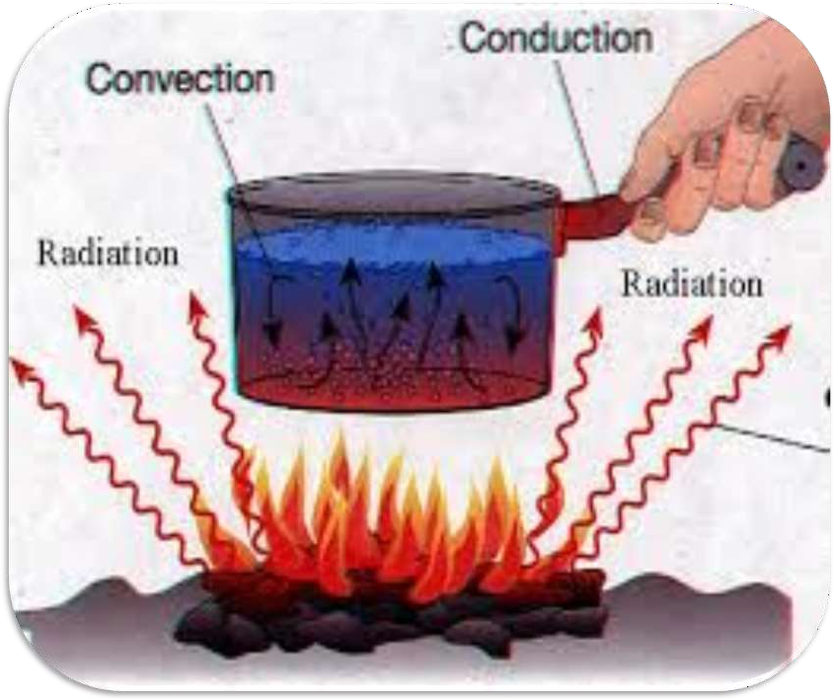

Slide 3
CONTENTS
Introduction
Modes of Heat Transfer
Conduction
Convection
Radiation
Summary

Slide 4
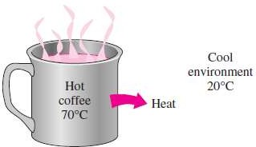
Introduction
tfeat always moves from a warmer place to a cooler place.
tfot objects in a cooler room will cool to room temperature.
Cold objects in a warmer room will
heat up to room temperature.
tfeat is a form of energy which passes from a body at higher temperature to a body at a lower temperature.

Slide 5
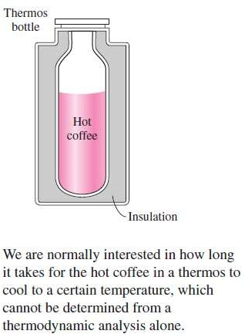
Why we need heat transfer
A thermodynamic simply tells us how much amount of heat transfer from one equilibrium state to another equilibrium state.
If two bodies at the same temperature are in contact, there is no net heat flow from one body to the other .
This condition is known as thermal equilibrium. The SI unit of heat is the Joule (J).

Slide 6
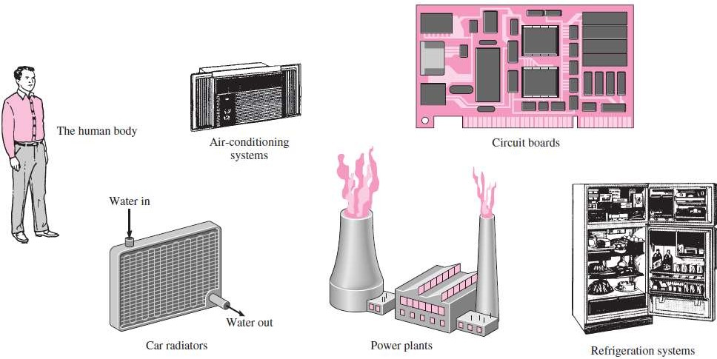
tfeat transfer plays major rule design of many devices,such as radiators, solar collectors, various components of power plants, even space craft.

Slide 7
Modes Of Heat Transfer
tfeat can travel through a medium and also through vacuum.
Types Of Modes
Conduction
Convection
Radiation

Slide 8
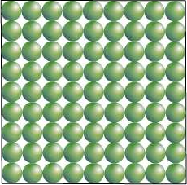
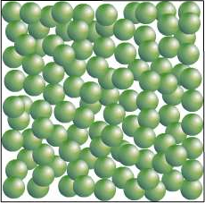
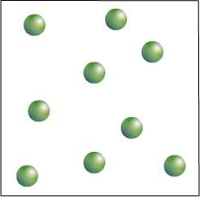
What is Conduction?
tfow are the particles arranged in a solid, a liquid and a gas?
solids
liquids
gases
Conduction is the transfer of energy from more energetic particles of a substance to adjacent less energetic ones result of interaction between particles.
It can be Understood from the Fourier law of Conduction

Slide 9

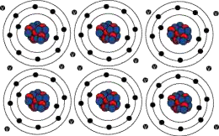
Why are metals good thermal conductors?
There are delocalised electrons (‘free’ electrons) in
metals
These free electrons can move freely throughout the metals
When heated, these free electrons gain kinetic energy and move from the hotter end to the colder end , carrying energy with them.
This process is much faster than conduction by the vibration of the molecules.

Slide 10
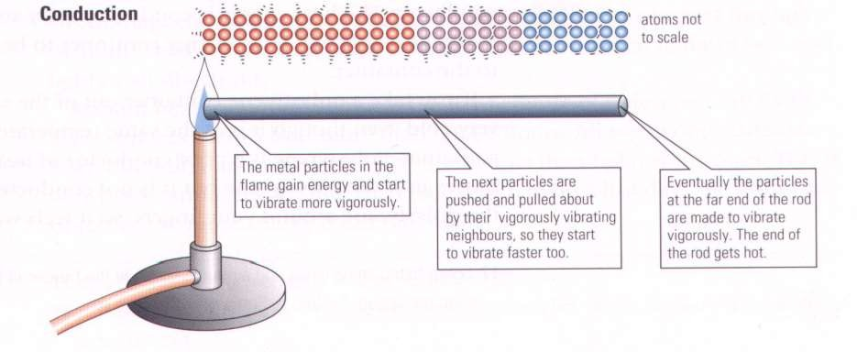
Conduction is the process by which heat is transmitted through a medium from one particle to another.

Slide 11
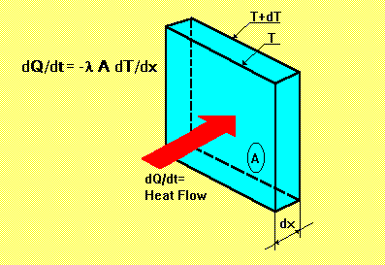


Fourier law Of Conduction
In 1822 Fourier postulated that the rate of heat transfer is proportional to the temperature gradient present in a solid.

Slide 12
Factors affecting thermal conductivity
Thermal conductivity in materials depends on the
following factors:
(i) The temperature difference (aө) between
The ends of the conductor.
(Ii) the length of the conductor (l).
(Iii) the cross-section area(a) of the conductor.
(Iv) the nature of the material (k).

Slide 13
Thermal conductivity in solid
If you stir hot tea using a metal spoon, you will observe that the handle of the spoon becomes warm.
Solids that are good conductors of heat (metals) use both
atom vibration and free electrons to conduct heat.
Why liquids are poor conductors of heat ?
This is because there are large inter-molecular distances between liquid molecules.There are also fewer and rare collisions between the molecules.
Electrolytes, e.g., Salt solution are better conductors of heat than pure liquids because of an increased compactness of the particles.
Thermal conductivity in gases
Gases are worse conductors of heat because of large
inter-molecular distance.

Slide 14



What is Convection ?
What happens to the particles in a liquid or a gas when you heat them?
The particles spread out and become less dense.
convection heat transfer

Slide 15
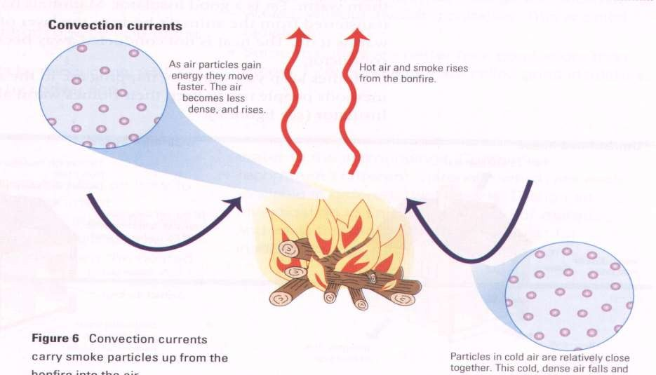
Convection is the process by which heat is transmitted from one place to another by the movement of heated particles of a gas or liquid.

Slide 16
Definition : Convection is the process by which heat is
transferred through fluids (liquids and gases).
When a liquid is heated, it expands and this lowers its density.
The less dense liquid rises and its place is taken by more dense colder liquid. This movement of liquid forms
convection currents.
Molecules in fluids are further apart and have negligible cohesive force.
Convection currents are set up much faster in gases than in liquids because of the extremely low cohesive forces existing between the molecules of the gases.

Slide 17
Types of Convection :
Natural convection: Natural convection occurs whenever heat flows between a solid and fluid, or between fluid layers.
As a result of heat exchange, Change in density of effective fluid layers taken place, which causes upward flow of heated fluid.
If this motion is associated with heat transfer mechanism only,
then it is called Natural Convection.
Forced convection: Mixing of hot and cold parts of the fluid through some external stirring, like a fan or pump.
If this motion is associated by mechanical means such as pumps,
gravity or fans, the movement of the fluid is enforced.
And in this case, we then speak of Forced convection

Slide 18
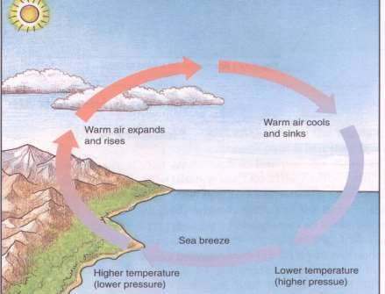
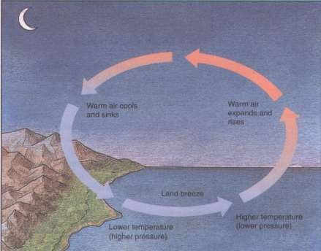
During the day the sun heats the land much faster than the sea.
The air above the land is heated, expands and rises.
Cold air from the sea moves inland to take its place.
Hence, sea breeze is obtained.
Land loses heat faster than the sea.
Hot air above the sea which is less dense, expands and rises.
Cold air from the land moves towards the sea.
Convection current is formed.
Land Breeze is obtained.

Slide 19
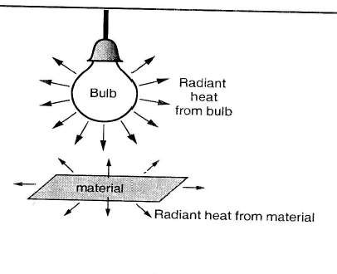
Radıatıon
tfeat transfer through vacuum is called thermal radiation. All bodies absorb and emit radiation.
An electric bulb in a room produces both light and radiant heat. The radiant heat is absorbed by the materials in the room, which in turn give out radiant heat of lower energy.

Slide 20
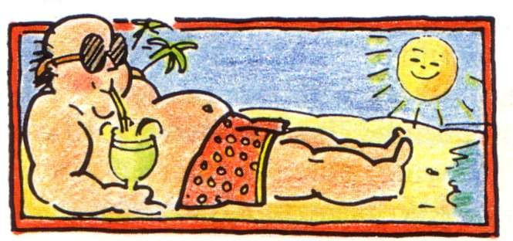
Radiation is a method of heat transfer that does not require any medium.
It can take place in a vacuum. In radiation, heat transmits energy in the form of waves.
The heat energy from the sun is radiated to us.

Slide 21
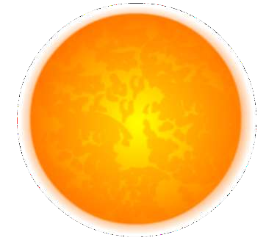

How Does Heat Travel Through Space?
The Earth is warmed by heat energy from the Sun.
tfow does this heat energy travel from the Sun to the Earth?
infrared
waves
There are no particles
The heat travels to Earth by
between the Sun and the
infrared waves. These are
Earth, so the heat cannot
similar to light waves and
travel by conduction or by
are able to travel through
convection.
empty space.

Slide 22
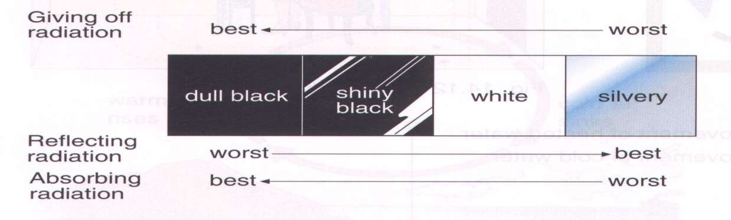
Emission Experiment
The shiny metal container would be the warmest after ten minutes because its shiny surface reflects heat Radiation back into the container so less is lost. The dull black container would be the coolest because it is the best at emitting heat radiation.

Slide 23

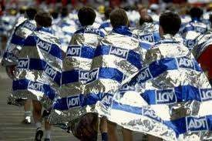
Radiation Questions ?
Why are houses painted white in hot countries?
White reflects heat radiation and
keeps the house cooler.
Why are shiny foil blankets wrapped around marathon runners at the end of a race?
The shiny metal reflects the heat radiation from the runner back in, this stops the runner getting cold.

Slide 24
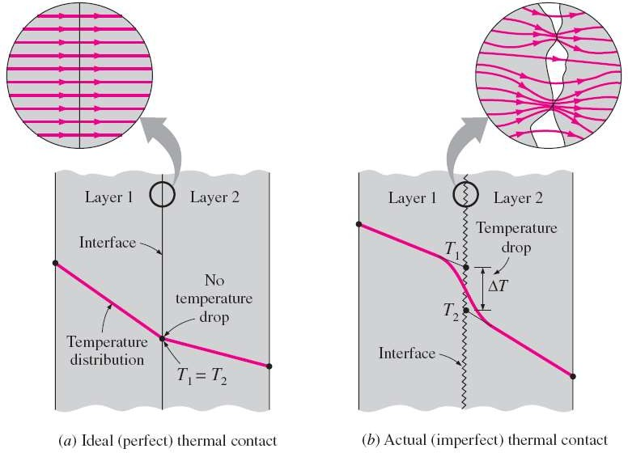
Thermal Contact Resistance
Temperature distribution and heat flow lines along two solid plates
pressed against each other for the case of perfect and imperfect contact.
24

Slide 25
Summary
Heat is a form of energy which flows as a result of
temperature difference between two regions.
There are three modes of heat transfer namely conduction,convection and radiation.
In conduction and convection a material is required
while in radiation,heat travels through a vacuum.
Thermal conductivity depends on:
Temperature difference-the greater the temperature difference the higher the rate of conduction.
Cross- sectional area-thicker materials conduct heat faster than thin ones.

Slide 26




