Slide 1
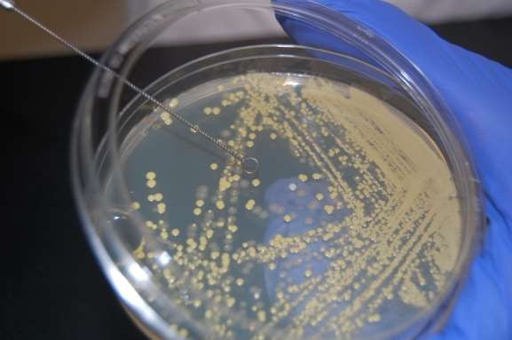
ISOLATION & PRESERVATION METHODS FOR PURE CULTURE
Deepankar ratha,
Assistant Professor, CUTM,Rayagada

Slide 2
Pure Culture Technique
Culture : Act of cultivating microorganisms or the microorganisms that are cultivated
Mixed culture : more than one microorganism
Pure culture : containing a single species of organism.
A pure culture is usually derived from a mixed culture (one containing many species) by transferring a small sample into new, sterile growth medium in such a manner as to disperse the individual cells across the medium surface or by thinning the sample many times before inoculating the new medium.

Slide 3
Why important ?
Pure cultures are important in microbiology for the following reasons-
Once purified, the isolated species can then be cultivated with the knowledge that only the desired microorganism is being grown.
A pure culture can be correctly identified for accurate studying and
testing, and diagnosis in a clinical environment.
Testing/experimenting with a pure culture ensures that the same results can be achieved regardless of how many time the test is repeated.
  Pure culture spontaneous mutation rate is low
  Pure culture clone is 99.999% identical

Slide 4
ISOLATION TECHNIQUE OF PURE CULTURE
Cultures composed of cells arising from a single progenitor
Progenitor is termed a CFU
Aseptic technique prevents contamination of sterile substances or objects
Common isolation techniques
-Streak plate method
-Pour plate method
-Spread plate method
-Roll tube method

Slide 5
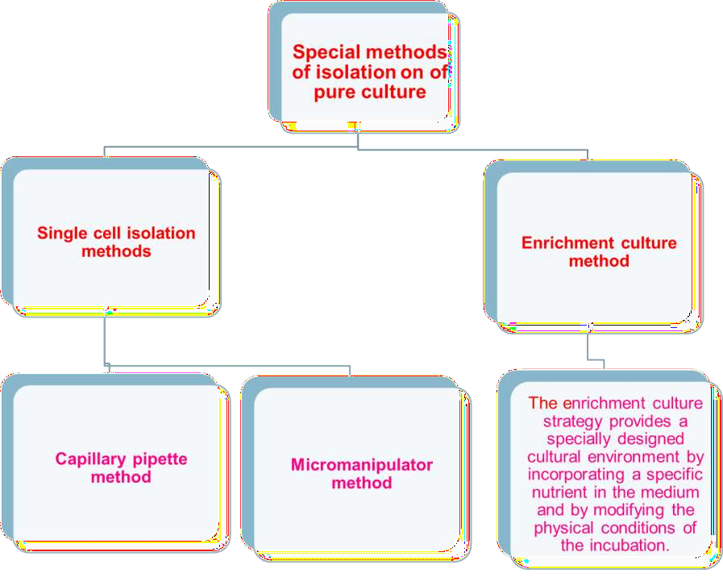

Slide 6
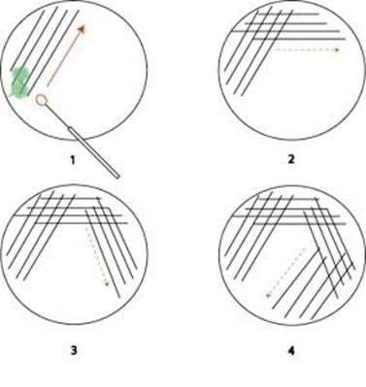
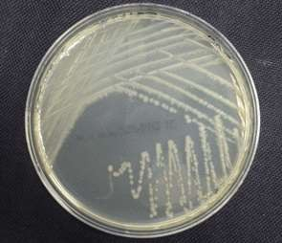
1.Streak plate method
Streaking is the process of spreading the needle on the surface of themedia.
microbial culture with an inoculating
Sterilize the inoculating needle by flame to make red hot and allow it to cool for 30
seconds.
Thesampleis streakedin suchawaytoprovideseriesofdilution.
purpose-thinoutinnoculumtogetsepratecolonies.
subculturingcanbedonebystreakingwel isolatedcoloniesfromstreakplatetonew plate.

Slide 7
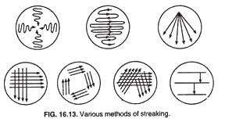

Slide 8
2. Pour plate method
Thebacterial culture and liquid agarmedium are mixed together.
After mixing the medium, the medium containing the culture poured into sterilized petridishes ( petriplates), allowed solidifying and then incubated.
After incubation colonies appear on the surface.
DISADVANTAGES-
Microorganism trapped beneath the surface of medium hence surface as wel as subsurface colonies are developed which makes the difficukties in counting the bacterial colony.
Tidious and time consuming method, microbes are subjected to heat shock because liquid
medium maintained at 45℃.
Unsuitable- Psychrophile

Slide 9
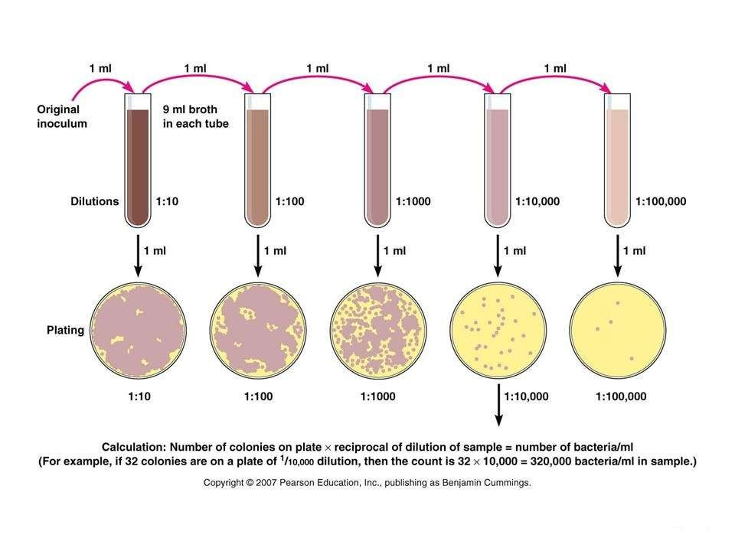

Slide 10
3. Spread plate method
Thisis the best method to isolate thepure colonies.
In this technique, the culture is not mixed with the
normal saline and serial y diluted.
agar medium. Instead it is mixed with
0.1 ml of sample taken from diluted mixture, which is placed on the surface of the agar plate and spread evenly over the surface by using Lshaped glassrod caled spreader.
Incubate the plates
After incubation, colonies are observed on the agar surface.

Slide 11
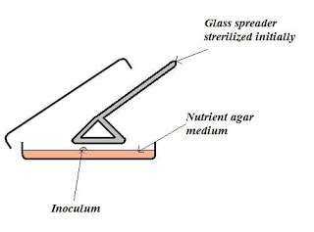
ADVANTAGES
It is asimplemethod.
In this method only surfacecolonies are formed.
Micro-organismsarenot exposed to higher temperature.

Slide 12
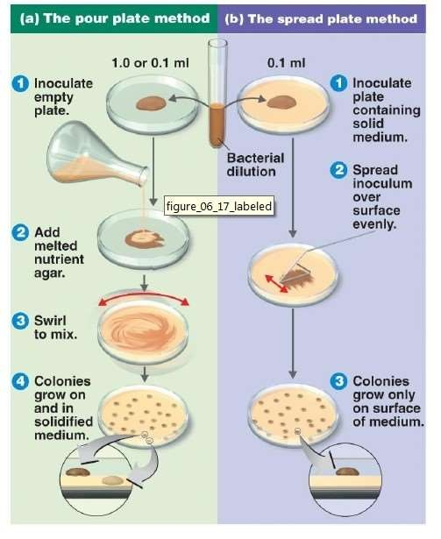

Slide 13
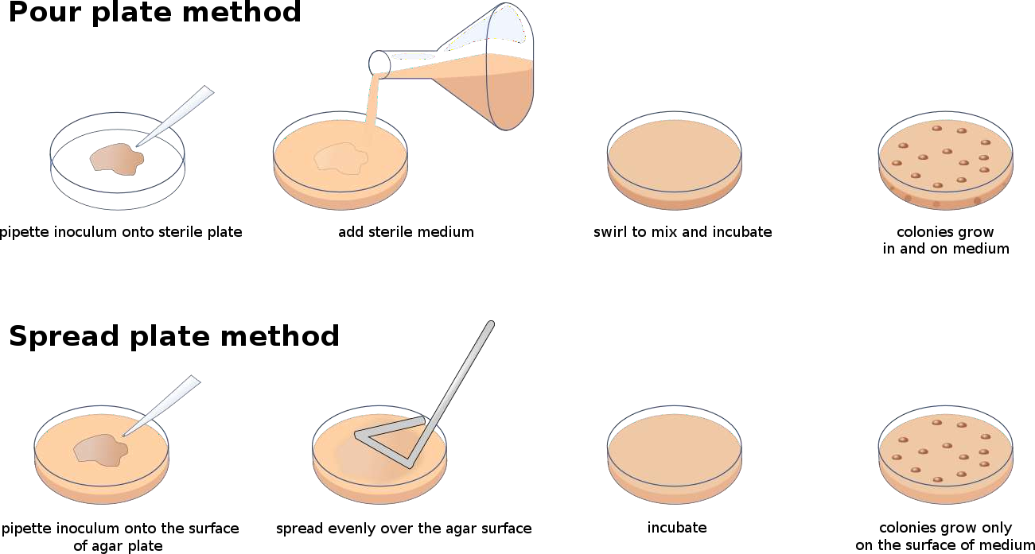

Slide 14
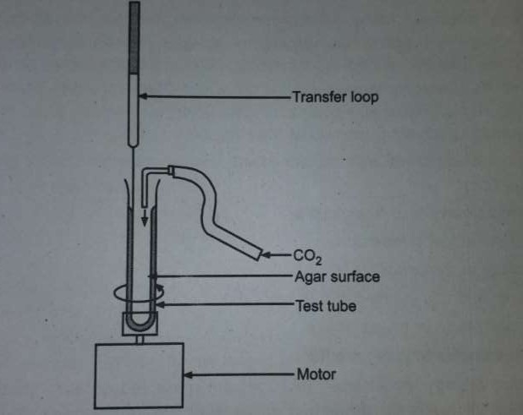
4. Roll tube method.

Slide 15
5. Micromanipulator method
Micromanipulators have been built, which permit one to pick out a single cell from a mixed culture. This instrument is used in conjunction with a microscope to pick a single cell (particularly bacterial cell) from a hanging drop preparation.
the single cell of microbe sucked into micropipette and transfered to large amount of sterile medium.
ADVANTAGES OF MICROMANIPULATOR METHOD-
The advantages of this method are that one can be reasonably sure from a single cell and one can obtain strains with in the species.
that the cultures come
DISADVANTAGES-
The disadvantages are that the equipment is expensive,its
manipulation is very tedious, and it requires a skilled person.

Slide 16
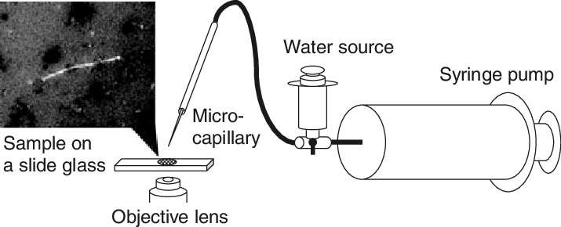

Slide 17
PRESERVATION OF PURE CULTURE
T o maintain pure culture for extended periods in viable condition without any genetic change is referred as Preservation.
During preservation most important factor is to stop microbial growth or at least lower the growth rate.
D u e to this toxic chemicals are not accumulated and hence viability of
microorganism is not affected.

Slide 18
Objectives of preservation
To maintain isolated pure culture for extended periods in a viable conditions.
To avoid contamination
To restrict Genetic Mutation

Slide 19
Why to Preserve Bacteria?
In nature there are only 1% bacteria which is pathogenic and harmful to Animalia and Plantae.
99% of bacterial populations are of economic importance for human beings and plants.
In soil for nutrient uptake in food industry,in sewage treatment,in medical
industry.
So the preservation of bacteria is one of the most profitable practice economically as well as environmentally.

Slide 20
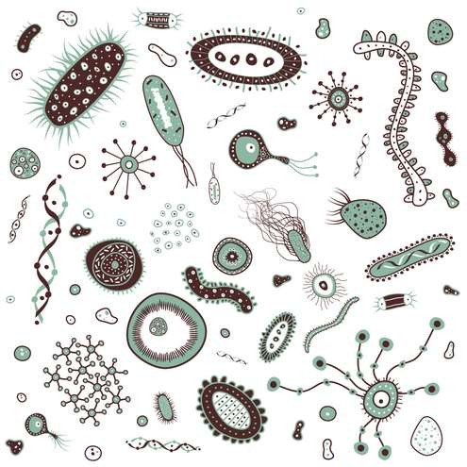
Academic purpose
Reserch Purpose
Biotechnology field
Fermentation Industry

Slide 21
Preservation methods of Bacteria
Periodic trnsfer to fresh medium
Storage at low temprature
Storage in sterile soil
Preservation by overlaying culture with mineral oil
Lyophillization or freeze drying

Slide 22
1. Periodic transfer to fresh medium
Strains can
be maintained by periodically
preparing
a fresh
culture from the previous stock culture.
The culture medium, the storage temperature, and the time transfers are made vary with the species .
interval at which the
The temperature and the type of medium chosen should support a slow rather than a rapid rate of growth so that the time interval between transfers can be as long as possible.
Many of the more common heterotrophs remain viable for several weeks or months on a medium like Nutrient Agar.
The transfer method has the disadvantage of failing to prevent changes in the
characteristics of a strain due to the development of variants and mutants.

Slide 23
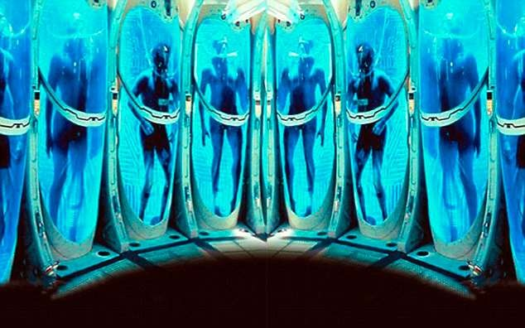
2. Storage at low temprature
REFRIGERATION
CRYOPRESERVATION

Slide 24
1. REFRIGERATION
Pure cultures can be successfully stored at 0-4°C either in refrigerators or in cold-rooms.
This method is applied for short duration (2-3 weeks for bacteria and 3-4 months for fungi) because the metabolic activities of the microorganisms are greatly slowed down but not stopped.
Thus their growth continue slowly, nutrients are utilized and waste products released in medium.
This results in finally the death of the micro

Slide 25
2. CRYOPRESERVATION
Cryopreservation (i.e., freezing in liquid nitrogen at -196°C or in the gas phase above the liquid nitrogen at -150°C) helps survival of pure cultures for long storage times.
In this method, the microorganisms of culture are rapidly frozen in liquid nitrogen at - 196°C in the presence of stabilizing agents such as glycerol or Dimethyl Sulfoxide (DMSO) that prevent the cell damage due to formation of ice crystals and promote cell survival.
This liquid nitrogen method has been successful with many species that cannot be preserved by lyophilization and most species can remain viable under these conditions for 10 to 30 years without undergoing change in their characteristics, however this method is expensive.

Slide 26
3. Storage in sterile soil
Storing organisms in soil fall into two groups;
sterile soil infested with small amount of inoculum,immediately
dried and stored in refrigerator.
Soil infested with the organism,than incubated allowing
The organism to grow;thus the mycelium and propagative unit of
second generation are preserved.
The soil preservation method is useful for fungi,and by this method actinomycetes are maintained in soil for 4 to 5 years,and there are several bacterial spp which are also maintained in soi for several years.

Slide 27
4.Preservation by overlaying culture with mineral oil
This is a simple and most economical method of maintaining pure cultures.
In this method, sterile liquid paraffin is poured over the slant (slope) of culture and stored upright at room temperature. The layer of paraffin ensures anaerobic conditions and prevents dehydration of the medium.
This condition helps microorganisms or pure culture to remain in a dormant state and, therefore, the culture can be preserved form months to years (varies with species).
ADVANTAGES
We can remove some of the growth under the oil with a transfer needle, inoculate a fresh medium, and still preserve the original culture.
The simplicity of the method makes it attractive, but changes in the characteristics of a strain can still occur.

Slide 28
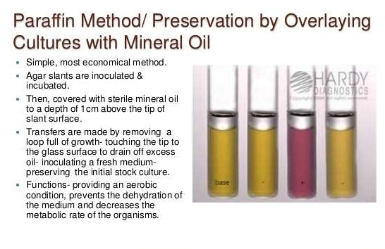

Slide 29
5. Lyophillization or freeze drying
Freeze drying is a stabilizing process in which a substance is first frozen and then the quantity of the solvent is reduced, first by sublimation (primary drying stage) and then desorption (secondary drying stage)
Better preservation occurs with freeze-drying than with other methods because freeze-drying reduces the risk of intracellular ice crystallization that compromises viability
Removal of water from the specimen effectively prevents this damage
Lyophilization is greatest with gram-positivebacteria (spore formers) and decrese with gram -negative bactetia but viability can be maintained as long as 30 years.

Slide 30
Large numbers of vials of dried microorganisms can be stored with limited space, and organisms can be easily transported long distances at roomtemperature
The process combines freezing and dehydration- Organisms are initially frozen and then dried by lowering the atmospheric pressure with a vacuumapparatus
Specimens can be connected individually to the condenser (manifold method) or can
be placed (in a chamber) where they are dehydrated in one larger airspace

Slide 31
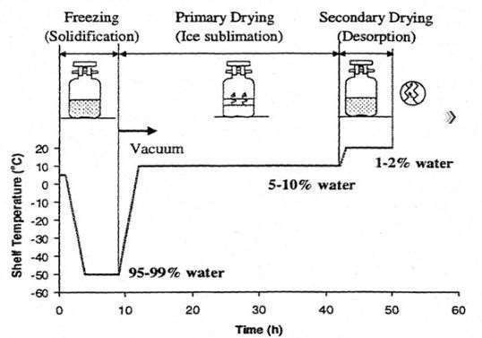
Lyophillization Process

Slide 32
StorageVials
1. Glassvials are used for all freeze-driedspecimens
When freeze-drying is performed in a chamber, double glass vials are used
(chamber method) : an outer soft glass
for protection and preservation of the dehydratedspecimen
Silica gel granules are placed in the bottom vial before the inner vial is inserted and cushioned withcotton
Manifoldmethod- a single glass vial is used
vial
is added
of the outer
6. storage vial must be sealed to maintain the vacuum and the dry atmospheric condition
Cryoprotective Agents
Two most commonly used agentsare
Skim milk for chamber lyophilization,and
sucrose for manifoldlyophilization
32

Slide 33
ADVANTAGES
Removal of wateratlow temperature
Thermolabilematerialscanbe dried.
Sterilitycan bemaintained.
Reconstitution iseasy

Slide 34
DISADVANTAGES
Many biological molecules are damaged by the stress associated with freezing, freeze- drying, or both.
  E.g. the process of drying causes extensive damage to molds, protozoa, and most
viruses
  Hence, these microorganisms can not be stored by thismethod
The product is prone to oxidation, due to high porosity and large surface area. Therefore the product should be packed in vacuum or using inert gas
Cost may be an issue, depending on the product

