Slide 1





INDUSTRIAL STERILIZATION ON LARGE SCALE
Deepankar ratha
Assistant professor,
CUTM,Rayagada

Slide 2

STERILIZATION
Sterilization can be defined as the process through which all forms of life are destroyed, removed or permanently inactivated.
Sterilization is essential concept at large scale as well as small scale for the preparation of sterile pharmaceutical products.

Slide 3
It’s aim is to provide a product that is safe and eliminates the possibility of contamination.

Slide 4

WHY
To reduce amount of
contaminant’s
present in environment, on surface of container’s, closure’s as well as equipment’s and to achieve better sterile condition.

Slide 5

SOURCE’S
Raw materials
Equipment & instrument’s
Manufacturing process
Container & closure system
Manufacturing environment
Worker’s

Slide 6


STERILIZATION PROCESSES
The sterilization is done by
Physical method
Chemical method

Slide 7

Physical Method
Moist heat
saturated steam autoclave
superheated water autoclave
air over steam autoclave
Dry heat
continuous tunnel sterilizer
hot air oven
Red heat
Flaming

Slide 8
Radiation
Non-ionizing radiations
Ultraviolet (UV) light
Ionizing radiations(cold sterilization)
X-rays
Gamma rays
Cathode rays

Slide 9
Filtration
Depth filter
sintered glass filter
Screen filter
particulate filter
microbial filter

Slide 10

Chemical Method
Chemical sterilization
Gaseous sterilization
Ethylene oxide
Formaldehyde
By using disinfectant or antimicrobial agent

Slide 11

PROCESS SELECTION
Process selection is most important and sensitive point for preparation of product.
Those product intended to be sterile should be terminally sterilized in their final container as clearly stated in EUROPIAN PARMACOPOEIA.
Where it is not possible to carry out terminal sterilization, choose the alternative method.

Slide 12
It is recognised that new terminal sterilization process other than those
assurance level equivalent to present official method, & such process when properly validated may offer alternative approaches.
describe | in | p’copoeia | may be
developed |  | to provide | sterility

Slide 13
The use of an inappropriate heat labile packaging material can not in itself be the sole reason for adoption of aseptic processing, rather manufacturers should choose the best sterilization
method achievable
for
formulation & select the packaging
a given
material accordingly.

Slide 14
The choice of packaging material for given product has to take into account factors other than the method of sterilization.
In such cases these other factor need to be clearly documented, explained & scientifically justified.

Slide 15



PROCESS FOR AQUEOUS PREPARATIONS
If the product is aqueous
Can product be sterilize by moist heat at 121°C for 15min
Can the product be
sterilize by moist heat
withF0 ≥8 min
Use autoclaving at 121°C for 15min
Can the formulation
Use moist heat with F0 ≥8 min
be filtered through a microbial retentive filter

Slide 16
Use pre sterilized individual component & aseptic compounding & filling
Use combination of aseptic filtration & aseptic processing

Slide 17
If the product is non-aqueous, semi solid or dry powder
Can the product be sterilized by dry heat at 160°C for 120min
Can the product be
Use sterilization at 160°C for 120 min
sterilized by dry heat with an alternative combination of time & temp° so the standard cycle achieving an SAL of
≤10⁻⁶

Slide 18
Use dry heat with an alternative combination of time & temp° so the standard cycle achieving an SAL of ≤10⁻⁶
Can the product be sterilized by a method different from dry heat
e.g. ionization
Can the sterilized by validated lower irradiation dose
Use a method different from dry heat e.g. ionization

Slide 19
Use the sterilized by validated lower irradiation dose
Can the formulation be filtered trough a microbial retentive filter
Use pre-sterilized individual components & aseptic compounding & filling
Use filtration & aseptic
technique

Slide 20

SPECIFICATIONS
MOIST HEAT STERILIZATION
Micro organisms destroyed by cellular protein coagulation
The objects to be sterilized are exposed to saturated steam under 1 atmosphere pressure at a minimum temperature of 121°C for 15 min.
An autoclave is commonly used for moist heat sterilization.
Because it does not require as high a tempº, moist heat sterilization cause less product and equipment damage compared to dry heat sterilization.

Slide 21
AUTOCLAVE
Is a device to sterilize equipment and supplies by subjecting them to high pressure saturated s
team at
Temp°C 115-118 121-124 126-129 | lb/sq.inch 10 15 20 | Time(min) 30 15 10
135-138 30 3
TYPES
Portable autoclave (Bench autoclave)
Stationary autoclave (Large sterilizer)

Slide 22
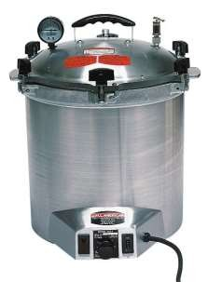
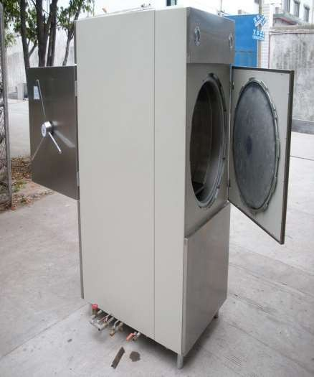

Slide 23
Main Features
Lid(door) fitted with clamps and asbestos jacket , stationary autoclave may be double doors at both ends one for loading and one for unloading.
Pressure gauge
Thermocouple for measurement of tempº.
Air vent to remove air before sterilization.
Safety valve to permit escape of excess steam to prevent explosion .
Modern autoclaves are recording (record pressure, temp during the whole process ) supplied with timer and are automatically controlled .

Slide 24
DRY HEAT STERILIZATION
Is appropriate for materials that cannot withstand moist –heat sterilization (e.g., oily materials and powders)
Objects are subjected to a temperature of at least 160º for 120 minutes( if higher temperatures can be used , less exposure time is required)

Slide 25
HOT AIR OVEN
Is a device to sterilize subject and supplies by subjecting them to direct heat at
Temp°C | Time(min)
170 | 60
160 | 120
150 | 150
140 | 180
Is appropriate for the materials that can not withstand steam sterilization (e.g. oily materials & powders)
If higher temperature can be used, less exposure time is required.

Slide 26
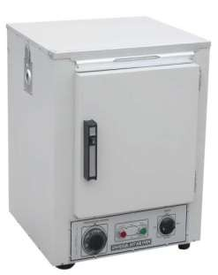
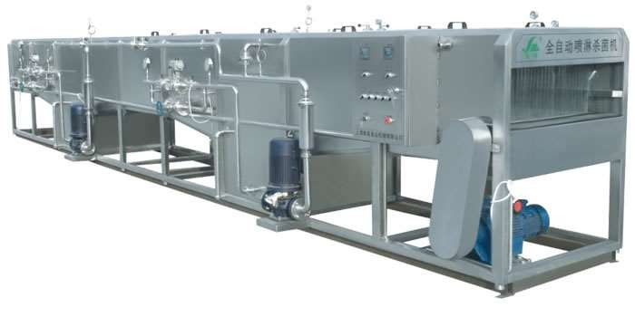

Slide 27
Main Features
Door fitted with the clamps and asbestos jacket has the single door
Regulator for temperature control
Fan attached inside for air circulation
Perforated shelf for keeping subject inside

Slide 28
RADIATIONS
Energy transmitted through space in variety of forms is generally called radiation
This method is also called as cold sterilization because it produce relatively little heat
Thus, it is possible to sterilize heat sensitive materials such techniques are being in food industries mainly

Slide 29
Non ionizing radiations (UV)
UV in region of 2537 A° has been shown to posses the greatest activity in destroying MO
Commonly employed in reduction of air- borne contamination in the maintenance of aseptic areas & rooms
Source of artificial UV radiation s is UV lamps (generally called sterilizing lamp or germicidal lamp)
UV light is absorbed by the nucleic acid of the cell where it does the greatest damage

Slide 30
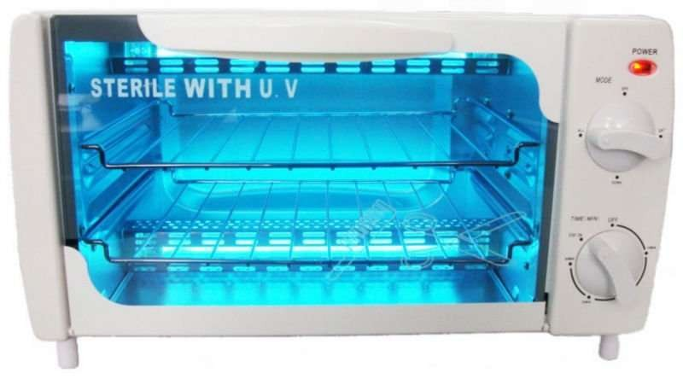
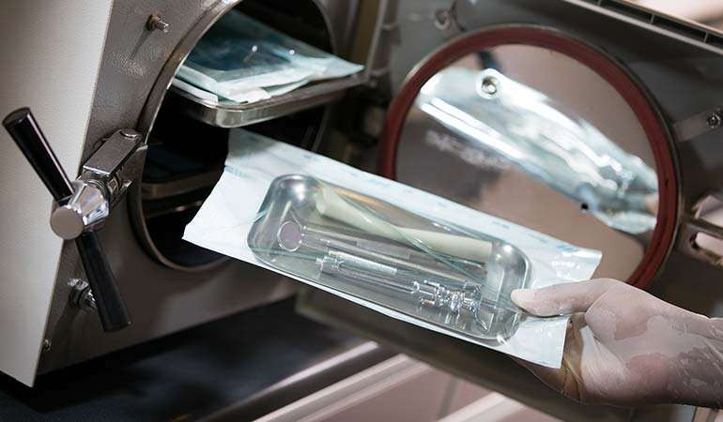

Slide 31
Ionizing radiations (cold sterilization)
X-rays, gamma rays & cathode rays are lethal to DNA & other vital cell constituents
They have high penetration power & considerable energy
The factors that effect the lethal activity of ionizing radiations are oxygen effect, protective compounds, sensitizing agents, pH of cultures, freezing, moisture & recovery conditions

Slide 32
Filtration
This is a non-thermal method of sterilization used widely in the p’ceutical industry where heat labile solutions are to be sterilized
This is useful for large volume solutions, eye drops, antibiotic solutions, sera & carbohydrate solutions
This also useful
for separation of
from
bacteriophages & bacterial toxins
bacteria for the isolation of MO which are scanty in fluids

Slide 33
3 main stages involved in filtration
1. Passage previously unite
of the solution through a sterilized bacteria-proof filter
Aseptic transference of filtrate to sterile containers then sealed aseptically
Testing of sample for sterility

Slide 34
Gaseous sterilization
The destruction of all living MO with chemical in gaseous or vapours state
When material is affected by the dry or moist heat then the gaseous sterilization is used
All these gases are toxic to human being above certain conc. and may exhibit other undesirable side effect
Ethylene oxide is most widely used gaseous sterilization agent in pharmaceutical industry
In addition to these, various glycols, methyl bromide and alcohol have been used for room sterilization

Slide 35
Ethylene oxide
It is colorless liq. with BP 10.8°C
Highly inflammable and may be explosive when mixed with air in conc. Greater than 3%. Its mixture with CO2 in certain proportion makes it inflammable
Conc. & time relationship commonly for sterilization is as below
ti
conc.(mg/lit) | exposure
e(hrs.)
44 | 24
88 | 10
442 | 4
884
2

Slide 36
Disinfectant or antimicrobial agents
Chemical agents most commonly used as disinfectant ant antiseptic e.g. phenols, alcohols, halogens, dyes, aldehyde etc.

Slide 37


DEVELOPMENT & VALIDATION OF PROCESS & EQUIPMENT
Process validation:
It is analysis of data gathered throughout the design & manufacturing of product in order to confirm that the process can reliably output products of determined standard.
Regulatory authorities like EMA & FDA have published guidelines relating to process validation

Slide 38
The purpose of validation is to ensure varied inputs lead to consistent & high quality outputs
Process validation is an ongoing process that must be frequently adapted as manufacturing feedback is gathered
End to end validation & production is essential in determining product quality because quality can not always be determined by finished product inspection

Slide 39
Process validation can be broken in to 3 steps
Process design
Process qualification
Continued process verification
Process design:
In this data from the development phase are gathered & analyzed to define the commercial manufacturing process. The data used to establish benchmark for quality & production control

Slide 40
Process qualification:
In this stage the process design assessed to conclude if the process is able to meet determine manufacturing target. All the process & manufacturing equipment is proofed to confirm quality & output capabilities
Continued process validation:
It is the ongoing monitoring of all aspects of production cycle. It aims to ensure that all levels production are controlled & regulated

Slide 41


EQUIPMENT VALIDATION/ QUALIFICATION
Equipment validation is divided into
Design qualification
Installation qualification
Operational qualification
Performance qualification

Slide 42
DQ:
It define the functional & operational specification of the instrument & details for the continues design in selection of supplier
IQ:
Demonstrates that the process or equipment meets all specifications, is installed correctly, and all required components and documentation needed for continued operation are installed and in place.

Slide 43
OQ:
Demonstrates that all facets of the
process correctly.
PQ:
or equipment are operating
It is the process of demonstrating
that an instrument
consistently performed according to specification
appropriate for it’s routine work

