Slide 1
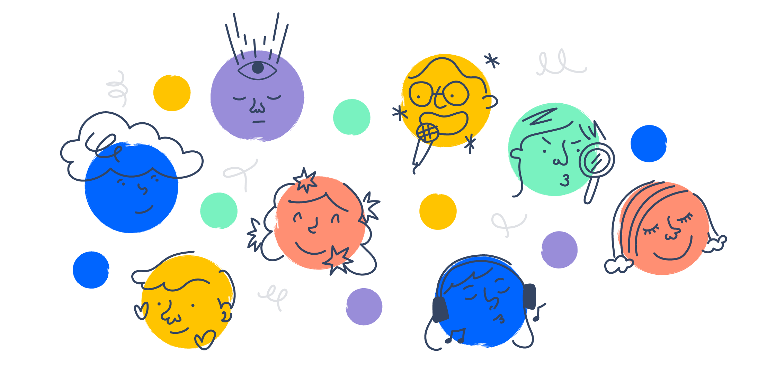
PERSONALITY
BY- DR.DEEPTI MISHRA
ASST. PROFESSOR (OB & HR)

Slide 2
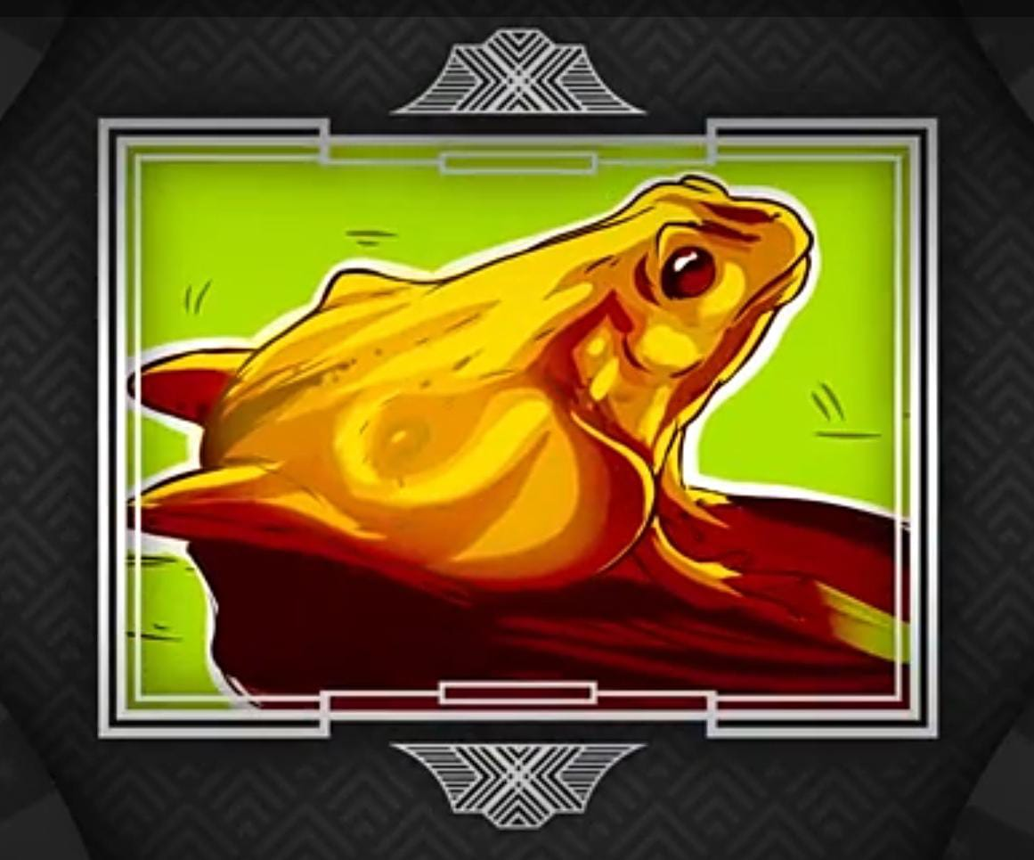
FROG- Straightforward, Honest, Confident, Reliable, Trustworthy HORSE- Analytical mind, Critical mind

Slide 3
RAT- Optimist, Take advantages in every situation CAT- Realistic, Know what you need, Never build castle in air

Slide 4
SQUIRREL- (Left side brain is more active), Analytical, Good in numbers DUCK- (Right side brain is more active), Good in art and creative, Emotional Intelligence

Slide 5
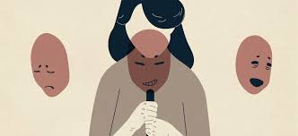
What is Personality ?
The word personality comes from the Latin word persona, which means “mask”.
It is the sum total of internal and external traits of an individual, which are relatively stable and make the individual different from others.
The sum total of ways in which an individual reacts to and interacts with others.

Slide 6
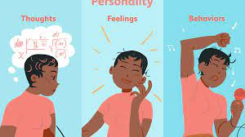
Personality = Behaviour + Attitude + Perception
Personality is about the way of thinking, feeling and behaving. It also involve how a person interact with others.

Slide 7
NATURE
It is unique and different from individual to individual.
It refers particularly to persistent qualities of an individual.
It is dynamic by nature.
It helps in adjusting the individual with the environment.

Slide 8
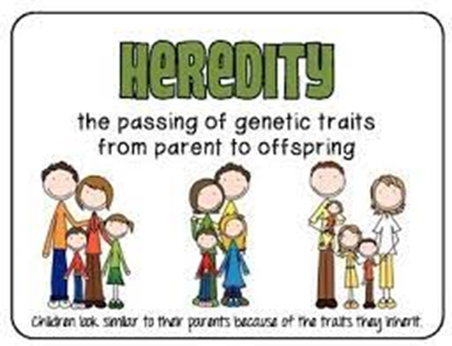
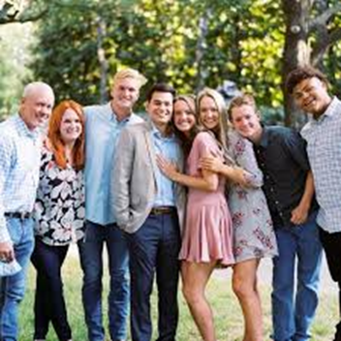
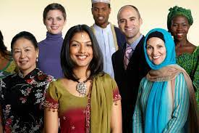
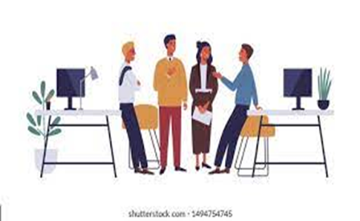
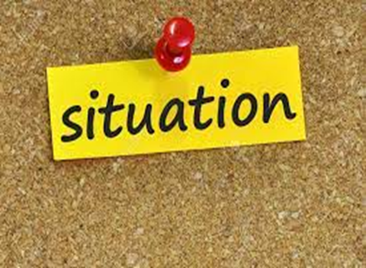
DETERMINANTS OF PERSONALITY
Heredity
Family
Environment
Socialization Process
Situational Consideration

Slide 9
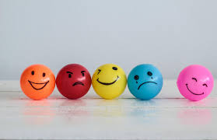
PERSONALITY TRAIT
The characteristic or feature in a person which describes him and makes him different from others.
Personality traits are characteristics and qualities that help define you as a unique individual.

Slide 10
THEORIES OF PERSONALITY
TRAIT THEORY
PSYCHOANALYTIC THEORY
HUMANISTIC THEORY
SOCIAL LEARNING THEORY

Slide 11
A. TRAIT THEORY
Allport’s Trait Approach:
GB Allport was first personality theorist.
Classify 4541 words into 3 main traits: Cardinal traits, Central Traits and Secondary trait.
Cardinal traits- are the most active and dominant traits of one’s personality. Through these traits we can describe the individual easily. Found in every situation. Ex. Mahatma Gandhi -Truth & non-violence.
Central traits- it includes traits are frequently employed for identifying and describing one’s personality. Mostly visible in the person’s behavior (need 7-8 traits for describing a person). Like honesty, kindness, shyness etc.
Secondary traits- these traits are rarely visible in a person’s behavior. These include those traits of an individual’s personality that play quite a secondary or insignificant role in the identification and description of the personality. Ex. Selfish, greedy etc.

Slide 12
Continue…
CATTELL’S TRAIT APPROACH:
RB Cattell further advance the trait approach by Allport.
171 words with personality and called it as Trait Element.
And 35 groups of these trait elements and called it as Surface Traits.
Out of these 35 surface traits, he found 16 Source Trait. Also known as 16PF

Slide 13
B. PSYCHOANALYTIC THEORIES
Also known as Freud’s theory of personality.
Developed by Sigmund Freud.
Human mind arrange in 3 layer: Conscious, Subconscious and Unconscious.
He also define human mind have 3 components:
Id- Work on pleasure principle, Focus on own satisfaction, doesn’t matter what other s feel.
Super ego- Idealistic by nature, Think about others, What is right and what is wrong, Develop in child at the age of 5, Extended to all the 3 layers of mind.
Ego- try to balance both id & super ego, act as intermediaries.

Slide 14
C. HUMANISTIC THEORIES
Humanistic personality theory relates to human experiences, uniqueness, freedom of choice, and meaning.
This theory developed as opposed to the psychoanalytic or behaviorist view of personality development.
Developed by Carl Rogers & Abraham Maslow (who found some limitations in Psychoanalytic and Behaviorist theory).
Humanistic personality theory states that people have self-motivation to achieve their potentialities and have a free will.
According to Abraham Maslow, people developed their personalities by fulfilling each of their needs in a hierarchical fashion.
This theory shows the evolution of a human’s needs, from the most basic to the more complex .

Slide 15
Continue..
Carl Rogers, another humanistic psychologist, proposed a theory called the Person-Centered Theory.
Also known as Client-centered therapy.
He said human behaviour is Goal oriented and people chose adaptive and self actualizing behaviour.
He said a person have 2 self- one is Real self (who you are right now) and another is Ideal self (who you want to be).
If gap is more then the person is confused and unhappy.
But if gap is less then these people are happy by nature..

Slide 16
D. SOCIAL LEARNING THEORIES
This theory is developed by Albert Bandura.
As per this theory people can learn from each other through observation, imitation and modeling.
ATTENTION
RETENTION & MEMORY
INITATION & MOTOR CAPABILITY
MOTIVATION

Slide 17
BIG FIVE MODEL- D W Fiske
Extroversion or Introversion
Agreeableness
Conscientiousness
Emotional Stability
Openness to Experience

Slide 18
MYERS BRIGGS TYPE INDICATOR (MBTI MODEL) – Katherine Briggs & Isable Briggs Myers
MBTI
Introversion or Extroversion
Sensing or Intuition
Thinking or Feeling
Judging or Perceiving

Slide 19
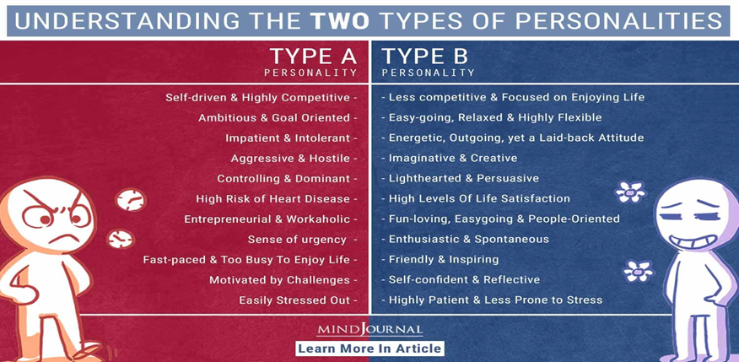
OTHER PERSONALITY TRAITS
Traits
Authoritarianism
Machiavellianism
Extroversion & Introversion
Achievement Oriented
Type A & Type B
Self Monitoring
Locus of Control
Self Esteem
Risk Taking

Slide 20
PERSONALITY TEST
Observation Method
Interview Method
Case History Method
Personality Inventory – MMPI & 16PFQ
Projection Method- Ink Blot Test & TAT

Slide 22
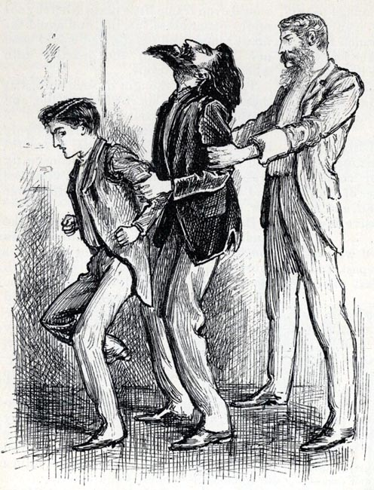

Slide 23
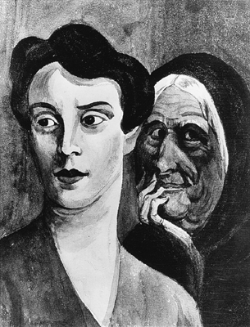

Slide 24
JOB FIT THEORY
TYPE | PREFER MODE | PERSONALITY CHARACTER | OCCUPATION
REALISTIC | They prefer physical activities, they require maximum skill, strength and co-ordination | Stable and shy by nature | Mechanic, farmer, front line worker
INVESTIGATIVE | Thinking, organizing, understanding | Analytical, independent | Mathematician, news reporter, economist, scientist
CONVENTIONAL | Orderly follow the rules | Practical, inflexible | Accountant, banker
SOCIAL | Helping others, help to develop others | Social, friendly, co-operative, understanding | Social workers, teacher, counselor
ARTISTICS | Expressive, creative | Imaginative, emotional, impractical | Painter, writer, poet

