Slide 1
World Wide Web Communication
The World Wide Web is about communication between web clients and web servers.
Clients are often browsers (Chrome, Edge, Safari), but they can be any type of program or device.
Servers are most often computers in the cloud.

Slide 2
HTTP Request / Response
Communication between clients and servers is done by requests and responses:
A client (a browser) sends an HTTP request to the web
An web server receives the request
The server runs an application to process the request
The server returns an HTTP response (output) to the browser
The client (the browser) receives the response

Slide 3
MQTT( Message Queuing Telemetry Transport)
MQTT stands for MQ Telemetry Transport.
It is a publish/subscribe, extremely simple and lightweight messaging protocol, designed for constrained devices and low-bandwidth, high-latency or unreliable networks.
The design principles are to minimize network bandwidth and device resource requirements whilst also attempting to ensure reliability and some degree of assurance of delivery. These principles also turn out to make the protocol ideal of the emerging “machine-to-machine” (M2M) or “Internet of Things” world of connected devices, and for mobile applications where bandwidth and battery power are at a premium.

Slide 4
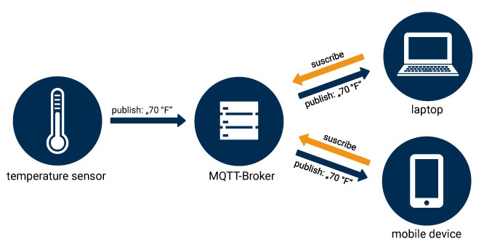

Slide 5
Like any other internet protocol, MQTT is based on clients and a server. Likewise, the server is the guy who is responsible for handling the client’s requests of receiving or sending data between each other.
MQTT server is called a broker and the clients are simply the connected devices.
When a device (a client) wants to send data to the broker, we call this operation a “publish”.
When a device (a client) wants to receive data from the broker, we call this operation a “subscribe”.
In addition, These clients are publishing and subscribing to topics. So, the broker here is the one that handles the publishing/subscribing actions to the target topics.

Slide 6
Example:
Let’s say there is a device that has a temperature sensor. Certainly, it wants to send his readings to the broker. On the other side, a phone/desktop application wants to receive this temperature value. Therefore, 2 things will happen:
The device defines the topic it wants to publish on, ex: “temp”. Then, it publishes the message “temperature value”.
The phone/desktop application subscribes to the topic “temp”. Then, it receives the message that the device has published, which is the temperature value.
Again, the broker role here is to take the message “temperature value” and deliver it to phone/desktop application.

Slide 7
MQTT Components:
That takes us to the MQTT components, which are 5 as follows:
Broker, which is the server that handles the data transmission between the clients.
A topic, which is the place a device want to put or retrieve a message to/from.
The message, which is the data that a device receives “when subscribing” from a topic or send “when publishing” to a topic.
Publish, is the process a device does to send its message to the broker.
Subscribe, where a device does to retrieve a message from the broker.

Slide 8
Why not HTTP?
HTTP is slower, more overhead and power consuming protocol than MQTT.
Slower: because it uses bigger data packets to communicate with the server.
Overhead: HTTP request opens and closes the connection at each request, while MQTT stays online to make the channel always open between the broker “server” and clients.
Power consuming: since it takes a longer time and more data packets, therefore it uses much power.

Slide 9
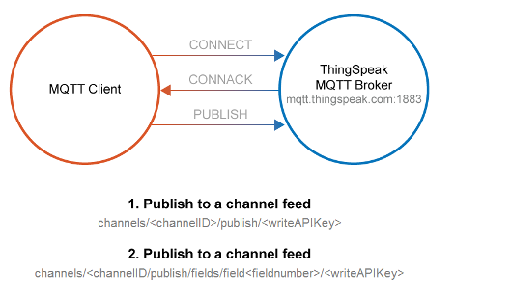

Slide 10
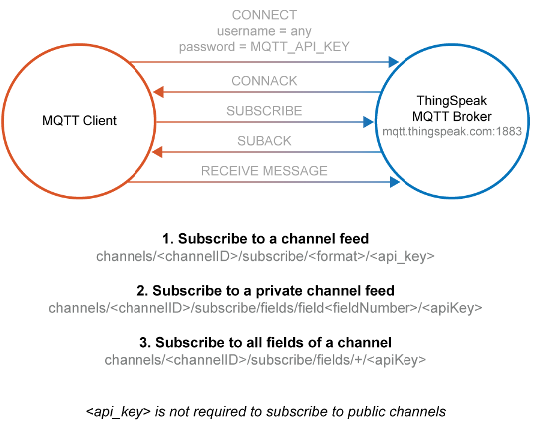

Slide 11
When to Use REST
In these scenarios, it is useful to use REST calls to update or retrieve data from a ThingSpeak channel.
You need to retrieve any historical data, such as data within a defined time range.
You want to Create Channel, Read Settings, Clear Channel, Delete Channel, or Create Chart.
You need a response for your GET or POST request.
When to Use MQTT
In these scenarios, it is useful to use MQTT to update data to a ThingSpeak channel.
Your device is power-constrained, and you want lower battery consumption to send data to ThingSpeak. Also, an MQTT PUBLISH operation is typically faster in this scenario.
Your device connectivity is intermittent, and you have limited bandwidth usage.
You want immediate updates of data posted to a channel.
You want messages pushed to you instead of needing to poll the server for new messages.

