Slide 1
The Nervous System

Slide 2
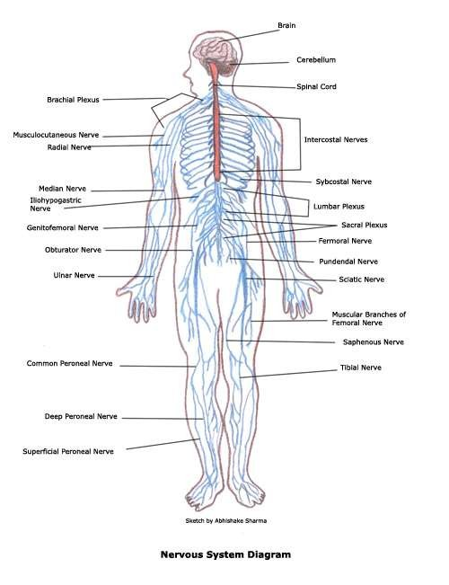
The nervous system
The Nervous system is the series of 100 + BILLION neurons in the body.
  Includes the following divisions
    Central Nervous System
    Peripheral Nervous System
    Autonomic Nervous System
  Functions include:
    Communication! Collecting data, interpreting, and sending messages.

Slide 3
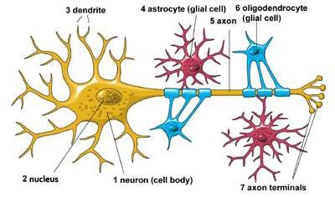
Tissue in the Nervous System
Nerve Cell = Neurons
  Cell body with dendrites (receives messages)
  Axon insulted in myelin sheath (sends messages along via action potential)
Glial Cells = Neuroglia
  These are cells that protect and support the neurons.

Slide 4
Neurotransmitters
These are chemical messengers that pass from neuron to neuron to continue the message.
  They are released into the synapse (space between neurons) and picked up by the next neuron.
  There are 200-300 chemicals in the body that serve as neurotransmitters.

Slide 5
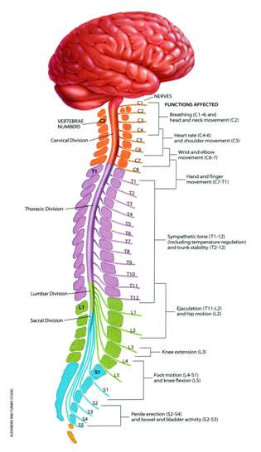
The Central Nervous System
This includes the brain and
spinal cord.
  Brain lives in the cranium and has several parts.
  Spinal Cord in housed inside the vertebral column.
The organs of the central nervous system (CNS) are covered by tough, protective tissues called meninges.
The CNS organs are surrounded by cerebrospinal fluids, which provides protection.

Slide 6
The Brain
Central Control of the body.
  Divided into four parts
    Cerebrum
    Diencephalon
    Cerebellum
    Brain Stem
  The brain has 4 ventricles (fluid filled spaces)
    These are highly vascular and lined with cells that produce cerebrospinal fluid. Maintains the blood-brain- barrier.

Slide 7
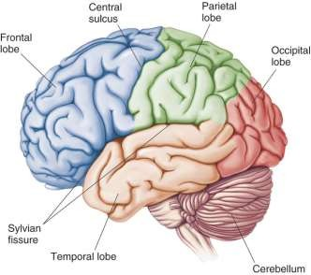
The Cerebrum
This is the sophisticated, upper
portion of the brain.
  Covered in “grey matter” surface with wrinkles and ridges called gyri and sulci.
  Divided into left and right hemispheres and into lobes.
    Frontal – personality, speech, logical
reasoning
    Parietal – sensory reception and spatial reasoning
    Occipital – Visual interpretation center
    Temporal – Hearing and receptive Language
    Limbic System – (deep in the brain)
emotion, short term memory,

Slide 8
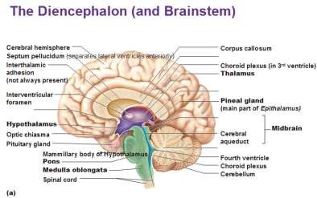
Diencephalon
Located deep in the brain, more primitive in function.
  Divided into the Thalamus and Hypothalamus
    autonomic nervous system control
    Regulation of heart rate
    Regulation of body temperature
    Body functions like hunger, sleep, thirst
    Plays a role in emotions, home of the “gut feeling”

Slide 9
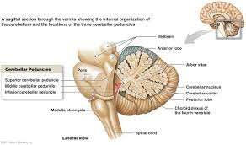
Cerebellum
This is the “Little Brain” located at the back of the head below the occipital lobe.
  Has hemispheres just like cerebrum.
  Interior white matter called “Tree of life”
  This part of the brain helps us coordinate our movements and stay balanced.

Slide 10
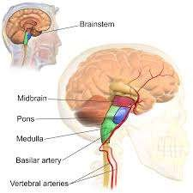
Brain Stem
Located at the base of the brain, most primitive part.
Has three main parts:
  Pons – connects cerebrum to cerebellum and the rest of the nervous system
  Midbrain – contains reflex (automatic response) regulation centers, plays role with sight and hearing
  Medulla Oblongata – vital functions such as heart rate, blood pressure, respirations, vomiting, and swallowing control.

Slide 11
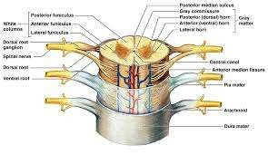
The Spinal Cord
Runs from the occipital bone to Lumbar Vertebrae #2.
  Spinal nerves of the peripheral nervous system branch from the
spinal cord.
  Opposite from the cerebrum, white matter is on the outside, and grey is on the inside.
  The main function of the spinal cord is to relay messages up to
and from the brain, and to serve as the reflex arch.

Slide 12
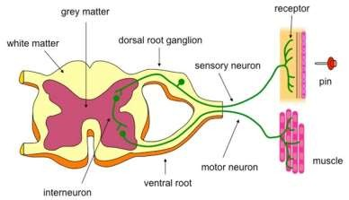
Reflex Arch
If a response, is reflexive, it means it is automatic.
  We do not have to think about it.
  In fact, the action occurs before the brain knows about it.
  Regulated at the point where the spinal nerve meets the spinal cord.
  Automatic protective action
  Message reaches the brain later

