Slide 1
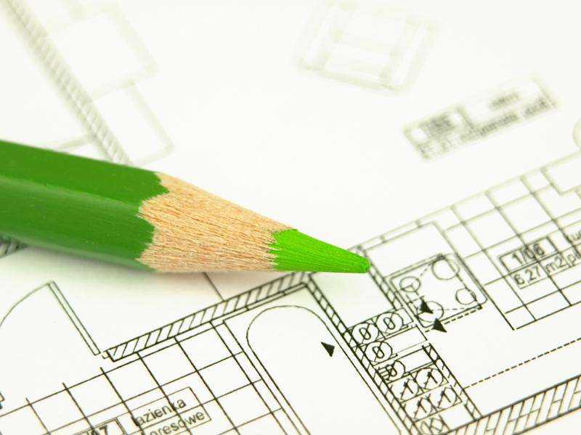


Plant Layout
Page 1

Slide 2
Facility Layout
Layout refers to the configuration of departments, work centers, and equipment, with particular emphasis on movement of work (customers or materials) through the system.
Layout decisions are important for three basic reasons:
require substantial investments of money and effort;
involve long-term commitments, which makes mistakes difficult to overcome; and
have a significant impact on the cost and efficiency of operations
Page 2

Slide 3
Factors affecting Plant Layout
Plant location and building
Nature of Product
Type of Industry
Plant Environment
Spatial Requirements
Repairs and Maintenance
Balance
Management Policy
Human Needs
Types of machinery and equipment
Page 3

Slide 4
The basic objective of layout design is to facilitate a smooth flow of work, material, and information through the system. Supporting objectives generally involve the following:
To facilitate attainment of product or service quality.
To use workers and space efficiently.
To avoid bottlenecks.
To minimize material handling costs.
To eliminate unnecessary movements of workers or materials.
To minimize production time or customer service time.
To design for safety.
Page 4

Slide 5



Plant Layout : Types
Page 5

Slide 6
The production process normally determines the type of plant layout to be applied to the facility:
Fixed position plant layout
Product stays and resources move to it.
Product oriented plant layout
Machinery and Materials are placed following the
product path.
Process oriented plant layout (Functional Layout).
Machinery is placed according to what they do and materials go to them.
Combined Layout
Combine aspects of both process and product layouts
Page 6

Slide 7
Product oriented plant layout
This type of plant layout is useful when the production process is organized in a continuous or repetitive way.
Continuous flow : The correct operations flow is reached through the layout design and the equipment and machinery specifications.
Repetitive flow (assembly line): The correct operations flow will be based in a line balancing exercise, in order to avoid problems generated by bottle necks.
The plant layout will be based in allocating a machine as close as possible to the next one in line, in the correct sequence to manufacture the product.
Page 7

Slide 8
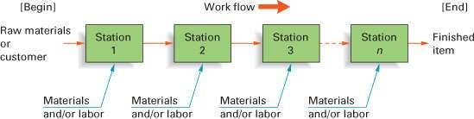

Product Layouts
Product layouts are used to achieve a smooth and rapid flow
of large volumes of goods or customers through a system.
Page 10

Slide 9
Advantages
Disadvantages
A high rate of output
Low unit cost due to high volume
Labor specialization
Low material-handling cost per unit
A high utilization of labor and equipment
The establishment of routing and scheduling in the initial design of the system
Fairly routine
accounting, purchasing, and inventory control
Morale problems and to repetitive stress injuries.
Lack of maintaining equipment or quality of output.
Inflexible for output or design
Highly susceptible to shutdowns
A high utilization of labor and equipment
Preventive maintenance, the capacity for quick repairs, and spare-parts inventories are necessary expenses
Incentive plans tied to individual output are impractical
Page 10

Slide 10
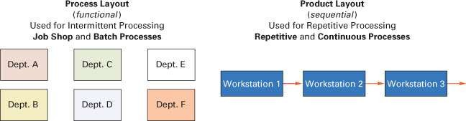
Process Layouts
Process layouts are designed to process items or provide
services that involve a variety of processing requirements.
Page 10

Slide 11
Process oriented plant layout (Functional Layout)
This type of plant layout is useful when the production
process is organized in batches.
Personnel and equipment to perform the same function are allocated in the same area.
The different items have to move from one area to another one, according to the sequence of operations previously established.
The variety of products to produce will lead to a diversity of flows through the facility.
The variations in the production volumes from one period to the next one (short periods of time) may lead to modifications in the manufactured quantities as well as the types of products to be produced.
Page 11

Slide 12
Advantages
Disadvantages
Handle a variety of processing requirements
Not vulnerable to equipment failures
General-purpose equipment is less costly and is easier and less costly to maintain
Possible to use individual incentive systems
In-process inventory costs can be high
Routing and scheduling pose continual challenges
Equipment utilization rates are low
Material handling is slow and inefficient, and more costly per unit
Job complexities reduce the span of supervision and result higher supervisory costs
Special attention necessary for each product or customer and low volumes result in higher unit costs
Accounting, inventory control, and purchasing are much more involved
Page 14

Slide 13
Fixed-Position Layouts
In fixed-position layouts, the item being worked on remains stationary, and workers, materials, and equipment are moved about as needed.
Fixed-position layouts are widely used in
farming, firefighting, road building, home building, remodeling and repair, and drilling for oil. In each case, compelling reasons bring workers, materials, and equipment to the “product’s” location instead of the other way around.
Page 14

Slide 14
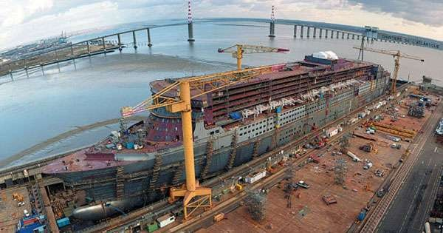
Page 14

Slide 15
Advantages
Disadvantages
Saves time and cost in movement
Flexible as changes in job design can be easily incorporated
More economical when several orders in different stages are executed
Adjustments can be made to meet shortage of materials or absence of workers.
Production period being very long, capital investment is quite heavy
Very large space is required for storage of materials and equipment
As several operations are carried simultaneously, possibility of confusion and conflicts are high
Page 14

Slide 16
Combination Layouts
Supermarket layouts are essentially process layouts, yet we find that most use fixed-path material-handling devices such as roller-type conveyors in the stockroom and belt-type conveyors at the cash registers.
Hospitals also use the basic process arrangement, although frequently patient care involves more of a fixed-position approach, in which nurses, doctors, medicines, and special equipment are brought to the patient.
Faulty parts made in a product layout may require off-line reworking, which involves customized processing. Moreover, conveyors are frequently observed in both farming and construction activities.
Cellular manufacturing - Group technology
Flexible manufacturing systems
Page 14

Slide 17
Essentials of Ideal Layout
Principle of minimum movement
Principle of flow
Principle of space
Principle of safety
Principle of flexibility
Principle of interdependence
Principle of overall integration
Principle of minimum investment
Page 17

Slide 18
Page 18

