Slide 1
BASICS OF FINGERPRINTING
SIGNIFICANCE OF POROSCOPY AND EDGEOSCOPY

Slide 2
What is poroscopy ?
Poroscopy is a method of personal identification through the comparison of the impressions of sweat pores .
Method was discovered and developed by Edmond Locard in 1912.
He showed that the sweat pores are permanent, immutable, and individual.
Locard proposed factors for the analysis of the pores for personal identification. These factors include:
number and frequency of pores,
distance between two continuous pores or interspacing,
size, shape, and position of the pores on the ridge

Slide 3
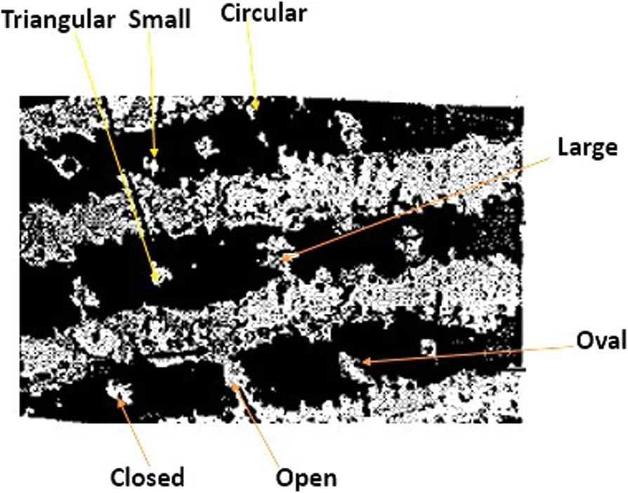
Advantages of poroscopy
Used to establish the identity or otherwise of individuals when available ridges do not provide sufficient ridge characteristics.
Picture taken through stereo-microscope using a digital micro camera showing individual types of pores in a rolled impression.

Slide 4
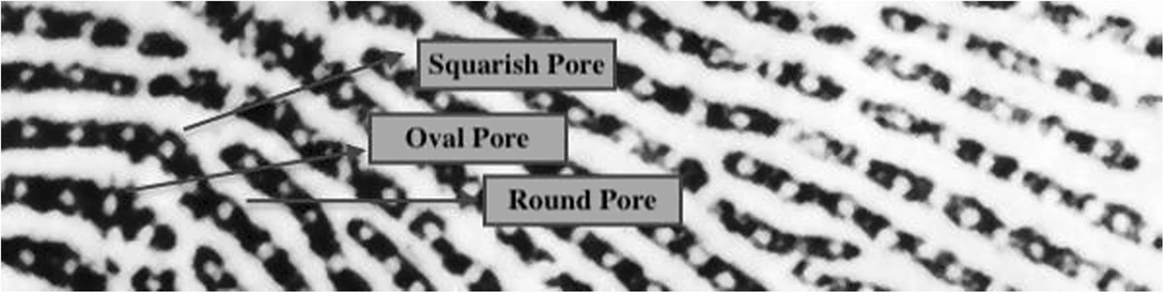
The photomicrographic image of rolled friction ridge impressions showing different shapes of the sweat pores.

Slide 5
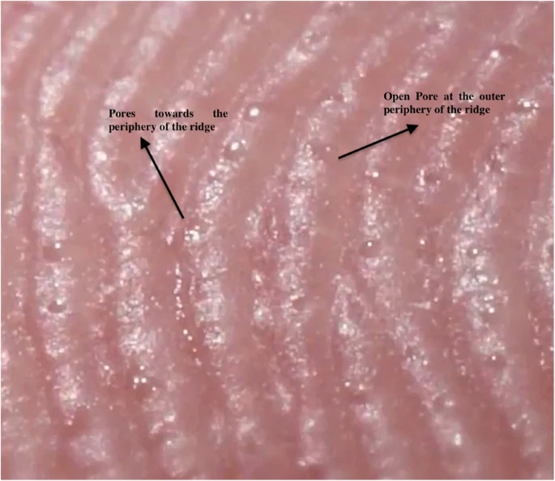
The photomicrographic image of rolled friction ridge impressions showing different positions (middle and periphery) of pores.

Slide 6
Drawbacks of Poroscopy
Lack of sufficient and systematic data about the various aspects of sweat pores, such as shape, size, position and interspacing frequency etc
The sweat pores may not always appear in latent/inked impressions.
Their microscopic nature restricts the fingerprint experts to give proper attention to examine their details and to use them for identification purposes.

Slide 7
What is Edgeoscopy ?
Edgeoscopy is a method of identification through the examination of the unique details and characteristics found along the edges of individual fingerprint ridges.
Characteristics are the result of the alignment and shape of the individual ridge units and the relationship between them, as well as the effects of pores that are close to the edge of the ridges.
These shapes are useful when quality of the friction ridges found in both the latent fingerprint and the exemplar print is high.
The method was pioneered by Salil Chatterjee in 1962.

Slide 8
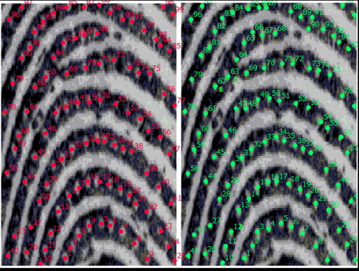
Showing poroscopy count and comparison with the help of count tool.

Slide 9
Drawbacks of Edgeoscopy
Lack of sufficient and systematic data about various aspects of edge details like as shape,position, and frequency, etc.

Slide 10
Sources
https://www.anilaggrawal.com
https://www.researchgate.net
https://ncrb.gov.in/

