Slide 1

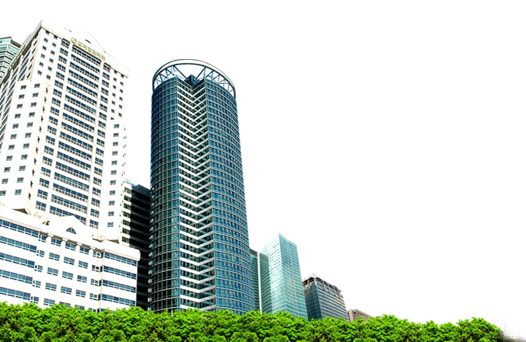




Process Design
and Facility Layout
1

Slide 2
Introduction
•
Make or Buy?
– Available capacity, excess capacity Expertise, knowledge, know-how exists?
Quality Consideration, specialized firms, control over quality if in-house
The nature of demand, aggregation Cost
–
–
–
–
Make some components buy remaining
2

Slide 3

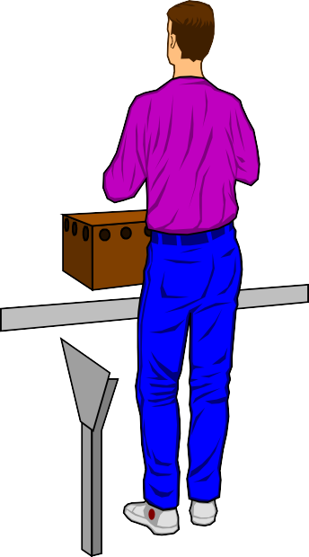
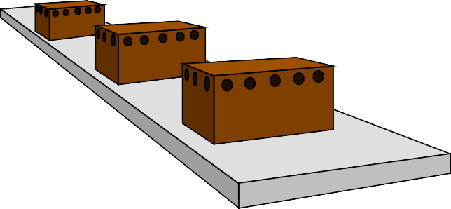

Introduction
▪
Process selection
•
Deciding on the way production of goods or services will be organized
▪
Major implications
•
Capacity planning
•
•
Layout of facilities
Equipment, Capital- equipment or labor intensive
• Design of work
3
systems

Slide 4
Process Selection and System Design
Facilities and
Equipment
Forecasting
Capacity Planning
Product and
Layout
Service Design
Process Selection
Technological
Work
Change
Design
Figure 6.1
4

Slide 5
Process Types
Job Shops: Small lots, low volume, general equipment, skilled workers, high-variety. Ex: tool and die shop, veterinarian’s office
Batch Processing: Moderate volume and variety. Variety among batches but not inside. Ex:paint production , BA3352 sections
Repetitive/Assembly: Semicontinuous, high volume of standardized items, limited variety. Ex: auto plants, cafeteria
Continuous Processing: Very high volume an no variety. Ex: steel mill, chemical plants
•
•
• Projects: Nonroutine jobs. Ex: preparing B₅A3352 midterm

Slide 6
Questions Before Selecting A Process
▪
Variety of products
and services
•
How much
▪
Flexibility of the process; volume, mix, technology and design
•
What type and degree
Batch
▪
Volume
•
Expected output
Job Shop
Continuous
Repetitive
6

Slide 7
Product – Process Matrix
 | Dimension | Job Shop | Batch | Repetitive | Continuous
Job variety
Process flexibility
Very High Very High
Moderate Moderate
Low Low
Very low Very low
Unit cost
Volume of output
Very High Very low
Moderate Low
Low High
Very low Very high
7

Slide 8
Variety, Flexibility, & Volume
Product Variety
High
Moderate Low Very Low
Equipment flexibility
High
Moderate Low Very Low
Low Volume
Job Shop
Moderate
Batch
Volume
High Volume
Repetitive assembly
Very high
Continuous Flow
Volume
8

Slide 9
Product – Process Matrix
Process Type High variety Low variety
Job Shop
Appliance repair Emergency room
Batch
Commercial bakery
Classroom Lecture
Repetitive
Automotive assembly
Automatic carwash
Continuous (flow)
Oil refinery Water purification
9

Slide 10
Product-Process Matrix
 | Low Volume One of a Kind |  | Multiple Products, Low Volume |  | Few Major Products, Higher Volume | High Volume, High Standard- ization
Job Shop | Book Writing | Movie Theaters |  | Automobile Assembly |  | Sugar Refinery
Batch
Assembly Line
Continuous Flow
Flexibility- Quality
Dependability- Cost
Flexibility-Quality
Dependability-Cost
10

Slide 11
Automation: Machinery that has sensing and control devices that enables it to operate
Fixed automation: Low production cost and high volume but with minimal variety and high changes cost
•
Assembly line
Programmable automation: Economically producing a wide variety of low volume products in small batches
•
•
•
Computer-aided design and manufacturing systems (CAD/CAM) Numerically controlled (NC) machines / CNC
Industrial robots (arms)
Flexible automation: Require less changeover time and allow continuous operation of equipment and product variety
•
•
Manufacturing cell
Flexible manufacturing systems: Use of high automation to achieve repetitive process efficiency with job shop process
•
•
Automated retrieval and storage Automated guided vehicles
•
Computer-integrated manufacturing (CIM)
11

Slide 12
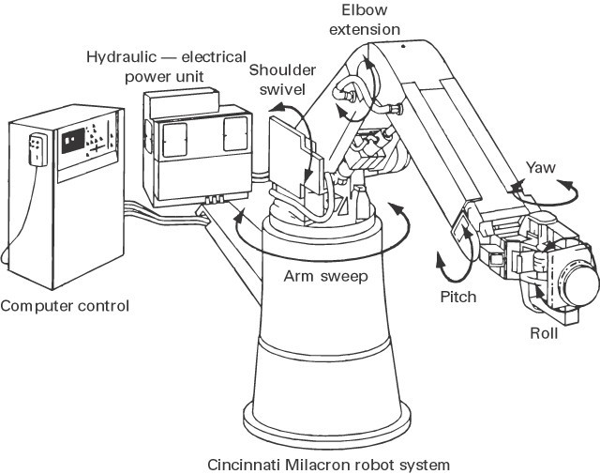
Robo
t
Show wafer_handler_web

Slide 13
Flexible Manufacturing System
▪
Group of machines that include supervisory computer control, automatic material handling, robots and other processing equipment
•
Advantage:
reduce labor costs and more consistent quality
lower capital investment and higher flexibility than hard automation
relative quick changeover time
Disadvantage
•
used for a family of products and require longer planning and development times

Slide 14
Computer-integrated manufacturing
▪
Use integrating computer system to link a broad range of manufacturing activities, including engineering design, purchasing, order processing and production planning and control
Advantage:
rapid response to customer order and product change, reduce direct labor cost, high quality
▪

Slide 15
Service Blueprint
▪
Service blueprint: A method used in service design to describe and analyze a proposed service. Flowchart:
Begin Turn on laptop Connect to LCD
A
Yes
A
View on
Lecture
No
Begin

Slide 16
Service Process Design
▪
▪
▪
▪
▪
▪
Establish boundaries Identify steps involved Prepare a flowchart
Identify potential failure points Establish a time frame for operations Analyze profitability

Slide 17
Layout
▪
Layout: the configuration of departments, work centers, and equipment,
•
Whose design involves particular emphasis on movement of work (customers or materials) through the system
▪
Importance of layout
•
•
•
Requires substantial investments of money and effort Involves long-term commitments
Has significant impact on cost and efficiency of short- term operations

Slide 18

The Need for Layout Decisions
Inefficient operations
For Example:
High Cost Bottlenecks
The introduction of new products or services
Changes in the design of products or services
Accidents
Safety hazards

Slide 19

The Need for Layout Design (Cont’d)
Changes in environmental or other legal requirements
Changes in methods and equipment
Changes in volume of output or mix of products
Morale problems

Slide 20
Basic Layout Types
▪
Product Layout
Layout that uses standardized processing operations to achieve smooth, rapid, high-volume flow
  Auto plants, cafeterias
▪
Process Layout
Layout that can handle varied processing requirements
  Tool and die shops, university departments
▪
Fixed Position Layout
Layout in which the product or project remains stationary, and workers, materials, and equipment are moved as needed
  Building projects, disabled patients at hospitals
•
Combination Layouts

Slide 21
A Flow Line for Production or Service
Flow Shop or Assembly Line Work Flow
Raw materials | Station |  |  |  | Station 2 |  | Station 3
 | 1
Station 4
Finished item
or customer
Material
Material
Material
Material
and/or labor
and/or labor
and/or labor
and/or labor

Slide 22
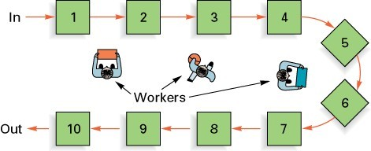
A U-Shaped Production Line
Advantage: more compact, increased communication facilitating team work, minimize the material handling

Slide 23
Process Layout
Process Layout (functional)
Dept. A
Dept. C
Dept. E
Dept. B
Dept. D
Dept. F
Used for Intermittent processing

Slide 24
Process Layout
Milling
Assembly
& Test
Grinding
Drilling
Plating
Process Layout - work travels to dedicated process centers

Slide 25
Layout types: Product or Process Make your pick
A
B
B A

Slide 26
Process vs Layout types
▪
▪
Job Shop Product
▪
Match?
▪
Project Process
▪
▪
Repetitive Fixed-point

Slide 27
Product layout
Advantages
Disadvantages
Lacks flexibility
Volume, design, mix
Boring for labor
Low motivation
Low worker enrichment
Can not accommodate partial shut downs/breakdowns
Individual incentive plans are not possible
•
•
•
•
•
High volume Low unit cost
Low labor skill needed Low material handling
High efficiency and utilization
Simple routing and scheduling
Simple to track and control
•
▪
•
▪
▪
•
•
•
•

Slide 28
Cellular Layouts
▪
Cellular Manufacturing
– Layout in which machines are grouped into a cell that can process items that have similar processing requirements.
A product layout is visible inside each cell.
▪
Group Technology
– The grouping into part families of items with similar design or manufacturing characteristics. Each cell is assigned a family for production. This limits the production variability inside cells, hence allowing for a product layout.

Slide 29
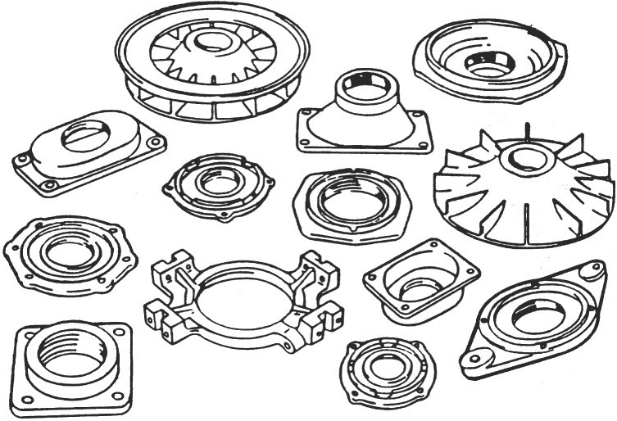
A Group of Parts
Similar manufacturing characters

Slide 30
Process vs. Cellular Layouts
Dimension Process Cellular
Number of moves between departments
Travel distances Travel paths
Job waiting times
Amount of work in process
Supervision difficulty
Scheduling complexity Equipment utilization
many few
longer variable greater higher
shorter fixed shorter lower
higher higher Lower?
lower lower Higher?

Slide 31
Process Layout
222
444
Mill
222
Drill
Grind
222
3333
Assembly
111
444
22222
1111 2222
111 333
333333333
44444
111
333333
Heat treat
Gear cutting
111
Lathes
111
333
444

Slide 32
Cellular Manufacturing Layout
Lathe | Mill | Drill | Heat treat | Gear cut
Assembly
-1111
-1111
Mill | Drill | Heat treat | Grind
222222222
- 2222
Lathe | Mill | Heat treat | Grind
3333333333
- 3333
Gear cut
44444444444444 Mill Drill
- 4444

Slide 33
Basic Layout Formats
▪
Group Technology Layout
Similar to cellular layout
Part Family W
Part Family X
Part Family Z
Assemble Y,W
Assemble X,Z
Part Family Y
Final Product
▪
Fixed Position Layout
– e.g. Shipbuilding

Slide 34
Fixed-Position and combination Layout
▪
Fixed-Position Layout:
item being worked on remains stationary, and workers, materials and equipment are moved as needed.
Example: buildings, dams, power plants
Combination Layouts: combination of three pure types.
Example: hospital: process and fixed position.
▪

Slide 35
Service Layouts
▪
Warehouse and storage layouts Issue: Frequency of orders Retail layouts
Issue: Traffic patterns and traffic flows Office layouts
Issue: Information transfer, openness
▪
▪

Slide 36
Design Product Layouts: Line Balancing
Line balancing is the process of assigning tasks to workstations in such a way that the workstations have approximately the same processing time requirements. This results in the minimized idle t along the line and high utilization of labor and equipment.
4 tasks 2 tasks
Worker 1 Worker 2
Each task takes 1 minutes, how to balance?
Cycle time is the maximum time allowed at each workstation to complete its set of tasks on a single unit
What is the cycle time for the system above?

Slide 37
Parallel Workstations
1 min.
30/hr.
1 min.
30/hr.
2 min.
30/hr.
1 min.
30/hr.
Bottleneck
30/hr.
2 min.
30/hr.
1 min.
60/hr.
1 min.
1 min.
60/hr.
30/hr.
2 min.
30/hr.
Parallel Workstations

Slide 38
The obstacle
▪
▪
The difficulty to forming task bundles that have the same duration.
The difference among the elemental task lengths can not be overcome by grouping task.
•
Ex: Can you split the tasks with task times {1,2,3,4} into two groups such that total task time in each group is the same?
Ex: Try the above question with {1,2,2,4}
•
▪
A required technological sequence prohibit the desirable task combinations
•
Ex: Let the task times be {1,2,3,4} but suppose that the task with time 1 can only done after the task with time 4 is
completed. Moreover task with time 3 can only done after the task with time 2 is completed. How to group?

Slide 39
Cycle Time
The major determinant: cycle time
Cycle time is the maximum time allowed at each workstation to complete its tasks on a unit.
Minimum cycle time: longest task time by assigning each task to a workstation
Maximum cycle time: sum of the task time by assigning all tasks to a workstation

Slide 40
Determine Maximum Output Cycle Time: Time to process 1 unit
OT:OperatingTimePerDay D: DesiredOutputRate
^{OT} = DesiredCycleTime
D
CT = CycleTime ← FromProcessDesign
^{OT} ≥ CT Can produce at the desired level, design is feasible
D
^{OT} < CT Cannot produce at the desired level, design is infeasible
D
Example: If a student can answer a multiple choice question in 2 minutes but gets a test with 30 questions and is given only 30 minutes then
OT=30 minutes; D=30
Desired cycle time=1 minute < 2 minutes = Cycle time from the p₄r₀ocess capability

Slide 41
of Workstations Required: Efficiency
Example: Students can answer a multiple choice question in 2 minutes but given a test with 30 questions and is given only 30 minutes. What is the minimum number of students to collaborate to answer all the questions in the exam?
Total operation (task) time = 60 minutes = 30 x 2 minutes Operating time=30 minutes
60/3=2 students must collaborate. This N_{min} below.
₌ Total task time for all products produced in a day ₌ (D)(∑t)
N
min
Availabale time in a day OT
₌ Total task time for a product ₌ ∑t
₌ ∑t
N
min
OT/D Availabale time for a product CT
∑t = sum of task times

Slide 42
Percent Idle Time
_{Percent idle time =} Idle time per cycle
(N)(CT)
Efficiency = 1 – Percent idle time

Slide 43
Example 1: Precedence Diagram
Precedence diagram: Tool used in line balancing to display elemental tasks and sequence requirements
0.1 min. 1.0 min.
a
b
c
d
e
0.2 min.
0.7 min.
0.5 min.

Slide 44
Example 1: Assembly Line Balancing
▪
Arrange tasks shown in the previous slide into workstations.
Use a cycle time of 1.0 minute
  Every 1 minute, 1 unit must be completed
– Rule: Assign tasks in order of the most number of followers
•
•
•
If you are to choose between a and c, choose a If you are to choose between b and d, choose b Number of followers: a:3, b:2, c:2, d:1, e:0
– Eligible task fits into the remaining time and all of its predecessors are assigned.

Slide 45
Assigning operations by the number of followers
Work- Station 1
Time
Remaining Eligible
Assign Station Task Idle Time
a
1.0
.9
.2
1.0
a,c c
none
b
c
-
.2
2
b
0
1.0
none d
-
0
3
d
.5
.3
e
e
-
-
.3
.5
- Eligible operation fits into the remaining time and its predecessors are already assigned.
- What is the minimum cycle time possible for this example?
45

Slide 46
Calculate Percent Idle Time
_{Percent idle time =} Sum of idle times at stations during a cycle
(N)(CT) = Total station time
Percent idle time = ^{0.2 + 0 + 0.3} = 0.167 = 16.7%
(3)(1)
Efficiency=1-percent idle time=1-0.167=0.833=83.3%

Slide 47
Line Balancing Heuristic Rules
Assign tasks in order of most following tasks.
Assign task in the order of the greatest task time.
Assign tasks in order of greatest positional weight.
– Positional weight is the sum of each task’s time and the times of all following tasks.

Slide 48
Solution to Example 1. Assigning operations using their task times.
Work- Station 1
Time
Remaining Eligible
Assign Station Task Idle Time
c
1.0
.9
.2
a,c a
none
a
-
.2
2
1.0
0
b none
b
-
0
3
1.0
.5
.3
d e
d e
-
-
.3
.5
Eligible operation fits into the remaining time and its predecessors are already assigned.

Slide 49
Positional Weights
Assign tasks in order of greatest positional weight.
Positional weight is the sum of each task’s time and the times of all following tasks.
a:1.8 mins; b: 1.7 mins; c:1.4 mins; d: 0.7 mins; e:0.2 mins.

Slide 50
Solution to Example 1. Assigning operations using their task times.
Work- Station 1
Time
Remaining Eligible
Assign Station Task Idle Time
a
1.0
.9
.2
a,c c
none
c
-
.2
2
1.0
0
b none
b
-
0
3
1.0
.5
.3
d e
d e
-
-
.3
.5
Eligible operation fits into the remaining time and its predecessors are already assigned.

Slide 51
Example 2
0.2
a
0.2
b
0.3
e
0.8
c
0.6
d
f
1.0
g
0.4
h
0.3

Slide 52
Solution to Example 2
Station 1
a b
Station 2
Station 3
Station 4
e
f
g
h
c
d

Slide 53
Designing Process Layouts
▪
Requirements:
•
List of departments
▪
Shape requirements
•
Projection of work flows
▪
One way vs. two way: Packaging and final assembly.
•
Distance between locations
▪
One way vs. two way: Conveyors, Elevators.
•
•
Amount of money to be invested List of special considerations
▪
Technical, Environmental requirements

Slide 54
Example 3:
Locate 3 departments to 3 sites
A B C
20 40
30
▪
Distances: ^{From\To}
A B C
-
in meters
20 -
40 30 -
▪
Work Flow:
From\To 1 |  | 2 | 3
1 - |  | 10 | 80
2 | 20 | - | 30
3 | 90 | 70 | -
in kilos

Slide 55
Example 3
▪
Mutual flow
:From\To 1 |  | 2 | 3
1 | - | - | -
2 | 30 | - | -
3 | 170 | 100 | -
▪
Closeness graph:
1
2
3

Slide 56
Designing Process Layouts
▪
▪
Create Layout Alternatives
Find the one which minimizes transportation costs and distance traveled

Slide 57
Example 3: Layout Alternative 1
30
170
100
1
3
2
B C
Total Distance Traveled by Material=7600 m
A

Slide 58
Example 3: Layout Alternative 2
170
30
100
1
2
3
B C
Total Distance Traveled by Material=10400 m
A

Slide 59
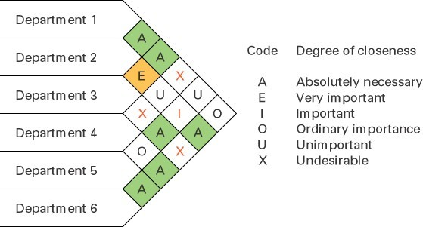
Closeness Rating: multiple criteria

Slide 60
Muther Grid
▪
Allow multiple objectives and subjective input from analysis or manager to indicate the relative importance of each combination of department pairs.
Subjective inputs are imprecise and unreliable
▪

Slide 61
Example 4
▪
Heuristic: assign critical departments first. The critical
departments are thoAses with X and A rating₁s₋.₂
Xs 1-4
3-6
3-4
▪
Solution:
1-3
2-6
3-5
4-6
5-6
61

Slide 62
Example 4
▪
Begin with most frequently in the A list (6)
Add remaining As to the main cluster
▪
▪
▪
Graphically²portray Xs
4
6
Fit th1e cluster into the arrangemen₃t
5
1
3
2
5
6
4
62

Slide 63
Summary
▪
Process Selection Objective, Implication, types
Product Layout
Line balancing: procedures and measures Process layout
Information requirements, measures From to chart and Muther grid
▪
▪
63

Slide 64
Tasks times and predecessors for an operation
Task label Time Predecessors A 2 None
7 A
5 None
2 None
15 C,D
7 A,E
6 None
4 B,G
9 A
10 None
4 None
8 J,K
6 A,L
C
E
D
F
A
B
H
N
G
I
J
L
M
K
64
N
15 F,H,I,M

Slide 65
Recitation example
▪
Find a workstation assignment by taking cycle time=17 minutes by assigning in the order of the greatest task time.
Can you find an assignment that uses only six stations and meets 17 minute cycle time requirement.
See the solution in the next recitation.
▪
▪
65

