Slide 1

Industrial Automation

Slide 2
Industrial Automation Components …
Field Instruments
Control Hardware
Control Software

Slide 3

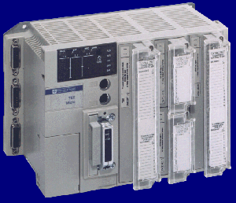


Automation : Typical installation . . . .
SCADA Software
Communication Cable
Control Hardware
Control Panel
Field Cabling
Junction Box
Field Cabling
Sensors Placed in the field

Slide 4
Automation : Advanced Technology . . . .
SCADA Software
Communication Cable
Control Hardware
Control Panel
Field Bus Network
Field Bus Scanners
Field Cabling
Smart Transmitters Placed in the field

Slide 5
Sensors ( Field Instruments )
Sensors with transmitters are the field devices placed in the field who actually sense the parameter and send the analog signal to the control hardware.
The analog signals used are Ohm (RTD), mV (Thermocouple), 4-20 mA, +/-10 V, etc

Slide 6
Widely used Sensors ( Field Instruments )
RTD : Output in Ohms (Temperature)
Thermocouples : Output in mV (Temperature)
Pressure Transmitters : 4-20mA, 0-10 V …..
Flow Transmitter : 4-20mA, 0-10 V …..
Level Transmitter : 4-20mA, 0-10 V …..
Conductivity meter : 4-20mA, 0-10 V …..
Density meter : 4-20mA, 0-10 V …..
pH transmitter : 4-20mA, 0-10 V …..
And Many more

Slide 7
Leading Manufacturers in Sensors
( Field Instruments )
Fisher Rosemount
Yokogawa
Anderson & Housers
Radix
ToshBro

Slide 8
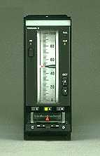
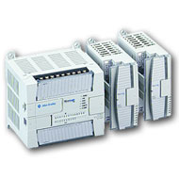
Control hardware
Standalone PID Controllers
Programmable logic controllers (PLC)
Distributed Control System

