Slide 1
Size Separation
Large pieces of material are usually estimated visually, difficulties arising only in the estimation of powders. size separation is a unit operation that involves the separation of mixture of verious size of particles into two or more portion by means of screening surface.
also known as sieving, sifting, classifying or screening.
Standards for Powders
Standards for powders for pharmaceutical purposes are laid down principally in the Indian Pharmacopoeia which states, that the degree of coarseness or fineness of a powder is differentiated and expressed by the size of the mesh of the sieve through which the powder is able to pass.

Slide 2
Size Separation
The IP specifies five grades of powder and the number of the
sieve through which all the particles must pass.
Grade of powder | Sieve through which all particles must pass
Coarse | 10
Moderately coarse | 22
Moderately fine | 44
Fine | 85
Very fine | 120

Slide 3
The IP specifies a second, smaller size of sieve for the coarser powders but states the not more than 40 per cent shall pass through.
The relevant grades of powder and sieve number are shown in the table:
Grade of powder | Sieve through which all particles must pass | Sieve through which not more than 40 per cent of particles pass
Coarse | 10 | 44
Moderately coarse | 22 | 60
Moderately fine | 44 | 85
Fine | 85 | Not specified
Very fine | 120 | Not specified

Slide 4
Thus, the full definition of Coarse Powder is that : It is powder all the particles of which pass through a No. 10 sieve and not more than 40 percent through a No. 44 sieve, this is usually referred to as a 10/44 powder.
Other grades are expressed in a similar way.

Slide 5
The Indian Pharmacopoeia makes two statements with regard to these `official' grades of powders in practice:
•
It is required that, when a powder is described by a number,
all particles must pass through the specified sieve.
When a vegetable drug is being ground and sifted, none must be rejected.
The reason for this will be apparent if the character of a vegetable drug is compared with a chemical substance. The latter is a homogeneous material so that, if a certain quantity, of a powder is required, an excess may be ground, a sufficient amount of the desired size range obtained by sieving, and the oversize particles (known as tailings) may be discarded.

Slide 6
A vegetable drug, however, consists of a variety of tissues of different degrees of hardness, so that softer tissues will be ground first and tailings obtained by sifting will contain a higher proportion of the harder tissues. In many cases, constituents are not distributed uniformly through vegetable tissues;
for example, in digitalis the glycosides are concentrated in the mid-rib and veins. Hence, if tailings are discarded when grinding and sifting the drug, it is likely that a high proportion of the active constituents will be lost.

Slide 7
In addition to the grades of powder specified by the British Pharmacopoeia, the British Pharmaceutical Codex details a further grade known as Ultra-fine Powder.
In this case, it is required that the maximum dimension of at least 90 percent of the particles must be not greater than 5µm and none must be greater than 50µm.
Determination of particle size for this grade is carried out by a microscopic method.

Slide 8

Sieves
Sieves for test purposes are the subject of a British Standard.
Most of the sieves used are of the wire mesh type, the number of the sieve indicating the number of meshes included in a length of 25.4 mm (1 inch) in each direction parallel to the wires.

Slide 9
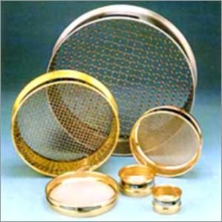
number of meshes that is
It should be noted that it is the
specified and not the number of
wires.
Thus, a No. 10 sieve has 10 meshes per inch in each direction, but it will be realized that if there were 10 wires there would be 9 meshes only.
The simple statement of the number of meshes per
unit length is not sufficient, however, as the size of the particle that will pass the sieve will depend on other factors, principally the diameter of the wire

Slide 10
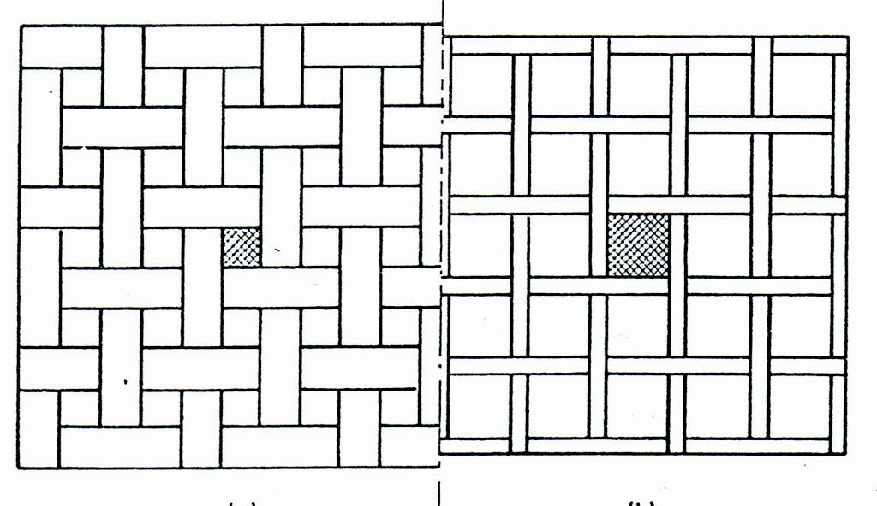
Effect of wire diameter on sieve mesh size.

Slide 11
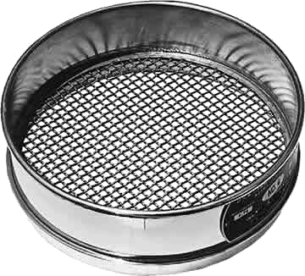
STANDARDS FOR SIEVES
according to B.P.
It is required that wire-mesh sieves shall be made
from wire of uniform, circular cross-section and for
each sieve the following particulars are stated:
Number of Sieve
This is the number of meshes in a length of 25.4 mm (1 in.), in each direction, parallel to the wires.

Slide 12
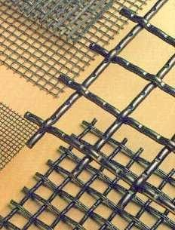
Nominal Size of Aperture (hole)
This is the distance between the wires, so that it represents the length of the side of the square aperture.
Nominal Diameter of the Wire
This dimension and the number of meshes form the basic standards for the sieve.
The wire diameter has been selected to give a suitable aperture size, but also to have sufficient strength to avoid distortion.

Slide 13

Approximate Screening Area.
This standard expresses the area of the meshes as a percentage of the total area of the sieve.
It is governed by the size of wire used for any particular sieve number and is kept within the range 35 to 40 per cent.
This gives suitable strength to the sieve, but leaves adequate area of meshes since these are obviously the useful area of the sieve.

Slide 14
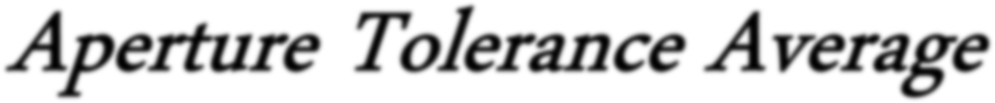
Aperture Tolerance Average
Some variation in the aperture size is unavoidable and this variation, expressed as a percentage, is known as the aperture tolerance average.
The term tolerance is used in engineering practice to mean the limits within which a particular quantity or dimension can be allowed to vary and still be acceptable for the purpose for which it is required.

Slide 15
Finer wires are likely to be subject to a greater proportional variation in diameter than coarse.
fine meshes cannot be woven with the same accuracy as coarse meshes. Hence, the aperture tolerance average is smaller for sieves of 5 or 10 mesh than is the case for 300 mesh.

Slide 16
PERFORATED PLATE SIEVES
Sieves may also be made by drilling holes in metal plate, so that this type will have circular apertures as against the square apertures of the wire mesh sieve.
In general, these sieves are used in the larger sizes and can be made with greater accuracy than
wire-mesh sieves, as
susceptible to distortion
well as being less
in use. This type is
commonly used also as screens in impact mills.

Slide 17
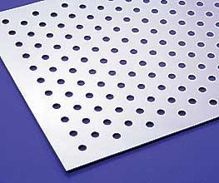
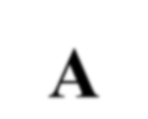
Usually, the holes are spaced with their centers arranged at the apices of equilateral triangles, so that all the apertures are equidistant
A
Perforated plate sieve.

Slide 18
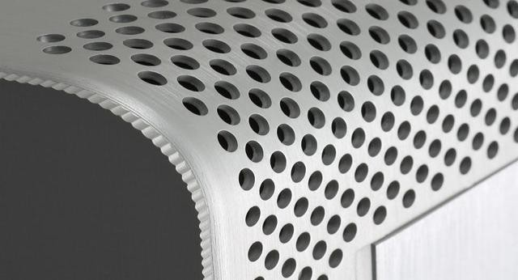
Similar standards are laid down with the appropriate
equivalent specifications for plate thickness and
nominal width of the bridge (dimension A in the
Figure) which control the strength of the sieve in the same way as wire diameter in wire mesh sieves.

Slide 19

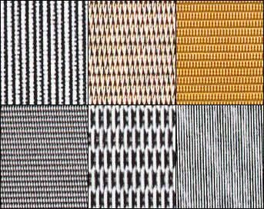
Materials Used for Sieves
The wire should be of
uniform, circular cross-section.
The material should have suitable strength to avoid distortion
Be resistant to corrosion by any substances
that may be sifted.

Slide 20

METALS
Iron wire Advantage cheap, Disadvantage
Rusting
Iron contamination of products

Slide 21
METALS
Coated Iron (coating with galvanizing or tinning).
Advantage
Increases the protection against corrosion
Increases the strength
Disadvantage
Coating after manufacture lead to some variation in the mesh size.

Slide 22
METALS
Copper
Advantage
Avoiding the risk of iron contamination
Disadvantage
As a soft metal, meshes can be distorted easily.

Slide 23

































METALS
□ Copper Alloys (brass and phosphor-bronze)
Advantages
Resemble copper in resistance to corrosion
possessing good
Their strength is greater so that less risk
of the meshes distortion.

Slide 24















METALS
Stainless Steel
Advantages
Good resistance to corrosion
Adequate strength
The most suitable purposes.
for pharmaceutical
Disadvantages Expensive

Slide 25
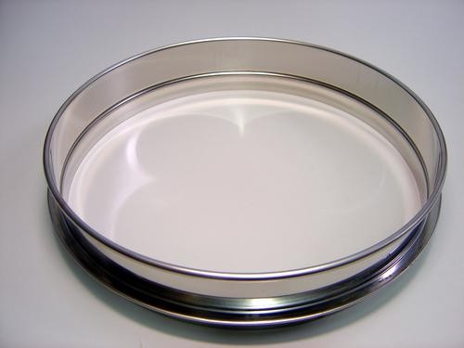

































NON-METALS
Used when all risk
of metallic contamination be avoided.
Used for sieves with fine meshes, since non-metal fibers are stronger than a metal wire of similar thickness.

Slide 26
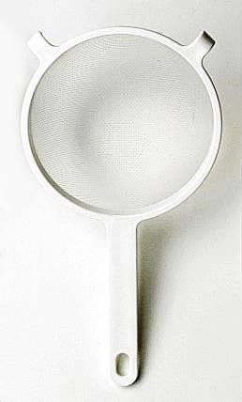
NON-METALS
Materials of natural origin (hair and silk), are used but synthetic fibers (nylon and terylene)
are more suitable
Advantages of synthetic fibers
Have more strength and resistance to corrosion.
can be extruded in all
a wide variety
diameters, so
of sieves to be
enabling made.

Slide 27
Sieving Methods
Sieves should be used and stored with care, since a sieve is of little value if the meshes become damaged or distorted.
With the exception granulation, material through a sieve.
of the should
use of never
sieves for be forced
Particles, if small enough, will pass through a sieve easily if it is shaken, tapped, or brushed.

Slide 28
I. MECHANICAL SIEVING METHODS
Principle:
Based on methods as:
Agitation Brush the sieve
Use centrifugal force

Slide 29



1. Agitation Methods
Sieves may be agitated in a number of different ways:
Oscillation (move back and forth)
The sieve is mounted in a frame that oscillating.
Advantages
Simple method
Disadvantages
The material may roll on the surface of the sieve,
and fibrous materials tend to “ball”.

Slide 30
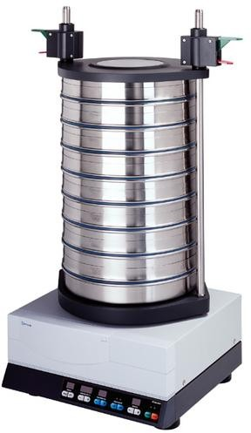
Vibration
The mesh is vibrated at high speed, often by an electrical device.
Advantages
The rapid vibration is imparted to the particles on the sieve and the particles are less likely to “blind” the mesh.

Slide 31


2. Brushing Methods
A brush can be used to move the particles on the surface of the sieve and to keep the meshes clear.
A single brush across the diameter of an ordinary circular sieve, rotating about the mid-point, is effective;
In large-scale production a horizontal cylindrical sieve is employed, with a spiral brush rotating on the longitudinal axis of the sieve.

Slide 32


3. Centrifugal Methods
Use a vertical cylindrical sieve with a high speed
rotor inside the cylinder, so that particles are thrown outwards by centrifugal force.
The current
helps sieving.
of air created by the movement
Especially is useful with very fine powders.

Slide 33
II. WET SIEVING METHODS (FLUID CLASSIFICATION)
Industrial methods of particle size separation
based on sedimentation or on elutriation.
Wet sieving is more efficient than the dry process,
because particles are suspended
passing easily through the sieve
readily and
with less
blinding of the meshes.

Slide 34


SEDIMENTATION METHODS
1. Sedimentation Tank
A suspension of the solids in a fluid, most commonly water, is placed in a tank and allowed to stand for a suitable time.
The upper layer is then removed, giving a single separation, or the suspension may be collected as a number of fractions by arranging for the pump inlet to remain just below the surface.
The suspension pumped out will then contain successively coarser particles.

Slide 35
Advantages
Simple process
Disadvantages
A batch process only
It does not give a clean split of particle sizes because some small particles will be near the bottom of the tank at the beginning of the process and so will be removed with the coarse particles.

Slide 36


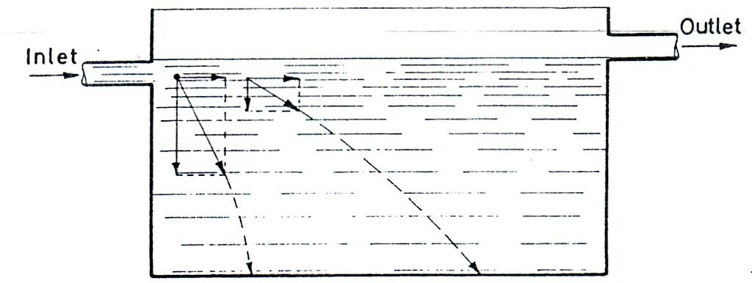
2. Continuous Sedimentation Tank
Continuous sedimentation tank

Slide 37
Particles entering the tank will be acted upon by a force
that can be divided into two components:
Horizontal component due to the flow of the fluid that carries the particle forward
Vertical component due to gravity, which causes the particle to fall towards the bottom of the tank.

Slide 38
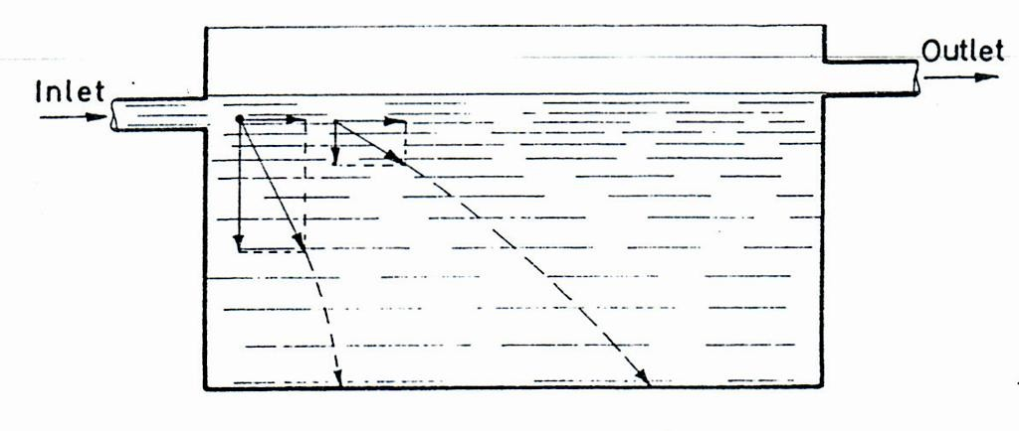
The latter will depend on Stokes' law, so that the velocity of fall is proportional to the diameter. Thus, particles will settle to the floor of the tank at a point that depends on particle size, the coarsest particles being nearest to the inlet and the finest nearest to the outlet.

Slide 39
on the floor, be collected
In some tanks, partitions are arranged
enabling particular size fractions to
continuously. In other tanks, the flow is arranged so that only coarse particles will settle out, fine particles being carried through to the overflow and collected elsewhere by sedimentation or filtration.

Slide 40
Advantages
Simple
Inexpensive
Continuous in operation
Gives a clean separation
of particles into
many size fractions as required.

Slide 41
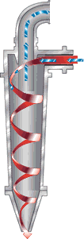
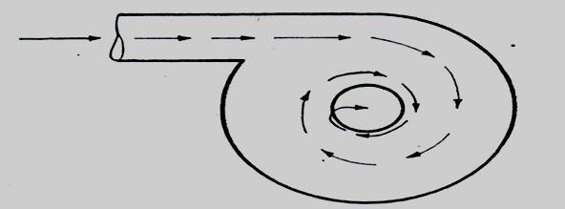
3. Cyclone Separator
The cyclone separator consists of a cylindrical vessel with a conical base
The rotatory flow within the cyclone causes the particles to be acted on by centrifugal force, solids being thrown out to the
walls, then falling to the conical base and out through the solids discharge.
Cyclone separator

Slide 42
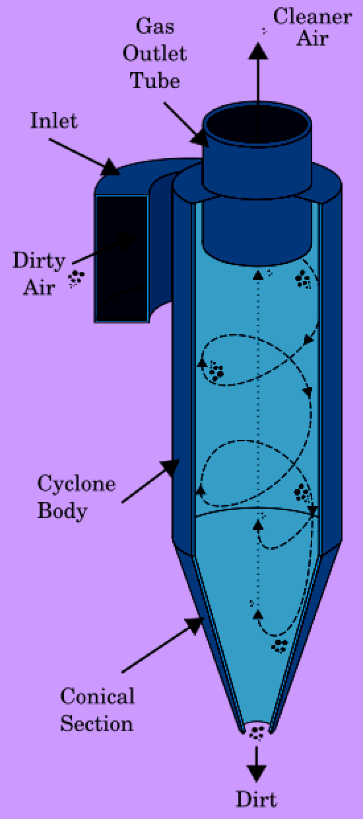
The suspension
tangentially at
is introduced
fairly high
velocity, so that a rotary
movement takes place within the vessel, and the fluid is removed from a central outlet
at the top.

Slide 43
The separator is still a form of sedimentation, but with centrifugal force used instead of the gravitational force.
Hence, depending on the fluid velocity, the cyclone can be used to separate all particles or to remove only coarser particles and allow fine particles to be carried through with the fluid.
Cyclones can be used with liquid
most
suspensions of solids, but the
common application is with suspensions of a solid in a gas, usually air.

Slide 44


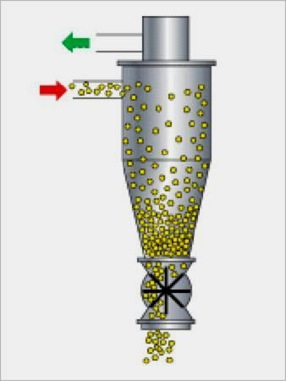
4. Mechanical Air Classifier
Mechanical air separation
methods use similar principles to the cyclone separator, but the air movement is obtained by means of a rotating disc and vanes, and separation is improved by the use of stationary vanes.

Slide 45
By controlling these vanes and the speed of rotation, it is possible to vary the size at which separation occurs.
conjunction and return further size
The method is used in
with mills to separate oversize particles for reduction.

Slide 46
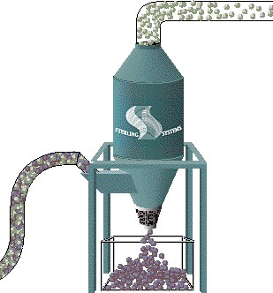
ELUTRIATION METHODS
Elutriation depends on the movement of a fluid against the direction of sedimentation of the particles.
Fluid and fine particles
For the gravitational system, the apparatus consists simply of a
Suspension
vertical column with near the bottom
an inlet for the
suspension, an outlet at the base
for coarse particles, and an overflow near the top for fluid and fine particles.
Coarse particles

Slide 47
One column will give a single separation into two fractions, but it must be remembered that this will not give a clean cut, since there is a velocity gradient across the tube, resulting in the separation of particles of different sizes according to the distance from the wall.
Fluid and fine particles
Suspension
Coarse
particles
Elutriation

Slide 48
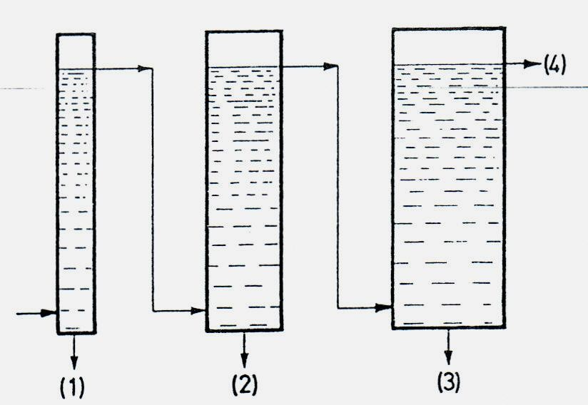
Multi-stage elutriator
(1) to (4) are fractions of decreasing particle size
If more than one fraction is required, a number of tubes of increasing area of cross-section can be connected in series. With the same overall flow-rate, the velocity will decrease in succeeding tubes as the area of cross-section increases, giving a number of fractions.

Slide 49
Advantages
The process is continuous.
The separation is quicker than with sedimentation
Disadvantages
The suspension has to sometimes be undesirable.
be dilute; which may

Slide 50

APPLICATIONS OF SEDIMENTATION AND ELUTRIATION
Both methods are used for similar purposes, usually following a size reduction process, with the object of separating oversize particles, which may be returned for further grinding, used for other purposes, or discarded according to the circumstances.

Slide 51
With liquids; the techniques are applicable to
insoluble solids, such as kaolin or chalk, which are often subjected to wet grinding followed by sedimentation or elutriation with water.
With gases, the methods are applicable to finer
solids that would separate too slowly in liquids, to water-soluble substances, or where dry processing is required.
Thus, a cyclone or mechanical air separator is often incorporated in circuit with a ball mill or hammer mill to separate and return oversize particles.

Slide 52
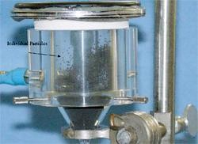
Suspended TRISO fuel particles in the
hopper for separation and individual transport

Slide 53
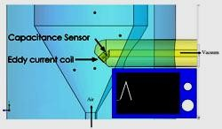
Cross-section diagram of hopper
showing placement of pneumatic transfer line and selected sensors for particular TRISO fuel application

