Slide 1
BACTERIAL STAINING
1
basic methods
Deepankar ratha,
Assistant Professor,
CUTM, Rayagada

Slide 2
Why we should be Stain Bacteria
3
Bacteria have nearly the same refractive index as water, therefore, when they are observed under a microscope they are opaque or nearly invisible to the naked eye. Different types of staining methods are used to make the cells and their internal structures more visible under the light microscope.
.

Slide 3

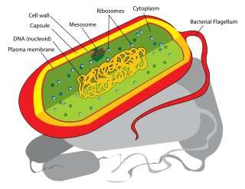
Staining helps in observation of Bacteria
4
Microscopes are of little use unless the specimens for viewing are prepared properly. Microorganisms must be fixed & stained to increase visibility, accentuate specific morphological features, and preserve them for future use.

Slide 4
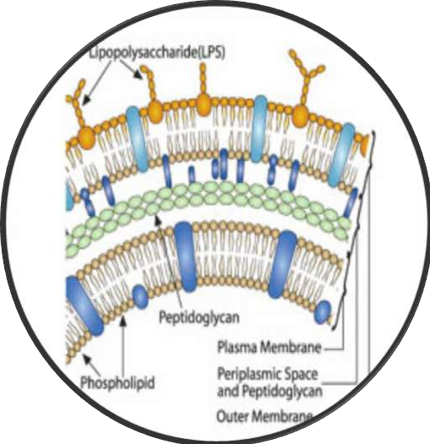
Stains and Staining
5
Bacteria are slightly negatively charged at pH 7.0
▫ Basic dye stains bacteria
▫ Acidic dye stains background
Simple stain
▫ Aqueous or alcohol solution of single basic dye

Slide 5
What is a Stain
6
A stain is a substance that adheres to a cell, giving the cell color.
The presence of color gives the cells significant contrast so are much more visible.
Different stains have different affinities for different organisms, or different parts of organisms
They are used to differentiate different types of organisms or to view specific parts of organisms

Slide 6
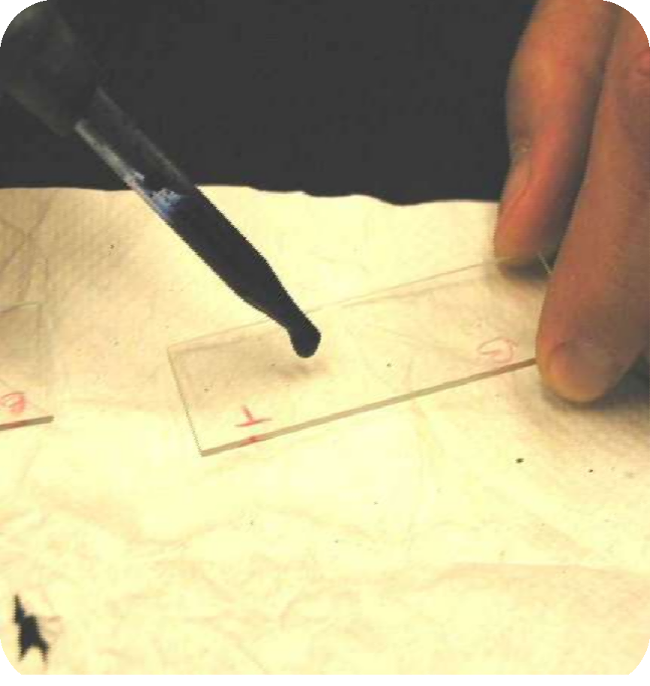
Staining Techniques
7
Staining is an auxiliary technique used in microscopy to enhance contrast in the microscopic image. Stains and dyes are frequently used in biology and medicine to highlight structures in biological tissues for viewing, often with the aid of different microscopes.

Slide 7
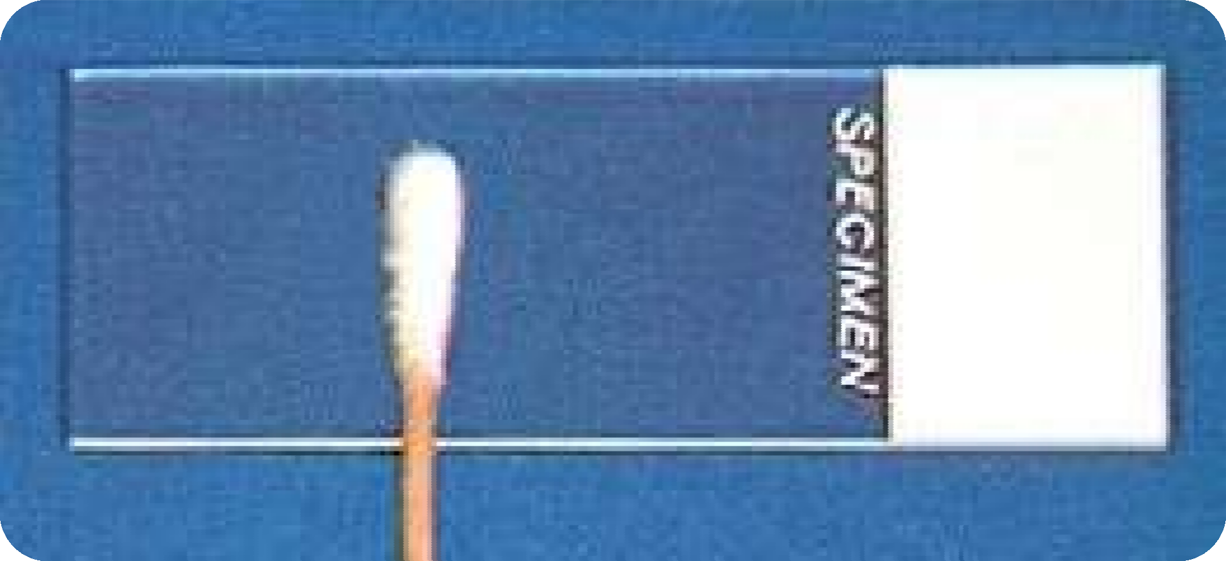
Smearing out of the sample
8

Slide 8
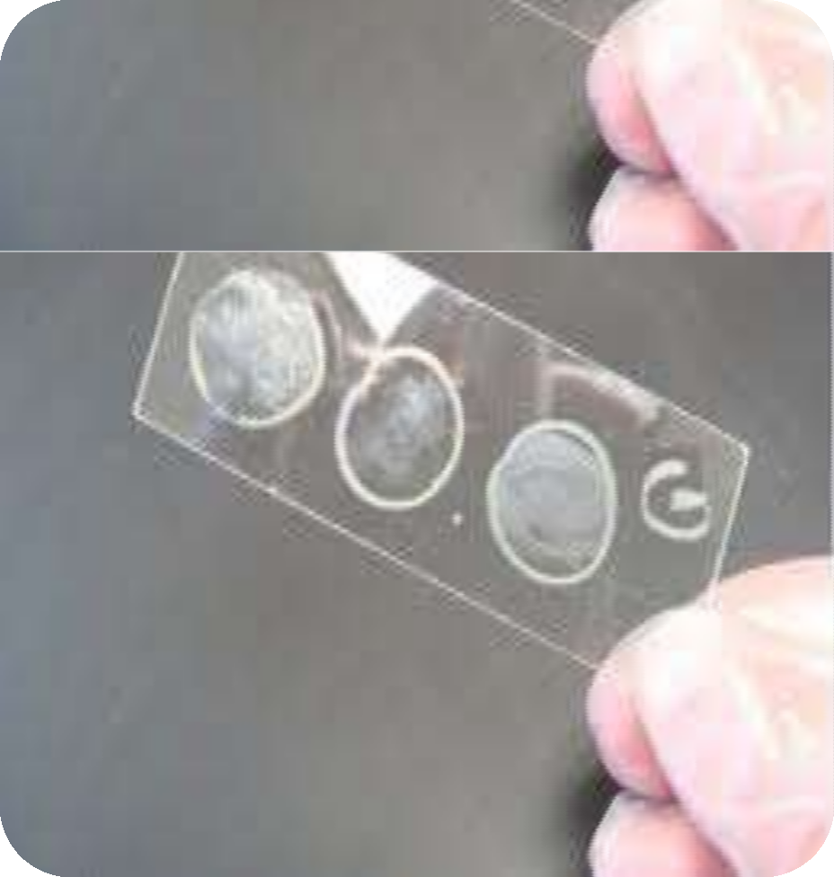
Fixation
9
Fixation–which may itself consist of several steps–aims to preserve the shape of the cells or tissue involved as much as possible. Sometimes heat fixation is used to kill, adhere, and alter the specimen so it will accept stains

Slide 9
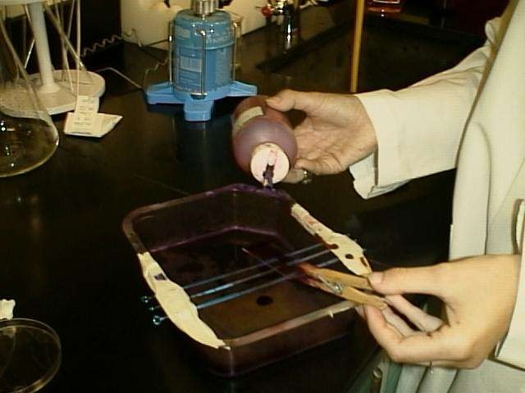
Simple staining
10
simplest, the actual staining process may involve immersing the sample (before or after fixation and mounting) in dye solution, followed by rinsing and observation.
The stain can be poured
drop by drop on the slide

Slide 10
Simple staining
11
Methylene blue, Basic fuchsin
Provide the color contrast but impart the same color to all the organisms in a smear
Loffler's ethylene blue: Sat. solution of M. blue in alcohol - 30mlKoH, 0.01% in water - 100mlDissolve the dye in water, filter. For smear: stain for 3’. For section: stain

Slide 11
Simple staining (cont..)
12
Dilute Carbol fuchsin:- Made by diluting Z-N stain with 10- 15 times its volume of water- Stain for 20-25 seconds, wash with water
Use: To demonstrate the morphology of Vibrio cholera
Polychrome methylene blue:
Use: M’Fadyean’s reaction - B. anthracis

Slide 12
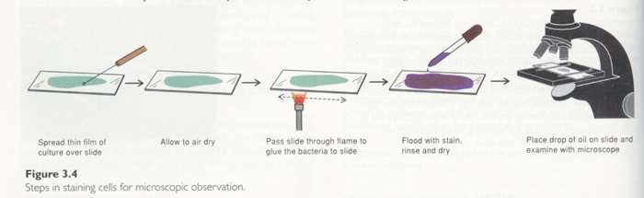
13
Simple Stains

Slide 13
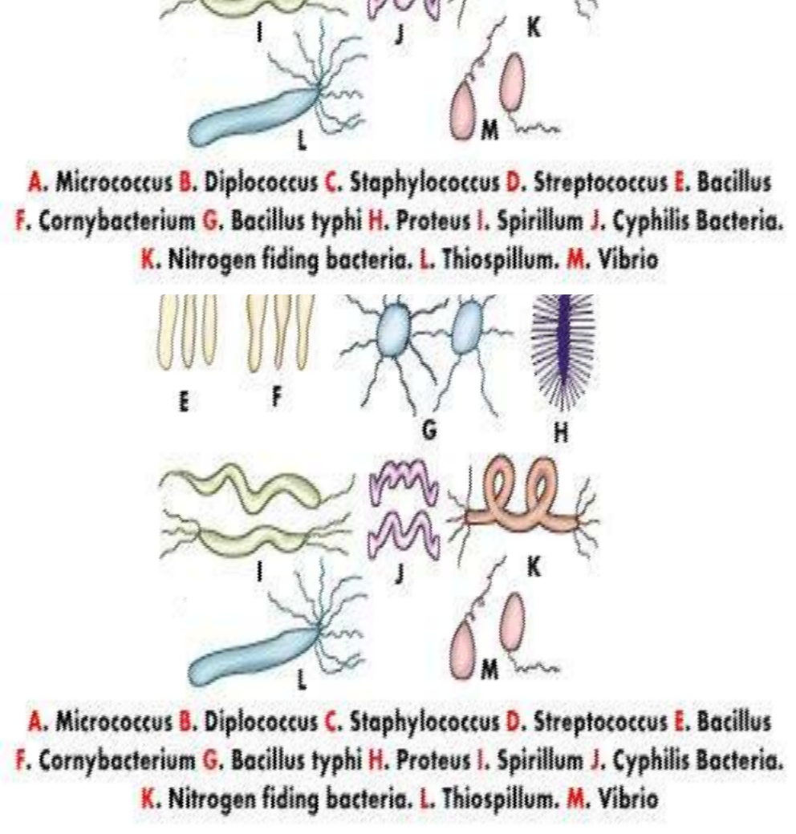
Bacterial arrangement
14
Clusters (group).
Chains.
Pairs (diploids).
No special arrangement.

Slide 14
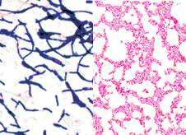
Simple Staining Easier to Perform But has Limitations
15
Simple easy to use; single staining agent used; using basic and acid dyes.
Features of dyes: give coloring of microorganisms; bind specifically to various cell structures

Slide 15
Differential Stains
16
Differential Stains use two or more stains and allow the cells to be categorized into various groups or types.
Both techniques allow the observation of cell morphology, or shape, but differential staining usually provides more information about the characteristics of the cell wall (Thickness).

Slide 16
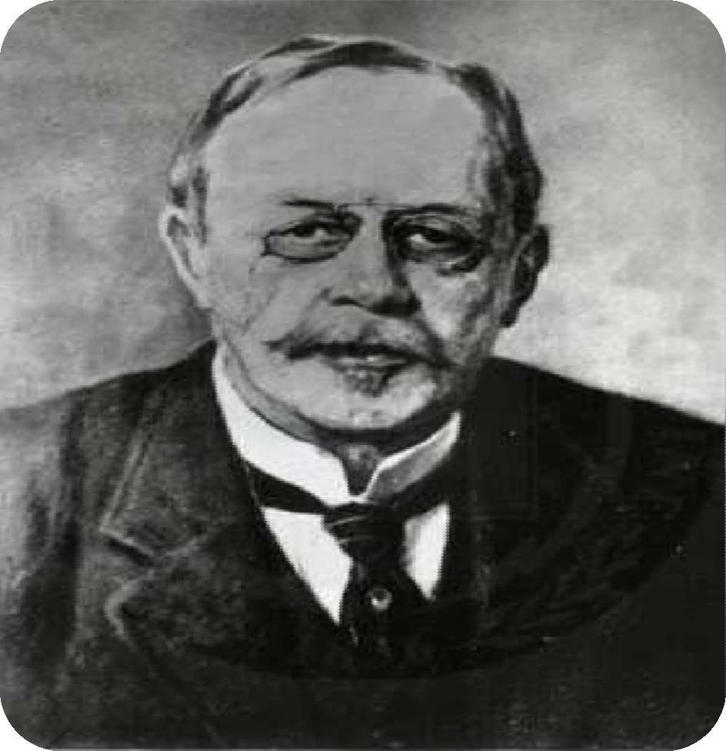
Gram staining
17
Named after Hans Christian Gram, differentiates between Gram- positive purple and Gram-negative pink stains and is used to identify certain pathogens.

Slide 17
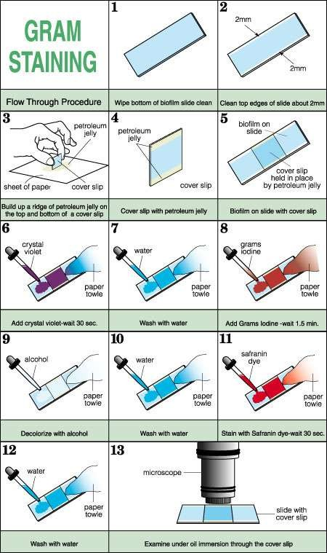
18

Slide 18
Gram staining - Principles
19
Gram staining is used to determine gram status to classify bacteria broadly. It is based on the composition of their cell wall. Gram staining uses crystal violet to stain cell walls, iodine as a mordant, and a fuchsin or safranin counterstain to mark all bacteria. Gram status is important in medicine; the presence or absence of a cell wall will change the bacterium's susceptibility to some antibiotics.
Gram-positive bacteria stain dark blue or violet. Their cell wall is typically rich with peptidoglycan and lacks the secondary membrane and lipopolysaccharide layer found in Gram-negative bacteria

Slide 19

Gram Staining Steps
20
Crystal violet acts as the primary stain. Crystal violet may also be used as a simple stain because it dyes the cell wall of any bacteria.
Gram’s iodine acts as a mordant (Helps to fix the primary dye to the cell wall).
Decolorizer is used next to remove the primary stain (crystal violet) from Gram Negative bacteria (those with LPS imbedded in their cell walls). Decolorizer is composed of an organic solvent, such as, acetone or ethanol or a combination of both.)
Finally, a counter stain (Safranin), is applied to stain those cells (Gram Negative) that have lost the primary stain as a result of decolorization

Slide 20
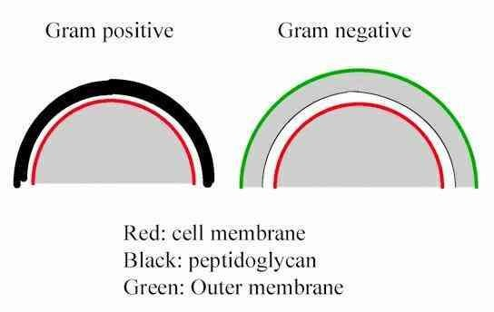
Stains differentiates different groups of Bacteria
21
To distinguish different kinds of bacteria into separate groups based on staining properties
Two types: Gram stain & Acid-fast stain.

Slide 21
Differential Stains:Gram Stain
22
 | Color of Gram + cells | Color of Gram – cells
Primary stain: Crystal violet | Purple | Purple
Mordant: Iodine | Purple | Purple
Decolorizing agent: Alcohol-acetone | Purple | Colorless
Counterstain: Safranin | Purple | Red

Slide 22
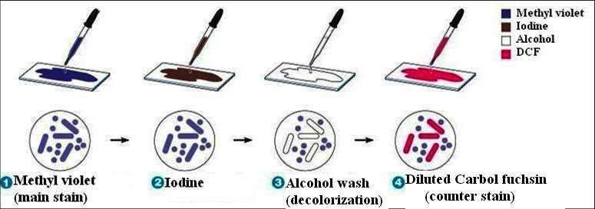
Gram Staining technique
23

Slide 23
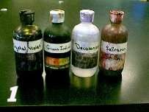
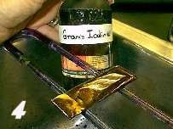
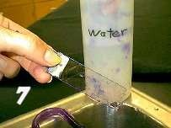
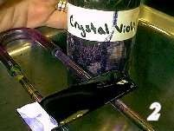

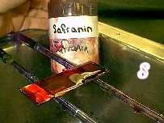
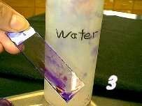
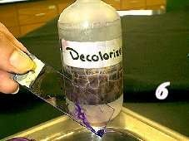

Gram Staining Procedure
24

Slide 24
25
Gram Staining technique

Slide 25
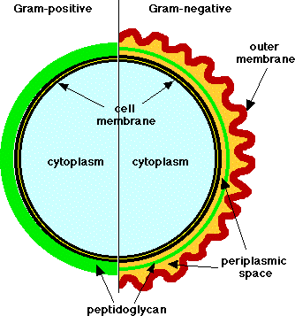
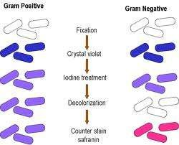
Structure and Reactivity to Gram Staining.
26

Slide 26
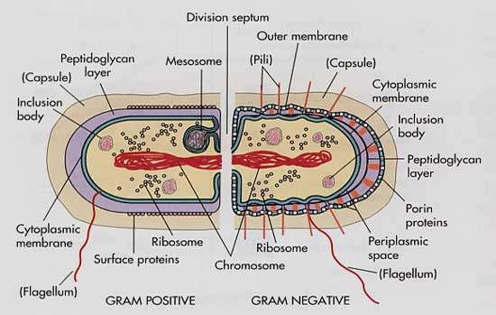
27

Slide 27
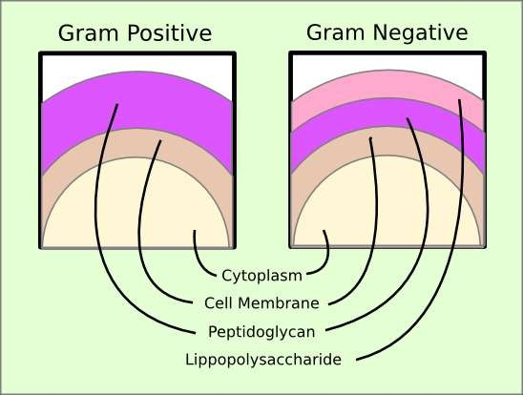
Cell structure differentiates Gram positive from Gram Negative
28

Slide 28
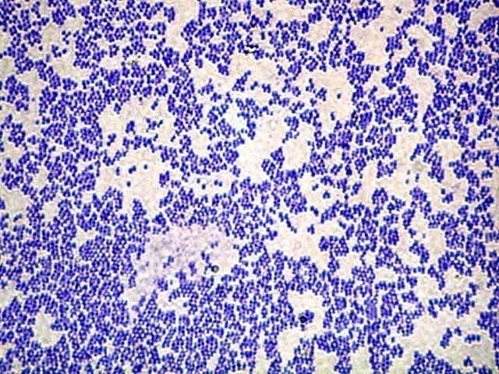
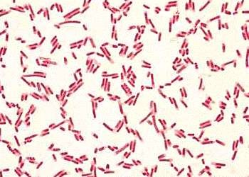
Gm+ve cocci & Gm-ve bacilli
29

Slide 29
Gram-positive
30
Gram-positive bacteria are those that are stained dark blue or violet by Gram staining. This is in contrast to Gram-negative bacteria, which cannot retain the crystal violet stain, instead taking up the counter stain (safranin or fuchsine) and appearing red or pink. Gram- positive organisms are able to retain the crystal violet stain because of the high amount of peptidoglycan in the cell wall. Gram-positive cell walls typically lack the outer membrane found in Gram-negative bacteria.

Slide 30
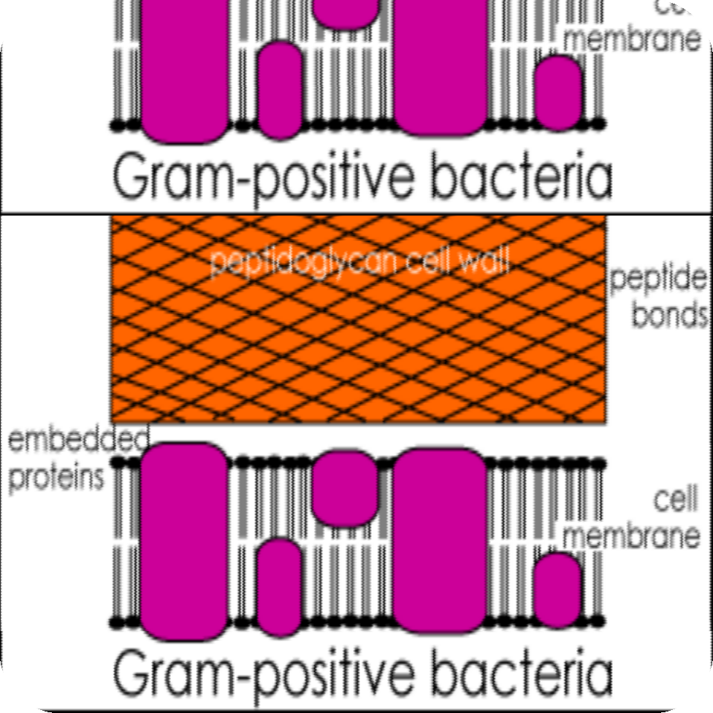
GRAM-POSITIVE BACTERIA
31
GRAM-POSITIVE BACTERIA are characterized by having as part of their cell wall structure peptidoglycan as well as polysaccharides and/or teichoic acids. The peptidoglycans which are sometimes also called murein are heteropolymers of glycan strands, which are cross-linked through short peptides.

Slide 31
What are Gram Negative Bacteria
32
Gram-negative bacteria are those bacteria that do not retain crystal violet dye in the Gram staining protocol. In a Gram stain test, a counter
stain (commonly safranin) is added after the crystal violet, coloring all Gram-negative bacteria with a red or pink color. The test itself is useful in classifying two distinct types of bacteria based on the structural differences of their cell walls. On the other
hand, Gram-positive bacteria will retain the crystal violet dye when washed in a decolorizing solution.

Slide 32
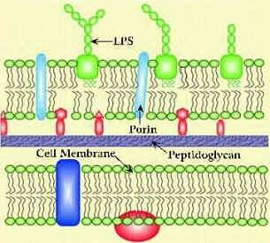
Gram negative bacteria
33
On most Gram-stained preparations, Gram-negative organisms will appear red or pink because they are counterstained. Due to presence of higher lipid content, after alcohol- treatment, the porosity of the cell wall increases, hence the CVI complex (Crystal violet - Iodine) can pass through. Thus, the primary stain is not retained.

Slide 33
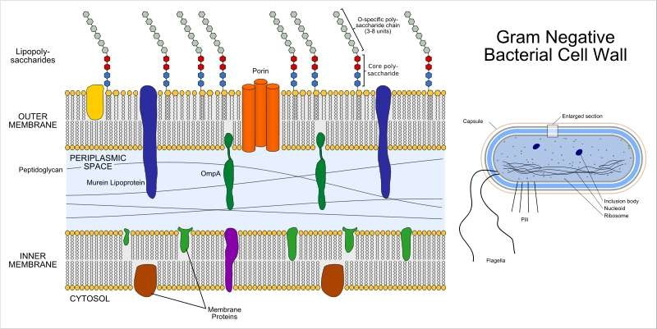
Structural Details of Gram –ve Bacteria
34

Slide 34
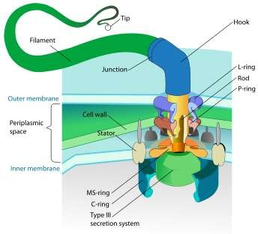
Gram Negative Bacteria
35
Also, in contrast to most Gram-positive bacteria, Gram- negative bacteria have only a few layers of peptidoglycan and a secondary cell membrane made primarily of lipopolysaccharide

Slide 35
Common Questions
36
1 Principles of Gram Staining and its uses.
2 Name common/pathogenic Gram positive and Gram negative Bacteria
3 Why some bacteria are Gram positive and others Gram negative.
4 Why some bacteria cannot be stained by Gram’s Method of staining.
5 What is the Use of Gram staining in your future clinical practice.

Slide 36
ACID FAST STAINING
37

Slide 37
Mycobacterium are Acid Fast Bacilli
38
Mycobacterium are Gram-resistant (waxy cell walls), non-motile, pleomorphic rods, related to the Actinomyces. Most Mycobacteria are found in habitats such as water or soil. However, a few are intracellular pathogens of animals and humans. Mycobacterium tuberculosis, along with M. bovis,
M. africanum, and M. microti all cause the disease known as tuberculosis (TB) and are members of the tuberculosis species complex. Each member of the TB complex is pathogenic, but M. tuberculosis is pathogenic for humans while M. bovis is usually pathogenic for animals.

Slide 38
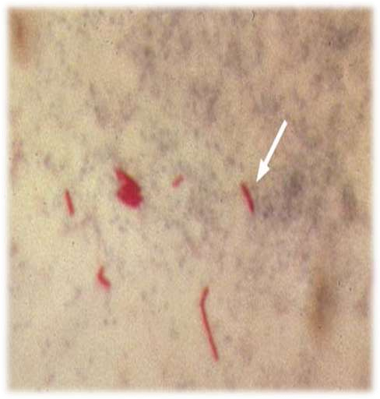
Acid-Fast Stain
39
Acid-fast cells contain a large amount of lipids and waxes in their cell walls
▫ primarily mycolic acid
Acid fast bacteria are usually members of the genus Mycobacterium or Nocardia
▫ Therefore, this stain is important to identify Mycobacterium or Nocardia

Slide 39
Ziehl-Neelsen stain
40
Ziehl-Neelsen staining is used to stain species of Mycobacterium tuberculosis that do not stain with the standard laboratory staining procedures like Gram staining.
The stains used are the red colored Carbol fuchsin that stains the bacteria and a counter stain like Methylene blue or Malachite green.

Slide 40



Acid-Fast Organisms
41
Primary stain binds cell wall mycolic acids
Intense decolorization does not release primary stain from the cell wall of AFB
Color of AFB-based on primary stain
Counterstain provides contrasting background

Slide 41

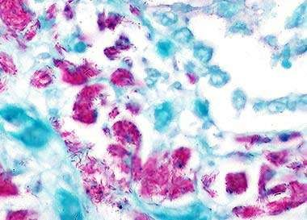
AFB Staining Methods
42
Zeihl Neelsen’s-hot stain
Kinyoun’s-cold stain
Modifications

Slide 42
Ziehl- Neelsen Procedure
43
Make a smear. Air Dry. Heat Fix.
Flood smear with Carbol Fuchsin stain
▫ Carbol Fuchsin is a lipid soluble, phenolic compound, which is able to penetrate the cell wall
Cover flooded smear with filter paper
Steam for 10 minutes. Add more Carbol Fuchsin stain as needed
Cool slide
Rinse with DI water
Flood slide with acid alcohol (leave 15 seconds). The acid
alcohol contains 3% HCl and 95% ethanol, or you can declorase with 20% H2 S04
▫ The waxy cell wall then prevents the stain from being removed
by the acid alcohol (decolorizer) once it has penetrated the cell
wall. The acid alcohol decolorizer will remove the stain from all other cells.

Slide 43
Ziehl- Neelsen Procedure (continued)
44
Tilt slide 45 degrees over the sink and add acid alcohol drop wise (drop by drop) until the red color stops streaming from the smear
Rinse with DI water
Add Loeffler’s Methylene Blue stain (counter stain). This stain adds blue color to non-acid fast cells!! Leave Loeffler’s Blue stain on smear for 1 minute
Rinse slide. Blot dry.
Use oil immersion objective to view.

Slide 44
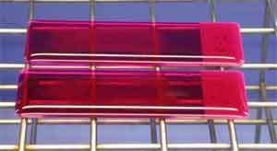
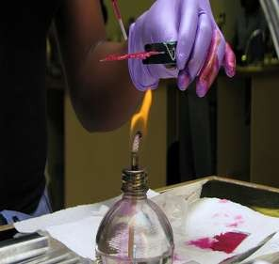
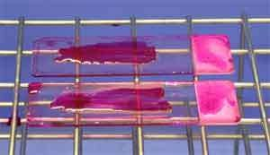
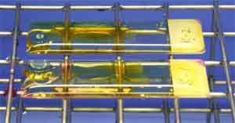
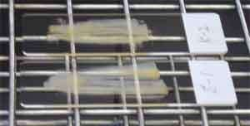
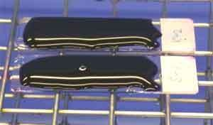
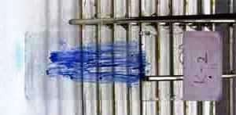
1
2
3
4
5
6
7
Ziehl-Neelsen stain

Slide 45
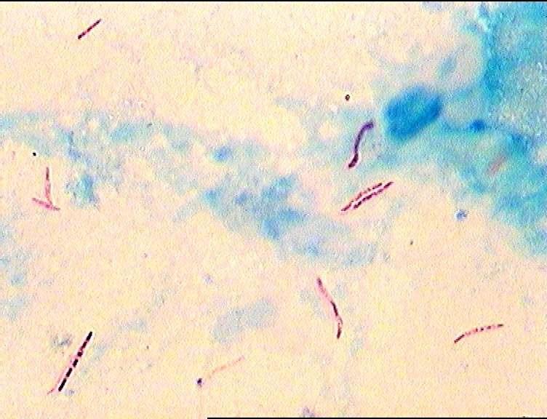
How the Acid fast bacteria appear
46

Slide 46
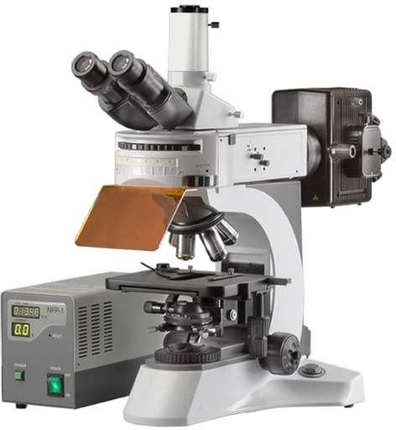
Fluorochrome AFB Microscopy
47
More rapid and sensitive Specificity : same with sufficient expérience Equipment cost , bulbs, technical demands
for busy labs External quality assessment should be done if this method is performed

Slide 47
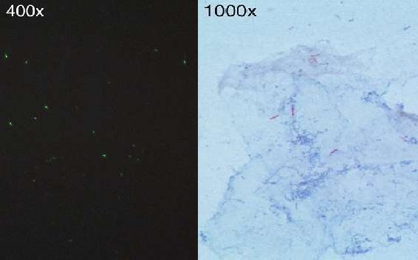
Fluorescence and Br_{Dr.}i_{T.V}g_{.Rao}h_{MD} t-field
48
Microscopy

Slide 48

Fluorochrome AFB Microscopy
49
Primary fluorochrome
Auramine O
Auramine O-Rhodamine B Acridine Orange
AFB fluoresces Green Yellow/orange Yellow/orange
Note: Color of AFB may vary with filter system

Slide 49
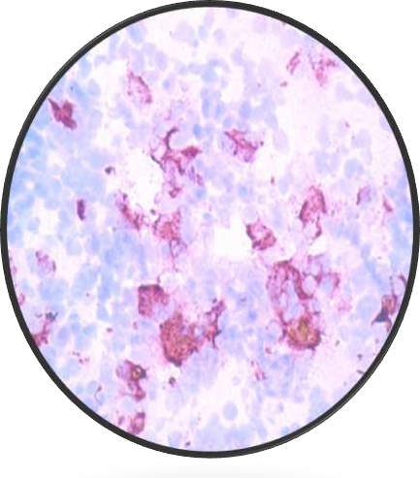
Staining of M.lepra
50
M.lepra are less acid fast than M.tuberculosis group of organisms,
The concentration of H2So4 is reduced to 5 % for decolorising

Slide 50
51
ALBERT’S STAINING FOR
C.diptheria

Slide 51
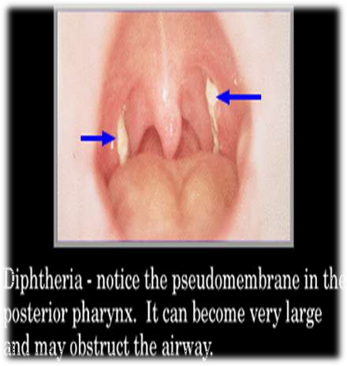
Diphtheria is Serious Disease When you suspect Diphtheria
52
In all cases of suspected cases of Diphtheria, stain one of the smears with Gram stain
If Gram stained smear shows morphology suggestive of C.diptheria, proceed to do Albert staining which demonstrates the presence or absence of metachromatic granules.

Slide 52
Appearance of C.diptheria
53
C.diptheria are thin Gram positive bacilli, straight or slightly curved and often enlarged (clubbing) at one or both ends and are arranged at acute angles giving shapes of Chinese letters or V shape which is characteristic of these organisms (Fig 1). Present in the body of the bacillus are numerous metachromatic granules which give the bacillus beaded or barred appearance. These granules are best
demonstrated by Albert’s stain.

Slide 53
Albert staining
54
Albert stain I
Toluidine blue 0.15 gm
Malachite green 0.20 gm
Glacial acetic acid 1.0 ml
Alcohol(95%) 2.0 ml Distilled water 100 ml
Albert stain II
Iodine 2.0 gm Potassium iodide 3.0 gm Distilled water 300 ml

Slide 54
Albert staining Procedure
55
Cover the heat-fixed smear with Albert stain I. Let it stand for two minutes.
Wash with water.
Cover the smear with Albert stain
II. Let it stand for two minutes.
Wash with water, blot dry and examine.

Slide 55
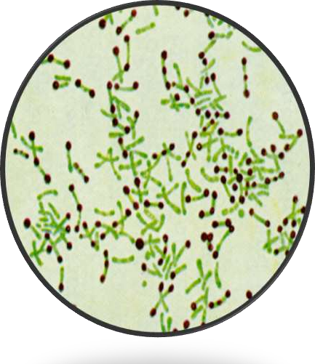
How the C.diptheria appear
56
To demonstrate metachromatic granules in C.diphtheriae. These granules appear bluish black whereas the body of bacilli appear green or bluish green.
•

Slide 56
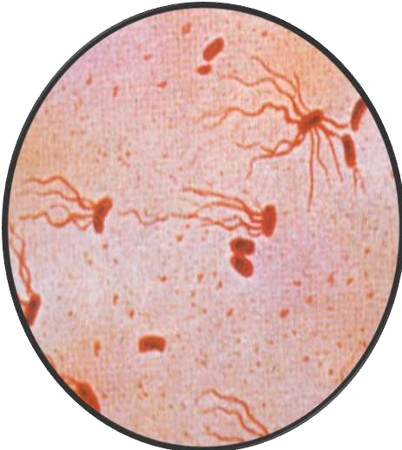
Flagellar - staining
57
Flagella are usually invisible under light microscopy, but their identification and anatomy are important in determining some pathogens. Certain chemicals that bind to the flagella are used in the staining process. The flagella color may change or an increase in contrast should make them visible.

Slide 57
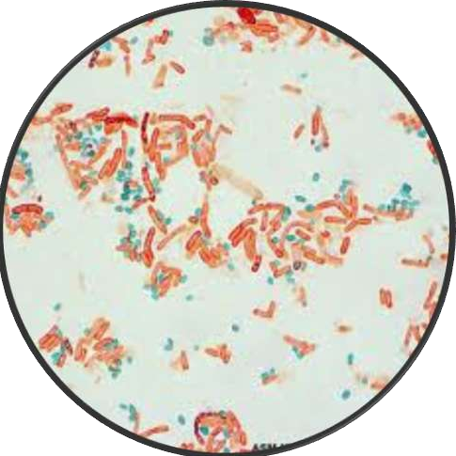
Endospore staining
58
The cell walls of endospores are impermeable to most chemicals, and being in the genera Bacillus and Clostridium, cause diseases such as anthrax, teatanus and gangrene. The staining process involves both a primary stain and a counterstain.

Slide 58
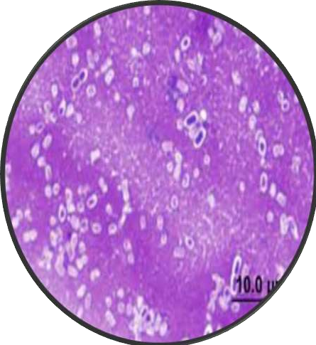
Capsule - Staining
59
A stain used to reveal negatively charged bacterial capsules. The encapsulated cells will have a halo appearance under the microscope.

Slide 59
Negative staining
60
India Ink, Nigrosin
Organisms are not stained, only the background is stained
Unstained organisms stand out in contrast
Use: To demonstrate the capsule of Cryptococcus neoformans, Streptococcus pneumoniae

Slide 60
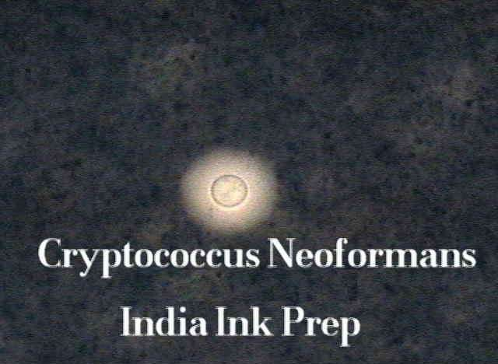
61
Dr.T.V.Rao MD

Slide 61
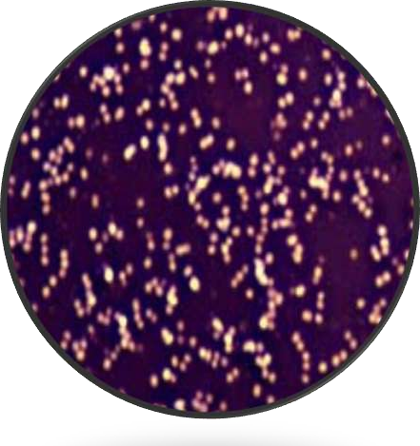
Nigrosin used for Negative Staining
62
Dr.T.V.Rao MD
The negative stain is particularly useful for determining cell size and arrangement. It can also be used to stain cells that are too delicate to be heat- fixed.

