Slide 1


Slide 2
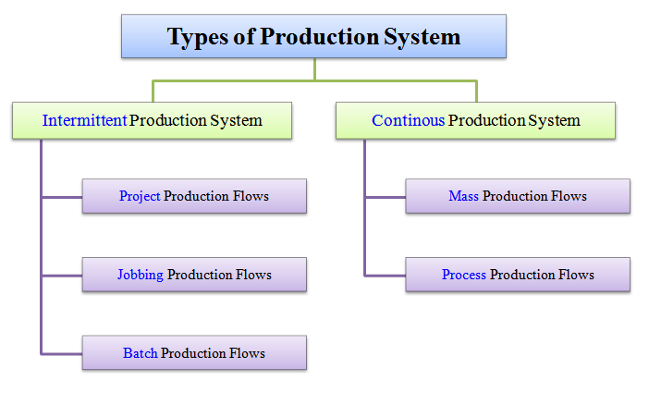
Types of Production system is grouped under two categories :
Intermittent Production System
Continuous Production System

Slide 3

Intermittent means something that starts (initiates) and stops (halts)
at irregular (unfixed) intervals (time gaps).
In the intermittent production system, goods are produced based on customer's orders.
These goods are produced on a small scale. The flow of production is not continuous.
In this system, large varieties of products are produced. These
products are of different sizes.
The design of these products goes on changing according to the design and size of the product. Therefore, this system is very flexible

Slide 4


The work of a goldsmith is purely based on the frequency of his customer's orders. The goldsmith makes goods (ornaments) on a small- scale basis as per his customer's requirements. Here, ornaments are not done on a continuous basis.
Similarly, the work of a tailor is also based on the number of orders he gets from his customers. The clothes are stitched for every customer independently by the tailor as per one's measurement and size. Goods (stitched clothes) are made on a limited scale and is proportional to the number of orders received from customers. Here, stitching is not done on a continuous basis.

Slide 5
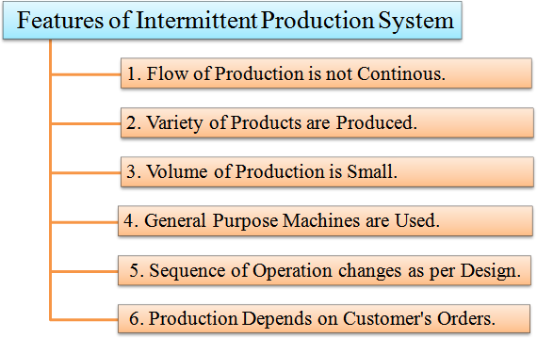

Slide 6
Project Production Flow
Jobbing Production Flow
Batch Production Flow

Slide 7
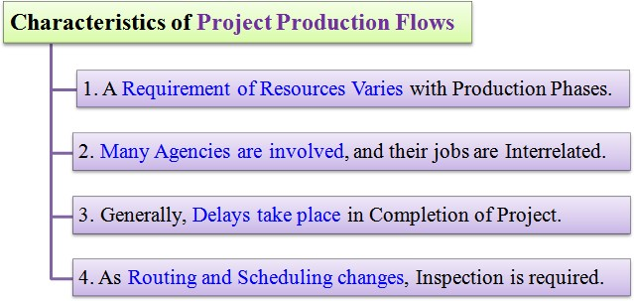
1. Project production flows
Here, in project production flows, company accepts a single, complex order or contract. The order must be completed within a given period of time and at an estimated cost.
Examples of project production flows mainly include, construction of airports, dams, roads, buildings, shipbuilding, etc.

Slide 8
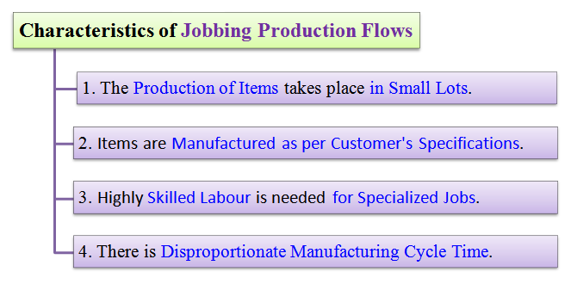
2. Jobbing production flows
Here, in jobbing production flows, company accepts a contract to produce either one or few units of a product strictly as per specifications given by the customer. The product is produced within a given period and at a fixed cost. This cost is fixed at the time of signing the contract.
Examples of such jobbing production flows include, services given by repair shops, tailoring shops, manufacturer of special machine tools, etc.

Slide 9
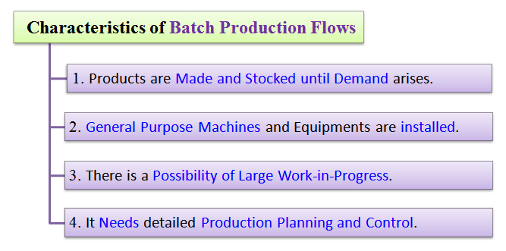
3. Batch production flows
In batch production flows, the production schedule is decided according to specific orders or are based on the demand forecasts. Here, the production of items takes place in lots or batches. A product is divided into different jobs. All jobs of one batch of production must be completed before starting the next batch of production.
Examples of batch production flows include, manufacturing of drugs and pharmaceuticals, medium and heavy machineries, etc.

Slide 10

Continuous means something that operates constantly without any irregularities or frequent halts.
In the continuous production system, goods are produced constantly as per demand forecast.
Goods are produced on a large scale for stocking and selling. They are not produced on customer's orders. Here, the
inputs and outputs are standardized along with the production process and sequence.

Slide 11

The production system of a food industry is purely based on the demand forecast. Here, a large-scale production of food takes place. It is also a continuous production.
The production and processing system of a fuel industry is also purely based on, demand forecast. CRUDE OIL and other raw sources are processed continuously on a large scale to yield usable form of fuel and compensate global energy demand.

Slide 12
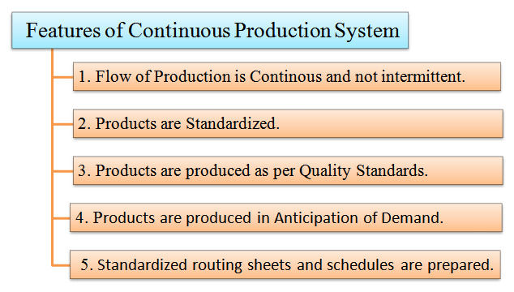

Slide 13
1. Mass Production Flows
2. Process Production Flows

Slide 14
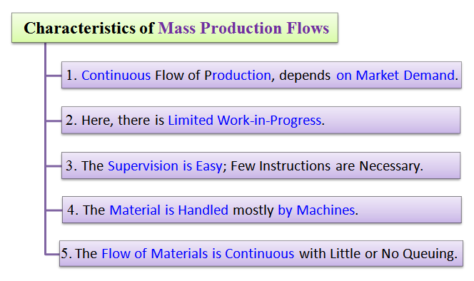
1. Mass production flows
Here, company produces different types of products on a large- scale and stock them in warehouses until they are demanded in the market.
The goods are produced either with the help of a single
operation or uses a series of operations.
E.g. of mass production is the production of toothpastes, soaps, pens, etc.

Slide 15
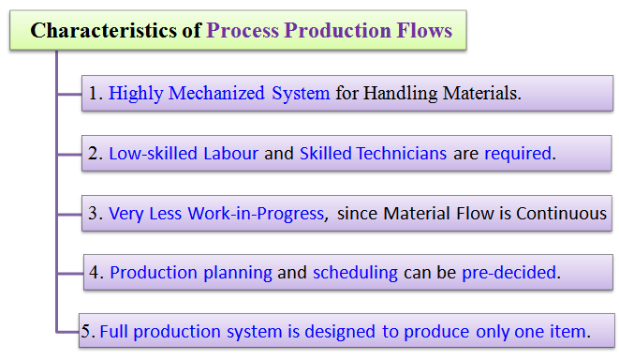
2. Process production flows
Here, a single product is produced and stocked in warehouses until it is demanded in the market. The flexibility of these plants is almost zero because only one product can be produced.
Examples of these plants include, steel, cement, paper, sugar, etc

Slide 16
ANY QUERIES ?

Slide 17


