Slide 1
Urinary System

Slide 2
Introduction
The urinary system, also known as the renal system
The urinary system refers to the structures that produce and conduct urine to the point of excretion.

Slide 3
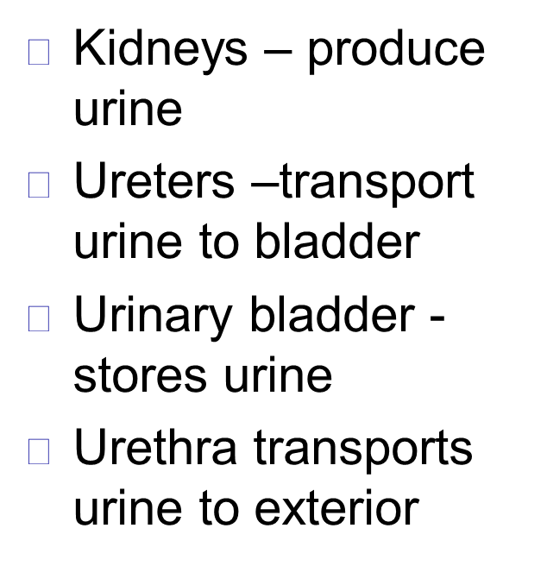
URINARY SYSTEM ORGANS
Kidneys (2)
Ureters (2)
Urinary bladder
Urethra

Slide 5
Kidney
The human body normally has two kidneys, one on the left and one on the right.
The functional unit of the kidney is nephron.
Urine is formed by nephrons

Slide 6
Location and External Anatomy of kidney
Located Lateral to T₁₂–L₃ vertebrae
Average kidney
12 cm tall, 6 cm wide,
3 cm thick

Slide 7
Protected by three connective tissue
Renal fascia
Attaches to abdominal wall
Adipose capsule
Fat cushioning kidney
Renal capsule
Fibrous sac
Protects from trauma and infection

Slide 9
KIDNEY
Gross anatomy
Renal parenchyma
Renal sinus

Slide 10
KIDNEY ANATOMY
Renal parenchyma
Two zones
Outer cortex
Inner medulla

Slide 12
Anatomy of the kidneys
Superficial outer cortex and inner medulla
The medulla consists of 6-18 renal pyramids
The cortex is composed of roughly 1.25 million nephrons

Slide 13
KIDNEY ANATOMY
Renal parenchyma
Renal pyramids
Extensions of cortex (renal columns) divide medulla into 6 – 10 renal pyramids
Pyramid + overlying cortex = Lobe
Point of pyramid = Papilla
Papilla nested in cup (minor calyx)
2 – 3 minor calyx
2 – 3 major calyx
Renal pelvis
Ureter

Slide 14
KIDNEY ANATOMY
Renal sinus
Surrounded by renal parenchyma
Contains blood & lymph vessels, nerves, urine-collecting structures
Hilus
On concave surface
Vessels and nerves enter and exit

Slide 15
➢ Major and minor calyx along with the pelvis drain urine to the ureters

Slide 16
Structure of the Kidney
Human Anatomy, 3rd edition Prentice Hall, © 2001

Slide 18
NEPHRONS
Nephrons
Functional units of kidney
~1.2 million per kidney
Three main parts
Blood vessels
Renal corpuscle
Renal tubule

Slide 19
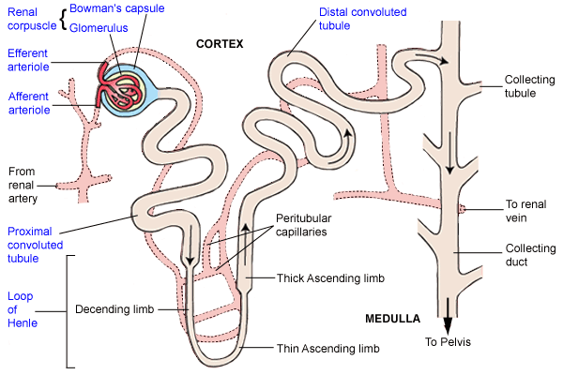

Slide 20
Renal corpuscle
Composed of a glomerulus and the Bowman's capsule,
The renal corpuscle is the beginning of the nephron.
It is the nephron's initial filtering component.

Slide 21
Glomerulus
The glomerulus is a capillary tuft that receives its blood supply from an afferent arteriole of the renal circulation.
The glomerular blood pressure provides the driving force for water and solutes to be filtered out of the blood and into the space made byBowman's capsule

Slide 22
The remainder of the blood passes into the efferent arteriole.
The diameter of efferent arterioles is smaller than that of afferent arterioles, increasing the hydrostatic pressure in the glomerulus.

Slide 23
Bowman's capsule
The Bowman's capsule, also called the glomerular capsule.
surrounds the glomerulus.
It is composed of a visceral inner layer formed by specialized cells
called podocytes.
Parietal outer layer composed of simple squamous epithelium.
➢

Slide 24
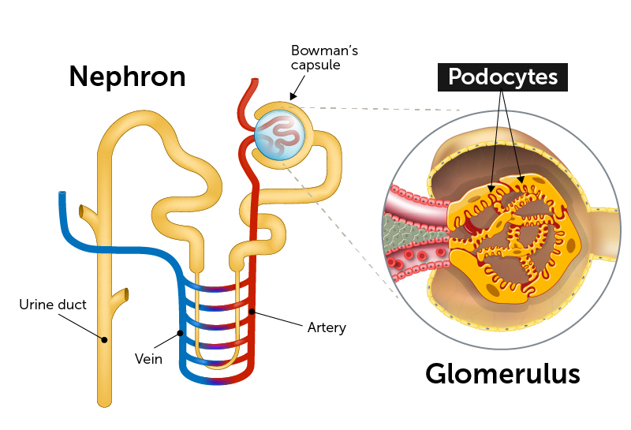
➢ Fluids from blood in the glomerulus are filtered through the visceral layer of podocytes, resulting in the glomerular filtrate.

Slide 25
NOTE
Renal corpuscle
Glomerulus plus capsule
Glomerulus enclosed in two-layered glomerular capsule
●
“Bowman’s capsule”
➢ Fluid filters from glomerular capillaries
●
“Glomerular filtrate”
Fluid collects in capsular space
Fluid flows into renal tubule

Slide 27
Renal tubule
Leads from glomerular capsule
Ends at tip of medullary pyramid
~3 cm long
Four major regions
●
Proximal convoluted tubule Nephron loop/ loop of Henle
Distal convoluted tubule Collecting duct
●
●
●

Slide 29
Proximal convoluted tubule (PCT)
Arises from glomerular capsule
Longest, most coiled region
➢
➢
lies in cortex
lined by simple cuboidal epithelium with brush borders which help to increase the area of absorption greatly.
➢ Prominent microvilli
●
Function in absorption

Slide 30
Nephron loop (“Loop of Henle”)
“U” – shaped, distal to PCT
lies in medulla 2 parts
Descending limb of loop of Henle
Ascending limb of loop of Henle

Slide 31
Ascending limb of loop of Henle
The ascending limb of loop of Henle is divided into 2 segments:
Lower end of ascending limb is very thin and is lined by simple squamous epithelium.
●
The distal portion of ascending limb is thick and is lined by simple cuboidal epithelium.
Thin ascending limb of loop of Henle
Thick ascending limb of loop of Henle (enters cortex and becomes DCT-distal convoluted tubule.)

Slide 32
➢ Thick segments
●
Active transport of salts
High metabolism, many mitochondria
●
➢ Thin segments
●
Permeable to water Low metabolism
●

Slide 33
Distal convoluted tubule (DCT)
Coiled, distal to nephron loop
Shorter than PCT
Less coiled than PCT
Very few microvilli
Contacts afferent and efferent arterioles
Contact with peritubular capillaries

Slide 34
Collecting duct
DCTs of several nephrons empty into a collecting duct
Passes into medulla
Several merge into papillary duct (~30 per papilla)
Drain into minor calyx

Slide 35
CLASSES The two general classes of nephrons are Short Cortical nephrons (80%)  Juxtamedullary nephrons (20%) which are classified according to the ➢ length of their Loop of Henle ➢ location of their renal corpuscle.

Slide 36
URINE FORMATION
About 1300 ml of blood enters the kidney ( 20% of the cardiac output ) every minute. Normal urine output-1-1.5l /day. About 180 liter of fluid is filtered by the glomerulus everyday of which 99% get reabsorbed and about 1.5 liters of urine is formed.
Overview
Blood plasma Urine
Three steps
Glomerular filtration
Tubular reabsorption
Tubular secretion
Water conservation

Slide 40
KIDNEY FUNCTIONS
Regulate blood volume, pressure
Regulate fluid osmolarity
Secrete renin
Secrete erythropoietin (EPO)
Acid-Base balance
Synthesize calcitriol (Vitamin D)

Slide 41
The Ureters
Pair of muscular tubes
Extend from renal pelvis to the bladder
Oblique entry into bladder prevents backflow of urine

Slide 42
Histology of Ureter
Mucosa – transitional epithelium
Muscularis – two layers
Inner longitudinal layer Outer circular layer
●
●
➢ Adventitia – typical connective tissue

Slide 43
➢ Carry urine from kidneys to urinary bladder via peristalsis
● Rhythmic contraction of smooth muscle
Enter bladder from below
Pressure from full bladder compresses
ureters and prevents backflow

Slide 44
Urinary Bladder
A collapsible muscular sac
➢ Stores and expels urine
➢
●
Full bladder – spherical
Expands into the abdominal cavity
Empty bladder – lies
●
entirely within the pelvis
Figure 23.13

Slide 45
Urinary Bladder
➢ Wall of bladder
Mucosa - transitional epithelium Muscular layer - detrusor muscle Adventitia
●
●
●

Slide 46
Urinary bladder
Wrinkles termed rugae
Openings of ureters common site for bladder infection

Slide 47
Urethra
Conveys urine from body
Internal urethral sphincter
Retains urine in bladder Smooth muscle, involuntary
●
●
➢ External urethral sphincter
●
Provides voluntary control over voiding of urine

Slide 48
Urethra in female
3 – 4 cm long in females
Bound by connective tissue to anterior wall of vagina
Urethral orifice exits body between vaginal orifice and clitoris

Slide 50
Urethra in male
~18 cm long in males
Prostatic urethra
~2.5 cm long, urinary bladder ,
prostate
Membranous urethra
~0.5 cm, passes through floor of pelvic cavity
Penile urethra
~15 cm long, passes through penis

