Slide 1
IIOT communication protocols

Slide 2
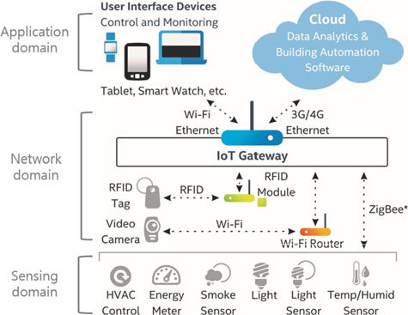

Slide 3
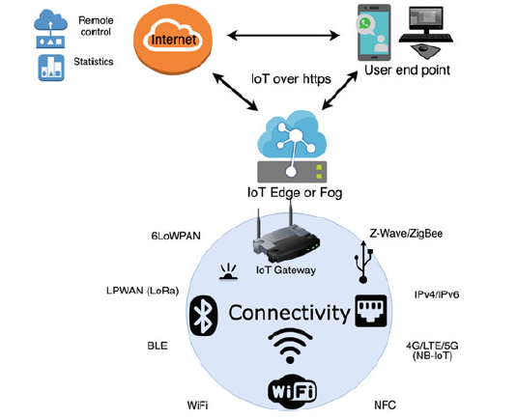

Slide 4
Bluetooth
Bluetooth is an universal for short range wireless voice and data communication.
It is a Wireless Personal Area Network (WPAN) technology and is used for exchanging data over smaller distances.
This technology was invented by Ericson in 1994. It operates in the unlicensed, industrial, scientific and medical (ISM) band from 2.4 GHz to 2.485 GHz.
Bluetooth ranges up to 10 meters. It provides data rates up to 1 Mbps or 3 Mbps depending upon the version

Slide 5
Bluetooth Low Energy(BLE)
Bluetooth and Bluetooth Low Energy are used for very different purposes. Bluetooth can handle a lot of data, but consumes battery life quickly and costs a lot more.
BLE is used for applications that do not need to exchange large amounts of data, and can therefore run on battery power for years at a cheaper cost. It all depends on what you’re trying to accomplish.

Slide 6
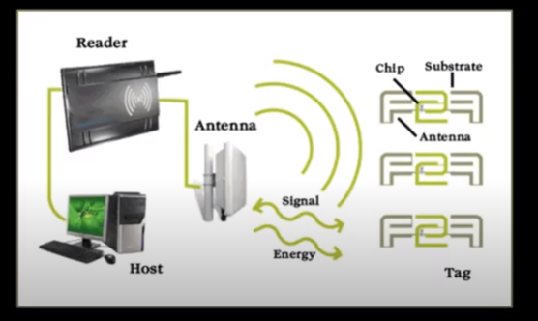
RFID(Radio frquency identification)

Slide 7
Radio-frequency identification (RFID) uses electromagnetic fields to automatically identify and track tags attached to objects.
An RFID system consists of a tiny radio transponder, a radio receiver and transmitter. When triggered by an electromagnetic interrogation pulse from a nearby RFID reader device, the tag transmits digital data, usually an identifying inventory number, back to the reader. This number can be used to track inventory goods.
There are two types of RFID tags:
Passive tags are powered by energy from the RFID reader's interrogating radio waves.
Active tags are powered by a battery and thus can be read at a greater range from the RFID reader, up to hundreds of meters.

Slide 8
Unlike a barcode, the tag does not need to be within the line of sight of the reader, so it may be embedded in the tracked object.
RFID tags are used in many industries. For example, an RFID tag attached to an automobile during production can be used to track its progress through the assembly line.

Slide 9
Near-Field Communication
Near Field Communication (NFC) is a short-range, wireless connectivity standard that enables contactless communication and data exchange between compatible devices held in close proximity.
A subset of Radio-Frequency Identification (RFID) technology, NFC operates on a base transmission frequency of 13.56 MHz and offers secure data transmission within a distance of approximately 10 centimeters.

Slide 10
125 - 134 KHz – Low Frequency (LF) – An extremely long wavelength with usually a short read range of about 1 - 10 centimeters. This frequency is typically used with animal tracking because it is not affected much by water or metal.
13.56 MHz – High Frequency (HF) & Near-Field Communication (NFC) – A medium wavelength with a typical read range of about 1 centimeter up to 1 meter. This frequency is used with data transmissions, access control applications, DVD kiosks, and passport security – applications that do not require a long read range.
865 - 960 MHz – Ultra High Frequency (UHF) – A short, high-energy wavelength of about a one meter which translates to long read range. Passive UHF tags can be read from an average distance of about 5 - 6 meters, but larger UHF tags can achieve up to 30+ meters of read range in ideal conditions. This frequency is typically used with race timing, IT asset tracking, file tracking, and laundry management as all these applications typically need more than a meter of read range.
As a general rule, higher frequencies will have shorter, higher-energy wavelengths and, in turn, longer read ranges.

Slide 11
RFID is the process by which items are uniquely identified using radio waves, and NFC is a specialized subset within the family of RFID technology.
Specifically, NFC is a branch of High-Frequency (HF) RFID, and both operate at the 13.56 MHz frequency. NFC is designed to be a secure form of data exchange, and an NFC device is capable of being both an NFC reader and an NFC tag. This unique feature allows NFC devices to communicate peer-to-peer.
NFC devices are an ideal solution for applications including but not limited to access control, consumer electronics, transport, payments, healthcare, information collection, information exchange, coupons, and ticketing

Slide 12
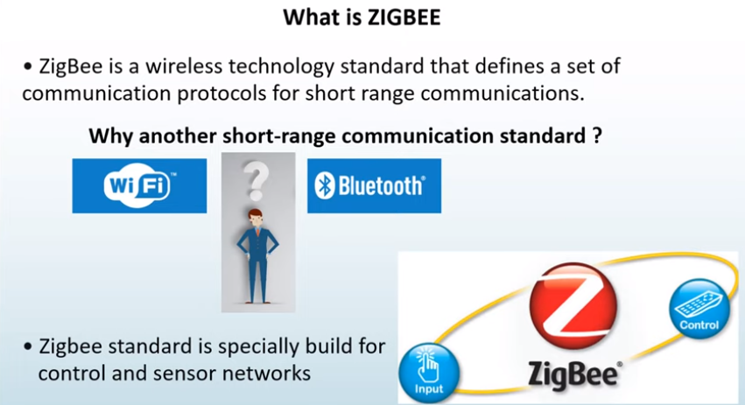

Slide 13
What is Zigbee

Slide 15
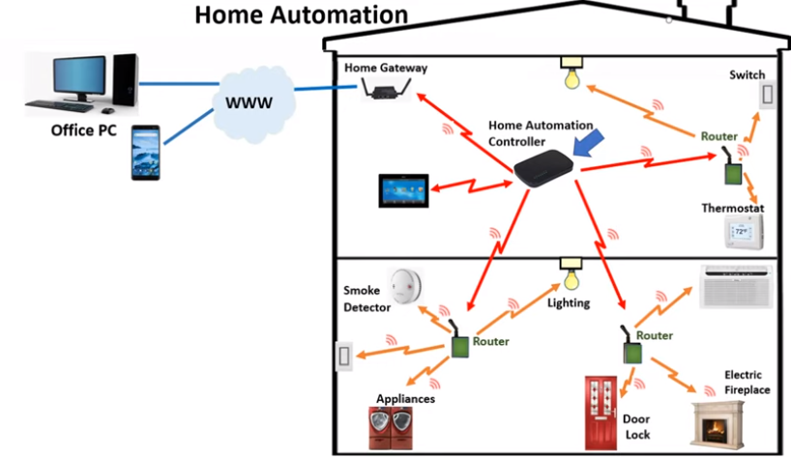

Slide 17
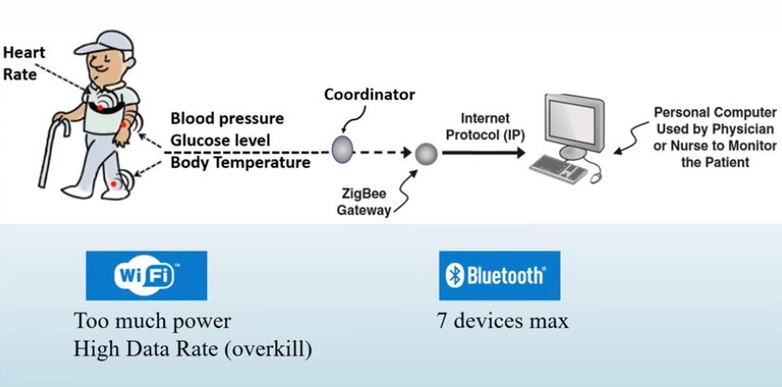
Remote monitoring system

Slide 18
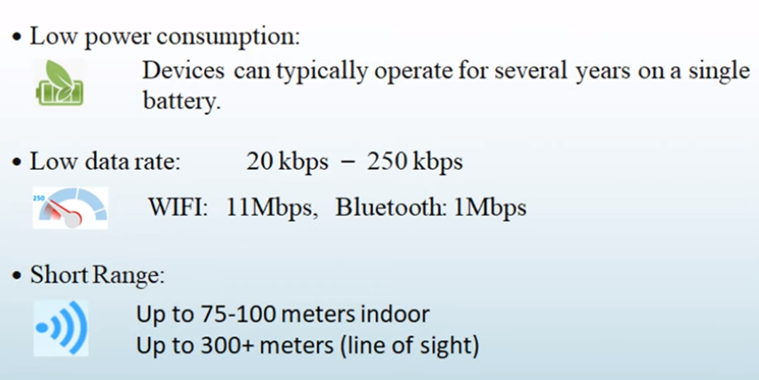
General characteristics of Zigbee standard

Slide 19
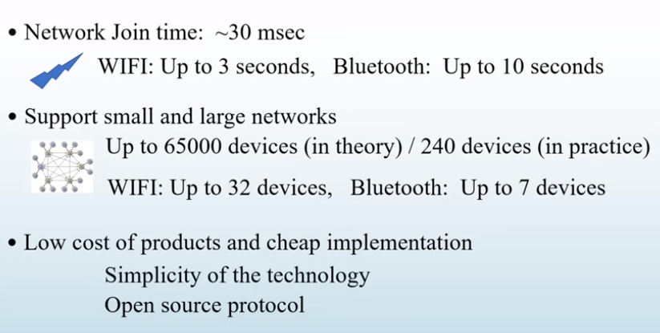

Slide 20
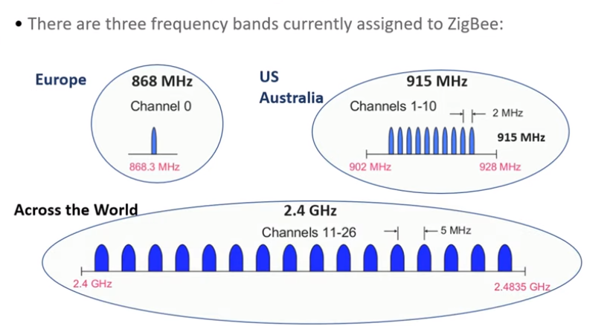
Operating frequency band

Slide 21
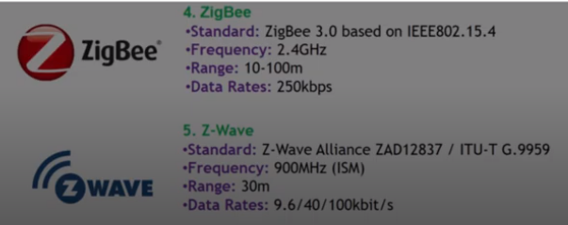

Slide 22
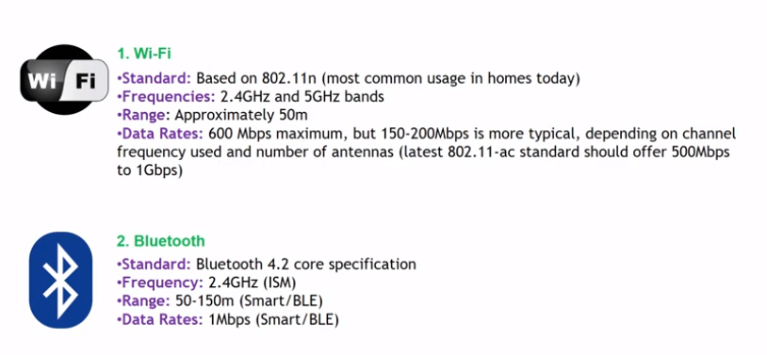

Slide 23
LPWAN
Low-Power Wide Area Networks (LPWANs) are a new phenomenon in Industrial IoT (IIoT). Providing long-range communication on small, inexpensive batteries that last for years.
LPWANs can connect several types of IIoT sensors and facilitate numerous applications from remote monitoring and worker safety to building controls and facility management.
LPWANs can only send small blocks of data at a low rate, and therefore are better suited for use cases that don’t require high bandwidth and are not time-sensitive.

Slide 24
Today, existing LPWANs operate in both the licensed (NB-IoT, LTE-M) and unlicensed (e.g. MIOTY, LoRa, Sigfox etc.) spectrum with varying degrees of network performance.
For example, while power consumption is a major issue for cellular-based, licensed LPWANs; Quality-of-Service and scalability are main considerations when adopting unlicensed technologies.

Slide 25
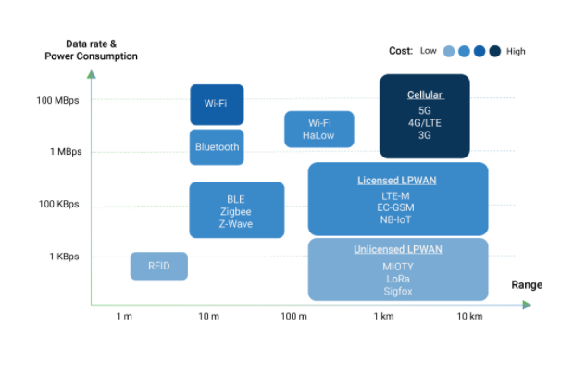
IOT protocols comparison

Slide 26
NarrowBand IoT (NB-IoT)
The NB-IoT provides low energy consumption, small volumes of data and transmission over large distances.
operates at even lower bandwidths (180 kHz/channel) and lower data rates (20 kbps) in the licensed LTE spectrum

Slide 27
The NB-IoT provides low energy consumption, small volumes of data and transmission over large distances or deep within buildings.
It is based on release 13 of 3GPP and operates at even lower bandwidths (180 kHz/channel) and lower data rates (20 kbps) in the licensed LTE spectrum. Mobility is sacrificed in favor of better indoor coverage and support for larger number of devices.
NB-IoT is managed by cellular operators with expected costs and regulations on access to this network

Slide 28
LTE-M
LTE-M or LTE-MTC(“Long-term Evolution Machine Type Communication"), is a type of low power wide area network radio communication technology standard developed by 3GPP for machine to machine and internet of things (IoT) applications.
The advantage of LTE-M over NB-IoT is its comparatively higher data rate, mobility, and voice over the network, but it requires more bandwidth, is more costly.

Slide 29
Extended coverage GSM IoT (EC-GSM-IoT) is a standard-based Low Power Wide Area technology. It is based on GPRS and designed as a high capacity, long range, low energy and low complexity cellular system for IoT communications.

Slide 30
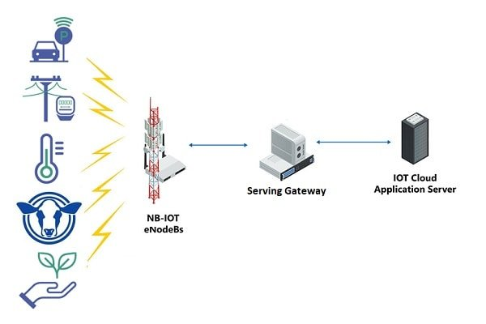
https://www.electronicshub.org/ir-sensor/#:~:text=An%20infrared%20sensor%20emits%20and,radiation%20to%20sense%20its%20surroundings.&text=The%20basic%20concept%20of%20an,received%20at%20the%20infrared%20receiver.

Slide 31
