Slide 1

STRUCTURAL, DIELECTRIC AND ELECTRICAL PROPERTIES OF MAGNESIUM DOPED CoFe₂O₄ COMPOSITE
Application of Gauss’s Law
Presented By
Dr. S. K. Satpathy
Assistant Professor, CUTM
Presented By
Mr. Ananga Udaya Naik
Research Scholar, CUTM

Slide 2
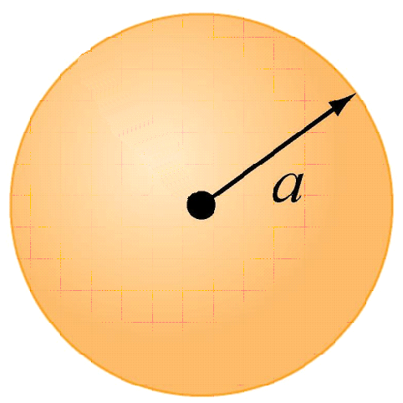
Gauss: Spherical Symmetry
+Q uniformly distributed throughout non-conducting solid sphere of radius a. Find E everywhere

Slide 3
Gauss: Spherical Symmetry
Symmetry is Spherical
Use Gaussian Spheres

Slide 4
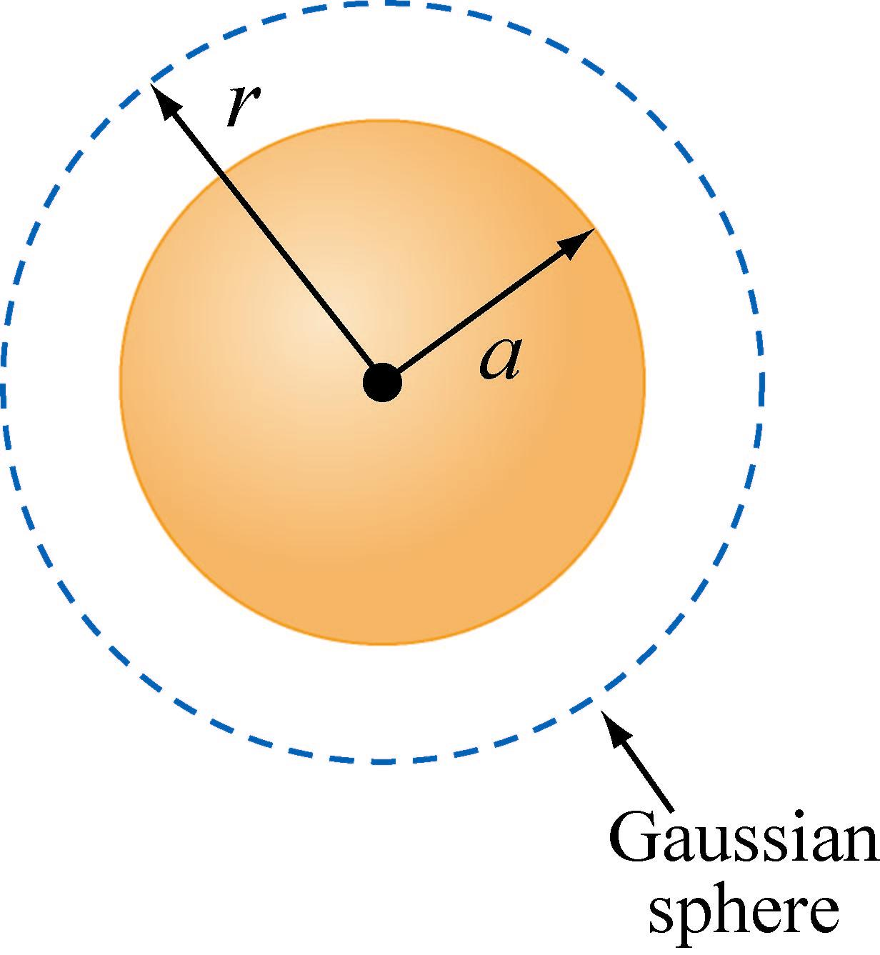
Gauss: Spherical Symmetry
Region 1: r > a
Draw Gaussian Sphere in Region 1 (r > a)
Note: r is arbitrary but is the radius for which you will calculate the E field!

Slide 5
Gauss: Spherical Symmetry
Region 1: r > a
Total charge enclosed q_{in} = +Q

Slide 6
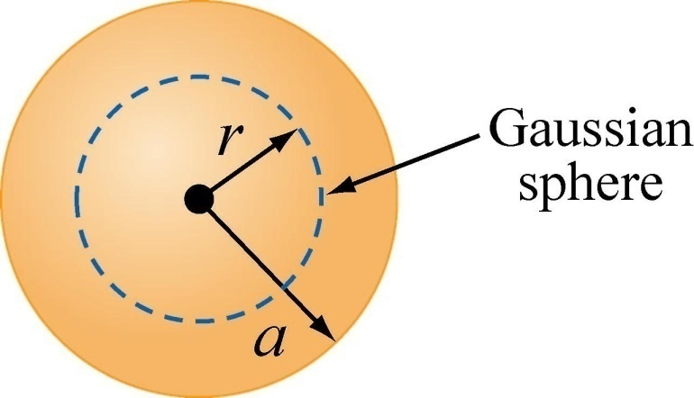
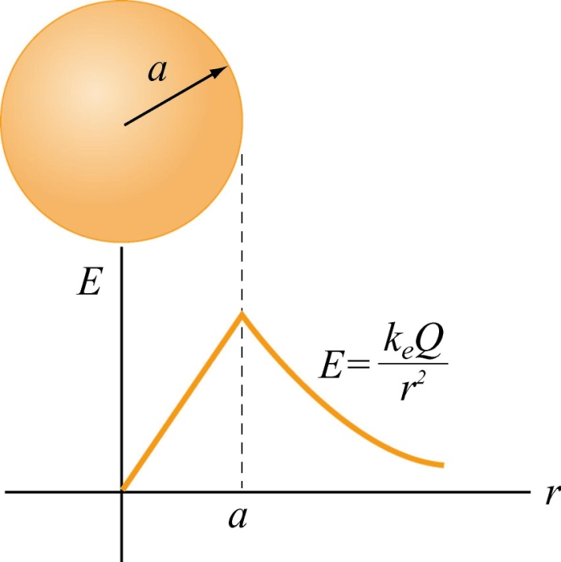
Gauss: Spherical Symmetry
Region 2: r < a
Total charge enclosed:
OR
Gauss’s law:

Slide 7
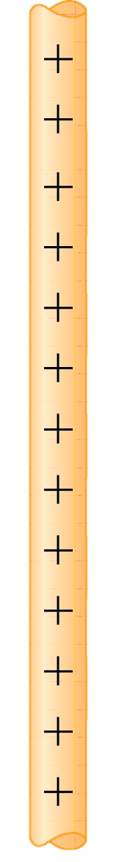
Gauss: Cylindrical Symmetry
Infinitely long rod with uniform charge density λ
Find E outside the rod.

Slide 8
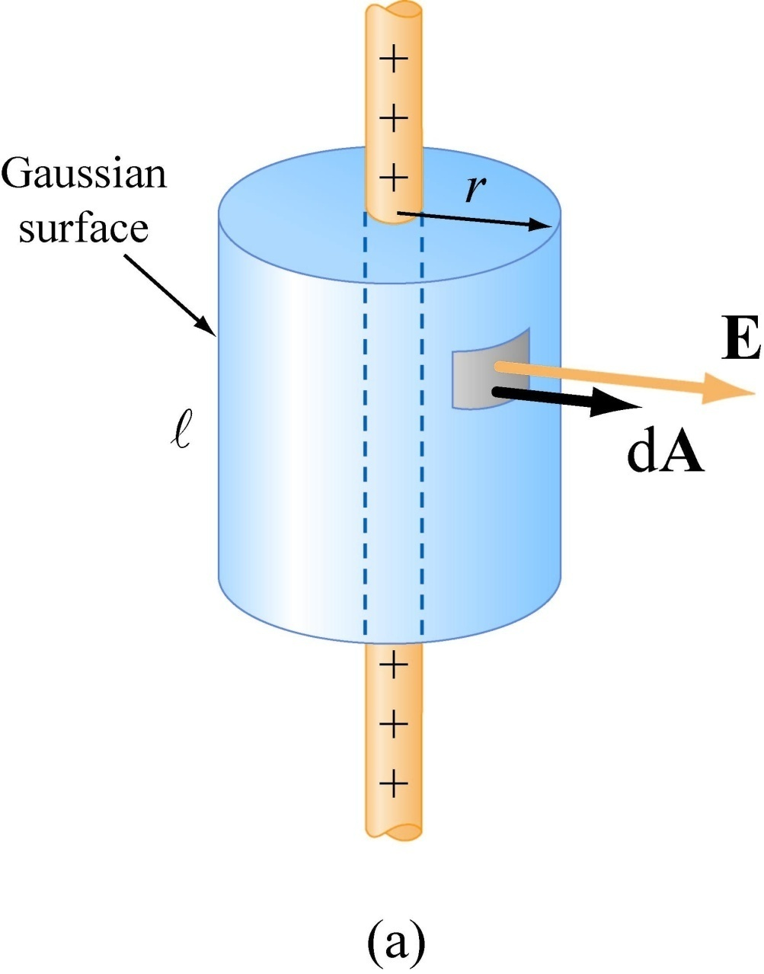
Gauss: Cylindrical Symmetry
Symmetry is Cylindrical
Use Gaussian Cylinder
Note: r is arbitrary but is the radius for which you will calculate the E field!
● is arbitrary and should divide out

Slide 9

Gauss: Cylindrical Symmetry
Total charge enclosed:

Slide 10
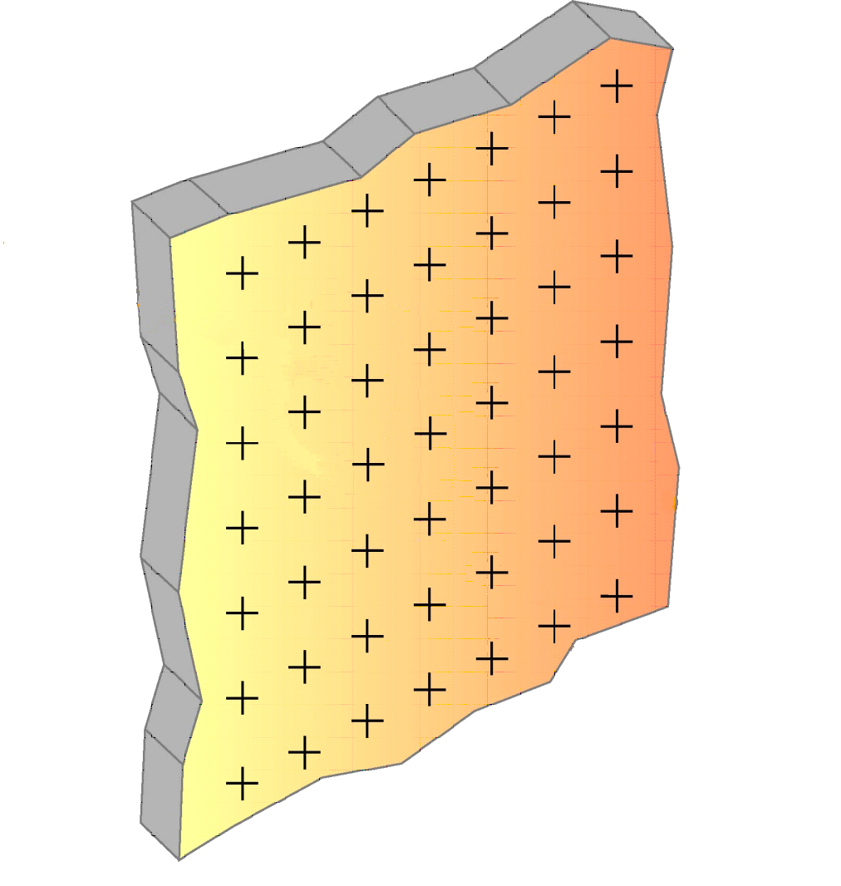
Gauss: Planar Symmetry
Infinite slab with uniform charge density σ
Find E outside the plane

Slide 11
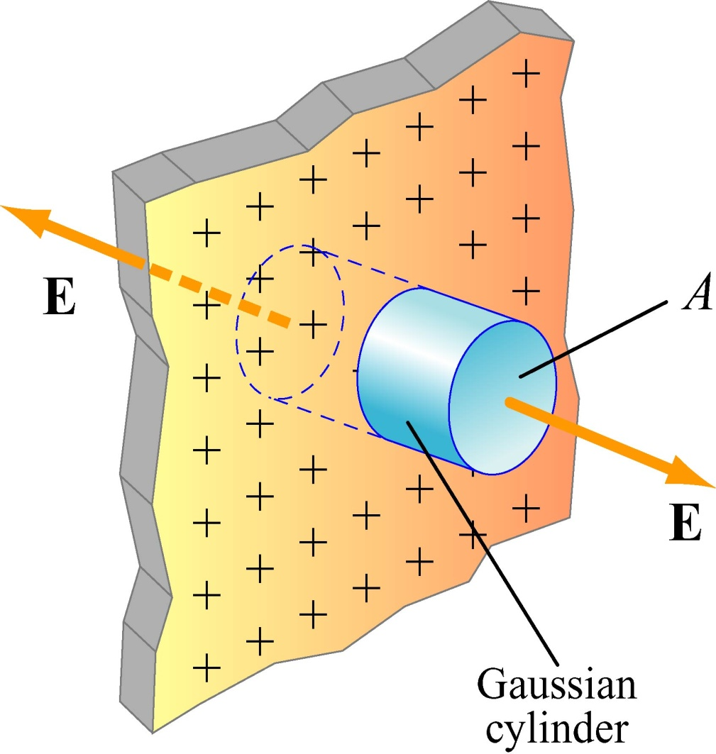
Gauss: Planar Symmetry
Symmetry is Planar
Use Gaussian Pillbox
Note: A is arbitrary (its size and shape) and should divide out
Gaussian
Pillbox

Slide 12
Gauss: Planar Symmetry
Total charge enclosed:
NOTE: No flux through side of cylinder, only endcaps
+
+
+
+
+
+
+
+
+
+
+
+

