Slide 1

STRUCTURAL, DIELECTRIC AND ELECTRICAL PROPERTIES OF MAGNESIUM DOPED CoFe₂O₄ COMPOSITE
Electric Field
Presented By
Mr. Ananga Udaya Naik
Research Scholar, CUTM
Presented By
Dr. S. K. Satpathy
Assistant Professor, CUTM

Slide 2
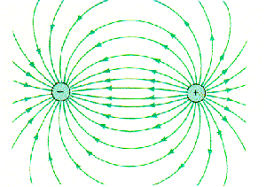
Electric Field Lines

Slide 3
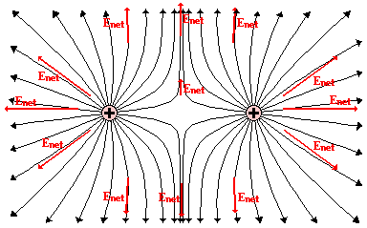
Electric Field Lines of two Positive Charges

Slide 4
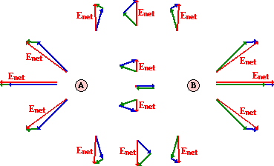
Electric Field Lines of two Positive Charges

Slide 5
Electric Field Lines
Lines that indicate the strength and direction of the electric field.
The more dense the lines, the stronger the field.
Electric field vectors are tangent to the curve.

