Slide 1
Clustal W
Pradip Kumar Prusty
Assistant Professor
Center for genetics and genomics

Slide 2
Introduction
Clustal W is a general purpose multiple sequence alignment program for DNA or proteins.
It produces biologically meaningful multiple sequence alignments of divergent sequence.
It calculate the best match for the selected sequence ,and lines them up so that the identiies.

Slide 3
Algorithm
Clustal W is a matrix-based algorithm, whereas tools like T-coffee are consistency-based.
Clustal W has a fairly efficient algorithm that competes well against in other software.
The first step to the algorithm is computing a rough distance matrix between each pair of sequence, also known as pairwise sequence alignment.

Slide 4
Accuracy and Results
The algorithm ClustalW uses provides a close –to-optimal result almost every time.
However, it does exceptionally well when the data set contains sequences with varied degrees of divergence.

Slide 5
Clustal Omega
Clustal omega is a new multiple sequence alignment program that uses seeded guide trees and HMM profile –profile technique to generate alignment between three or more sequence.
Ideally, might think to build up multiple alignments through weighted sum of pairs (pairwise scores)
But this is too computationally intensive
And doesn’t make much biological sense

Slide 6
Basic Steps
Compute the pairwise alignments for all against all sequences.
The similarities are stored in a matrix
Convert the sequence similarity matrix values to distance measures , reflecting evolutionary distance between each pair of sequence.
Construct a tree for the order in which pairs of sequence are to be aligned and combined with previous alignments.
Progressively align the sequence together into each branch point of the guide tree, starting with the least distance pairs of sequence.

Slide 7
Uses of MSA
Functional prediction
Phylogeny
Structural prediction
Protein analysis
To distinguish between orthology and parology

Slide 8
Ideally, might think to build up multiple alignments through weighted sum of pairs (pairwise scores)
But this is too computationally intensive
And doesn’t make much biological sense
So use heuristics and progressive alignment methods

Slide 9
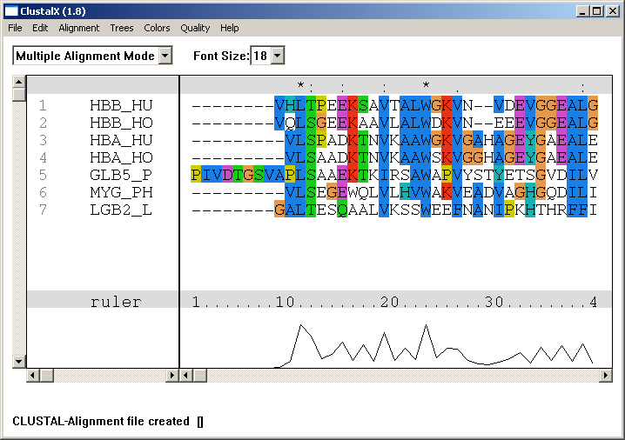
ClustalW
www.clustal.org

Slide 10
CLUSTAL
Quick, pairwise alignment of all sequences
Line up pairs, with the most similar first

Slide 11
CLUSTAL
Fix the alignment between pairs and treat as one sequence

Slide 12
CLUSTAL
Align your fixed pairs with each other

Slide 13
CLUSTAL
Align your fixed pairs with each other

Slide 14
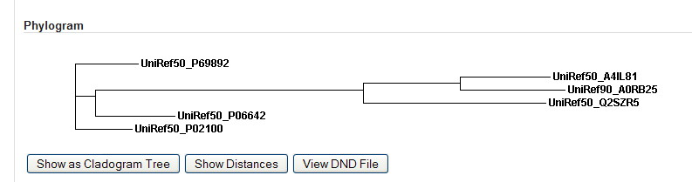
Note, this is not a phylogram!
Only a guide tree for the alignment

Slide 15
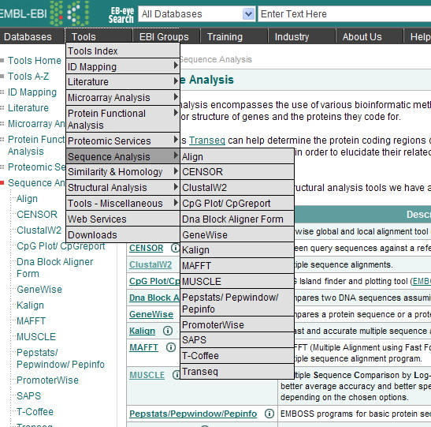
ClustalW at the EBI

Slide 16
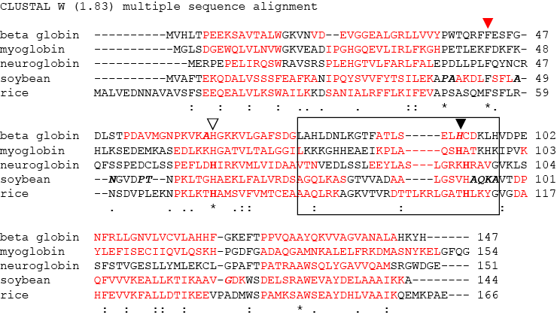
ClustalW
Note how the region of a conserved histidine (▼) varies depending on which of five prominent algorithms is used

Slide 17
Homology vs. Similarity
Presence of similar features because of common decent
Cannot be observed since the ancestors are not anymore
Is inferred as a conclusion based on ‘similarity’
Homology is like pregnancy: Either one is or one isn’t! (Gribskov – 1999)
Quantifies a ‘likeness’
Uses statistics to determine ‘significance’ of a similarity
Statistically significant similar sequences are considered ‘homologous’

Slide 18
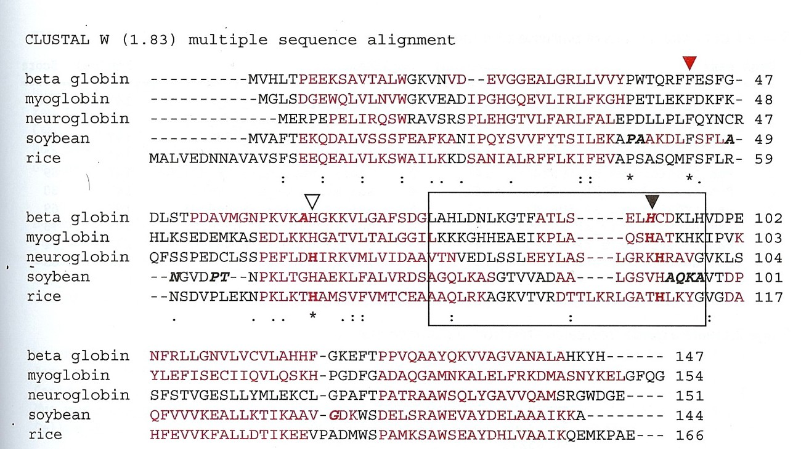
ClustalW example
Pevsner, Jonathan. Bioinformatics and Functional Genomics. 2nd. Baltimore Maryland:
Wiley-Blackwell, 2009. 179-207. Print.

Slide 19
Summary of ClustalW method
For years, ClustalW was the best method available.
It’s still a solid performer, provided that sequences are closely related and do not have significant structural differences
Distinguishing characteristics:
Progressive alignment based on a guide tree
Gap parameters informed by hydrophobicity of amino acids and by previously inserted gaps
Amino acid substitution matrices derived from observed sequence divergence (different matrices for different groups).
29

Slide 20
THANK YOU

