Slide 1
Molecular Docking

Slide 2
Molecular Docking In Drug Discovery
Screening specific candidates is challenging
Screening
Preclinical
Clinical trial
Review
Large scale manufacture
5,000 ~ 10,000
compounds
250
compounds
5
compounds
Pre-discovery
1
40x
50x
5x
10000x
250x
5x
1x
40x reduction of non-specific candidates

Slide 3
Molecular Docking: General Concepts
Molecular docking is a well established computational technique which predicts the interaction energy between two molecules.
Molecular docking studies are used to determine the interaction of two molecules and to find the best orientation of ligand which would form a complex with overall minimum energy.
The small molecule, known as ligand usually fits within protein’s cavity which is predicted by the search algorithm. These protein cavities become active when come in contact with any external compounds and are thus called as active sites.

Slide 4
Different types of Interactions
Interactions between particles can be defined as a consequence of forces between the molecules contained by the particles. These forces are divided into four categories:
Electrostatic forces - Forces with electrostatic origin due to the charges residing in the matter. The most common interactions are charge-charge, charge-dipole and dipole-dipole.
Electrodynamics forces-most widely known is the Van der Waals interactions.
Steric forces - Steric forces are generated when atoms in different molecules come into very close contact with one another and start affecting the reactivity of each other. The resulting forces can affect chemical reactions and the free energy of a system.
Solvent-related forces -These are forces generated due to chemical reactions between the solvent and the protein or ligand. Examples are Hydrogen bonds (hydrophilic interactions) and hydrophobic interactions.

Slide 5
Search Algorithm
These algorithms determine all possible optimal conformations for a given complex (protein-protein, protein-ligand) in a environment i.e. the position and orientation of both molecules relative to each other. They can also calculate the energy of the resulting complex and of each individual interaction.
The different types of algorithms that can be used for docking analysis are given below:
Molecular dynamics
Monte Carlo methods
Genetic algorithms
Fragment-based methods
Point complementary methods
Distance geometry methods
Systematic searches

Slide 6
Scoring function
These are mathematical methods used to predict the strength of the non-covalent interaction called as binding affinity, between two molecules after they have been docked.
Scoring functions have also been developed to predict the strength of other types of intermolecular interactions, for example between two proteins or between protein and DNA or protein and drug.
These configurations are evaluated using scoring functions to distinguish the experimental binding modes from all other modes explored through the searching algorithm.
For example:
• Empirical scoring function of Igemdock
Fitness = vdW + Hbond + Elec
• Binding Energy
∆G_{bind} = ∆G_{vdw} + ∆Gh_{bond} + ∆G_{elect} + ∆G_{conform} + ∆G_{tor} + ∆G_{sol}

Slide 7
Screening
Define the problem
Chalk out the possibilities to solve the problem
Identify a target (protein/ enzyme)
Screen available ligands (phytochemicals) against the target
Effective ligands can be screened

Slide 8
Types of docking
The following are majorly used type of docking are-
Lock and Key or Rigid Docking –In rigid docking, both the internal geometry of the receptor and ligand is kept fixed during docking
Induced fit or Flexible Docking - In this model, the ligand is kept flexible and the energy for different conformations of the ligand fitting into the protein is calculated. Though more time consuming, this method can evaluate many different possible conformations which make it more reliable.

Slide 9
Major steps in molecular docking
Step I – Building the Receptor In this step the 3D structure of the receptor should be downloaded from PDB; and modified. This should include removal of the water molecules from the cavity, stabilizing charges, filling in the missing residues, generation the side chains etc according to the parameters available. After modification the receptor should be biological active and stable.
Step II – Identification of the Active Site After the receptor is built, the active site within the receptor should be identified. The receptor may have many active sites but the one of the interest should be selected. Most of the water molecules and heteroatoms if present should be removed.

Slide 10
Major steps in molecular docking
Step III – Ligand Preparation Ligands can be obtained from various databases like ZINC, PubChem or can be sketched using tools like Chemsketch. While selecting the ligand, the LIPINSKY’S RULE OF 5 should be applied. The rule is important for drug development where a pharmacologically active lead structure is optimized stepwise for increased activity and selectivity, as well as drug-like properties, as described.
For the selection of a ligand using LIPINSKY’S RULE:
Not more than 5 –H bond donors.
Molecular Weight NOT more than 500 Da.
Log P not over 5 for octanol water partition coefficient.
NOT more than 10 H bond acceptors.
Step IV- Docking This is the last step, where the ligand is docked onto the receptor and the interactions are checked. The scoring function generates scores depending on which the ligand with the best fit is selected.

Slide 11
Molecular Docking: A Case Study

Slide 12
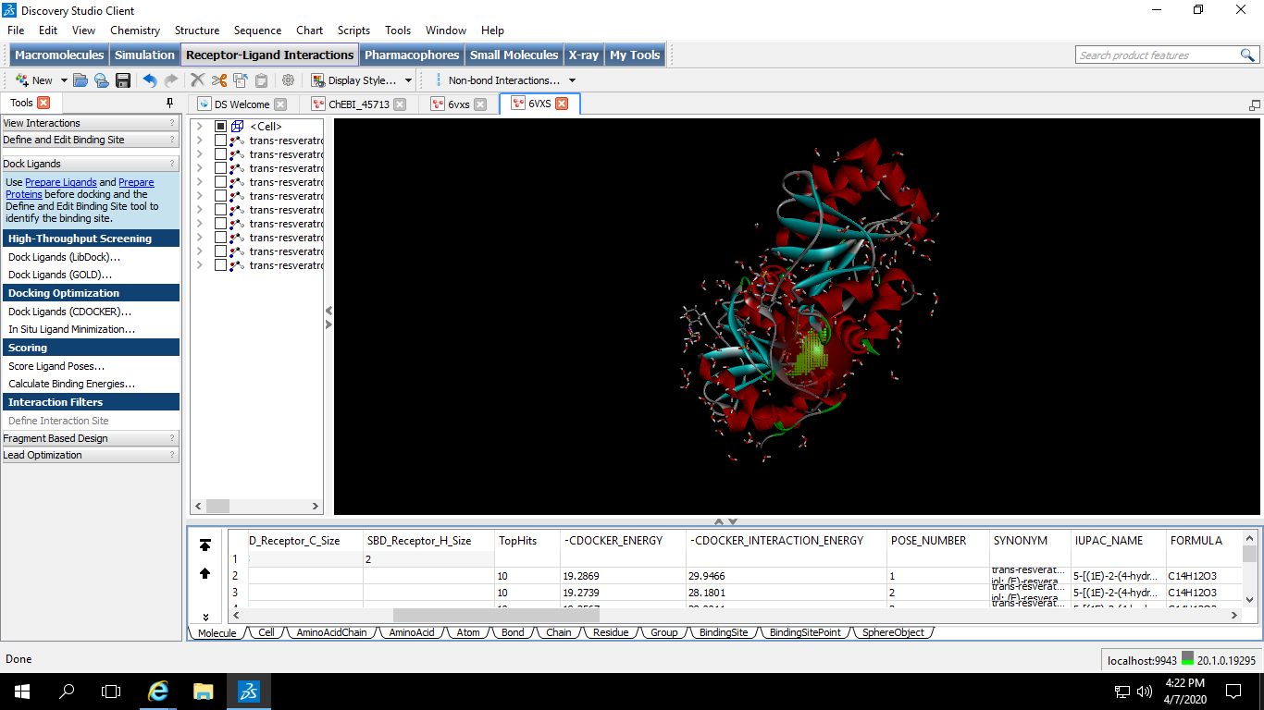
Identifying target molecule
ADP ribose phosphatase of NSP3
Procedure
PDB Accession: 6VXS
Discovery Studio
File
Open
Select the file
Active site
Tools
Receptor-Ligand interaction
From receptor cavities
ADP-ribose 1’-phosphate + H₂O ADP-ribose + phosphate
Define and edit binding site

Slide 13
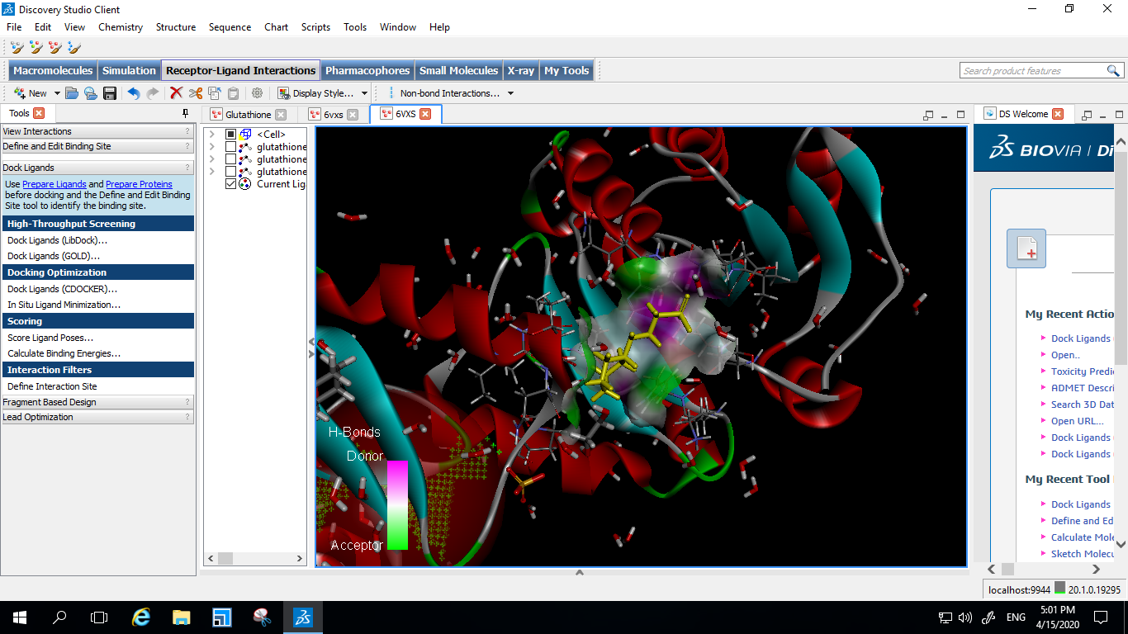
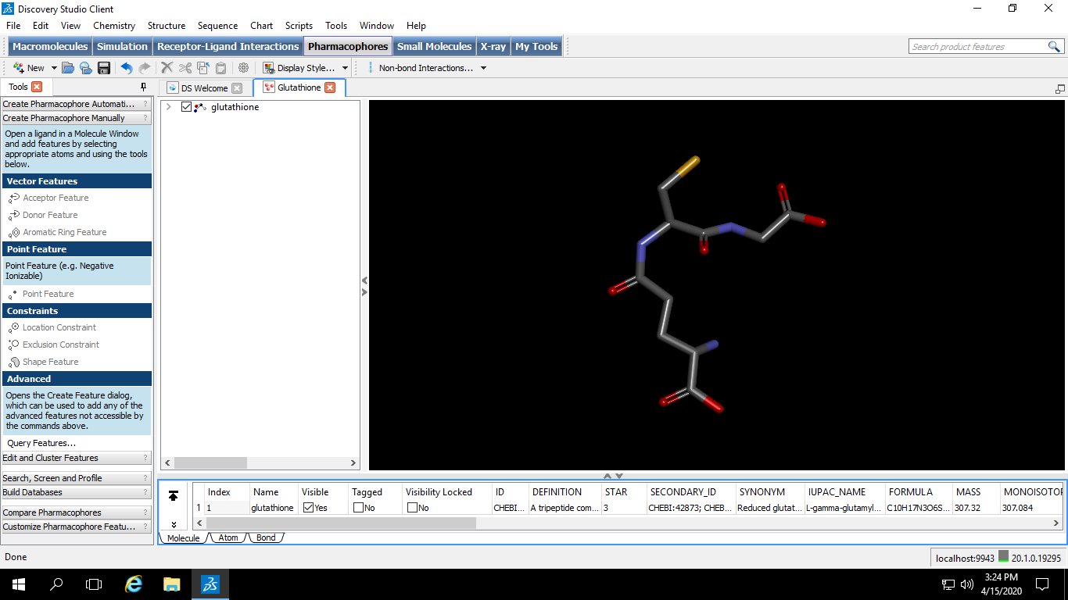
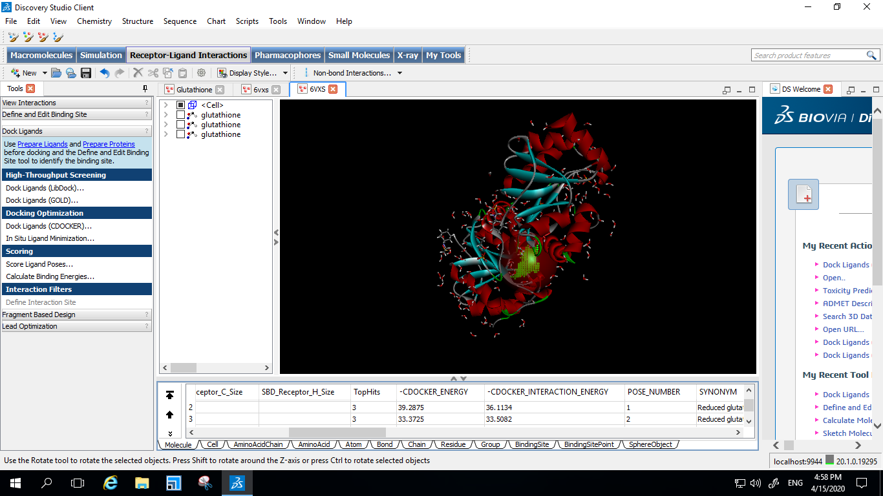
Screening of Phytochemicals
Ligand
Receptor
Glutathione
Ligand | Receptor (PDB Accession)
Glutathione | 6VXS
-CDOCKER ENERGY | -CDOCKER INTERACTION ENERGY
39.2875 | 36.1134
Procedure
Receptor-Ligand interaction
Dock Ligands
CDOCKER
Glutathione effectively binds to the active site of the target protein

Slide 14
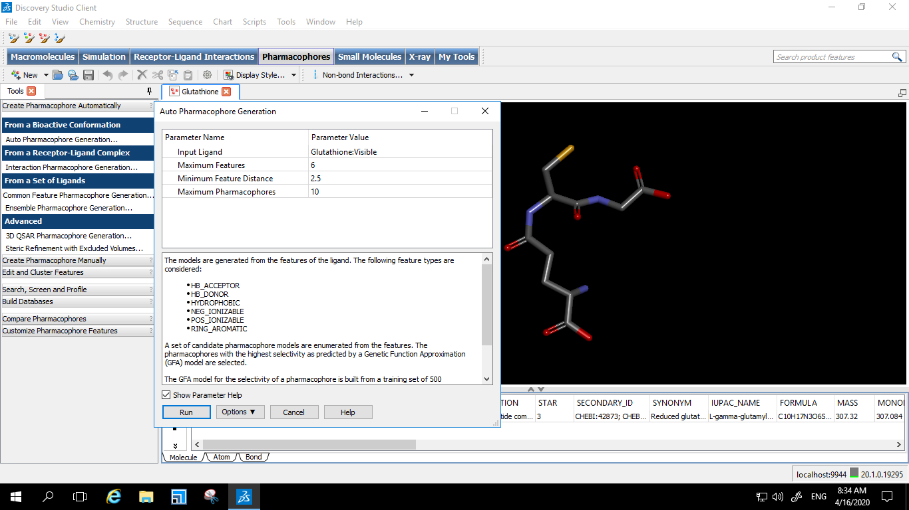
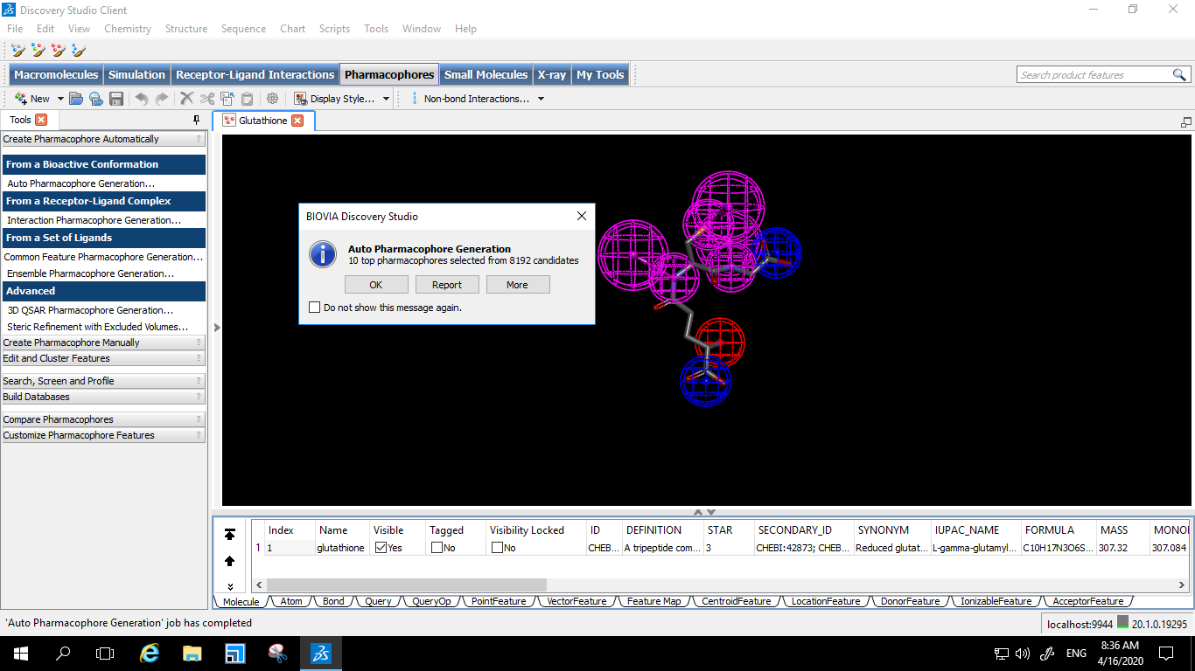
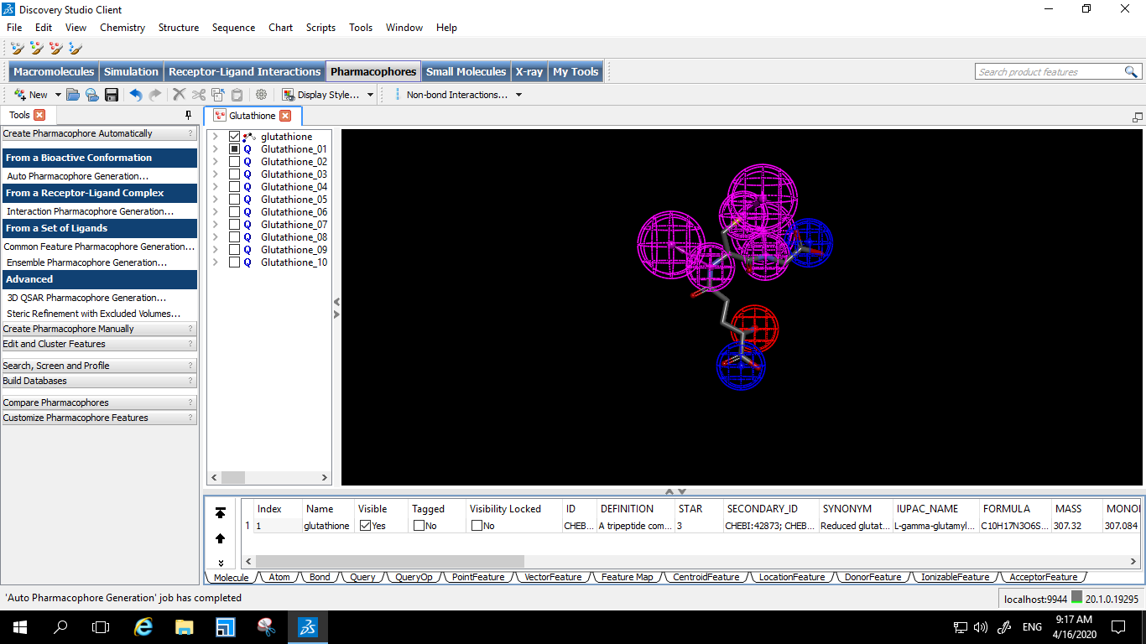
Possible pharmacophores
Automated generation of pharmacophores
Procedure
Tools
Pharmacaophore
Auto
pharmacophore generation
But, all the 8192 are not positive candidates!

Slide 15
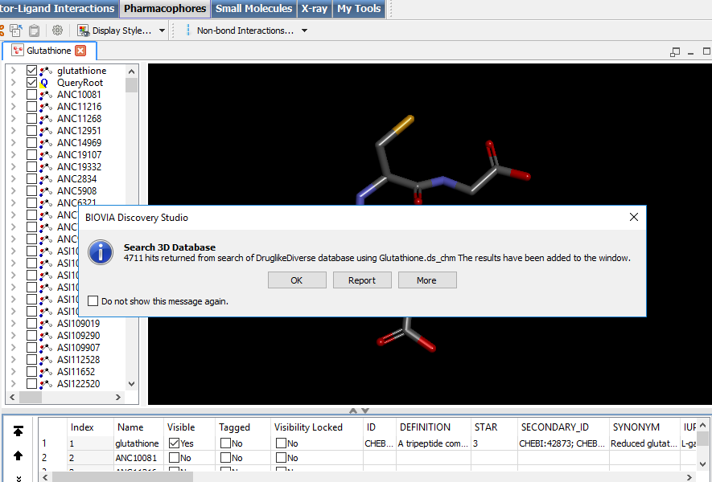
Generation of pharmacophores depending on input query
Procedure
Tools
Pharmacaophore
Search, Screen and Profile
Search 3D Database
4711 hits from drug like diverse database
But, all the 4711 are not positive candidates!

Slide 16
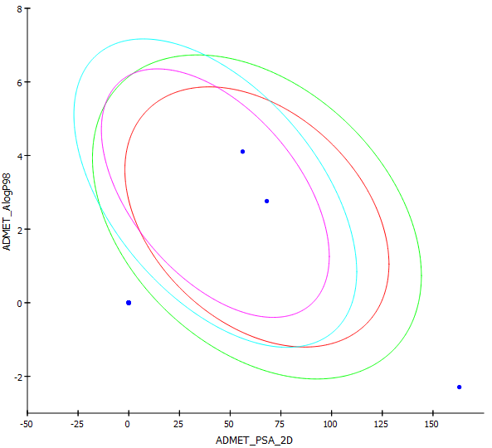
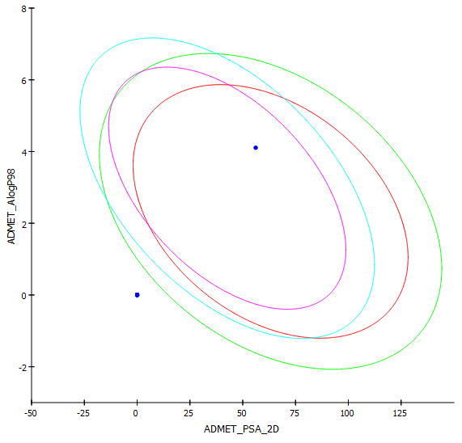
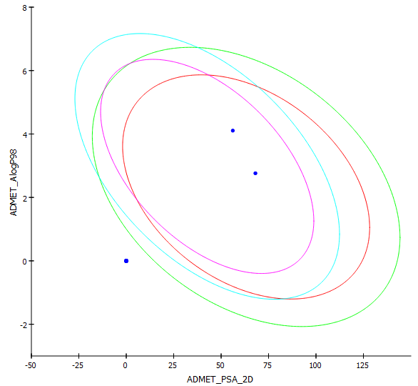
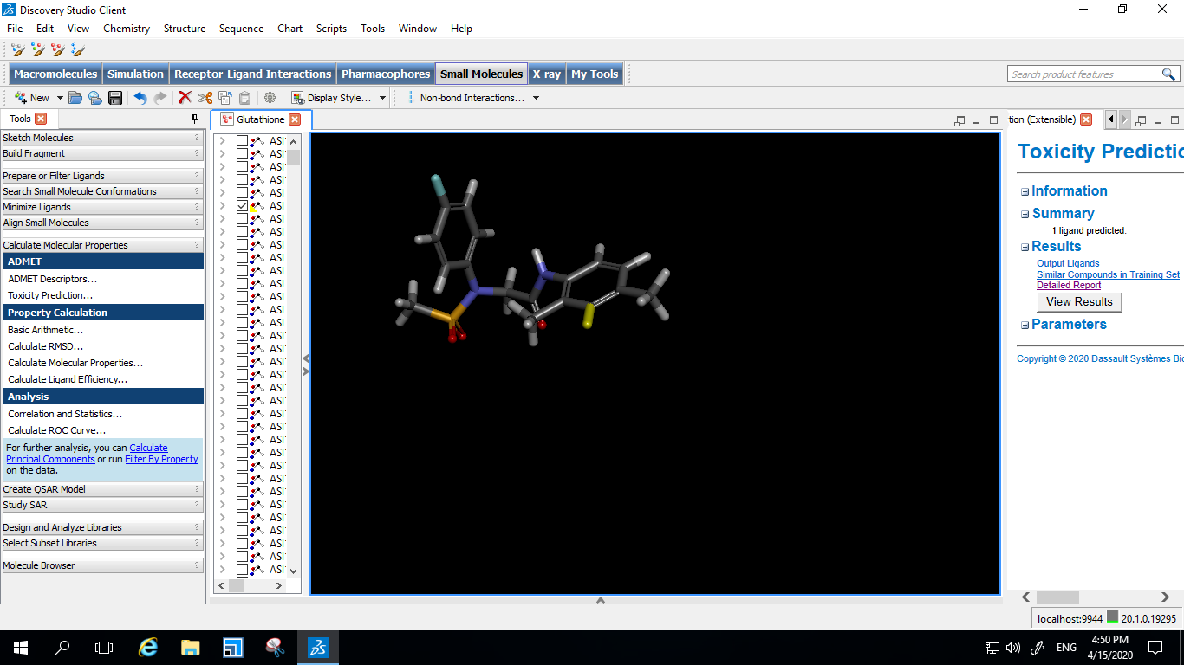
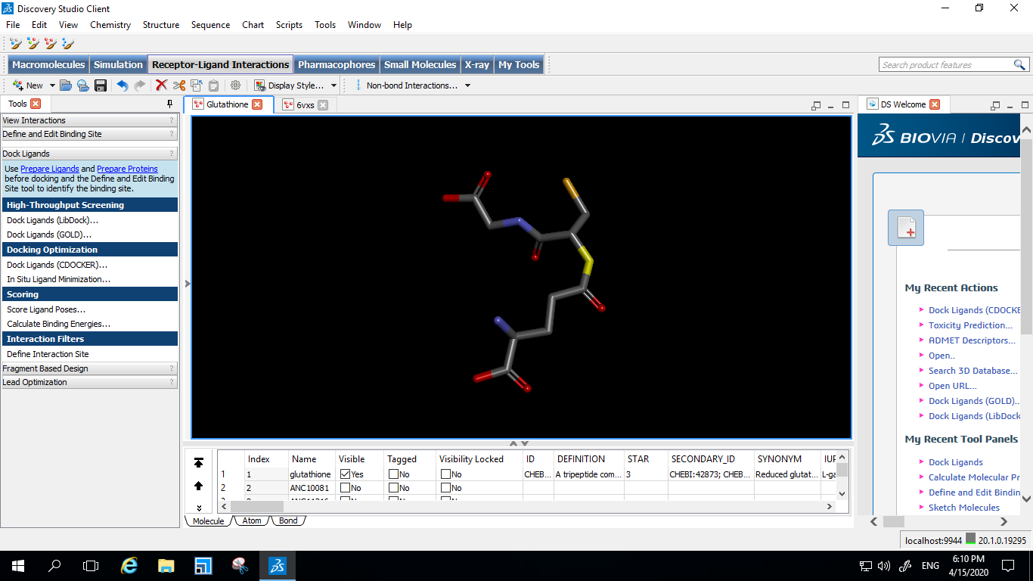
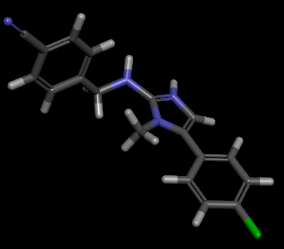
ADMET and Toxicity
Glutathione
AS1184301
AS1109019
Glutathione
AS1184301
AS1109019

Slide 17
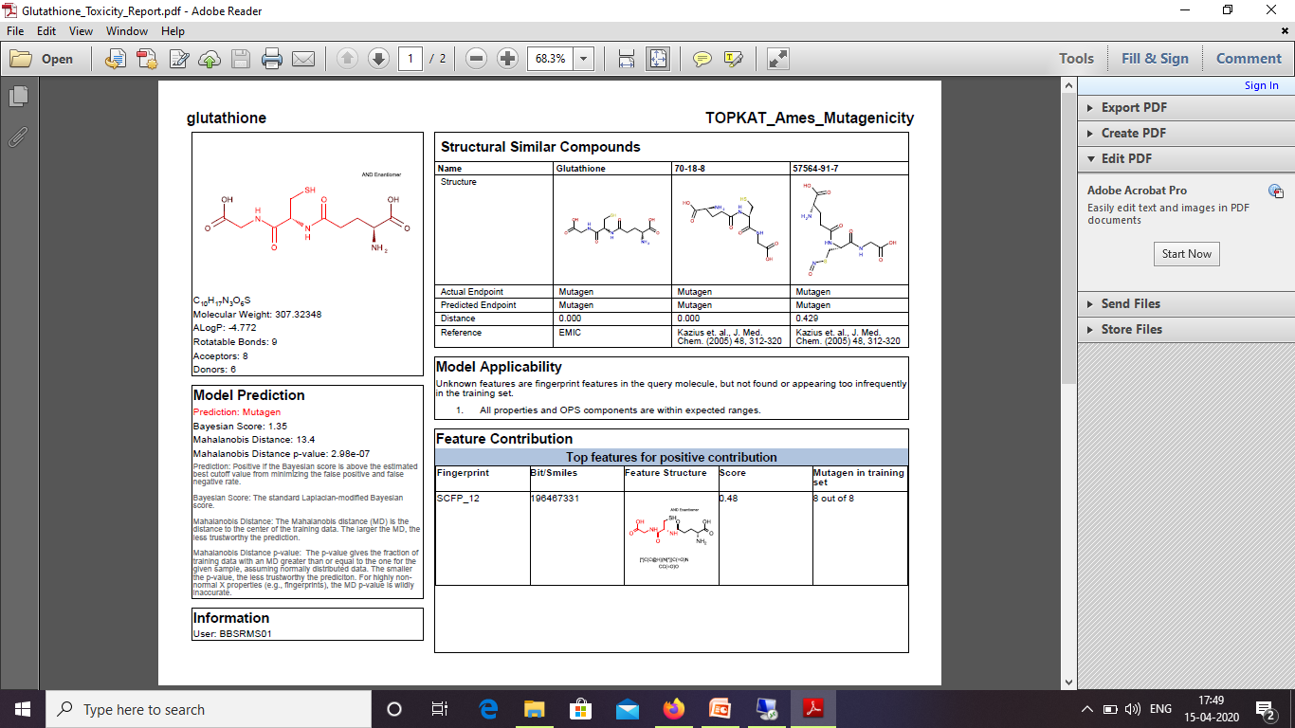
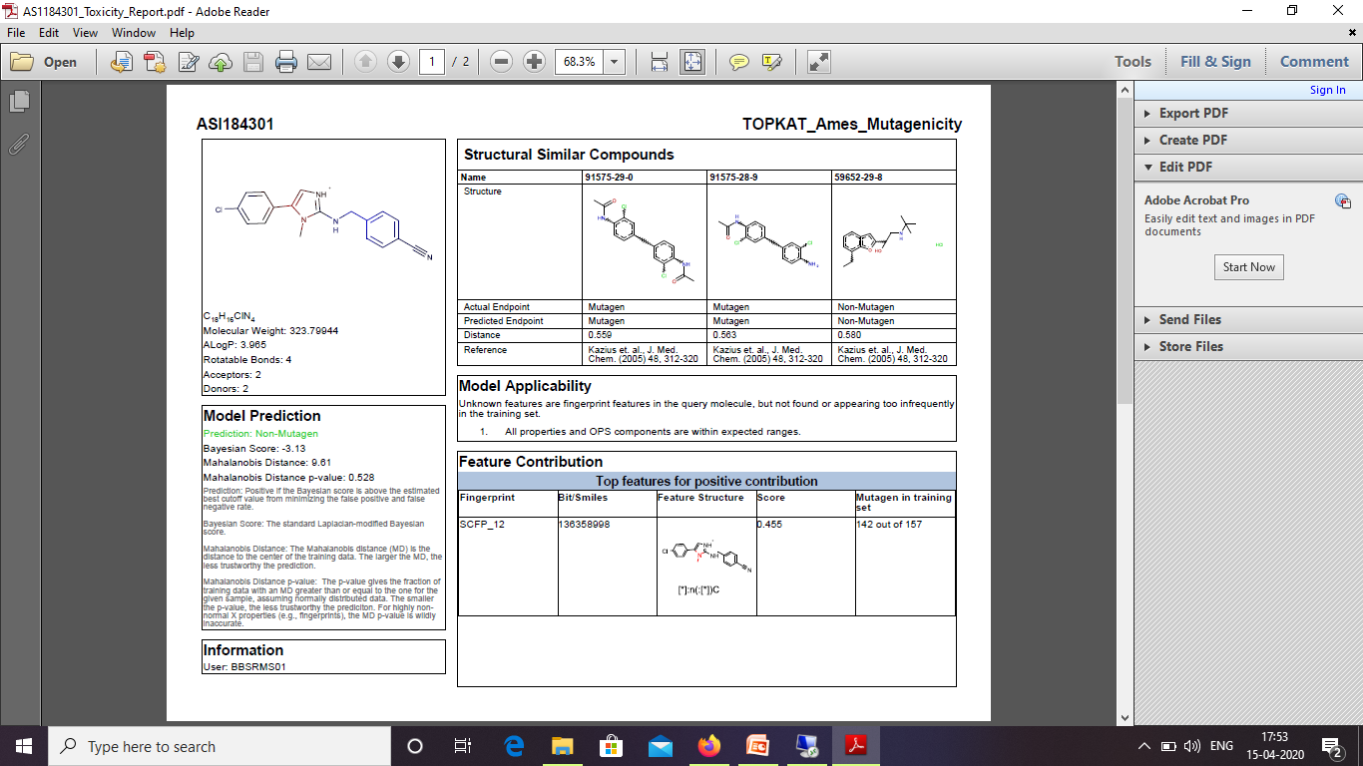
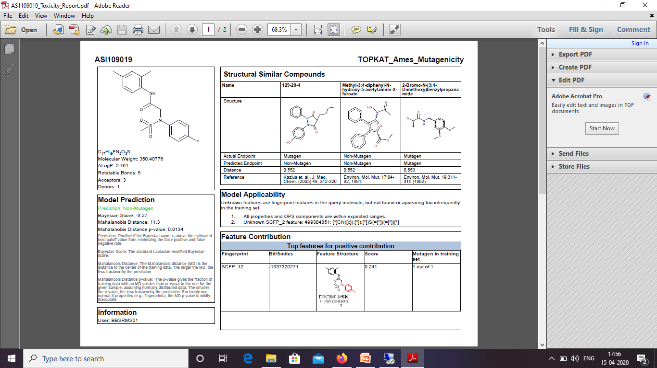
Mutagenic nature
Ligand | Mutagenic nature
Glutathione | Mutagen
AS1184301 | Non-mutagen
AS1109019 | Non-mutagen
Procedure
Tools
Small molecules
ADMET
Screening
TOXICITY

Slide 18
Receptor-Ligand interaction
Ligand | Receptor (PDB Accession) | -CDOCKER ENERGY | -CDOCKER INTERACTION ENERGY
Glutathione | 6VXS | 39.2875 | 36.1134
AS1184301 | 6VXS | 8.083 | 22.690
AS1109019 | 6VXS | 24.409 | 32.447

