Slide 1
Introduction to Gerbera

Slide 2
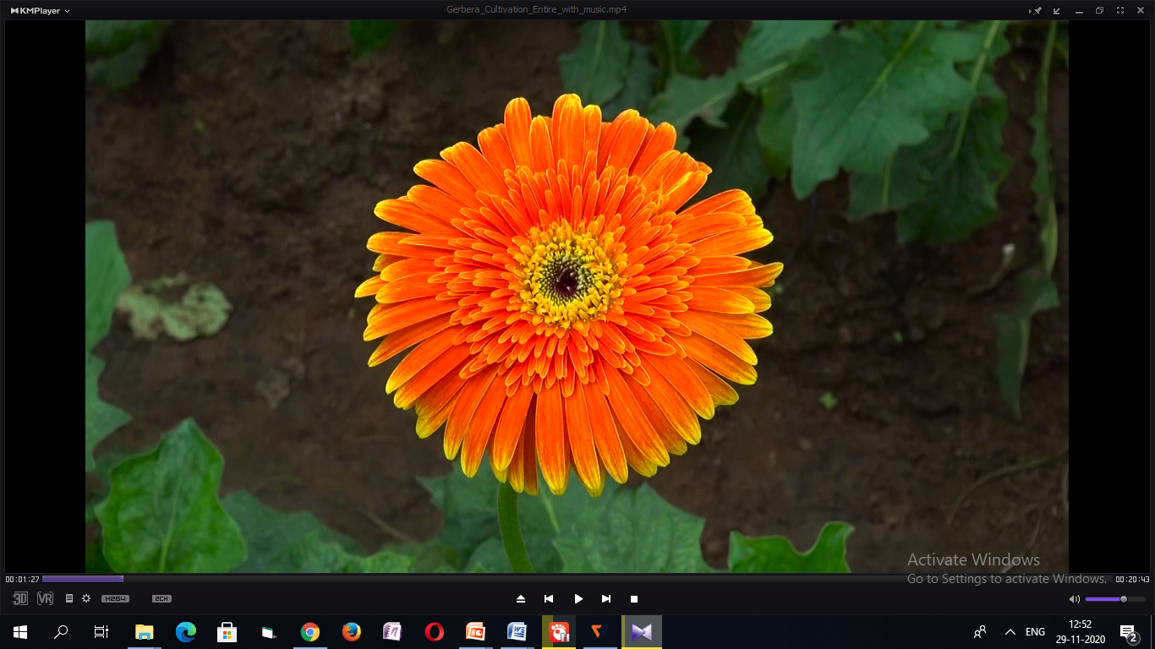
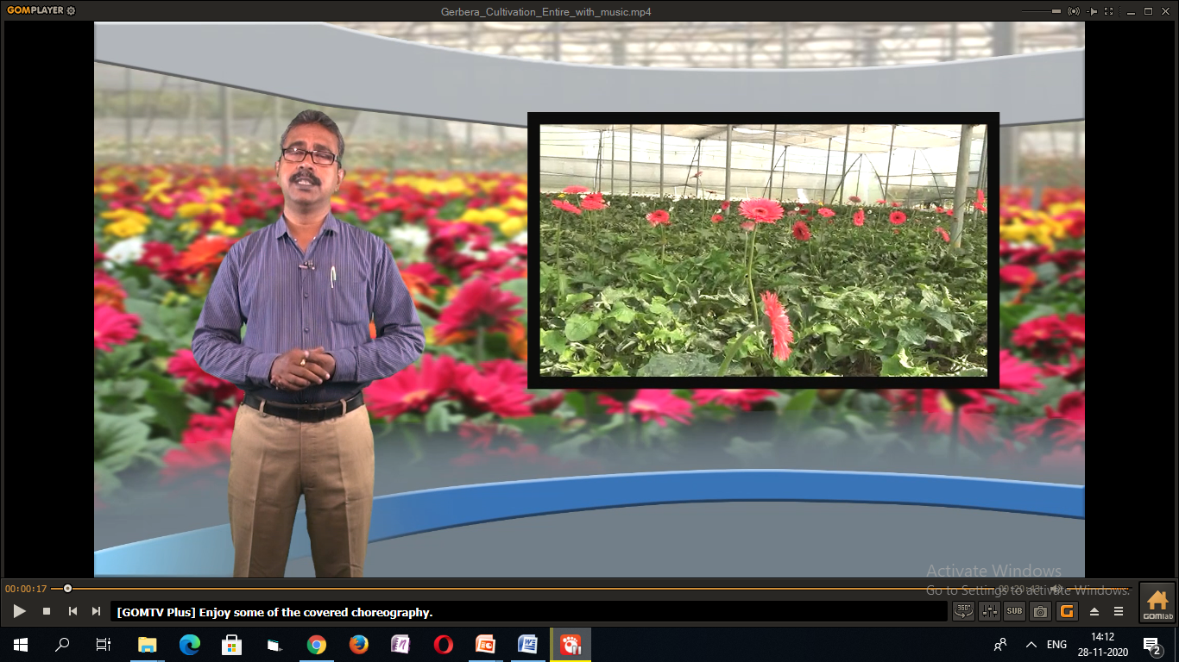
Gerbera
Scientific Name: Gerbera jamesonii
Family: Asteraceae
Origin: South Africa
2n = 50
Common name: African daisy

Slide 3
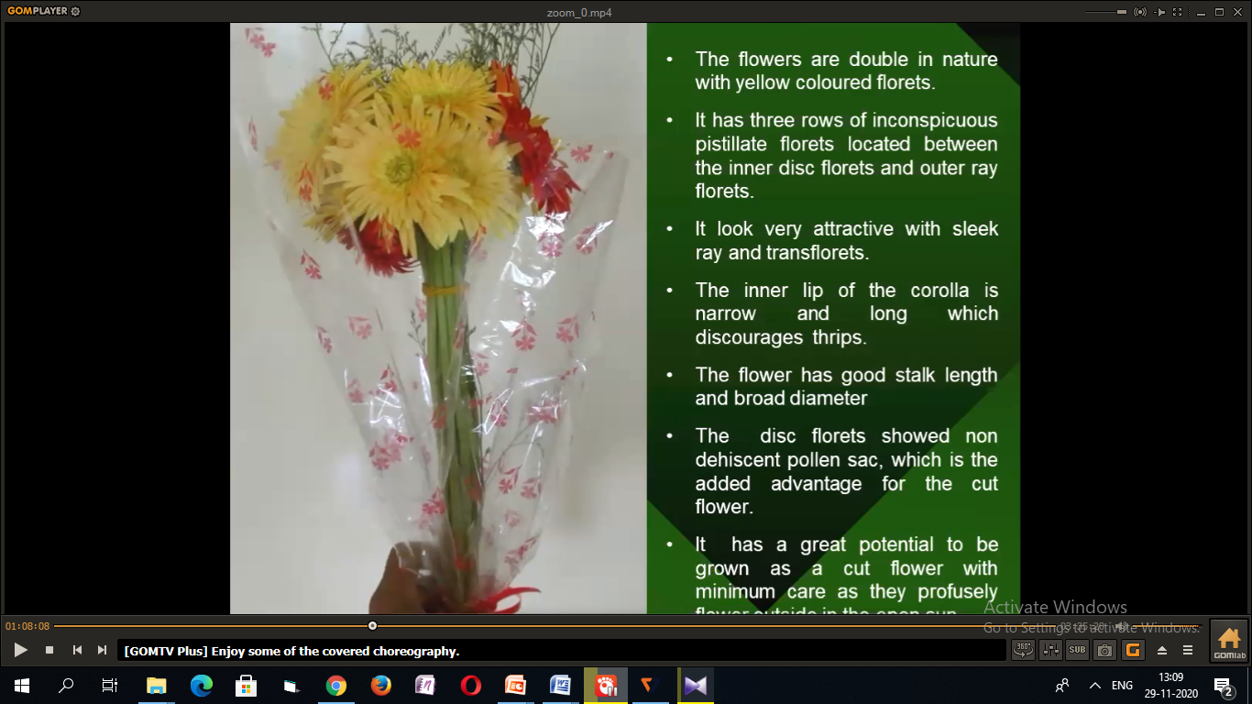
Importance and use of Gerbera flowers
Gerbera flowers are beautiful and attractive
Decorations
Bouquet preparation
Flower pot preparation

Slide 4
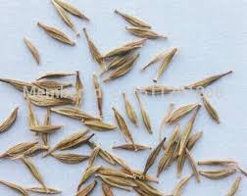
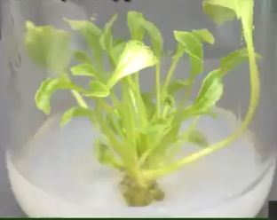
Characteristics
Gerbera is a herbaceous plant
Flowers look like daisy
Usually prefers warm and humid climate
Propagated by
-seeds
-Cuttings
-Tissue cultured plants
Gebera Seeds
Tissue cultured Gerbera

Slide 5
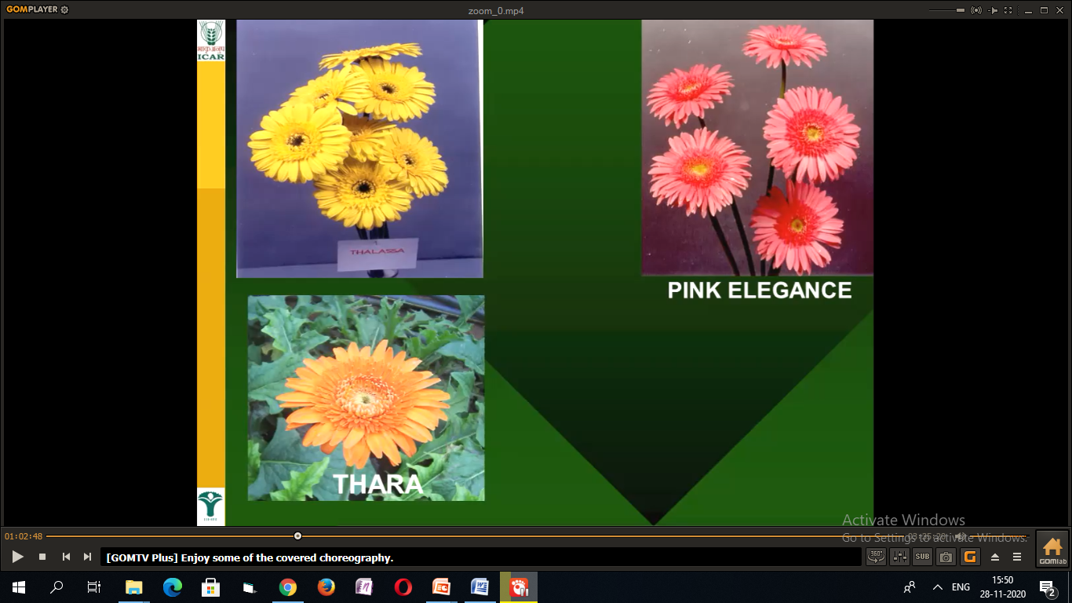
Botanical Description
Asexually reproduced
Perennial flower plant
Stemless
Pitiolated leaves
Flower type:
- Single: Single row of petals around the centre of the flower
-Semi-double: Consists of only ray and disc florets
- Double: Consists of ray, disc and trans florets

Slide 6
Status of Gerbera in India
Sr No. | State | Production(000MT) (Cut) | Production(000MT) (Loose)
1 | ARUNACHAL PRADESH | 0.02 | -
2 | ASSAM | 7.43 | 4.99
3 | HIMMACHAL PRADESH | 0.30 | -
4 | KARNATKA | 2.37 | -
5 | Maharashtra | 0.66
6 | Manipur | 0.01
7 | MEGHALAYA | 0.92 | -
8 | MIZORAM | 0.00 | 0.03
9 | NAGALAND | 0.04 | -
10 | SIKKIM |  | -
11 | Tamil Nadu | 0.52
12 | TELANGANA | 3.13 | -
13 | UTTARAKHAND | 5.14 | -
 | Total | 20.54 | 5.02
NHB, 2015-16

Slide 7
Popular Hybrids

Slide 8
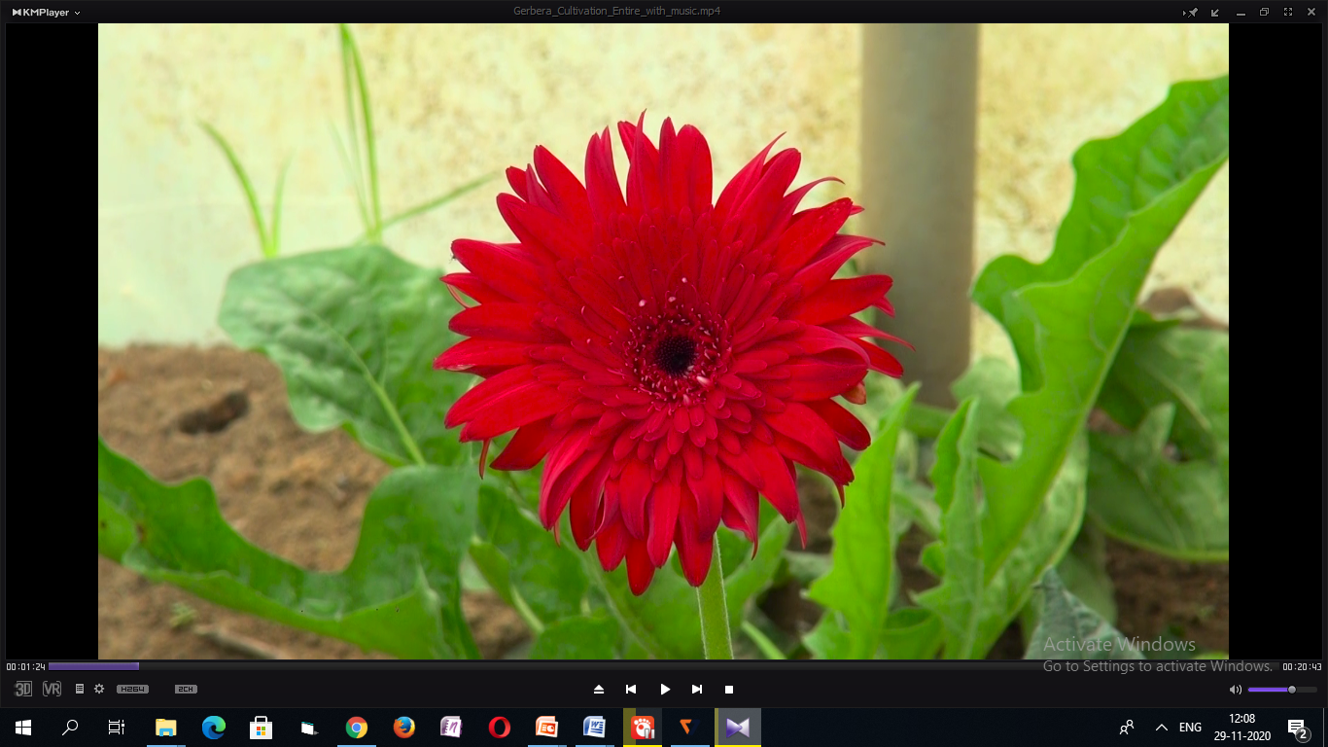
Red coloured hybrids
Red bull
Ruby red
Zingaro
Miracle
Yanara

Slide 9
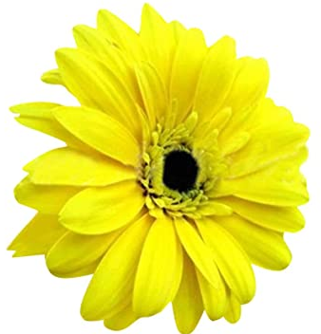
Yellow coloured hybrids
Supernova
Imperial
Piton
Dana-elen

Slide 10
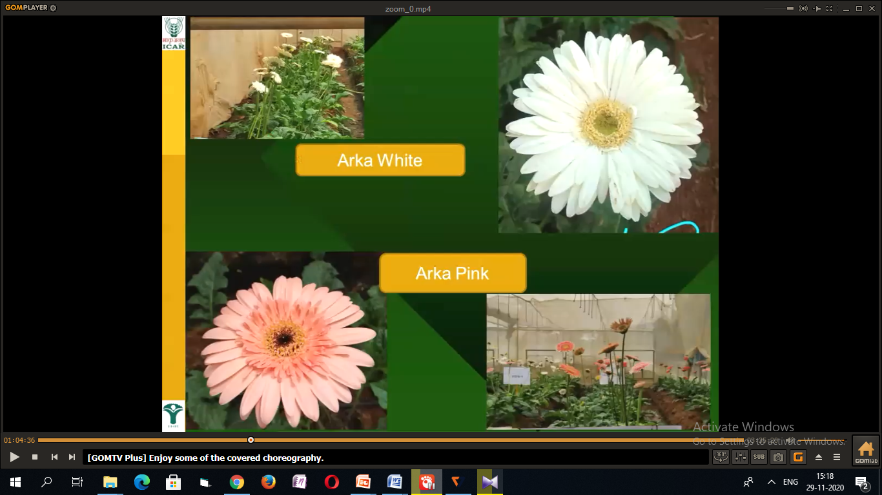
Pink coloured Hybrids
Rosalin
Salvador
Pink elegance
Essence
Prime rose
Intense

Slide 11
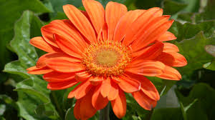
Orange coloured Hybrids
Dune
Sunset
Sunway
Golianth

Slide 12
White coloured Hybrids
Snow flake
Balance
Vital
Shimmer

Slide 13
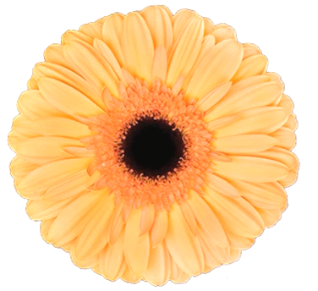
Peach coloured Hybrids
Aida
Foske

Slide 14
Thank You

