Slide 1

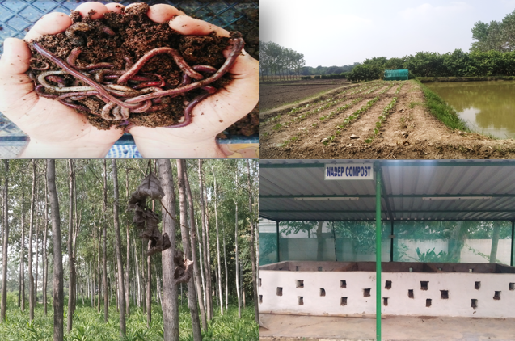
Center for Smart Agriculture
Organic Farming
Module 1: Fundamentals of Organic Farming
Session 1: Introduction to Organic farming: Definition, Concepts, Principles, Objectives

Slide 2

Organic Farming
“Organic agriculture is a unique production management system which promotes and enhances agro-ecosystem health, including biodiversity, biological cycles and soil biological activity, and this is accomplished by using on-farm agronomic, biological and mechanical methods in exclusion of all synthetic off-farm inputs”

Slide 3
“Organic farming is a system which avoids or largely excludes the use of synthetic inputs (such as fertilizers, pesticides, hormones, feed additives etc.) and to the maximum extent feasible rely upon crop rotations, crop residues, animal manures, off-farm organic waste, mineral grade rock additives and biological system of nutrient mobilization and plant protection”

Slide 4
OBJECTIVES OF ORGANIC FARMING
01
To produce food of high nutritional quality in sufficient quantity
02
To work with natural systems rather than seeking to dominate them

Slide 5
To encourage and enhance the biological cycles within farming system involving microorganism
03
04
To maintain and increase the long term fertility of soils
To use, as far as possible, renewable resources in locally organized agricultural systems
05

Slide 6
To work, as much as possible, within a closed system with regard to organic matter and nutrient elements
06
To give all livestock, conditions of life that allow them to perform all aspects of their innate behavior
07
To avoids all forms of pollution that may result from agricultural techniques
08

Slide 7
To maintain the genetic diversity of the agricultural system and its surroundings, including a safe working environment
09
To consider the wider social and ecological impact of the farming system
10

Slide 8
4 Basic Principles of Organic Farming
Principle of HEALTH | Principle of ECOLOGY | Principle of FAIRNESS | Principle of CARE
Organic agriculture should sustain and enhance the health of soil, plant, animal, human and planet as one and indivisible | Organic agriculture should be based on living ecological systems and cycles, work with them, emulate them and help sustain them | Organic agriculture should build on relationships that ensure fairness with regard to common environment and life opportunities | Organic agriculture should be managed in a precautionary and responsible manner to protect the health and well-being of current and future generations and the environment

Slide 9

As organic management is an integrated approach; manipulation and adoption of one or few steps may not yield significant results. For optimization of productivity all the essential components need to be developed in a systematic manner.
Habitat development
On-farm facilities for input production
Cropping sequence and combination planning
3-4 year rotation plan and
Growing of crops suiting to the region, soil and climate.

Slide 10
Thank You

