Slide 1

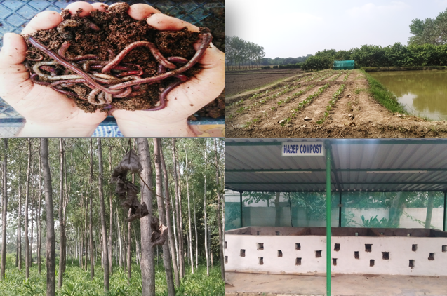
Center for Smart Agriculture
Organic Farming
Module 2: Preparation and application of organic inputs
Session 10: Biofertilizers: Type, application, benefits

Slide 2
Bio-fertilizers are defined as preparations containing living cells or latent cells of efficient strains of microorganisms that help crop plants for uptake of nutrients by their interactions in the rhizosphere when applied through seed, roots or soil.
They accelerate certain microbial processes in the soil which augment the extent of availability of nutrients in a form easily assimilated by plants.
Use of biofertilizers is one of the important components of organic nutrient management, as they are cost effective and renewable source of plant nutrients.

Slide 3
There are three ways of using biofertilizers
Seed treatment
Root dipping
Soil application

Slide 4
Seed Treatment
Seed Treatment is a most common method adopted for all types of inoculants. The seed treatment is effective and economic.
In case of solid formulation, 200 g of carrier based biofertilizers are suspended in 300-400 ml of water and mixed thoroughly. Ten kg seeds are mixed and treated with this paste and dried in shade. The treated seeds have to be sown as soon as possible.
For application of liquid biofertilizer, a plastic bag having size (21” x 10”) can be used. The bag should be filled with 2 kg or more of seeds. The bag should be closed in such a way to trap the airs as much as possible. The bag should be squeezed for 2 minutes or more until all the seed are uniformly wetted. Then bag is opened, inflated again and shaked gently. Stop shaking after each seeds gets a uniform layer of culture coating. The bag is opened and the seed is dried under the shade for 20-30 minutes.

Slide 5
Root dipping
For application of Azospirillum/ /PSM on paddy transplanting/ vegetable crops this method is used. The required quantity of Azospirillum/ /PSM of 200 ml liquid inoculant or 200 g carrier based biofertilizerhas to be mixed with 5-10 litres of water at one corner of the field and the roots of seedlings has to be dipped for a minimum of half-an-hour before transplantation

Slide 6
Soil application
In case of liquid formulation, use 200ml of PSM per acre. Mix PSM with 400 to 600 kg of FYM along with ½ bags(25kg) of rock phosphate if available. The mixture of PSM, FYM and rock phosphate have should be kept under any tree or under shade for overnight and maintain 50% moisture. Use the mixture as soil application in rows or during leveling of soil. In case of carrier based formulations, 6 kg of biofertilizers are mixed in 400 to 600 kg of compost and kept overnight under shade by maintaining 50% moisture and applied.

Slide 8
Thank You

