Slide 1

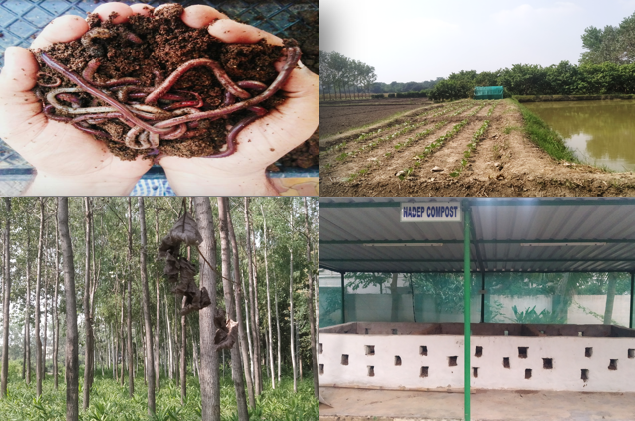
Center for Smart Agriculture
Organic Farming
Module 3: Organic crop management
Session 13: Weed management in organic production

Slide 2
Introduction
In organic farming, weed management is directed at preventive measures and timing of cultural weed management practices besides crop rotation and smothering intercrops. Weeds are often cited as the most significant problem in organic farming systems.
They are certainly the problem that most concerns the farmers, who are considering converting their farm from a conventional one into an organic one.

Slide 3
Concept
The concept of weed management in organic agriculture is: because herbicides are not allowed in organic farming system emphasis is on prevention, decision-making and control technology: control on organic farms of yield-and quality-limiting weed populations requires strategies that account for long-term effects.
This in turn requires knowledge about the population dynamics of weeds over a rotation and about the seed setting of weeds. If weeds are not suppressed in time, they may become very aggressive (competitive) and complete their life cycle thus producing a seed bank for the coming years and the subsequent crops in the rotation.

Slide 4
Preventive measures aim at reducing the supply of weed seeds and multiplication of weed plants and at destroying weed before the crop is sown.
Measures can be taken at different levels: farm level (rotation, intercropping, adjusting (uniform and broad) row distances for adequate mechanical management), crop level (building up tolerance of a crop by optimising the growing conditions) and variety level (genetic characteristics for competitiveness through plant architecture, rapid juvenile growth. deep rooting or allelopathic exudates).
Not only do crops differ in their competitiveness towards weeds, but also within a crop species varieties have been found to differ in competitiveness

Slide 5
Some weed management options in organic farming
Competitive crops
Crop rotation
Intercropping
Summer ploughing
Sowing of weed free seeds
Mechanical control etc…..

Slide 6
Benefits of organic weed control
No pollution
No ground water contamination
No herbicide residue in food
Reduced dependence on purchased inputs
Improved soil health etc….

Slide 7
Thank You

