Slide 1

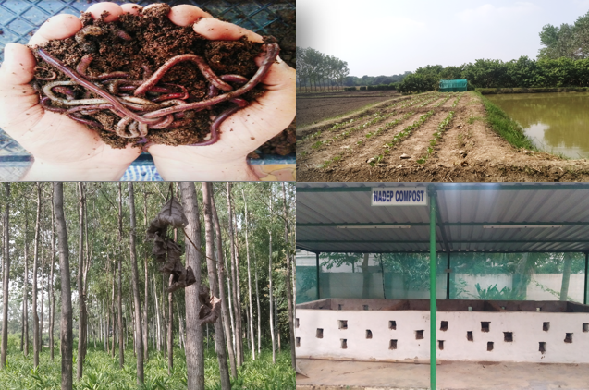
Center for Smart Agriculture
Organic Farming
Module 3: Organic crop management
Session 16: Dos and Don’ts of Organic farming

Slide 2
Dos of Organic farming
Addition of orgnic manures, compost, vermicompost etc
Use Crop rotation
Inclusion of legumes in cropping system
Green manuring
Improving farm biodiversity
Use of bio enhancers like jibamrut, Panchagavya etc..
Use of preventive strategy for pest and disease control
Biological pest control

Slide 3
Don’ts of Organic farming
Organic farming does not allow/ Prohibits the following:
Genetically modified organisms
Nanomaterials
Human sewage sludge
Plant growth regulators
Hormones
Antibiotic use in livestock etc..
Synthetic fertilizers and pesticides

Slide 4
Organic farming promotes the use of natural substances while prohibiting/strictly limiting the use of synthetic substances
Organic farming promotes:
Sustainability
Food security
Food safety
Self sufficiency etc..

Slide 5
Organic farming promotes the use of on farm inputs, which gives the following advantages:
Reduces cost of input
Promotes self sufficiency
Promotes resource recycling
Improve resource use efficiency

Slide 6
Thank You

