Slide 1
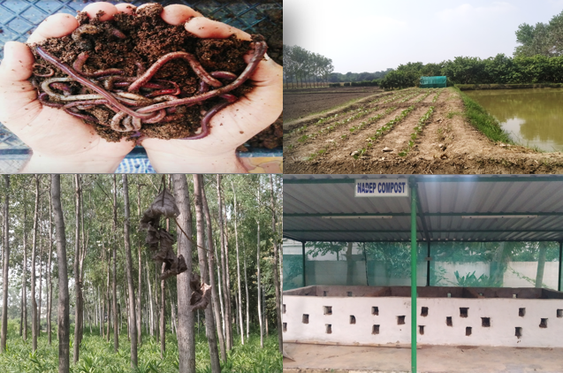
Center for Smart Agriculture
Organic Farming
Module 4: Organic Certification
Session 17: Organic certification: Requirement and Procedure, Advantages of organic certification.

Slide 2
Organic certification involves a set of production standards for growing, storage, processing, packaging and shipping that include:
Prohibition of synthetic chemical inputs (e.g. fertilizer, pesticides, hormones, antibiotics, food additives, etc) and genetically modified organisms;
Use of farmland that has been free from chemicals for a number of years (often, two or more);
Keeping detailed written production and sales records (audit trail);
Maintaining strict physical separation of organic products from non-certified products;
Undergoing periodic on-site inspections.

Slide 3
Purpose of certification:
To assure quality and prevent fraud.
For organic producers, certification identifies suppliers of products approved for use in certified operations.
For consumers, "certified organic" serves as a product assurance,
Certification is essentially aimed at regulating and facilitating the sale of organic products to consumers.

Slide 4
Third Party Organic certification systems in India
National Programme on Organic Production (NPOP), launched during 2000 for farm and livestock certification for organic commodities was the first milestone for organic quality assurance system in the country.
29 Accredited certification agencies authorized under the programme are certifying organic producers.

Slide 5
NPOP certification is a system of process certification wherein an independent organization reviews entire production, processing, handling, storage and transport etc to ensure the compliance of organic standards
The process typically includes comprehensive review of cultivation practices including:
Land management,
Usage of inputs,
Use of machinery,
Pest management and post harvest in crops,
Rearing practices compatible to their natural behaviour,
welfare of animals,
Avoidance of synthetic feed additives and hormones
Limited usage of allopathic drugs and antibiotics in animal products
and processing and handling through document review and on-site physical inspection.

Slide 6
Certification Procedure in brief
Application is made to the certification agency in the prescribed format with necessary farm and process details
Screening of application by certification agency and if necessary further details/clarification sought
Cost estimate comprising of certification charge, inspection charge, travel cost, reporting cost, laboratory charges etc is sent for acceptance
Acceptance of cost by the grower/producer
Signing of agreement between grower/producer and certification agency (Contd..)

Slide 7
Certification agency seeks cropping/production/cultivation/processing plan and supply a copy of the standards to the grower/producer to follow
Certification agency raises an invoice and asks the producer payment of initial fee
Grower/producer pays the fee
Inspection schedule is worked out
Inspection is carried out at one or more than one occasion
(Contd…..)

Slide 8
If required unannounced inspection can also be done. In case of doubt, the inspection team can also draw plant/soil/raw material/input/product sample for laboratory analysis.
Inspection report/(s) submitted to the certification committee
Certification agency asks for final payment
Final payment is made
Certification is granted
(Contd…)

Slide 9
On grant of scope certificate Producer/operator applies for license for use of India Organic Logo
Certification body grants the license for use of India Organic Logo
Grower/producer releases the stock for sale with Certification Mark
Reference:
National Programme for Organic Production: A training Manual (2018). Agricultural and Processed Food Products Export Development Authority (APEDA). Ministry of Commerce and Industry, Government of India. https://apeda.gov.in/apedawebsite/organic/NPOP_Training_Manual_English_E_Book.pdf

Slide 10
Thank You

