Slide 1

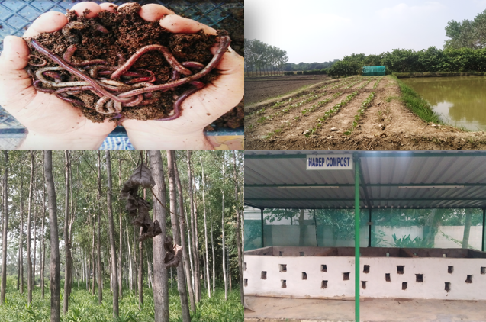
Center for Smart Agriculture
Organic Farming
Module 1: Fundamentals of Organic Farming
Session 2: Basic concepts of cropping pattern, cropping system and farming system

Slide 2

Cropping systems
Cropping systems are the resultant product of principle and practices of cropping, resources, environment and available package of technology (production & management).

Slide 3
Cropping pattern
The yearly sequence and spatial arrangement of crop or of crops and fallow on a given area (a farm), region, province or country apportioning due consideration to natural features (soil and climate), crop efficiency and capability, socio-economic structure, technological and extension infra-structure (changeable) and the national agricultural policy.

Slide 4
Multiple cropping
Multiple cropping refers to intensification of cropping both in time and space. It includes sequential cropping, inter-cropping and mixed cropping.
Sequential cropping
Intercropping
Mixed cropping
Multiple cropping

Slide 5
Intercropping
It refers to growing of two or more dissimilar crops simultaneously on the same piece of land, base crop necessarily in distinct row arrangement.
.
Intercropping
Mixed inter-cropping
Row inter-cropping
Strip inter-cropping
Relay inter-cropping

Slide 6
Strip inter-cropping
Growing component crops in different strips wide enough to permit independent cultivation but narrow enough to the crop to interact agronomically.
Mixed inter-cropping
Growing component crops simultaneously with no distinct row arrangement. This is commonly used in labour intensive subsistence farming situations.
Row inter-cropping
Growing component crops simultaneously in different row arrangement. This issued in mechanized agriculture.
Relay inter-cropping
It refers to planting of succeeding crop before the harvest of preceding crop, planting of succeeding crop may be done before or after flowering before or after attainment of reproductive stage, completion of active life cycle, senescence of leaves or attainment of physiological maturity.

Slide 7
Mixed cropping
Growing of two or more crops simultaneously on the same piece of land seeded either after the seeds of the crops intended to be grown mixed or sowing alternate rows in various replacement ratios.
This may or may not have distinct row arrangement and the mixed plant community faces inter and intra row competition with a different plant type/variety.
Objective
Minimization of risk and insurance against crop failure due to aberrant weather conditions.

Slide 8
Some important terminologies……………
Monoculture: The repetitive growing of the sole crop on the same piece of land. It may either be due to climatologically limitation or due to specialization by a farmer to grow a particular crop.
Ratoon cropping: The cultivation of crops are growth coming out of roots or stalks of the preceding crop after harvest, although not necessarily for grain is termed as ratoon cropping/ratooning.
Mixed farming: It is defined as a system of farming on a particular farm (regardless of size) which includes crop production, raising of livestock, poultry, fish and bee keeping, and/or tress to sustain and satisfy as many necessities of the owner (farmer) as is possible. Subsistence is the objective here. Its based on the principle of give and take. Farm animals feed on farm produce and in return manure is given to the crop.

Slide 9
Thank You

