Slide 1

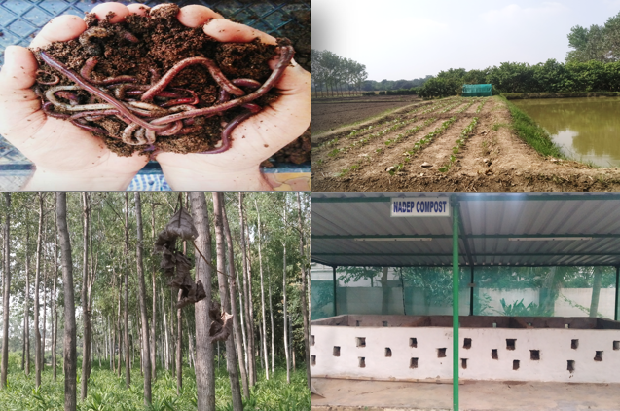
Center for Smart Agriculture
Organic Farming
Module 1: Fundamentals of Organic Farming
Session 3: Integrated Farming system

Slide 2

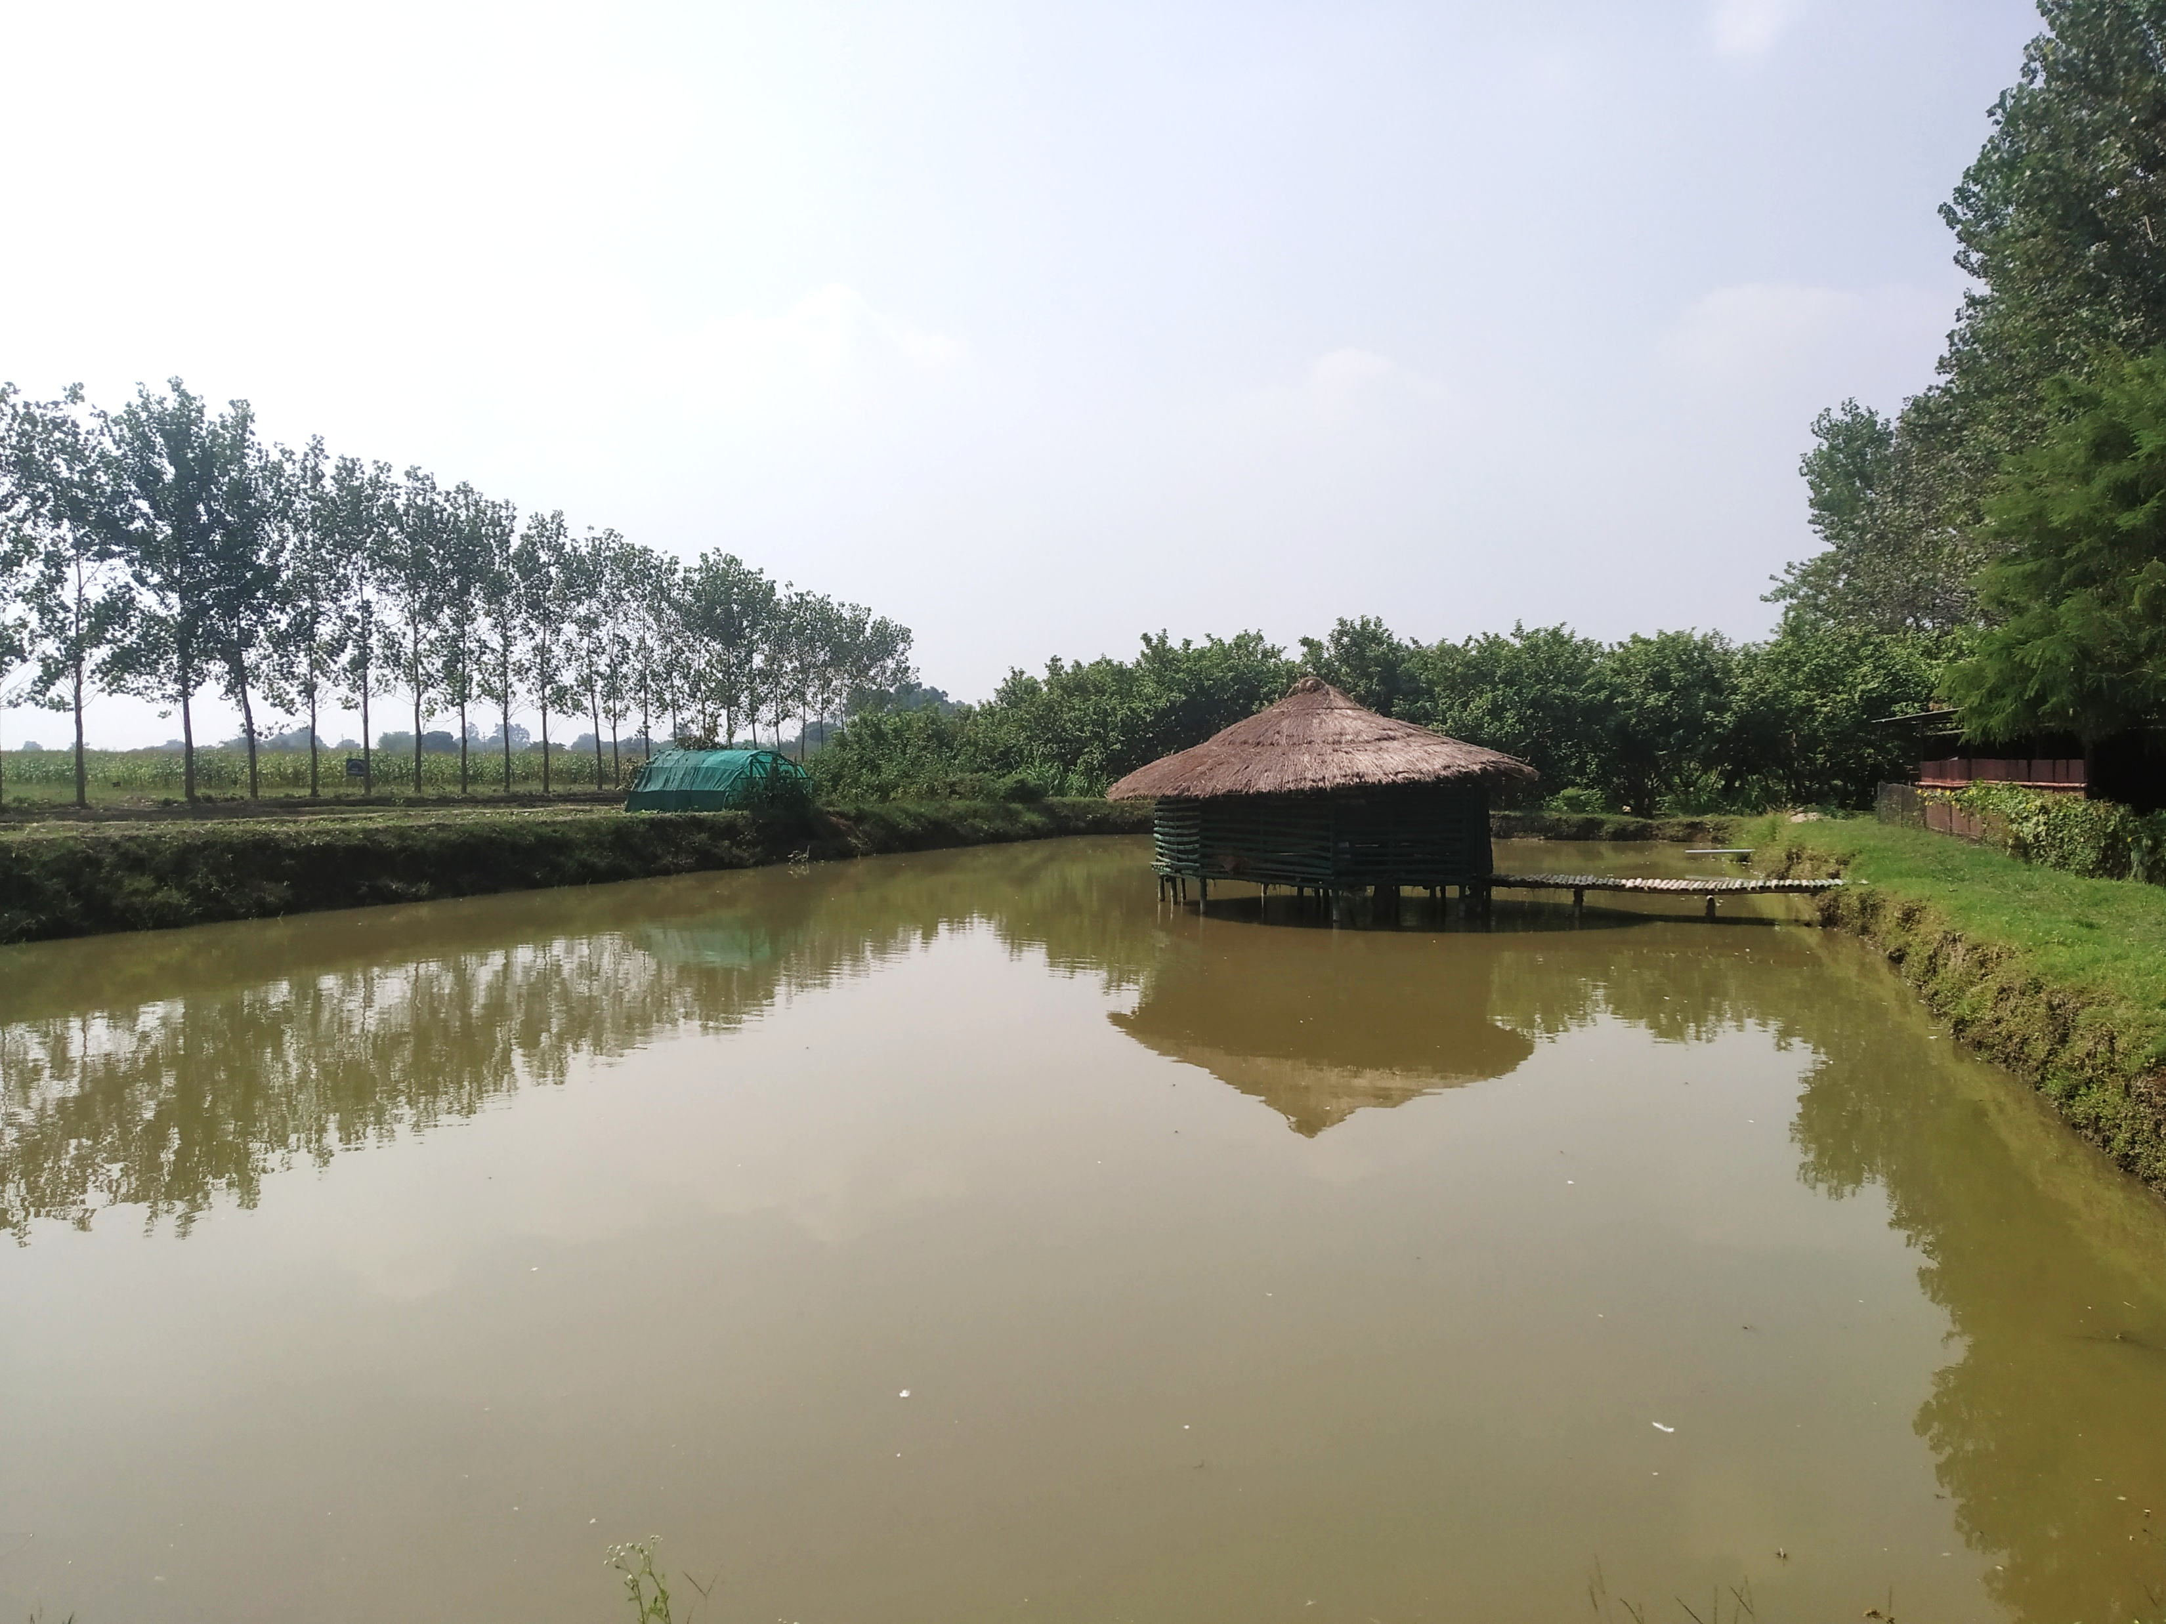
Integrated Farming System
Integration of various agricultural enterprises viz., cropping, animal husbandry, fishery, forestry etc. have great potentialities in the agricultural economy. These enterprises not only supplement the income of the farmers but also help in increasing the family labour employment.

Slide 3
Components of Integrated Farming System
Integrated Farming system includes enterprises like:
Crop production
Fishery
Duckery
Poultry
Apiary
Dairy
Mushroom production etc….

Slide 4
Importance of Integrated Farming System
.Recycling and utilization of other available resources in the farm
Maximum possible return and Profitability

Slide 5
Create adequate employment opportunities
Improves Productivity
Improves Sustainability

Slide 6
Balanced Food production
Environmental Safety
Adoption of New Technology

Slide 7
Saves energy
Increase Input efficiency

Slide 8
Thank You

