Slide 1
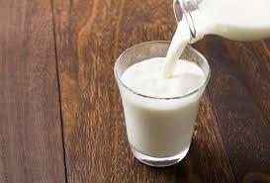
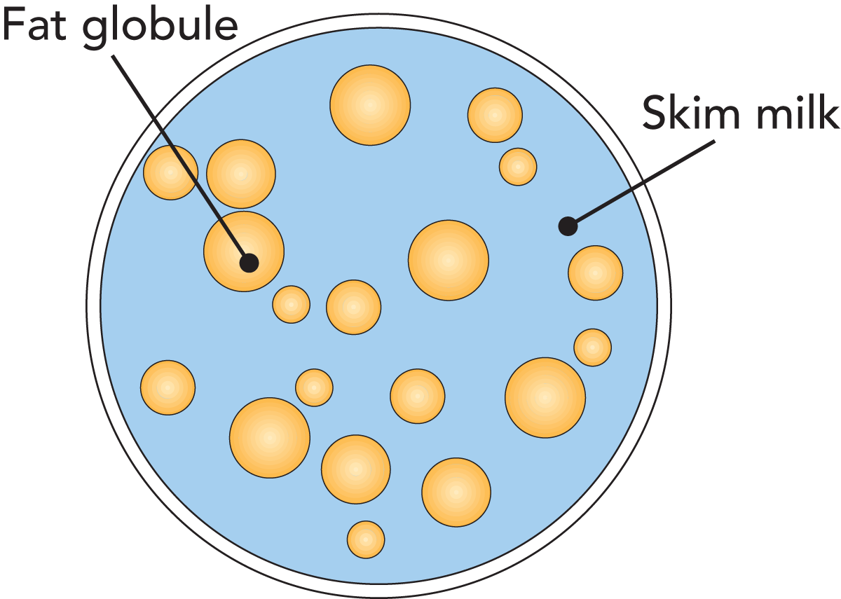
Physical chemistry of milk
Soma Maji

Slide 2
Definition of milk
Milk may be defined as the whole, fresh, clean, lacteal secretion obtained by the complete milking of one or more healthy milch animals, excluding that obtained within 15 days before and 5 days after calving to avoid colostrum milk and should contain minimum prescribed percentage of milk fat and milk Solid Not Fat.
(De, 1980)
Gross Composition of cow milk
Component | Average Content percentage (w/w) | Range Percentage (w/w) | Average % of Dry matter
Water | 87.3 | 85.5 -88.7
Solids not fat | 8.8 | 7.9-10.0 | 69
Fat | 3.9 | 2.4-5.5 | 31
Protein | 3.25 | 2.3-4.4 | 26
Lactose | 4.6 | 3.8-5.3 | 36
Casein | 2.6 | 1.7-3.5 | 20
Mineral substances | 0.65 | 0.53-0.80 | 5.1
Organic acids | 0.18 | -- | 1.4
Walstra and Jenness, 1984)

Slide 3
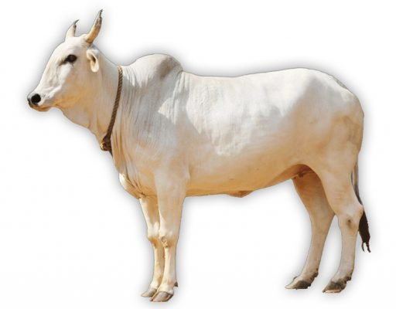
Gross composition of milk from different species of mammals
Composition (g/100g) | Human | Cow | Buffalo | Goat | Sheep | Horse | Camel
Water | 87.1 | 87.3 | 82.8 | 86.7 | 82.0 | 88.8 | 86.5
Fat | 4.5 | 3.9 | 7.4 | 4.5 | 7.2 | 1.9 | 4.0
Casein | 0.4 | 2.6 | 3.2 | 2.6 | 3.9 | 1.3 | 2.7
Whey Protein | 0.5 | 0.6 | 0.6 | 0.6 | 0.7 | 1.2 | 0.9
Lactose | 7.1 | 4.6 | 4.8 | 4.3 | 4.8 | 6.2 | 5.0
Ash | 0.2 | 0.7 | 0.8 | 0.8 | 0.9 | 0.5 | 0.8

Slide 4
Major constituents of milk
The major constituents of milk are, water, fat, proteins, lactose, minerals and
miscellaneous compounds.
1. Water
It is the medium in which all the milk constituents are dispersed. It is a universal vehicle and plays an important role in the physical properties exhibited by the milk. It also assists in maintaining the much desirable equilibrium and keeps the constituents of the milk in their native state. Water acts as a solvent in keeping the constituents in soluble, colloidal or emulsion form and influences the collegative properties of milk.
2. Fat
Fat is the costliest component of milk. It is characterized by its presence as an emulsion. The unique feature of milk fat is its fatty acid composition. Milk fat is rich in saturated fatty acids and mono unsaturated fatty acids and also acts as a carrier for the fat soluble vitamins. The unique feature of the milk fat from ruminants is that they are having short chain saturated fatty acids in substantial quantities and imparts the unique flavour to the milk and milk products. Presence of long chain unsaturated fatty acids reduce the melting point of milk fat. In order to maintain the emulsion stability several surface active substance are also associated with the milk fat and present in higher proportion in fat globule membrane.

Slide 5
3. Proteins
Milk is rich in protein content and has a unique protein namely the casein. It is present in the form of colloidal dispersion in milk and is responsible for several physical properties of milk. It also supplies all the essential amino acids, hence a complete protein and is easily digestible. In addition to casein, milk also contains (other) proteins which are known as whey proteins. Milk is a biological secretion of living cells synthesized through several (enzyme mediated) biochemical reactions (which are often mediated through enzymes). It is a well known fact that these enzymes are basically protein in nature and act as biological catalysts. Milk is a good source for several enzymes which have both desirable and also undesirable effect on preservation and processing of milk.
4. Lactose
Lactose is a major soluble component present in milk. Milk contains approximately 4.6% carbohydrate that is predominately lactose with trace amounts of monosaccharides and oligosaccharides. Lactose is a disaccharide of glucose and galactose. It is first carbon source for the microbes gaining entry into milk. It is a reducing sugar and is present in soluble state. It is a good source of energy for the young ones. In addition to lactose, milk also contain several other carbohydrates in trace levels (negligible).

Slide 6
5. Minerals
Minerals in milk are mainly inorganic salts, partly ionized and partly present as complex salts. Some inorganic matter is bound covalently such as calcium phosphate groups in casein. They are responsible for the ionic balance of milk and helps in maintaining the equilibrium between the soluble and colloidal state.
6. Vitamins
Milk contains almost all the essential vitamins which include fat soluble and water soluble vitamins. It is a very good source for the most essential fat soluble vitamin namely the Vitamin A. It is also interesting to observe that this vitamin is existing in the cow milk in its precursor form i.e. carotene a provitamin A imparts golden yellow colour to milk. Milk is not a good source of Vitamin K and Vitamin C.
7. Miscellaneous compounds
Milk contains many components which are in low concentrations (less than 100 mg/liter) which do not fall into any of the above categories. These compounds may be considered as natural if they present in freshly drawn milk and have been detected in most samples tested for that component. The compounds considered in this category are gases, alcohols, carbonyl compounds, carboxylic acids, conjugated compounds, non protein nitrogenous compounds, phosphate esters, nucleotides, nucleic acids, sulfur containing compounds, hormones etc.

Slide 7
Density and specific gravity
Density is one the important physical property of a matter. Density has a direct relationship with weight and volume of a substance. The knowledge about density is helpful in understanding the behaviour of substance when placed in a different environment. The density of milk and milk products is used to convert volume into mass and vice versa, to estimate the solids content of milk and to calculate other physical properties (e.g. kinematic viscosity). The relationship of this property with the temperature will also be helpful in developing various processing techniques of milk products.

Slide 8
Definition:
Density
Density is defined as the mass of a certain quantity of material divided by its volume. It is expressed in kg.m-3 (SI units) or g.ml-1. The symbol ρ used to express density.
Since density closely depends on temperature it is usually denoted with temperature ρ20 meaning the density at 20°C .
Specific gravity
The mass or weight of a certain volume of the product divided by the mass of an equal volume of water is known as specific gravity. Thus specific gravity (s.g) of a product can be obtained by using the formula.
s.g = ρ_{product} / ρ_{water}

Slide 9
Difference between the Density and Specific Gravity
Specific gravity i.e. relative density is a dimensionless quantity. It is mostly useful as a comparison but not in absolute units. Whereas density can measured in specific units.
Specific gravity does not provide the actual difference in the mass of two substances since it is only on relative basis. It tends to be rather vague while the density will help in giving the exact mass of the product per unit volume.
Specific gravity is more suitable for only liquids while density is for both solids and liquids.
Measuring the specific gravity is simple and more convenient, less laborious and does not require any sophisticated equipment and quick results can be obtained, while the density needs specific equipment like pycnometer, sensitive balance and other materials.
Specific gravity can be measured by people with minimum skill but density measurement requires specially trained individual for this purpose.
In a given time, a large number of samples could be tested for specific gravity whereas only limited samples for density could be determined.

Slide 10
Determination of specific gravity is more economical in comparison to the density determination
Methods for the Determination of the Density and Specific Gravity of Milk
A very common instrument for direct measurement of density of a liquid is the hydrometer, which measures the volume displaced by an object of known mass. A common laboratory device for measuring fluid density is a pycnometer; a related device for measuring the absolute density of a solid is a glass pycnometer. Another instrument used to determine the density of a liquid or a gas is the digital density meter - based on the oscillating U-tube principle.
Hydrometer
Hydrometer is an instrument used to measure the specific gravity (or relative density) of liquids; that is, the ratio of the density of the liquid compared to the density of water.
The operation of the hydrometer is based on the Archimedes principle that a solid suspended in a fluid will be buoyed up by a force equal to the weight of the fluid displaced. Thus, the lower the density of the substance, deeper the hydrometer will sink.
A hydrometer is usually made of glass and consists of a cylindrical stem and a bulb filled with mercury or lead shot to make it float upright. The liquid to be tested is poured into a tall jar or measuring cylinder and the hydrometer is gently inserted / lowered into the liquid until it floats freely. The point at which the surface of the liquid touches the stem of the hydrometer is noted. Hydrometers usually contain a paper scale inside the stem, so that the specific gravity can be read directly. The scales may be Plato, Oechsle, or Brix, depending on the purpose.
Hydrometers may be calibrated for different uses, such as a lactometer for measuring the density (creaminess) of milk, a saccharometer for measuring the density of sugar in a liquid, or an alcohol meter for measuring higher levels of alcohol in spirits

Slide 11
Lactometer
A lactometer (or galactometer) is a hydrometer used to test relative density of milk. The specific gravity of milk does not give a conclusive indication of its composition since milk contains a variety of substances that are either heavier or lighter than standard substance i.e. water. Additional tests for fat content are necessary to determine overall composition of milk. Another instrument, invented by Doeffel, is two inches long, divided into 40 parts, with division beginning at the point to which it sinks when placed in water.
Pycnometer
A pycnometer (from Greek: πυκνός (puknos) meaning "dense"). A pycnometer is usually made of glass, with a close-fitting ground glass stopper with a capillary tube through it, for facilitating the escape of air bubbles from the apparatus. This device enables accurate measurement of a liquid's density in reference to an appropriate working fluid, such as water or mercury, using an analytical balance.
The specific gravity of the liquid can easily be calculated if the weight of empty flask, flask with full of water, and flask with full of an experimental liquid are known. The particle density of a powder, for which the usual method of weighing cannot be applied, can also be determined with a pycnometer. The powder is added to the pycnometer and is then weighed, to get weight of the powder sample. The pycnometer is then filled with a liquid of known density, in which the powder is completely insoluble. The weight of the displaced liquid can then be determined, and hence the specific gravity of the powder.

Slide 12
Westphal balance
This balance is used to measure the specific gravity (or density) of liquids. This is usually supplied in its box, along with the characteristic U-shaped balancing masses and the plummet in the upper right-hand corner. The sliding top of the box has the decorative molding attached to it.
The arm is first balanced with the plummet totally immersed in water at 15.5°C. The plummet has a built-in thermometer and has a known volume (equal to 5 gms of water at 15.5°C) and mass (15g). A 5g mass is placed on the hook holding the plummet, and screw on the foot is adjusted until the index pointer on the end of the beam lines up with the point on the frame. The plummet is then completely immersed in the unknown liquid, and the system is rebalanced, using a series of riders on the nine equally paced notches on the beam, thus giving the value of the added mass for each decimal place.
This gives the buoyant force of the liquid relative to water, and hence the specific gravity, which may be obtained to four decimal places.

Slide 13
Factors affecting density and specific gravity of milk:
Density of milk is influenced by the combined effect of densities of its various components. As such it is dependent on the amount of dissolved or suspended matter, changes in the constituents and the physical state of components in milk. Milk density is further influenced by the various factors such as temperature history of samples, biological differences of micelles and processing conditions of milk. Among the various milk constituents, milk fat content is known to be the main cause for variation in the density of milk. The physical state of the milk fat was observed to have greater influence on density.
Recknagel phenomenon
Recknagel, observed that the density of specific gravity of milk as soon as milking is lower than the same milk held for long periods of time, especially of milk under cold storage. Such phenomenon is known as Reckngel phenomenon. It attributed the increase in the hydration of the protein at low temperature as the major cause for such a phenomenon rather than the escape of the air bubbles. Subsequent work carried out by other scientists attributed this phenomenon to the ratio between the liquid and solid.
Temperature
Density and specific gravity decreases with increase of temperature and decreased with increase in temperature. This is the reason for obtaining corrected lactometer reading while calculating the specific gravity of milk at designated temperature of the lactometer. Sp. gravity of milk is = 1 + CLR / 1000, Where CLR is Corrected lactometer reading at a particular temperature expression. For attaining the maximum density and to avoid the Recknagel phenomenon it is suggested that milk should be heated to a temperature of 40°C and specific gravity is determined when cooled to 20°C to ensure reproducible state of milk fat.

Slide 14
Type of the milk and breed
These two factors influence the density/specific gravity of milk since there is variation in the composition which would otherwise influence this property. As the milk fat is lighter constituent, the milk with higher fat content will have lower the specific gravity and vice versa. However, although buffalo milk contains more fat than cow milk, its specific gravity is higher than the latter. This is because buffalo milk contains more solids-not-fat as well, which ultimately results in a higher specific gravity.
The specific gravity of milk is decreased by:
Addition of water
Addition of cream (fat)
Increased temperature.
The specific gravity of milk is increased by:
Addition of separated milk
Removal of fat
Reduction of temperature.
Processing and other factors
There will be an increase in the milk density due to refrigerated storage. Slow crystallization of the fat and change in the hydration of the globule membrane is responsible for this increase in the density.
Fat content and temperature have been related to the density of creams.
Homogenization slightly increases the density of whole milk but not of skim milk. Sterilization decreases the density of both milks. These changes are very small and negligible due large variations observed from sample to sample.
The specific gravity of cream decreases regularly with increase in the fat content. Skim milk has specific gravity of 1.0320 to 1.0365 at 15°C /15°C. The removal of water in the manufacture of concentrated milk products raises the specific gravity.
Baume hydrometer is widely used for this purpose. The Baume’s reading is related to specific gravity as follows :
1. Sp. Gravity at 60°F/60°F = 145/145-Be Where Be = Baume scale reading at 60°F
2. The concentrated milk products will have high viscosity as such the Baume’s reading is often taken at 120°F instead of 60°F.
The milk with higher SNF content will have higher density. Similarly the processes in which water is removed will have similar effect on the density of milk.
Densities of the liquid dairy products such as whey, evaporated milk, sweetened condensed milk and freshly frozen ice cream vary in similar way as to milk.

Slide 15
Liquid state – surface tension:
The surface tension of a solid is a characteristic of surface properties and interfacial interactions such as adsorption, wetting or adhesion. The knowledge of surface tension is helpful in understanding these mechanisms and more specifically in milk and food packaging industry in relation with wettability of systems.
Definition and Concept of Surface Tension
Surface tension is a property of the surface of a liquid that allows it to resist an external force. In other words surface tension is the property of a liquid that makes it stretch like elastic. The cohesive forces among liquid molecules are responsible for the phenomenon of surface tension and are responsible for many behavioral properties of liquids. Surface Tension may be defined as the force along a line of unit length where the force is parallel to the surface but perpendicular to the line.
The area of contact between two phases is called the interface and is known as surface when one of the two phases is gaseous phase. The properties of interfaces and surfaces are determined by the number, kind, and orientation of the molecules located in them.
Cohesion or the tension of molecules in the surface resulting from the imbalance of forces acting on them causes the surface to act as though it is covered with a film or skin. As a result of this property the surface portion of liquid to be attracted to another surface or another portion of liquid as in connecting bits of water or as in a drop of mercury that forms a cohesive ball. In the bulk of the liquid, each molecule is pulled equally in every direction by neighbouring liquid molecules, resulting in a net force of zero. The molecules at the surface are pulled inwards as they do not have other molecules on all sides of them creating some internal pressure and thus forcing liquid surfaces to contract to the minimal area. Surface tension is responsible for the shape of liquid droplets.
In terms of energy, a molecule in contact with a neighbour is in a lower state of energy than when it is not in contact with a neighbour. The molecules in the interior of liquid have as many neighbours. The molecules at boundary are having some missing neighbours and therefore have a higher energy. For a liquid to minimize its energy state the number of higher energy boundary molecules must be minimized and this results in a minimized surface area.

Slide 16
Units of surface tension
Surface tension has the dimension of force per unit length or of energy per unit area. Surface tension, represented by the symbol γ is defined as the force along a line of unit length, where the force is parallel to the surface but perpendicular to the line. Its SI unit is newton per meter but the cgs unit of dyne/cm is also used. An equivalent definition is work done per unit area and is measured in SI system as joules per square meter and in the cgs system as ergs per cm². Although these two expressions are equivalent, but it is customary to refer the term surface energy when the energy per unit of area is to be mentioned. The term surface energy is more of a general term in the sense that it also applies to solids and not just liquids
Interfacial tension
The tension caused across the two phases in a liquid is known as interfacial tension. The more effective depressants of interfacial tension tend to be concentrated at the interface to the exclusion of other substance present there. In many cases the amount of material concentrated at the interface is greater than would be predicted. In milk the important interfaces are those between the liquid product and air and between the milk plasma and the fat globules. Studies on the surface tension (liquid/ air) have been made to ascertain the relative effectiveness of the milk components as depressants, to understand the release of the surface active components as a result of processing and the release of the free fatty acids during lipolysis and to explain the characteristic foaming phenomenon of the milk. Interfacial tensions between milk fat and solutions of milk components have been measured during the stabilization of fat globules in raw and processed milks.

Slide 17
Measurement of Surface Tension
The methods used for measuring the surface and interfacial tension may be grouped as dynamic and static. In dynamic method the measurements are made on freshly formed surfaces during the period required for equilibrium. Such methods enable the rate of orientation of molecules in the interfaces to be followed. The method of vibrating jets is a dynamic method.
Majority of the information on surface and interfacial phenomena in milk has been obtained with various static methods. The major principles involved in the determination are:
Rise in the height of liquid in a capillary tube
Weight of drops formed by specific volume of liquid flowing from a capillary tip. Some times this method is considered to be semi dynamic method
Force required to pull a ring or plate out of the surface
Maximum pressure required to force a bubble of gas through a nozzle immersed in the liquid
Shape of a drop hanging from a capillary.
Among these methods the method involving pulling of a ring or plate from the surface is most widely employed. This method is rapid, simple, more reliable and give an accurate result ± 0.25%. The result could be more accurate when the force is measured with an analytical balance. Apparatus employing tension balance with various degrees of sensitivity (du Nouy balances) are also available.
8.3.1 Principle of surface tension measurement
There are several methods of measuring surface tension including those based on the following principles.
The duNouy ring method is one technique by which the surface tension of a liquid can be measured. The method involves slowly lifting a ring, often made of platinum, from the surface of a liquid. The force required to pull the ring from the liquid's surface is measured and related to the liquid's surface tension.
Number of drops formed when a given amount of liquid is allowed to fall from a pipette.
The pressure required to force a bubble through a nozzle immersed in the liquid

Slide 18
Factors influencing surface tension determination of milk
The factors which influencing the measurement of surface tension are.
Temperature history of the milk
Age of the milk
Time required for measurement and
Correction factors required for individual instruments
The surface tension of milk is influenced by several factors and it is difficult to specify with any certainty an average value. Values ordinarily fall within the extremes of 40 – 60 dynes / cm measured at 20°C and the mid value of this range will give the average value.
This may be compared with water which has a surface tension of 72.75 dynes/cm at that temperature. The milk proteins, fat, phospholipids and free fatty acids are the principal surface active components that contribute to the surface properties. The surface active substances tend to concentrate in the surface in proportion to their concentration and ability to lower the surface tension and. Soluble constituents like salts and sugars do not tend to concentrate at the surface because they do not lower the surface tension. Various dilution studies of milk, skim milk, whey, and solutions of milk proteins reveal that casein and whey proteins of lactalbumin fraction ( β-lactoglobulin, α-lactoglobulin and bovine serum albumin) are powerful depressants while immunoglobulin fraction are not having greater influence on this property of milk. The shorter chain fatty acids contribute more to the rancid flavour and the larger ones are more effective surface tension depressants. The fatty acids released by lipolysis are very effective depressants of surface tension. Butyric acid has little action on reducing the surface tension, acids with longer chain lengths particularly capryllic, capric and possibly mono and di glycerides are responsible for lowering of surface tension due to lipolysis.
Homogenization of raw whole milk or cream stimulates lipolysis and thus leads to a decrease in surface tension of the product which has been pasteurized previously.
However, the exact reason for such behaviour is not known. It is suggested that the denaturation or other changes in the lipoprotein complex or a reduction in the amount of protein available to the milk air interface because of the adsorption on the extended fat surface are responsible for decreased surface tension. Another suggestion for such behaviour of milk is that the homogenization reduces the amount of free fat in the product.

Slide 19
Heat treatment has little effect on the surface tension except that sterilization treatments cause an increase by few dynes cm-1 coinciding with grain formation. This effect undoubtedly results from denaturation and coagulation of the proteins so that they are no longer effective surface active agents.
Table 1 Surface tension of various milk products
Milk product | Surface Tension (dynes/cm)
Rennet whey | 51-52
Skim milk | 52-52.5
Whole milk | 46-47.5
25% cream | 42-45
Sweet cream butter milk | 39-40
From the data presented in the Table1 it could be observed that the proteins of whey are not effective surface tension depressants. The fat globules in milk and cream (as well as traces of free fat on the surface) serve to reduce the surface tension significantly below that of skim milk. The fat globule membrane material released from the fat globules during churning of cream are exceedingly surface active and are responsible for the very low surface tension of butter milk.

Slide 20
Viscosity
Newtonian and non – Newtonian behaviour of fluids
Definition of Viscosity:
Viscosity of liquids can be defined as the resistance of a liquid to the motion of its layers relative to one another. Viscosity is also defined as ratio of shearing stress (S) to the shear rate which pertains to simple shear flow (i.e. laminar flow with parallel streamlines). In such fluids the shear rate is then equal to the velocity gradient G which is perpendicular to the direction of flow.
Units of viscosity
The usual symbol for dynamic viscosity is the Greek letter μ. The symbol η is also used by chemists. The SI physical unit of dynamic viscosity is the pascal-second (Pa•s) which is equivalent to N•s/m², or kg/ (m•s). The c.g.s physical unit for dynamic viscosity is the poise. It is more commonly expressed as centi poise (cP)

Slide 21
Types and Forms of Viscosity
Newton's law of viscosity is not a fundamental law of nature but an approximation that holds in some materials and fails in others. Thus there exist a number of forms of viscosity.
Newtonian fluids
Fluids for which the viscosity coefficient depends only on temperature and pressure and is independent of the rate of shear are called "Newtonian". Newtonian fluid is the fluid in which the viscosity remains constant for all rates of shear if constant conditions of temperature and pressure are maintained. In common terms, this means the fluid continues to flow, regardless of the forces acting on it. For example, water is Newtonian, because it continues to exemplify fluid properties no matter how fast it is stirred or mixed. Other examples may be aqueous solutions, emulsions. Gases, pure liquids, and solutions of materials of low molecular weight exhibit behaviour of this type. E.g. Skim milk and whole milk do not differ appreciably from Newtonian behaviour. For a Newtonian fluid, the viscosity depends only on temperature and pressure not on the forces acting upon it if the fluid is a pure substance or else it will also be influenced by the chemical composition if it is not a pure substance.
Non Newtonian fluids
A non-Newtonian fluid is a fluid whose flow properties differ in any way from those of Newtonian fluids. Generally speaking, a non-Newtonian fluid is defined as one in which the relationship between shear stress and shear rate (S/R) is not constant. Most commonly the viscosity of non-Newtonian fluids is dependent on shear rate or shear rate history. The viscosity of non-Newtonian fluids changes as the shear rate is varied. Non-Newtonian fluids exhibit a more complicated relationship between shear stress and velocity gradient than simple linearity. There are several types of non-Newtonian flow behaviour, characterized by the way a fluid's viscosity changes in response to variations in shear rate.
1. Shear thickening: viscosity of the substance increases with the shear rate is increased.
2. Shear thinning: viscosity of the substance decreases with the shear rate is increased.
3. Thixotropic: It is the property of certain gels or fluids that are viscous under normal conditions, but become thin, less viscous and flow over time when shaken, agitated, or otherwise stressed. Shear thinning liquids are very commonly, but misleadingly, described as thixotropic.
4. Rheopectic: It is the rare property of some non-Newtonian fluids to show a time dependent change in viscosity; the longer the fluid undergoes shearing force (shaken, agitated, or otherwise stressed) the higher its viscosity
5. A Bingham plastic is a material that behaves as a solid at low stresses but flows as a viscous fluid at high stresses.
6. A magnetorheological fluid is a type of "smart fluid" which, when subjected to a magnetic field, greatly increases its apparent viscosity, to the point of becoming a viscoelastic solid.

Slide 22
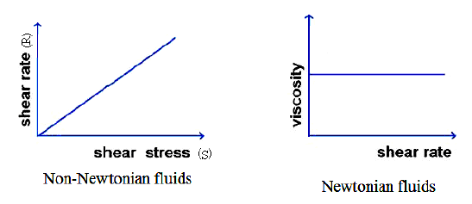
Many materials also exhibit hysteresis, where by the coefficient of viscosity at a particular shear rate depends upon whether the shear rate is being decreased or increased. The cream, concentrated milks, butter and cheese exhibit varying degree of non-Newtonian behaviour.
Fig 1 shows the relationship between shear stress S and shear rate R and the fluid's viscosity at a varying shear rate R. At a given temperature the viscosity of a Newtonian fluid remains constant regardless of which viscometer model, spindle or speed is used to measure it.
Fig 1: Relationship between shear stress (S) and shear rate (R)

Slide 23
Apparent viscosity
It is the viscosity of a fluid measured at a given shear rate at a fixed temperature. In order for a viscosity measurement to be meaningful, the shear rate must be stated or defined. This type of viscosity is ordinarily met in concentrated fluid milk products particularly in ice cream mix. It refers to a thickened condition of the product which can be dispelled by agitation. It results from the formation of gel structure in the medium.
Plasticity
The property exhibited by a complex, non-newtonian fluid in which the shear force is not proportional to the shear rate. This property is ordinarily differentiated from viscosity on the basis of the force necessary to cause flow. Liquids of substantial fluidity start to flow and continue to do so by driving force of their own weight.
However, certain relatively non fluid substances will only start to flow after application of initial external pressure. These substances are said to exhibit plastic flow.

Slide 24
Stoke's Law
When small spherical bodies move through a viscous medium, the bodies drag the layers of the medium that are in contact with them. This dragging results in relative motion between different layers, which are away from the body. Therefore, a viscous drag comes into play, opposing the motion of the body. It is found that this backward force or viscous drag increases with increase in velocity of the body.
According to Stoke, the viscous drag 'f ', depends on the coefficient of viscosity 'η' of the medium, the velocity (v) of the body and radius (r) of the spherical body
f α η v r
f = k η v r
Where k is found to be 6π

Slide 25
Viscosity of milk
The viscosity of a substance refers to, its resistance of flow. It is a measure of the friction between molecules as they slide past one another. The viscosity of a heterogeneous substance such as milk at a given temperature depends upon its composition and the physica1 state of its colloidally dispersed substances, including milk fat. The viscosity of fluids is influenced by various factors and knowledge of which is of immense value in understanding the behaviour of these fluids during processing.
Factors Influencing the Viscosity of Milk
Viscosity of milk and milk products is important in determining the flowing rate of cream, rates of mass and heat transfer, the flow conditions in dairy processes. Milk and skim milk, excepting cooled raw milk, exhibit Newtonian behaviour in which the viscosity is independent of the rate of shear. The viscosity of these products depends on the temperature and pH. An increase or decrease in pH of milk also causes an increase in casein micelle voluminosity.
Important factors that influence the viscosity of milk are as follows:
1. State and concentration of protein
2. State and concentration of fat
3. Temperature of milk
4. Age of the milk

Slide 26
State and concentration of the protein
The viscosity of colloidal systems depends upon the volume occupied by the colloidal particles. Changes in the caseinate micelles produced by either raising or lowering the pH results in increased viscosity. The viscosity is approximately doubled by the addition of 10 ml of 1.4 to 3.8 N ammonia to 90 ml milk. Addition of alkali (pH up to 11.7), urea (up to 4.8 M) and calcium complexing agents to concentrated (22.7% solids) skim milk causes a marked transient increase of several folds in viscosity followed by a sharp decline. This is due to the swelling of the micelles followed by their disintegration.
State and concentration of fat
Viscosity increases with increasing concentration of fat and solids-not -fat, but consistent general relationship could not be established
Temperature
The viscosity of milk and dairy products depends up on the temperature and on the amount and state of dispersion of the solid components. Cooling temperature increase viscosity due to the increased voluminosity of casein micelle and temperatures above 65°C increase viscosity due to the denaturation of whey proteins

Slide 27
Cooled raw milk and cream exhibit non-Newtonian behaviour in which the viscosity is dependent on the shear rate. Agitation may cause partial coalescence of the fat globules (partial churning) which increases viscosity. Fat globules that have under gone cold agglutination may be dispersed due to agitation, causing a decrease in viscosity.
The viscosity of milk and other products at 20 ºC is given in the Table 1
Table 1: Viscosity of whey and various types of milk
Type of milk | Viscosity
Whey | 1.2
Skim milk | 1.5
Whole milk | 2.0
From these values it is evident that the caseinate micelles and the fat globules are the most important contributors to the viscosity.

Slide 28
Determination of Viscosity
The unit of viscosity is poise. It is defined as the force required to maintain a relative velocity of 1cm/sec between two parallel planes placed 1 cm apart. The unit commonly used for milk is centi poise (10-2 poise)
A useful quantity in fluid flow calculations is the kinematics viscosity or viscosity/density.
In dealing with the solutions and colloidal dispersion the following quantities are often used.
Relative viscosity: η_{rel} = η_{soln} / η_{solv}
Specific viscosity: η_{sp} = η_{rel} - 1
Reduced viscosity : η_{red} = η_{sp}C where c is the concentration of the solute
Intrinsic Viscosity: [ η]= lim (η_{sp}/ C) as c goes to zero
Types of viscometers
Three types of viscometers that are used for determination of viscosities of dairy products are
Coaxial cylinders: e.g. Mc Michaecouetter and Brookfield
Falling sphere e.g. Hoeppler
Capillary tubes e.g. Ostwalds, McKennell
Falling sphere and capillary tube viscometers are not suitable for measurements of non-
Newtonian fluids because of the correction for non uniform shear rates. These methods are not only tedious but the results obtained are not accurate. A Mobil meter, which has some features of both the coaxial cylinder and falling sphere viscometers, has been used to measure viscosities of evaporated milk. A sealed micro viscometer of the falling sphere type in which the specimen can be sterilized has been proposed for studies of changes occurring in sterilization of concentrated milk products.

Slide 29
Refractive index
Refractive index also called index of refraction is the measure of the bending of a ray of light when passing from one medium into another. If i is the angle of incidence of a ray in vacuum (angle between the incoming ray and the perpendicular to the surface of a medium, called the normal), and r is the angle of refraction (angle between the ray in the medium and the normal), the refractive index n is defined as the ratio of the sine of the angle of incidence to the sine of the angle of refraction;
i.e., n = sin i / sin r. Refractive index is also equal to the velocity c of light of a given wavelength in empty space divided by its velocity v in a substance, or n = c/v. Measurement of this bending gives a direct measure of refractive index, n = sin i / sin r . Where ‘i’ is the angle of the ray to the surface as it approaches (incidence) and ‘r’ is the exit angle (refraction). Since the refractive index varies with the sample temperature and the wave length of the light these must be critically controlled and specified. Thus n20D refers to the index at 20 °C with D line of the sodium spectrum (589.0 and 589.6nm). The refractive index of water is n20D =1.33299, the value of n20D for cow’s milk generally falls in the range of 1.3440 to 1.3485. Buffalo milk is similar to that of cow’s milk while human, goat, and ewe milk appear to have higher refractive index values. Since refractive index increments contributed by each solute in a solution are additive, much consideration has been given to the possible use of refractive index as a means of determining total solids or added water in milk. The refractive index of milk itself is somewhat difficult to determine because of the opacity but by using a refractometer such as Abbe’s instrument which employs a thin layer of sample, it is possible to make satisfactory measurement particularly of skim milk products and sweetened condensed milk.

Slide 30
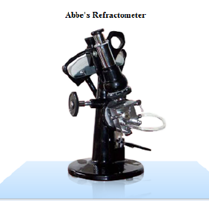

Slide 31
The relation between solids content (on the basis of weight per unit volume) and refractive index is linear and the contributions of the several components are additive.
The individual components of milk differ in specific refractive increment Δn(ρc) where
‘ρ’ is the density of the sample and ‘c’ is the weight /weight concentration specific refractive increment 'n') of the component. Thus the relation between percent solids and refractive index will vary between lot of milk. Studies by the researches have revealed the following specific refractive increments (mn g-1).
Casein complex 0.207
Soluble proteins 0.187 and lactose 0.140
The total contribution to the refractive index for milk containing 2.34% casein complex, 0.83% serum proteins, and 4.83% lactose becomes 0.00500 +0.00159 + 0.00695 or 0.01354. The residue 0.95% contributes 0.00166 to the total difference between the refractive indices of water and the milk. The refractive index of milk fat is 1.4537 to 1.4578 at 40°C. Fat does not contribute to the refractive index of whole milk because refraction occurs at the interface of air and the continuous phase. Sterilization and storage does not alter the refractive index.

Slide 32
Colloid
Introduction:
About 87% of milk is water, in which the other constituents are distributed in various forms.
Milk has various components in the form of emulsions, colloids, molecular and ionic solutions.
Lactose in milk is present in form of true solution and milk fat as an emulsion whereas milk proteins are dispersed as a colloid.
Definition of colloid:
A colloid is a substance microscopically dispersed evenly throughout another substance or a colloid system is one in which a substance is distributed throughout another substance in the form of finely divided particles. These systems are known as disperse systems or dispersions. They usually consist of at least two phases; a dispersed phase (or internal phase) and a continuous phase (or dispersion medium).
Definition of dispersed phase and dispersion medium:
The dispersed phase consists of the suspended particles and dispersion medium surrounding the suspended particles.

Slide 33
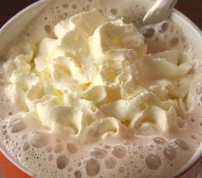
Classification of colloid
Based on the affinity of dispersed molecules with dispersing media colloid can be classified into two groups.
Lyophilic colloid
Lyophobic colloid
Definition of Lyophilic colloid: If the affinity on dispersion medium is more it is lyophillic or reversible sol. Lyophilic colloidal systems with aqueous continuous phase are known as hydrophilic.
Definition of Lyophobic colloid: If the affinity on dispersion medium is less it is lyophobic or irreversible sol. The lyophobic systems with aqueous dispersion medium are known as hydrophobic.

Slide 34
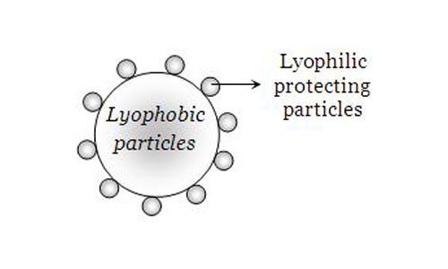
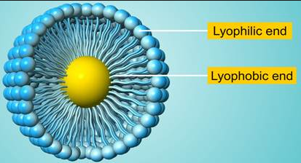
Differences between the lyophylic and lyophobic colloids
Characteristics | LYOPHYLIC | LYOPHOBIC
Physical state | Reversible | Irreversible
Method of preparation | Can be prepared by simple methods of mixing | Needs special methods for preparation
Stability | More solvated because of which it is more stable | Not solvated hence less stable
Viscosity | Viscosity is more for sol than for dispersion medium | Viscosity of sol is similar to dispersion medium
Surface Tension | Surface tension is less than dispersion medium | Surface tension of colloid sol is same for dispersion medium
Tyndall effect | Exhibit weak tyndall effect | Exhibit strong tyndall effect

Slide 35
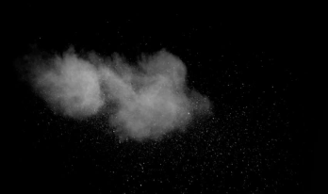


Classification of colloids on the basis of the physical state of dispersed phase and dispersion medium
Dispersed phase | Dispersion medium | Name | Examples
Solid | Gas | Solid aerosol | Smoke dust, cloud
Solid | Liquid | Sol | Paints, blood
Solid | Solid | Solid sol | Coloured gem stones
Liquid | Solid | Gel | Jelly, Gelatin
Liquid | Liquid | Emulsion | Milk, hair cream
Liquid | Gas | Liquid Aerosol | Fog, mist
Gas | Solid | Solid sol | Pumice stone, foam rubber
Gas | Liquid | Foam | Whipped cream froth

Slide 36
Difference between true solution and colloidal solution
Property | True solution | Colloidal solution
Particle size | Less than 10 - 7 cm | Between 10 - 5 and 10 - 7 cm
Visibility of particles | Invisible to naked eye and even not under powerful microscope | Invisible to naked eye. Visible under powerful microscope
Sedimentation of particles | Do not settle down | Settle down under high centrifugation
Filtration through filter paper | No residue is formed | Residue is formed
True solution: A true solution is a homogeneous solution in which the solute particles have diameters less than 10-7cm. i.e., the solute particles are of molecular dimensions. The particles are invisible even under powerful microscopes.
The colloidal particles were observed to be in constant motion in a zig zag path in all possible directions. This motion is known a Brownian motion. It arises because of the impact of solvent molecules on the colloidal particles. The forces are unequal from different directions.

Slide 37
Properties of colloidal system
The colloidal system will have two phases one is a dispersed phase and a dispersion medium. The state of aggregation of the dispersed phase and the intensity of its interaction with the dispersion medium determines many fundamental characteristics of the colloid system.
Lyophillic colloids have a strong attraction for the molecules of dispersion medium and thus binding large number of them into so called solvent shells.
In lyophobic colloids the particles do not interact so strongly with the molecules of the surrounding medium
Lyophobic colloids are heterogeneous and are highly disperse colloidal systems
Lyophillic colloids are in fact true solutions which mean that molecular species disperse homogenous in the system and not colloids.
The great difference in the size of the solvent and solute particles and to the structure of these particles However to the large size of the molecules solutions of such substances are in many respects similar to colloid system

Slide 38
Milk as a colloidal solution
Chemical definition of milk:
Milk is a chemical substance which consists milk protein in colloidal form, milk fat in emulsion form and lactose and some minerals in true solution.
Stability of the colloidal system in milk:
The stability of a colloidal system is the capability of the system to remain as it. Stability is hindered by aggregation and by sedimentation phenomena that determine phase separation.
If the hydrophobic colloid particles are fluid (fat globules at normal temp and air bubbles) which may coalesce with each other if the thin film of continuous phase between closely approaching globules or bubbles is ruptured.
Two colloidal particles of equal composition always attract each other because of van der Waals forces. If the attraction energy is not too strong the Brownian motion will be sufficient to keep the particle apart and maintain the colloidal stability
There will also be repulsion due to hydration on close contact of individual molecular chains when the protruding chains are hydrophilic. This is important for the stability of fat globules

Slide 39
De- stabilization of the colloidal system in milk
Disintegration of the colloid system could be by two processes namely sedimentation and coagulation
Sedimentation: The dispersed phase may either settle out or raise to the surface of the system depending upon the difference in densities between the dispersed particles and the dispersion medium and is known as sedimentation
Coagulation: The dispersed particles adhere to one another or coalesce increase in size. This process is called coagulation. Under definite conditions coagulation can proceed spontaneously since it is accompanied by decrease in surface
The determination of kinetic stability and aggregate stability will help in characterizing the stability of colloidal system with respect to sedimentation process and to change in particle size (coagulation)

Slide 40
Emulsion
Definition:
An 'emulsion' is a system in which the dispersion medium and dispersed phase are liquids. For an emulsion to be stable, the two liquids must practically be insoluble in each other or only slightly soluble. One liquid (the dispersed phase) is dispersed in the other (the continuous phase). Example: butter and margarine, milk and cream
Water-in-oil emulsion (W/O) : fat surrounds droplets of water. Example- butter and margarine.
Oil-in water emulsion (O/W) : water surrounds droplets of fat. Example-milk, cream, mayonnaise, ice cream, salad dressing.
Emulsification: Emulsification is the process by which emulsions are prepared.
Addition of emulsifying agents will reduce the inter facial tension by being adsorbed on the inter phase. Due to the stabilizing effect of these emulsifiers, substances with much larger size than that of ordinary colloids can also be stabilized.

Slide 41
Factors influencing the properties of emulsion:
The continuous phase
Temperature
Average droplet size
Distribution of the droplets
Volume fraction of the oil dispersed in water
The oil that is dispersed
Various additives which help in the stability of the emulsion

Slide 42
Colligative properties
Definition
Colligative properties are properties of solutions that depend on the number of molecules in a given amount of solvent and not on the properties/identity (e.g. size or mass) of the molecules or those properties of solutions that depend on the number of dissolved particles in solution, but not on the identities of the solutes.
The four commonly studied colligative properties are
1. Freezing point
2. Boiling point
3. Vapour pressure
4. Osmotic pressure.
Since these properties yield information on the number of solute particles in solution, one can use them to obtain the molecular weight of the solute.

Slide 43
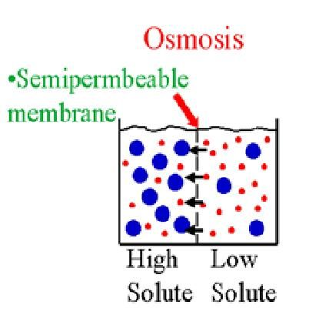
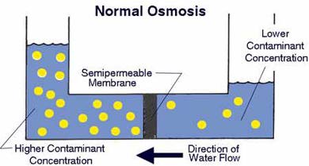
Osmotic Pressure
Definition:
Osmosis is the movement of solvent molecules through a selectively permeable membrane into a region of higher solute concentration, aiming to equalize the solute concentrations on the two sides.

Slide 44
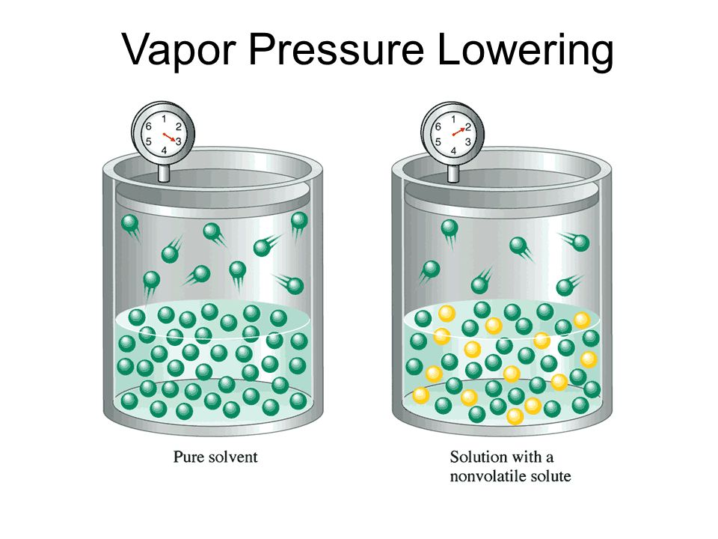
Raoult's Law
The French chemist Francois Henricus Raoult discovered a law to determine the vapour pressure of a solution when a solute has been added to it. Raoult’s law states that the vapour pressure of an ideal solution is dependent on the vapour pressure of each chemical component and the mole fraction of the component present in the solution.
Vapour Pressure:
When a non-volatile solute is added to a liquid to form a solution, the vapour pressure above that solution decreases.
Liquid molecules at the surface of a liquid can escape to the gas phase when they have a sufficient amount of energy to break free of the liquid's intermolecular forces. That vaporization process is reversible. Gaseous molecules coming into contact with the surface of a liquid can be trapped by intermolecular forces in the liquid. Eventually the rate of escape will equal the rate of capture to establish a constant, equilibrium vapour pressure above the pure liquid.

Slide 45
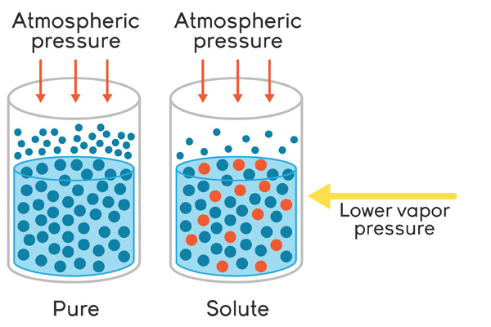
Vapour pressure
If we add a non-volatile solute to that liquid, the amount of surface area available for the escaping solvent molecules is reduced because some of that area is occupied by solute particles. Therefore, the solvent molecules will have a lower probability to escape the solution than the pure solvent. That fact is reflected in the lower vapour pressure for a solution relative to the pure solvent. That statement is only true if the solvent is non-volatile. If the solute has its own vapour pressure, then the vapour pressure of the solution may be greater than the vapour pressure of the solvent.

Slide 46
Raoult's law
The law that mathematically describes the vapour pressure lowering phenomenon.
Raoult's law is given in:
P = Csolvent Po
Where, P - vapour pressure of a solution
Csolvent - Vapour pressure of the solvent above a solution
Po - vapour pressure of the pure solvent
Raoult's law states that the vapour pressure of a solution (P), equals the mole fraction of the solvent (Csolvent), multiplied by the vapour pressure of the pure solvent (Po). While that "law" is approximately obeyed by most solutions, some show deviations from the expected behaviour. Deviations from Raoult's law can either be positive or negative. A positive deviation means that there is a higher than expected vapour pressure above the solution. A negative deviation, conversely, means that we find a lower than expected vapour pressure for the solution.
Solutions that obey Raoult's law are called ideal solutions because they behave exactly as we would predict. Solutions that show a deviation from Raoult's law are called non-ideal solutions because they deviate from the expected behaviour. Very few solutions actually approach ideality, but Raoult's law for the ideal solution is a good enough approximation for the non- ideal solutions that we will continue to use Raoult's law.

Slide 47
Boiling Point
Definition:
Boiling point of a solution is the temperature at which the vapour pressure of the liquid equals to the external (Atmospheric) pressure.
The water content in fluid milk is highest and hence the boiling point of milk will be close to that of water. But being a collegative property it is influenced by the dissolved substances like lactose, minerals etc. and hence it is slightly higher than that of water.
Since the vapour pressure of a solution is always less than the vapour pressure of the pure solvent it follows that the boiling point of a solution will always be higher than that of the pure solvent.
Pure water boils at 100 º C. Milk constituents are responsible for the elevation of the boiling point of milk.
Addition of water lowers the concentration of dissolved substances responsible for the elevating the boiling points. As such adulterated milk with water boils at a lower temperature than the normal milk. The boiling point of normal milk is 100.15º C.

Slide 48
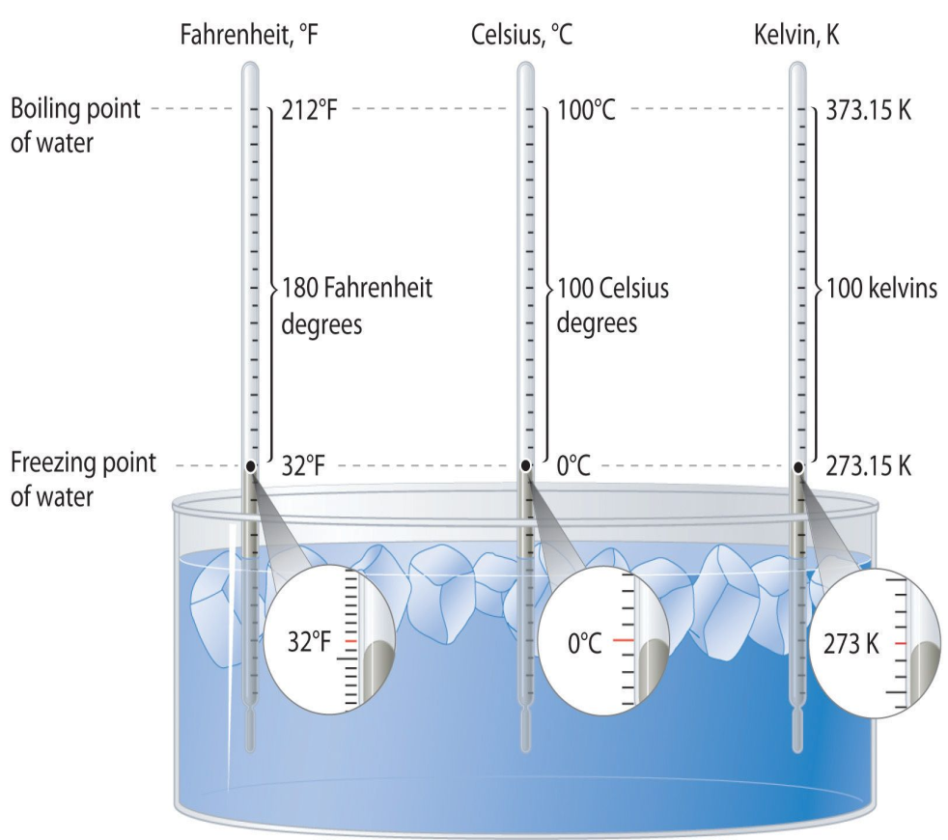
Freezing point
Definition:
Freezing point of a substance is defined as the temperature at which its solid form and its liquid form can exist in equilibrium with each other. In other words it is the temperature in which they have the same vapour pressure.
The depression of freezing point of a solvent by a dissolved solute is proportional to the concentration of the dissolved substance.
Roults law:
T_{r} = K_{f}Cm
Where, K_{f}= Molar depression constant
Tr = depression of freezing point for
solution
Cm = molar concentration of solute.
The freezing point depression of milk is very constant. Since it is proportional to its osmotic pressure, which is essentially equal to the blood, which in turn is kept almost constant. Generally freezing point of milk ranges between -0.530 to – 0.570ºC.

Slide 49
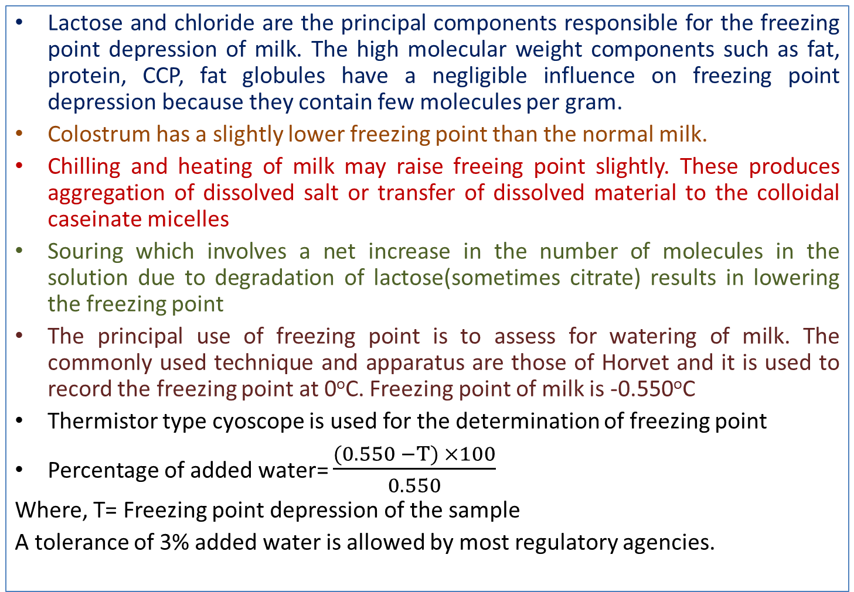
Factors affecting the freezing point
Lactose and chloride are the principal components responsible for the freezing point depression of milk. The high molecular weight components such as fat, protein, CCP, fat globules have a negligible influence on freezing point depression because they contain few molecules per gram.
Colostrum has a slightly lower freezing point than the normal milk.
Chilling and heating of milk may raise freeing point slightly. These produces aggregation of dissolved salt or transfer of dissolved material to the colloidal caseinate micelles
Souring which involves a net increase in the number of molecules in the solution due to degradation of lactose(sometimes citrate) results in lowering the freezing point
The principal use of freezing point is to assess for watering of milk. The commonly used technique and apparatus are those of Horvet and it is used to record the freezing point at 0ºC. Freezing point of milk is -0.550ºC
Thermistor type cyoscope is used for the determination of freezing point
Percentage of added water= $\frac{(0.550 −T) ×100}{0.550}$
Where, T= Freezing point depression of the sample
A tolerance of 3% added water is allowed by most regulatory agencies.

Slide 50
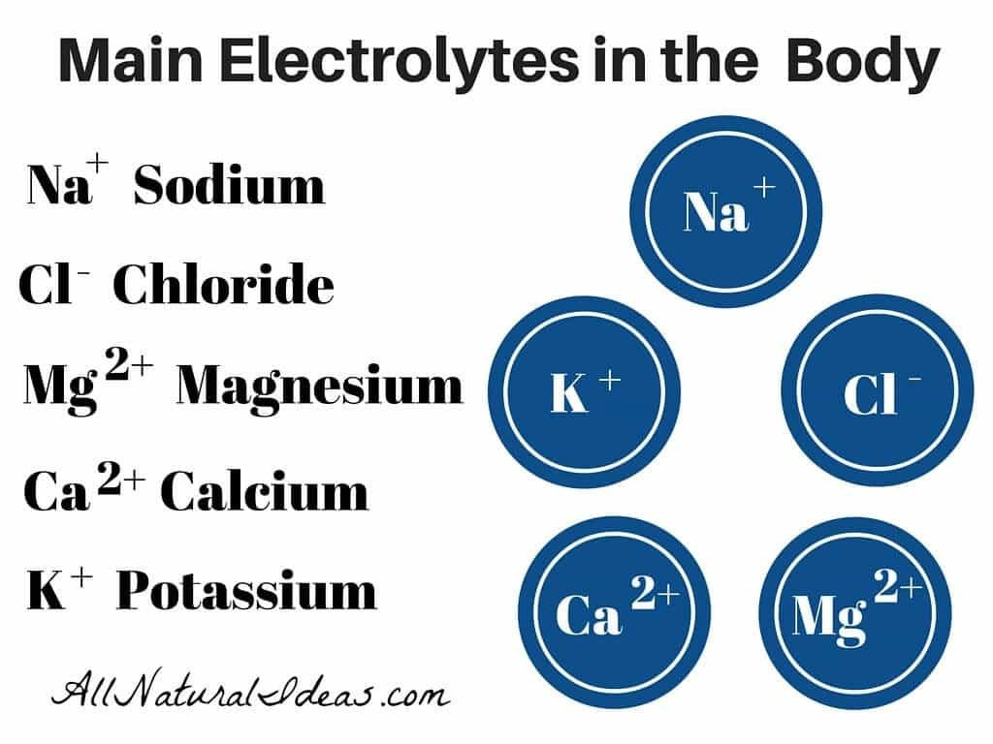
ELECTROLYTES AND NON ELECTROLYTES, IONIC MOBILITY
Electrolyte:
Substances which cause increase in electrical conductivity in solutions and which dissociate in the process of conducting the electric current are known as electrolytes. In other words, electrolyte is an electrical conductor in which current is carried by ions rather than by free electrons (as in a metal).
Non electrolyte:
A non-electrolyte, however, is a compound composed of molecules that does not conduct electricity when molten or in aqueous solutions. If the substances which give the expected result to osmotic pressure, freezing point and boiling point but do not significantly increase the electrical conductivity such substances are known as non electrolytes.

Slide 51
Electrical conductance
Definition:
Electrical conductance is the measure of a material’s ability to allow the transport of an electrical charge.
Units:
seimens/meter
Micromho/cm or mmho/cm
Electrical conductance is an electrical phenomena where a material contains movable particles with electric charge (such as electron) which can carry electricity. When a difference of electrical potential is placed across a conductor, its electrons flow, and an electric current appears.
The instrument used for measurement of electrical conductance is known as conductivity meter.

Slide 52
Ionic Equilibria
Definition:
Ionic equilibria is a state of a substances that undergo ionization easily, or in polar substances in which ionization can be induced.
Ionic and polar substances are more easily soluble in polar solvents because of the ease of ionization taking place in the solvent medium.
With the dissolution of ionic and polar substances in the solvent, these solutions become rich in mobile charge carriers (ions) and thus can conduct electricity.
Substances, which are capable of conducting electricity, are called as electrolytes while those substances which are non-conducting are called as non-electrolytes.
In a water molecule the electrons are shared unevenly between the oxygen & hydrogen making it a polar molecule. Because of this water molecules have a partial negative charge on oxygen, and a partial positive charge on hydrogen. Accordingly the water molecules can form strong electrostatic attractions with other water molecules, polar molecules and ions.

Slide 53
pH and its scales
pH Scale:
When water molecule dissociates and attains ionic equilibrium the concentration of both [H+] and [OH-] ions will be equal. Increase of either H+ or OH- would result in the imbalance of the equation. As such this phenomenon is used to measure the acidic or alkaline condition of the solution. This is referred as pH scale.
Definition of pH:
The pH is a quantity characterizing the activity (or concentration) of hydrogen ions and is numerically equal to the negative common logarithm of the activity or concentration expressed in g-ions/l.
The pH scale of acidity defines pH as the negative common logarithm of the concentration of H⁺
pH = - log [H⁺]

Slide 54
Example
Dissociation of water:
H2O ↔ H⁺ + OH⁻ ---------- 1
In non neutral media, the activities aH+ and an OH- are not equal to each other.
They are inversely proportional to each other. Thus on adding the acid to water we increase the concentration of hydrogen ions and therefore augment the value of aH+ but this will accelerate the opposite direction of reaction.
Some of the added hydrogen ions bind an equivalent amount of OH- to form H2O and a reduction in a OH- occurs.
Equilibrium is established again when the product of the ion activities once more acquires the value it had prior to the addition of the acid.
Hence any increase in hydrogen ion concentration causes a corresponding decrease in hydroxyl ion concentration and vice versa.

Slide 55
pOH
Definition:
pOH is defined as the negative common logarithm of the concentration of hydroxide ion (OH⁻)
pOH = -log [OH⁻ ]
In the pOH scale, 7 is neutral, less than 7 is basic and greater than 7 is acidic.
Relationship between pH and pOH,
pH + pOH = 14
This formula allows to readily convert the values of pH and pOH.
Because Kw is constant, the product of [H⁺] and [OH⁻] is always equal to 10-14.

Slide 56
pKa and pKb
The pH and pOH as values are used to describe the acidic or basic strength of solutions.
Whereas pKa (-log Ka) and pKb (-log Kb) are used as a measure of acidity and basicity, respectively, for standard acids and bases.
In Strong acid, pKa value is less than zero. Because it almost completely dissociates in water, which gives an aqueous solution a relatively low pH.
In Weak acid, pKa value is greater than zero. Because they only partially dissociate in water, to make solutions with larger pH's than those strong acids produce at the same concentration.
Similarly,
In strong base, pKb value is less than zero
In weak base, pKb value is greater than zero.
Note: The prefix "p" in front of a symbol means "take the negative log".

