Slide 1


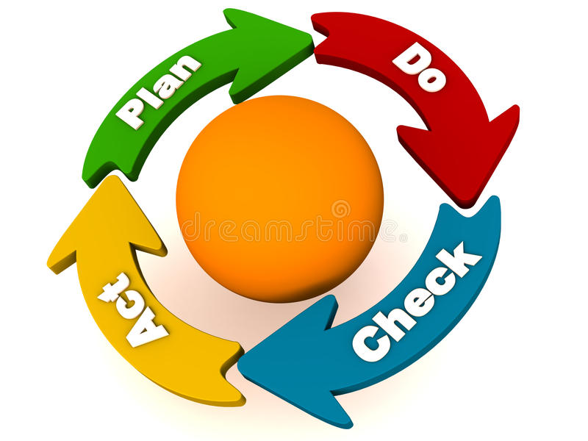
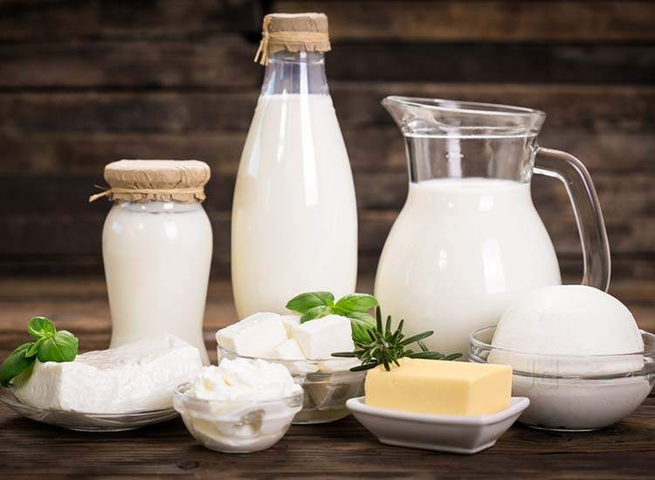
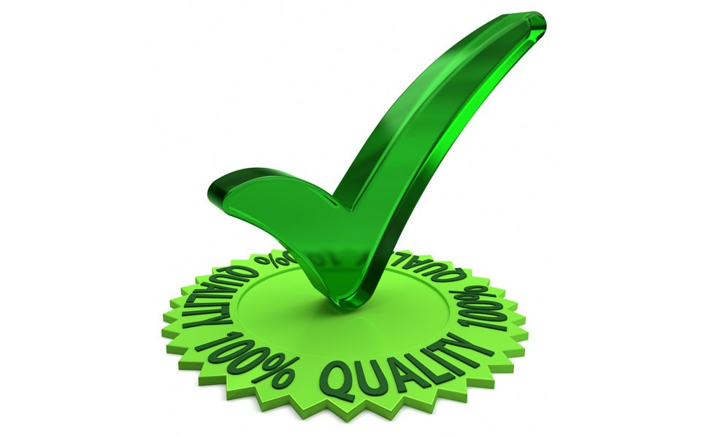
Importance of chemical quality control, quality assurance and total quality management in dairy industry
Soma Maji
Assistant Professor
Department of Dairy Technology

Slide 2
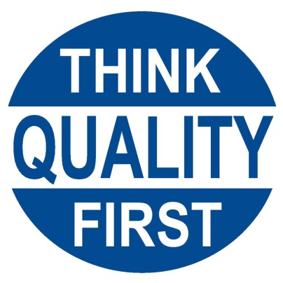
Why Quality for milk?
Milk group contributes highest to the total output of the agricultural sector
Rising liberalization of agro-industrial markets and the world-wide integration of food supply chains require new approaches and systems for assuring food safety.
New hazards and concerns
Increased consumer awareness
Stricter regulatory frame works
Hence, quality management tools like Hazard analysis and critical control points (HACCP), ISO 22000:2005 - Food Safety Management Systems, Six Sigma etc. are very much relevant in the present era of Globalization and aware consumers

Slide 3
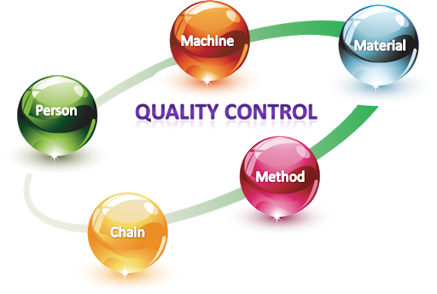
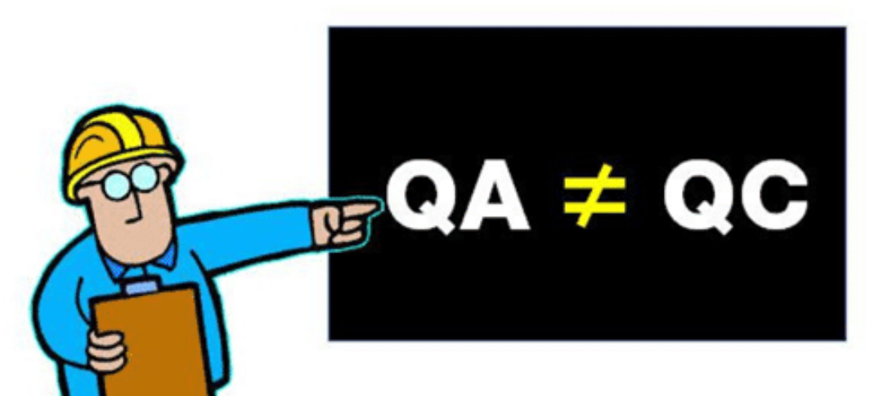
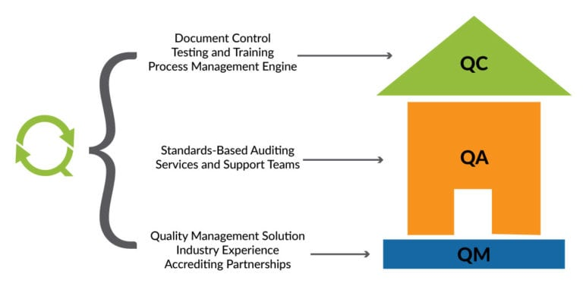
Three terms..
Quality control (QC)
Quality assurance (QA)
Total quality management (TQM)

Slide 4
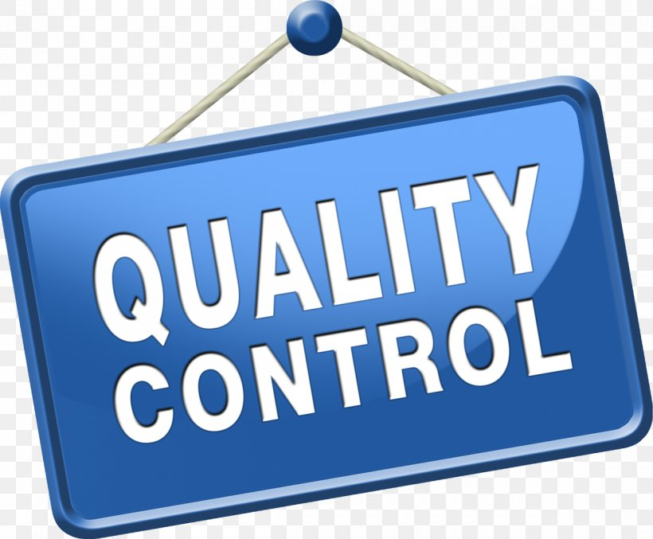
Quality control
Definition:
It is the set of activities used to ensure that the products and services meet / fulfil the requirements for quality.
Traditionally Q.C is a laboratory function only and is related to analysis of samples i.e. testing and judging of raw materials/ and finished products for acceptance or rejection.
Purpose & aim
To ensure that products are within the well defined and accepted standards thereby protecting the legal and health rights of consumers and financial interests of producers / manufacturers.
Limitations
Recall of products is more because products are tested in the last stage or as finished products. This ultimately wears the impact on reputation of the company.

Slide 5
Total quality control (TQC)
Quality cant not be achieved only by QC department
Coordination and cooperation of all functions needed
Market Research
R & D
Purchase (Sourcing)
Operations (Process)
Marketing
Sales
Quality Control
An integrated organizational approach to delight customers by meeting their expectations on a continuous basis through involvement of everyone in the organization.
It helps in minimizing rejection and rework.

Slide 6
Responsibilities of QC Department
Inspection of supplies and materials
Inspection of raw products
Scheduling of operations
Measurement of production efficiency
Measurement of equipment efficiency
Inspection of the finished product
Warehousing controls
Shipping and storage controls
Preparation of specifications and procedures in written handbook form
Preparation of statistical procedures and schedules
Sanitation inspections
Conformance to local and federal regulations
Waste disposal control

Slide 7
Quality Assurance (QA)
Definition:
It is the set of activities which ensures that the quality levels of products and services are properly maintained and that the supplier and customer quality issues are properly resolved.
Quality assurance gives adequate confidence that product or service will satisfy given requirements for quality.
Purpose/Aim
Internal purpose
Within an organization QA provides confidence to the management.
External purpose
Outside the organization provides confidence to consumers or others. Compared to QC, QA is much wider in the sense, it demands full control over the quality of raw materials, control over the process at different levels and control over distribution set up etc.
Notion is that “Prevention rather than Detection”. It is a proactive approach rather than a reactive approach.

Slide 8
Importance of Quality Assurance
To maintain legal standards and legal requirements
To fulfil customer’s requirement in terms of various attributes
Physical (body, texture, colour, etc.)
Chemical composition
Microbiological
Safety
Consumers should get what they pay for
This leads to increased consumer satisfaction and less complaints
To check adulteration in incoming material in order to prevent substandard product, hazards or problems in the process
To check efficiency of processes: heating, cooling, removing hardness from water, effluent treatment etc.
To safeguard nutritive value of milk and milk products
To check wastage of material
To help in research and developments
To ensure general cleanliness and sanitation in factory premises

Slide 9
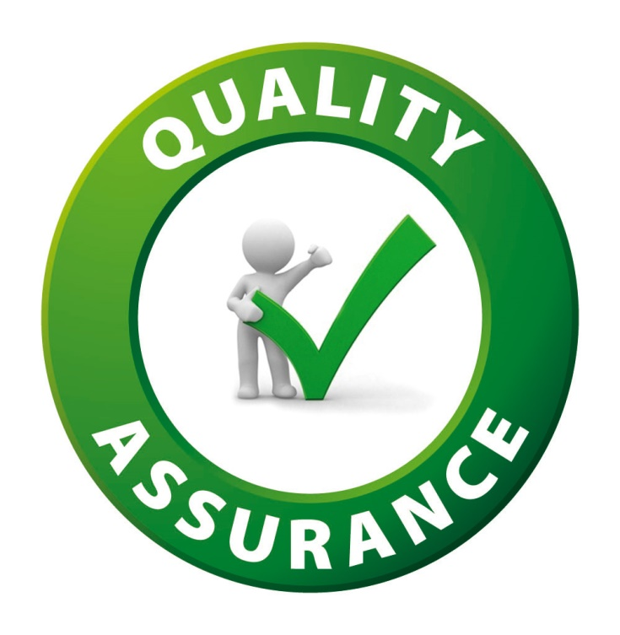
Benefits
Reduction in unit cost of production
Reduction in wastage and scrape
Less complaints from customer
Avoids repeated inspection
Increases production since rejection reduces
Efficiency of unit goes up
Management gets proud place in society
Boost employee’s morale

Slide 10
Roll of Quality Assurance Department
Sanitation- defines requirements for cleaning and sanitary activity and their monitoring
Sanitation standard operating procedure (SSOP)
Standard operating procedure (SOP)
Good manufacturing practices (GMP)
Foreign material control
Quality control- Chemical and Microbiological testing
Documentation control
Pest control
Hazardous material control
Allergen Protocol for controlling allergenic material
Record control- identification and maintenance
Calibration
Water quality and water treatment programmes
Sensory training and sensory evaluation
Supplier certification and on going supplier evaluations

Slide 11
Roll of Quality Assurance Department
16. Receiving, storage and control of raw ingredients and packaging material
17. Handling customer’s complaints
18. Labeling- application and control of labels
19. Preventive maintenance
20. Formalized management review process
21. Waste water (effluent treatment programme)
22. Training
23. Corrective/preventive action- root cause analysis and follow up evaluation to confirm effectiveness of action taken
24. Internal auditing

Slide 12
Difference between quality assurance and quality control
Quality Control | Quality Assurance
Product oriented | Process oriented
Reactive approach | Proactive approach
Corrective action | Preventive action
Focuses on testing for quality | Focuses on building in quality
Detects defects | Prevents defects
Meant for implementing the process developed by a team | Meant for developing and organizing the best quality process
Makes sure that the results of what you have done are what you expected | Makes sure that you are doing the right thing the right way

Slide 13
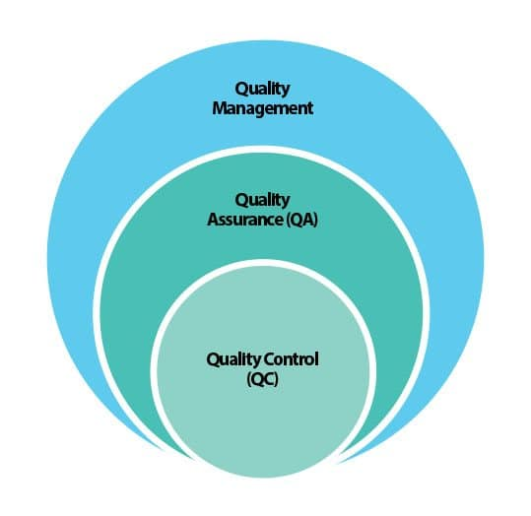
Total Quality Management (TQM)
Definition:
TQM may be defined as an integrated organizational approach in delighting customers by meeting their expectations on a continuous basis through everyone involved with the organization working on continuous improvement in all spheres namely-process, products and service along with proper problem solving methodology.
TQM is a journey- it is the path as well as the goal.

Slide 14
Basic principles of TQM
Be customer focused – place the customer at the centre of everything you do
Do it right first time and every time- quality first and always
Continuous improvement – by using the tool of PDCA in every aspect of work
Communicate and educate
1. Improve communication means tell the people what is going on
2. Educate- train the people and retain them
Measure and recorded
1. While finalizing the goals, the Quality indicators (measurements) should be finalized.
2. Record the measures as per prescribed documentation
3. It allows the company to make decisions based on facts, not opinion.
Do it together- introduce team working
1. Reduces conflict and in-fighting and increases trust and respect
2. Bitting problems with wider range of skill – therefore better and more balance solution

Slide 15
Elements of TQM and Integrated TQM Model
The TQM model has three major area
1. Total Employee Involvement (TEI)
Include- transformation, Kiazen (small improvement), Hoshin Kanri (Policy development), small group activity, etc.
2. Total Waste Elimination (TWE)
Include the concept of segregation, arrangement, cleanliness, maintenance or standard and discipline for everything (men and material) i.e. house Keeping.
Follow the principle of JIT (Just-In-Time), so minimum inventories are maintained.
3. Total Quality Control (TQC)
Include – SQC, PDCA cycle, HACCP, QSM (ISO-9000)

Slide 16
Benefits of TQM
For customers
Greater care
Value for money
Greater satisfaction
Better availability
Result in better customer loyalty.
For employees
Empowerment
More respect
More training and better skill
Appreciation and recognition
Work satisfaction
For company (organization)
Continuous improvement in quality
Better motivated work force
Defects are reduces
Reduction in cost
Increase in productivity
Faster solution of problems
Result in increased cash flow and net profit

Slide 17
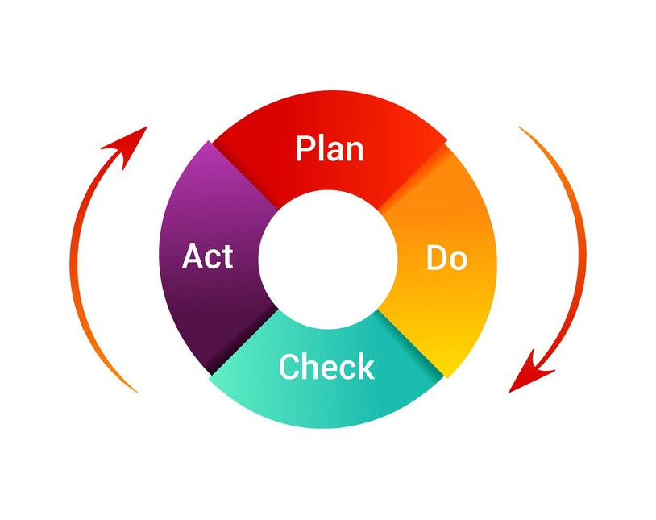
Related theory…
Deming’s Philosophy:
Adward Deming proposed his concept of quality assurance.
According to which, it involves both process monitoring and eliminating the causes of unsatisfactory performance at all stages.
It is the name given to entire cycle of activities through which the fitness for use of process, product or service is achieved, with a view to carry out a company’s quality function in accordance with the laid down quality objective and policies.
It has divided quality control into four activities i.e.
Plan
Do
Check and
Act.
Which is known as Deming’s PDCA cycle/wheel.

Slide 18
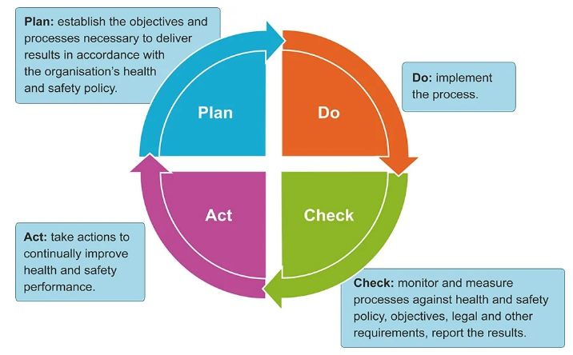

Slide 19
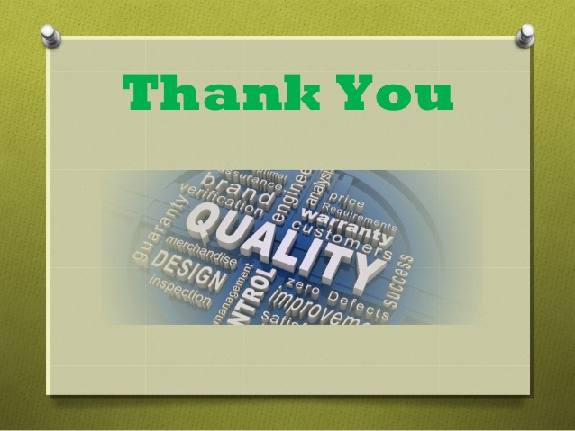

Slide 20
https://spark.adobe.com/page/W2OgjpcyCL1XS/

