Slide 1

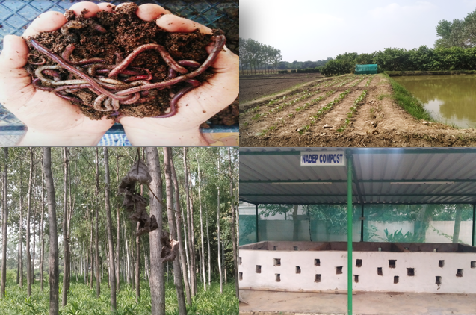
Center for Smart Agriculture
Organic Farming
Module 2: Preparation and application of organic inputs
Session 5: Mulching: Types, Advantage

Slide 2
Advantages of Mulching
Protecting the soil from wind and water erosion: soil particles cannot be washed or blown away.
▪ Improving the infiltration of rain and irrigation water by maintaining a good soil structure
▪ Keeping the soil moist by reducing evaporation
▪ Suppressing weed growth
▪ Preventing the soil from heating up too much
▪ Providing nutrients to the crops
▪ Increasing the content of soil organic matter: part of the mulch material will be trans-formed to humus.

Slide 3
Selection of Mulch Material:
The kind of material used for mulching will greatly influence its effect. Material which easily decomposes will protect the soil only for a rather short time but will provide nutrients to the crops while decomposing.
Hardy materials will decompose more slowly and therefore cover the soil for a longer time. If the decomposition of the mulch material should be accelerated, organic manures such as animal dung may be spread on top of the mulch, thus increasing the nitrogen content.
Where soil erosion is a problem, slowly decomposing mulch material (low nitrogen content, high C/N) will provide a long-term protection compared to quickly decomposing material

Slide 4
Sources of Mulching Material
▪ Weeds or cover crops.
▪ Crop residues.
▪ Grass
▪ Pruning material from trees
▪ Cuttings from hedges
▪ Wastes from agricultural processing or from forestry

Slide 5
Recommendations while using mulches
Some organisms can proliferate too much in the moist and protected conditions of the mulch layer. Slugs and snails can multiply very quickly under a mulch layer.
Ants or termites which may cause damage to the crops also may find ideal conditions for living.
When carbon rich materials such as straw or stalks are used for mulching, nitrogen from the soil may be used by microorganisms for decomposing the material. Thus, nitrogen may be temporary not available for plant growth. .
If the layer of mulch is not too thick, seeds or seedlings can be directly sown or planted in between the mulching material.

Slide 6
Thank you
Thank You

