Slide 1
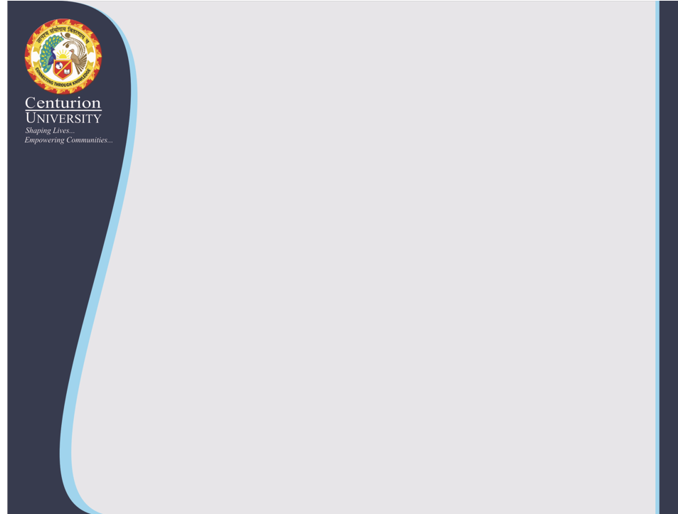
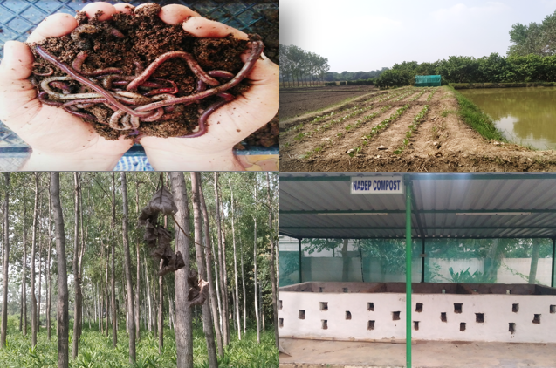
Center for Smart Agriculture
Organic Farming
Module 2: Preparation and application of organic inputs
Session 7: Preparation of vermicompost

Slide 2
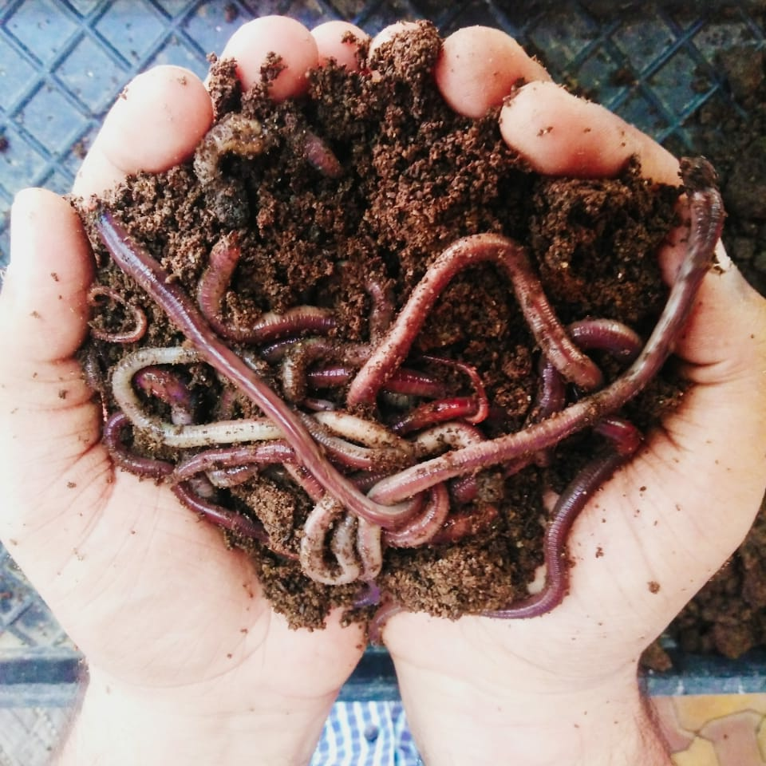
Vermiculture is the culture of earthworms. Vermicomposting is a method of preparing compost in which earthworms are used to convert organic materials (usually wastes) into a humus-like compost.
Earthworms consume biomass and excrete it in digested form called worm-casts. The casts are rich in nutrients, growth promoting substances, beneficial soil micro flora and having properties of inhibiting pathogenic microbes.

Slide 3
Earthworm species
There are nearly 3600 types of earthworms in the world and they are mainly divided into two types: (1) burrowing; and (2) non-burrowing. The burrowing types live deep in the soil. On the other hand, the non-burrowing typesconvert the organic waste into vermicompost faster. The earthworm species commonly used for vermicomposting are:
Eisenia foetida(Red earthworm)
Eudrilus eugeniae(African earthworm or night crawler)
Perionyx excavatus (Composting earthworm)

Slide 4
Procedure of vermicomposting
Preparation of organic wastes for vermicomposting
Breaking of large lumps
Cutting of bigger plant parts into smaller ones
Exposing to sun to reduce excess moisture content
Application of 4% aqueous solution of neem pesticides to kill insects, if any
Treatment with lime dust to reduce pH
Half decomposition of these materials is done by heaping the above mixture with sufficient moisture content for 21 days.
(Contd…)

Slide 5
B. Preparation of vermi bed
Vermi bed is prepared by putting pebbles, sand and loamy soil one above the other is having 2 inches of thickness each at the bottom of the unit. Alternatively coir or any plant refuse which does not decompose easily can also be used. This should be watered followed by putting well decomposed FYM of 4 inches thickness over it.
(Contd..)

Slide 6
C. Putting the substrates and composting
Above the layer of FYM the half decomposed materials are to be kept to fill up the pit. Then the worms are released.
When there are more number of pits, half decomposition can be done in some of them in which different materials can be put in layers till the pit is filled up and worms are to be released after the thermophillic stage of half decomposition is over.
For a 2m X 1m X 0.6m (= 1.2 m³) tank 2 kg earthworms (2000 to 2500) are to be released.
The number worms may be doubled when they are available in more quantities and compost is necessary to prepare within a month instead of normal time of 2 months.
After filling up of the unit, it is to be covered preferably with an old wet gunny bag to reduce loss of moisture and encourage the activities of the worms at the surface.
Intermediately the unit is to be watered to maintain moisture content of 40-50%.

Slide 7
D. Harvesting and post-harvest technologies
Harvesting of vermicompost is done when the compost looks dark brown and soft.
The compost is piled for 3-4 hours so that the worms go down and form a ball which can be separated for further use or selling the worms at premium price.
After separation of worm balls, the compost should be dried under shed for reducing its moisture content to around 30%.
The compost is passed through a sieve of 2-3 mm diameter so that the earthworm cocoons and the undecomposed materials could be separated for further use.
Packaging and labelling can be done to attract the consumers for commercial production and at farmers’ level it can be kept in gunny bags.
After completion of the process, the vermicompost should be removed from the bed at regular intervals and replaced by fresh partially decomposed organic materials.

Slide 8
E. Precautions during the process
The following precautions should be taken during vermicomposting:
The floor of the unit should be compact to prevent migration of earthworms into the soil.
Only plant-based materials such as grass, leaves or vegetable peelings should be utilized in preparing vermicompost.
Materials of animal origin such as eggshells, meat, bone, etc are not suitable for preparing vermicompost.
Gliricidia loppings and tobacco leaves are not suitable for rearing earthworms.
The organic wastes should be free from plastics, chemicals, pesticides and metals etc.
15-20 days old cow dung should be used to avoid excess heat.
The earthworms should be protected against birds, termites, ants and rats.
Adequate moisture should be maintained during the process. Optimum moisture level (30-40 %) and 18-25ºC temperature should be maintained.

Slide 9
Thank You

