Slide 1

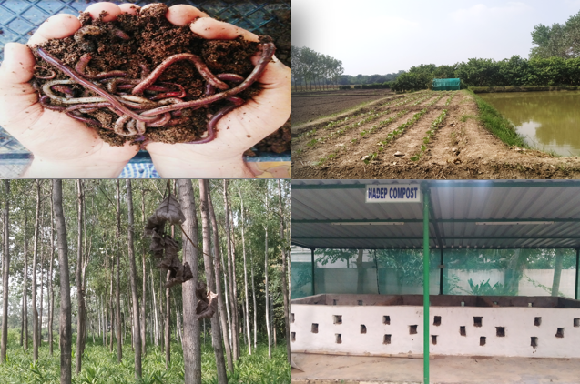
Center for Smart Agriculture
Organic Farming
Module 2: Preparation and application of organic inputs
Session 9: NADEP composting

Slide 2
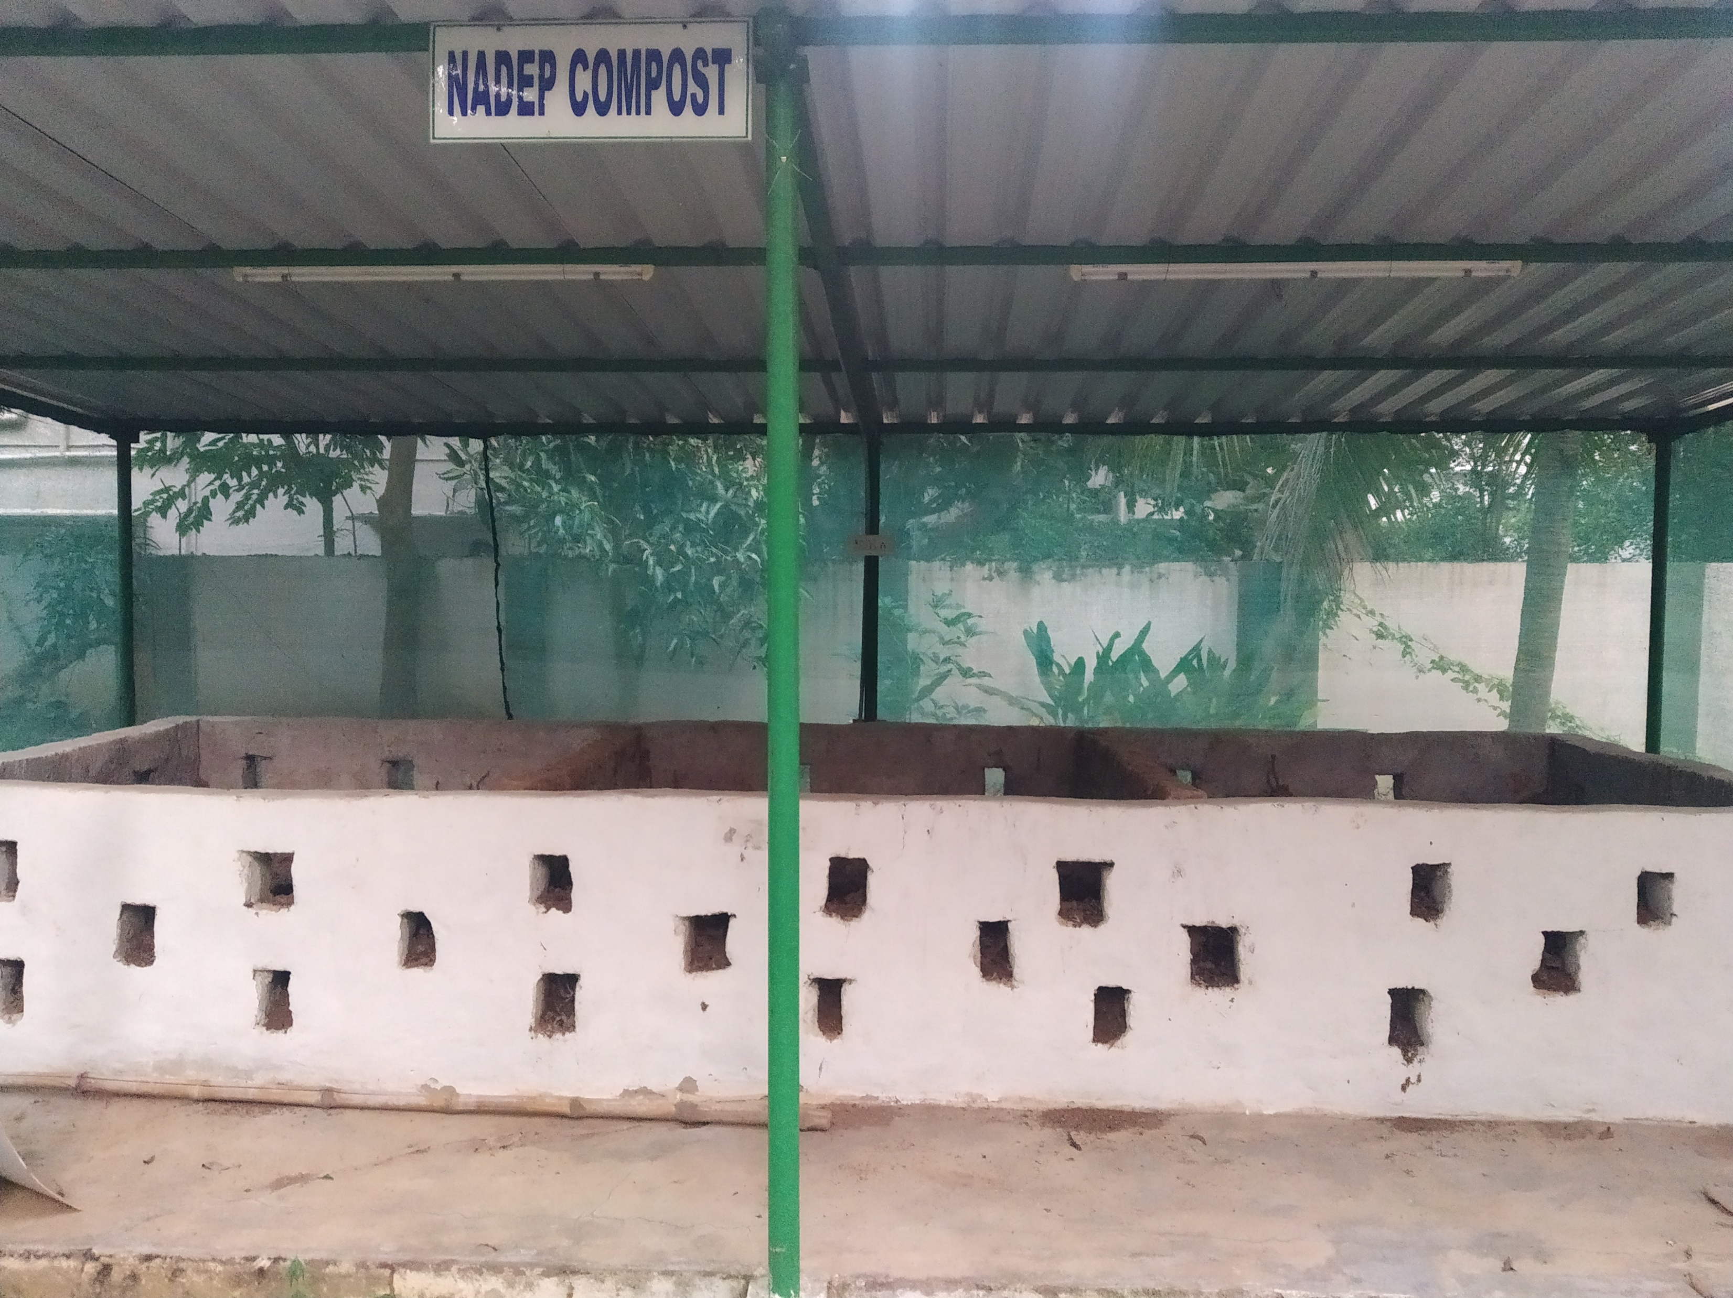
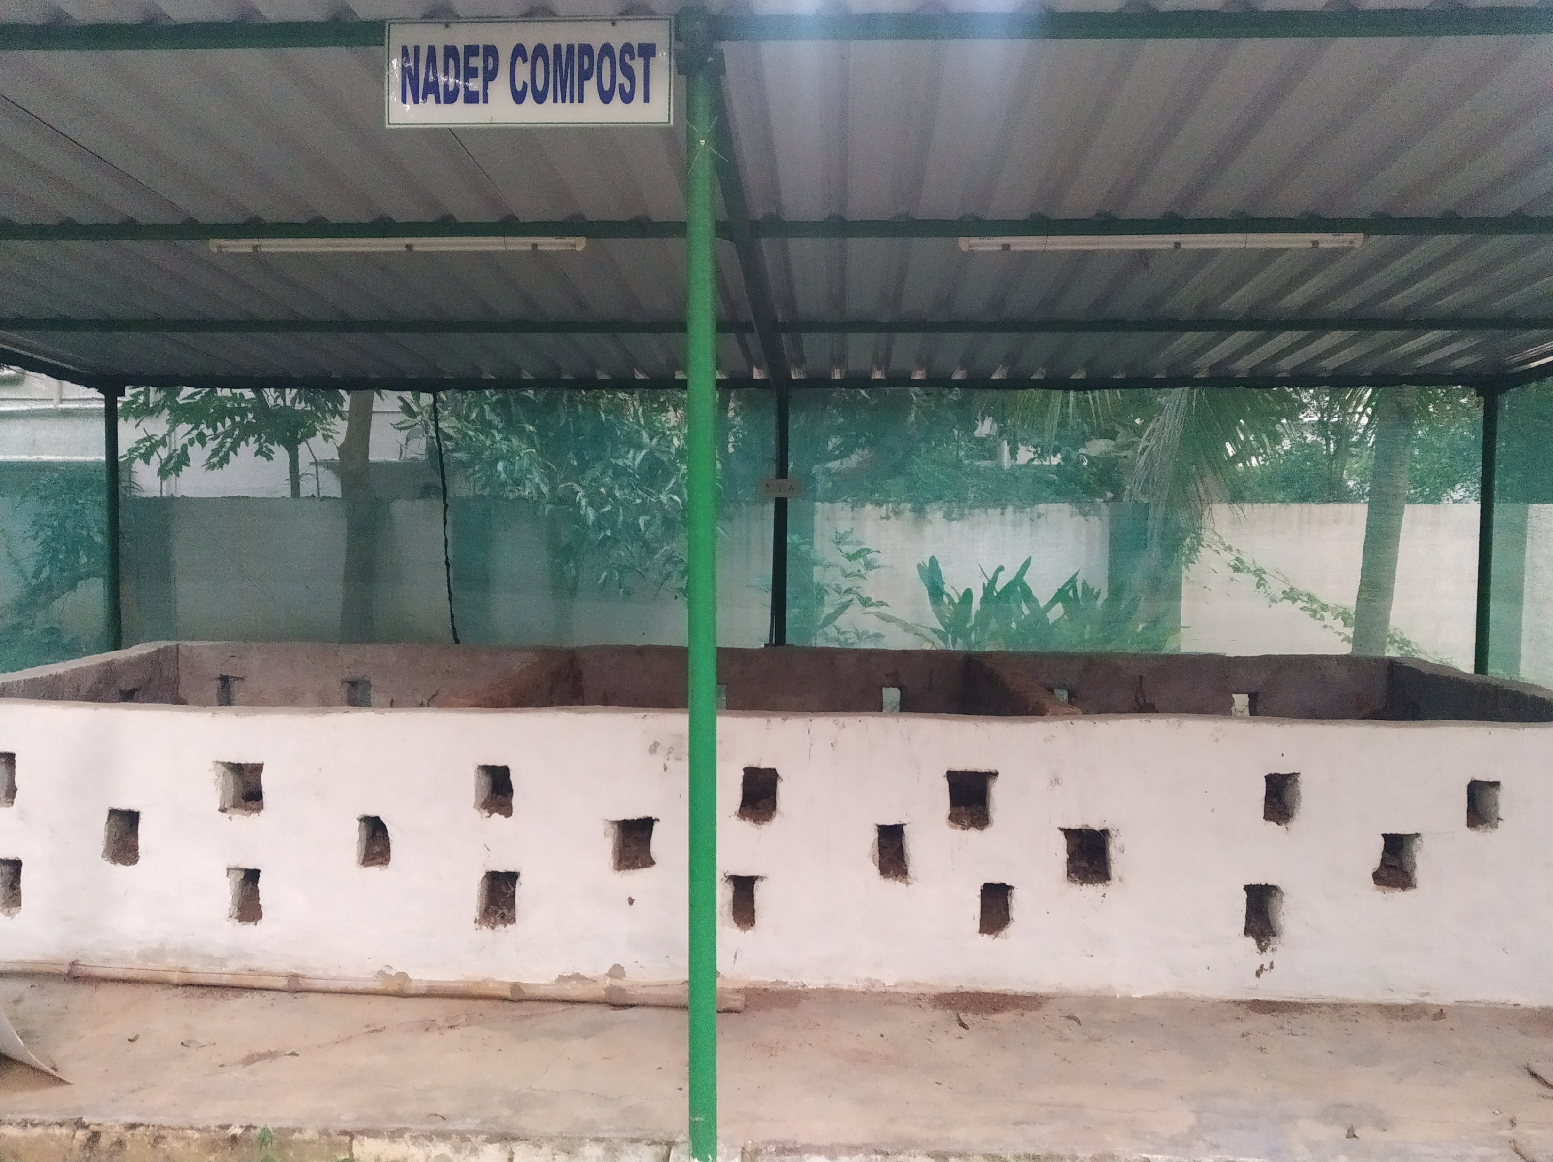
Construction of NADEP tank:
The inside dimensions of the tank are as follows: Length: 3 metres Width: 2 metres Height: 1 metre
The floor of the tank is made of bricks laid on the ground and covered with a layer of cement.
Each of the four walls has three rows of holes or gaps between the bricks
After the tank is built, the walls and floor are covered with a light plaster of fresh cow dung mixed with water, and then the plaster is left to dry.

Slide 3
Filling the Tank NADEP tank is filled in one or two days of hard work. It has to be done by a team. Before filling the tank, the following materials must be collected together:
1. Dry and green plant materials: 1400–1500 kg is needed. Grass, hay or straw that has left over from feeding animals, or that has been damaged by rain, is very suitable.
2. Cow dung or partly dried bio slurry (the discharge from a biogas digester): 90–100 kg or 10 sacks.
3. Dried soil that has been collected from cattle pens, cleaning drains, paths, etc.: 1750 kg are needed. The soil should be sieved to remove old tins, plastic, glass, stones, etc. (Contd..)
.

Slide 4
4. Water: amount varies with the season and the proportion of dry to green plant materials available. However, usually an equivalent amount to plant materials is needed, i.e. 140–150 litres.
5. If urine from cattle and/or people is available, it should be diluted in the proportion of 1 part urine for 10 parts water (1 jug of urine put into 10 jugs of water in a bucket).
6. Before starting to fill the tank, sides and floor of the tank are thoroughly wetted with slurry made from fresh cow dung mixed into water

Slide 5
The three layers used to fill the tank are as follows: First layer: use 100–150 kg of dry or mixed dry and green plant materials to make a layer 15–25 cm thick at the sides, and slightly thicker in the middle. Second layer: mix 4 kg of cow dung or 10 kg of fresh biogas slurry in 25–50 litres of water and sprinkle or scatter it over the plant materials so they get completely moistened. Third layer: cover the wet plant waste and cow dung or slurry layer with 50–60 kg of clean, sieved top soil.
Continue to fill the tank like a sandwich with these three layers put in sequence. Put more materials in the middle of the tank than around the sides. This will give a dome shape to the filled tank with the centre 30–50 cm higher than the sides.
Cover the last layer of plant materials with a layer of soil 7–8 cm thick. Make a cow dung plaster and cover the soil so that there are no cracks showing. The top of the filled tank can also be covered with plastic, particularly to protect the compost making process during rainy seasons

Slide 6
After the tank is filled, the progress of compost making can be tested by pushing a stick into the tank through the gaps in the wall.
As the materials decompose in the compost making process, the top of the filled tank will shrink down below the sides of the tank
When the compost pit has been filled or the piling of materials is complete, it should be checked regularly to make sure that there is enough but not too much moisture, and that it is getting hot, at least in the first two to three weeks (Kumawat et al., 2017).

Slide 7
Thank You

