Slide 1
Basic knowledge regarding Voltage, current, resistance and power, Ohm’s Law

Slide 2
Voltage
The unit of voltage is the volt (V)
One volt is the potential difference (voltage) between two points when one joule of energy is used to move one coulomb of charge from one point to the other
V=W/Q
Example:
How much energy is used to move 50 C from one point in a circuit to another when the voltage between the two points is 12 V?
W = Q × V = 50 × 12 J = 600 J

Slide 3
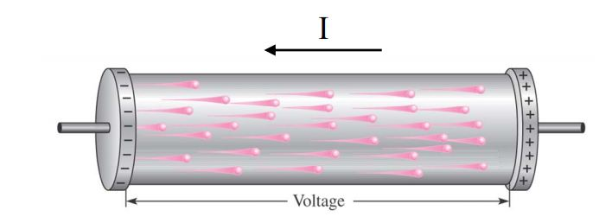
Current
The movement of free electrons from negative to positive is electrical current (I)
electrical current is the rate of flow of charge
I=Q/t

Slide 4
Resistance
The property of a material that restricts the flow of electrons is called resistance (R)
Where there is current through any material that has resistance, heat is produced by the collisions of electrons and atoms
One ohm of resistance exists if there is one ampere of current in a material when one volt is applied across the material.

Slide 5
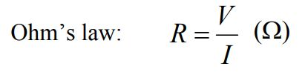
Ohm's Law
Ohm's Law is a formula used to calculate the relationship between voltage, current and resistance in an electrical circuit.
To students of electronics, Ohm's Law (E = IR) is as fundamentally important as Einstein's Relativity equation (E = mc²) is to physicists. E = I x R.

