Slide 1
Types of Microgrid System

Slide 3
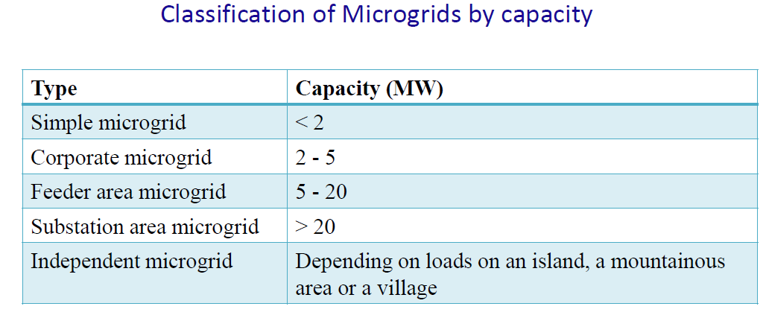

Slide 4
