Slide 1
Basic Electricity
Presented by
Prof. Nimay Chandra Giri

Slide 2
Definition
Electricity, phenomenon associated with stationary or moving electric charges.
In electricity the particle involved is the electron, which carries a charge designated, by convention, as negative.
Thus, the various manifestations of electricity are the result of the accumulation or motion of numbers of electrons.

Slide 3
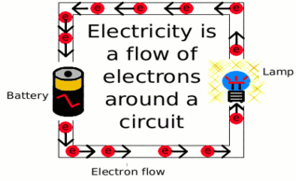
Representation

Slide 4
Importance
Electricity is a form of energy and we need it for just about everything! Almost all of our modern conveniences are electrically powered.
It is basically a no-loss energy. It converts energy into useful power without losses and without pollution.
Smart electrification will allow us to make better use of energy, reduce emissions and ultimately help mitigate climate change.

Slide 5
Use
Heating.
Cooling.
Water Heater.
Washer and Dryer.
Lights.
Refrigerator.
Electric Oven.
Charging
Machines operation

Slide 6
Parameters
Voltage: An electromotive force or potential difference between two points. Unit- Volts (V).
Current: An electric current is a flow of electric charge. Unit- Ampere (A)
Resistance: is the opposition to the flow of electric current. Unit- Ohm
Electromagnetic: it describe the electrical and magnetic forces or effects produced by an electric current.
Work: In physics, work is related to the amount of energy transferred to or from a system by a force. It is a scalar-valued quantity with SI units of Joule.
Power: Power is defined to be the rate at which work is performed, or the derivative of work over time or the ability or capacity to do something in a particular way. The SI unit for power is the watt.
Energy: Ability to do Work. It has the same units as work, the Joule (J). Energy Efficiency- the amount of energy extracted from a system divided by the total energy you put into the system.

Slide 7
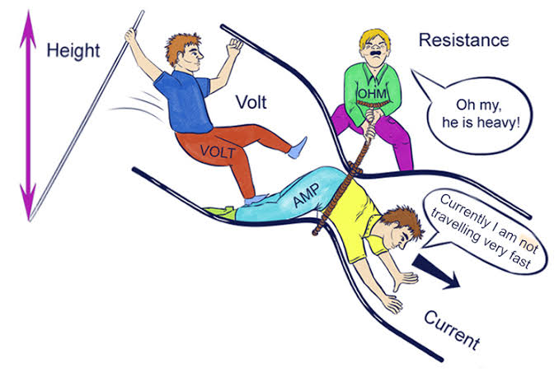
Ohm's Law
Ohm's law says that in an electrical circuit, the current passing through a resistor between two points, is related to the voltage difference between the two points, and are related to the electrical resistance between the two points.
Three forms are -V = IR, I = V/R, and R= V/I.

