Slide 1
Solar Cell, Module & Array
Presented by
Prof. Nimay Chandra Giri

Slide 2
Definition
Solar energy contains- Light energy & Heat energy.
A solar cell, or photovoltaic cell, is an electrical device that converts the energy of light directly into electricity by the photovoltaic effect (i.e. EM effect), which is a physical and chemical phenomenon.
Photovoltaic relating to the production of electric current at the junction of two substances exposed to light/photon.
A Solar PV cell is the most basic unit of a solar PV system. It is a form of photoelectric cell, defined as a device whose electrical characteristics, such as current, voltage, or resistance, vary when exposed to light. It is made up by semiconducting materials (Ex. Silicon).

Slide 3
Principle
Solar cell principle- Photovoltaic cells consist of two or more layers of semiconductors with one layer containing positive charge and the other negative charge lined adjacent to each other.
Light striking the crystals induces the “photovoltaic effect,” which generates electricity

Slide 4
Cell, Module & Array
Each Solar PV cell (Si type) can produce maximum open-circuit voltage of approximately 0.5 to 0.6 volts.
A Solar PV module/panel consists of multiple PV cells connected in series/parallel to provide a higher voltage/current output.
PV modules are manufactured in standard sizes such as 36-cells, 60-cells and 72-cells module. A PV string is a system consists of multiple PV modules.
While solar panel efficiency is generally around 15-20%, solar cell efficiency can reach 42% in some cases.
Array consists of multiple PV string in parallel.

Slide 5
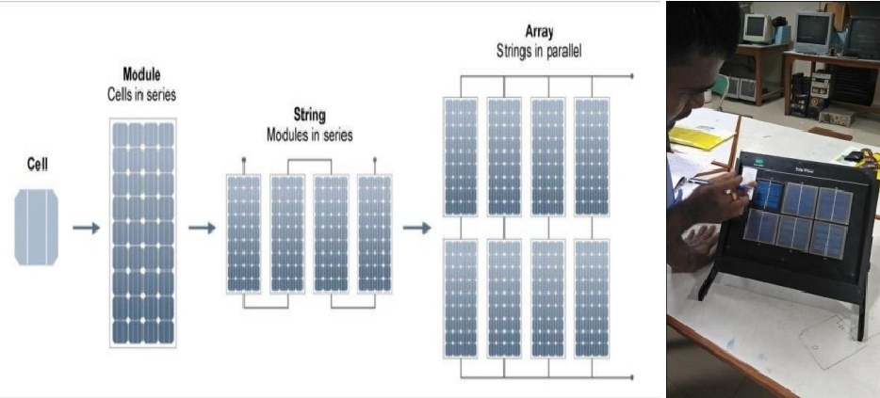
Photographs

Slide 6
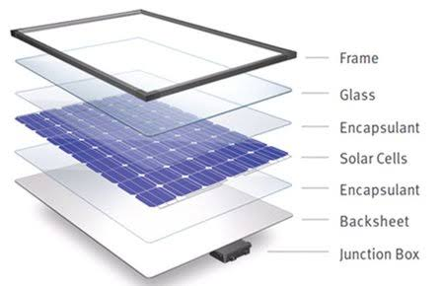
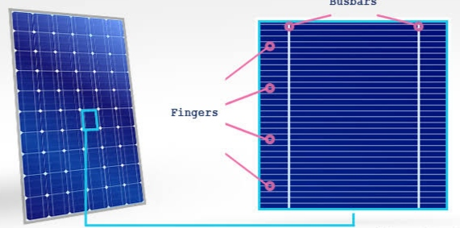
Solar PV Panel/Module

Slide 7
Advantages
Renewable energy
Clean in nature
Portable
Accessable
Eco-friendly
Economically viable
Easy to install
Minimum O&M

Slide 8
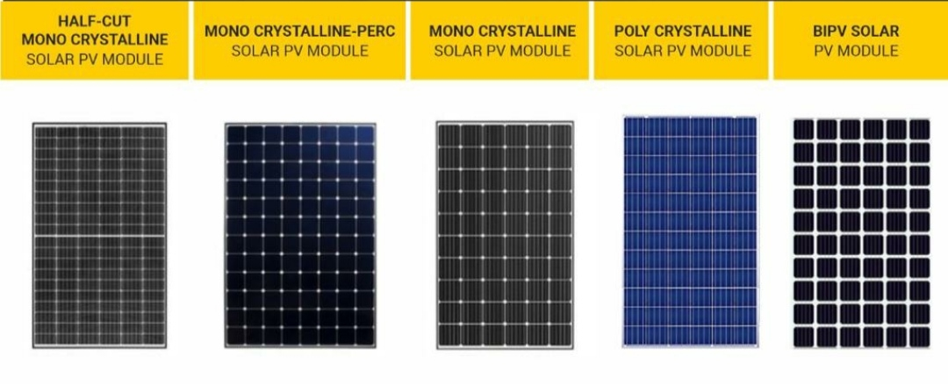
Technology

Slide 9
Operation
The operation of a photovoltaic (PV) cell requires three basic attributes:
The absorption of light, generating either electron-hole pairs or excitons.
The separation of charge carriers of opposite types.
The separate extraction of those carriers to an external circuit.

Slide 10
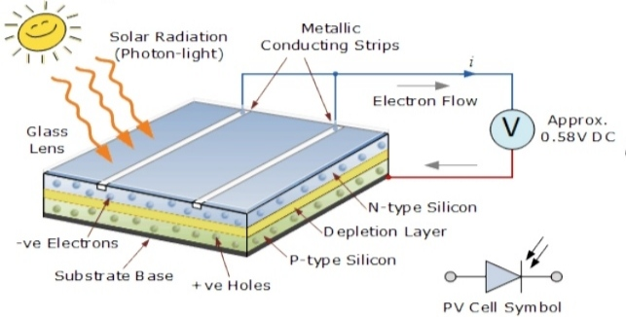
Photographs: Operation

Slide 11
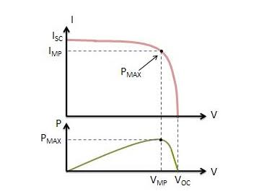
IV Characteristics
It represents the changes of current, I w.r.t. variable voltage, V. The IV & PV curve is as below

Slide 12
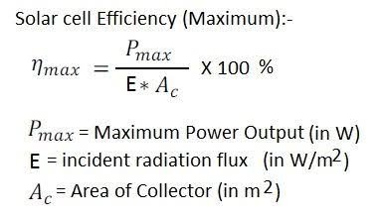
Efficiency
Efficiency = Pout / Pin. To calculate Pin (the input power) use the area of the solar cell.
It also depends on parameters like- Light,temperature , weather, shadow, materials...

