Slide 1
Solar PV System
Presented by
Prof. Nimay Chandra Giri

Slide 2
Definition
Solar PV system consists of - Solar panel, Controller/ Inverter, Battery and Electrical appliances.
PV Modules: Converts sunlight into DC electricity.
Solar Charge Controller: Regulates the voltage and current coming from the PV panels going to battery and prevents battery overcharging and prolongs the battery life.
Inverter: Converts DC output of PV panels into a clean AC current for AC appliances or fed back into grid line.
Battery: Stores energy for supplying to electrical appliances when there is a demand

Slide 3
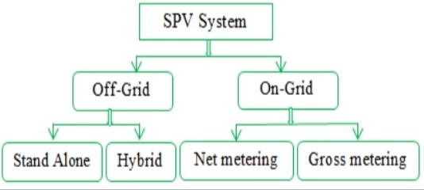
Types

Slide 4
Block Diagram: On-grid system

Slide 5
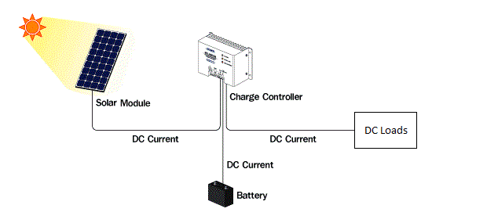
Block Diagram: Off-grid system

Slide 6
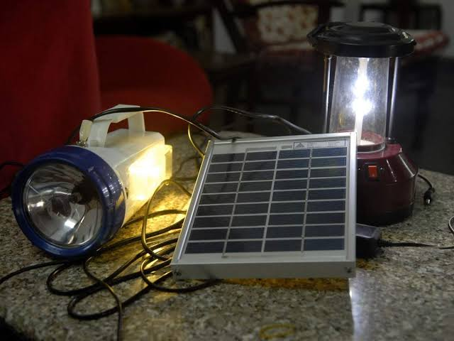
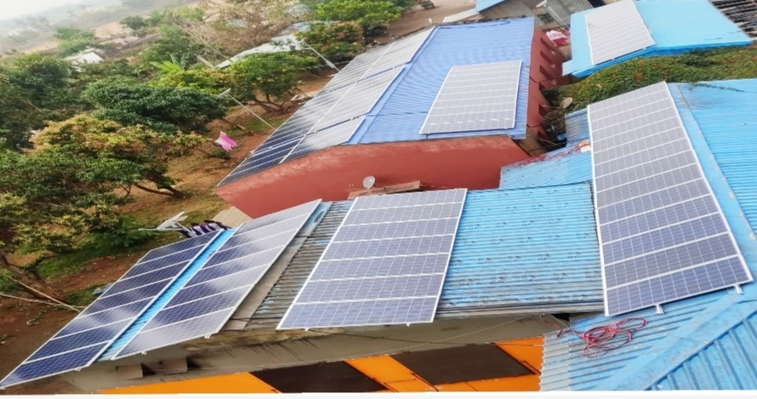
Photographs

Slide 7
Advantages
Renewable energy
Environment friendly
Easy to install
Minimum O&M required
Reduce the electricity bill
Extra power can be fed to the grid
Creat employbility

Slide 8
Applications
Installed in rooftops, Industry premises, School, Medicals, Railway etc.
Saving Commercial Units.
Backup Power supply.
Environmental Friendly.
Ever Green System.
Agricultural

