Slide 1
Solar Battery
Presented by
Prof. Nimay Chandra Giri

Slide 2
Definition
A container consisting of one or more cells, in which chemical energy is converted into electricity and used as a source of power.
A device that reserves energy for later consumption that is charged by a connected solar system, is known as Solar Battery.
Rated in Volt Ampere Hours (V Ah) C10
Capacity - Ah

Slide 3
Types
Maintenance free battery: come sealed for life from the factory, and do not require maintenance of the electrolyte levels.
Efficiency - 75-80%
It is a secondary cell, meaning that it is rechargeable. Pure lead or lead oxide used for the electrodes. Efficiency - 80-90%.
Lithium-ion battery: rechargeable battery that uses lithium ions as the primary component of its electrolyte. Efficiency - 90-98%.

Slide 4
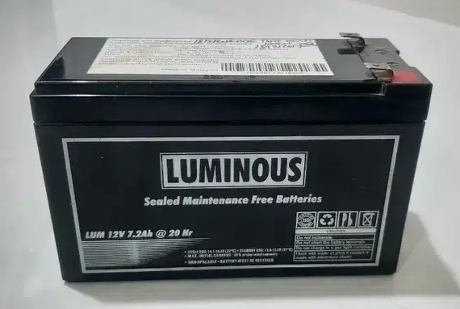
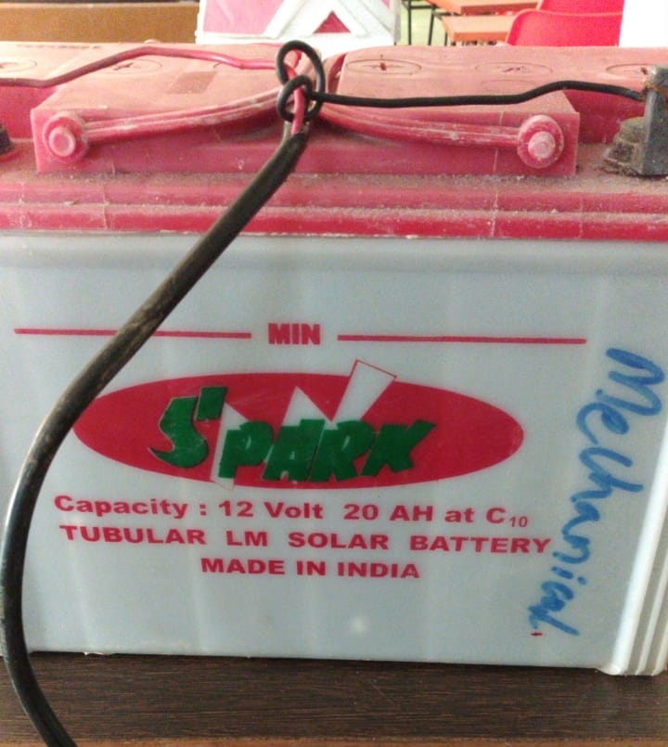

Photographs

Slide 5
Calculation
Charging of battery: Example: Take 100 AH battery. If the applied Current is 10 Amperes from Solar panel, then it would be 100Ah/10A= 10 hrs approximately.
Discharge time is basically the Ah or mAh rating divided by the current.
So for a 100Ah battery with a load that draws 10A you have: 100Ah/10A= 10 hours takes.

Slide 6
Advantages
Store energy
Compatible
Portable
Low maintenance

Slide 7
Applications
To run emergency light
To run study light
To run street light
To run Camera
To run Phone
To run Laptop
To run Electronic circuit

