Slide 1
Solar Charge Controller
Presented by
Prof. Nimay Chandra Giri

Slide 2
Definition
CCR is a electrical device, which is used to control the flow of current in the circuit.
It also control voltage from/to the Panel and also from/to the Battery.
A solar charge controller is available in two different technologies, PWM and MPPT.
MPPT has higher efficiency than PWM type.
PWM is preferable for Home applications but MPPT is for industrial applications.
Rating : Volt Ampere (DC).

Slide 3
Function
A charge controller or charge regulator is basically a voltage and/or current regulator to keep batteries from overcharging.
It regulates the voltage and current coming from the solar panels going to the battery.
It also control the flow of current to the load.

Slide 4
Congratulation : PWM
12V solar panel can charge a 12V battery. A 24V solar panel or solar array (two 12V panels wired in series) is needed for a 24V battery bank, and 48V array is needed for 48V bank. If you try to charge a 12V battery with a 24V solar panel, you will be throwing over half of the panel’s power away. If you try to charge a 24V battery bank with a 12V solar panel, you will be throwing away 100% of the panel’s potential, and may actually drain the battery as well.

Slide 5
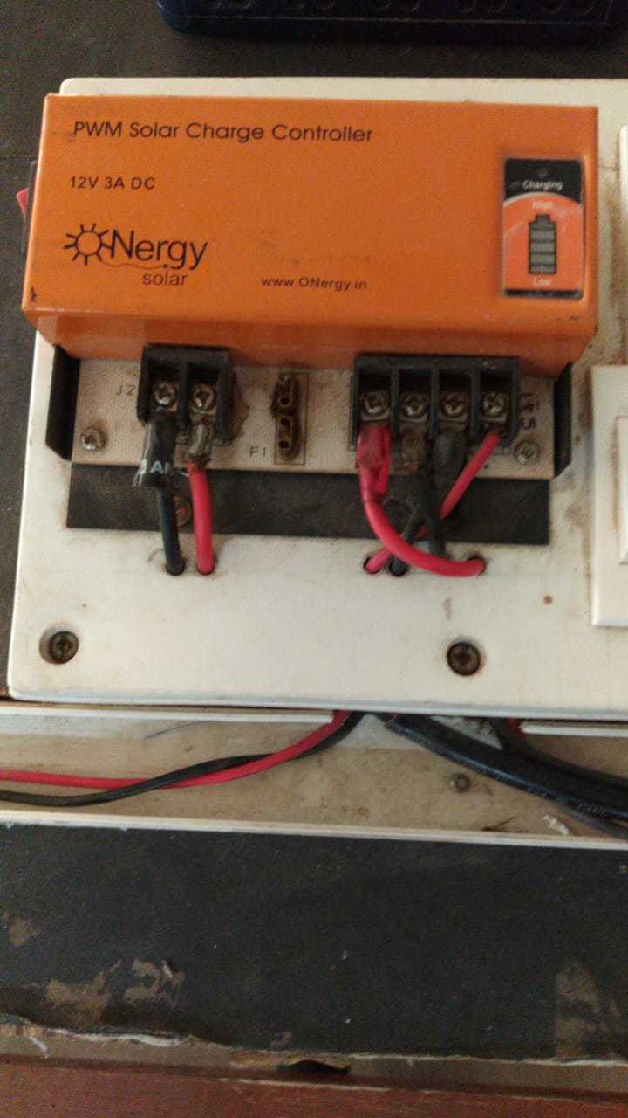
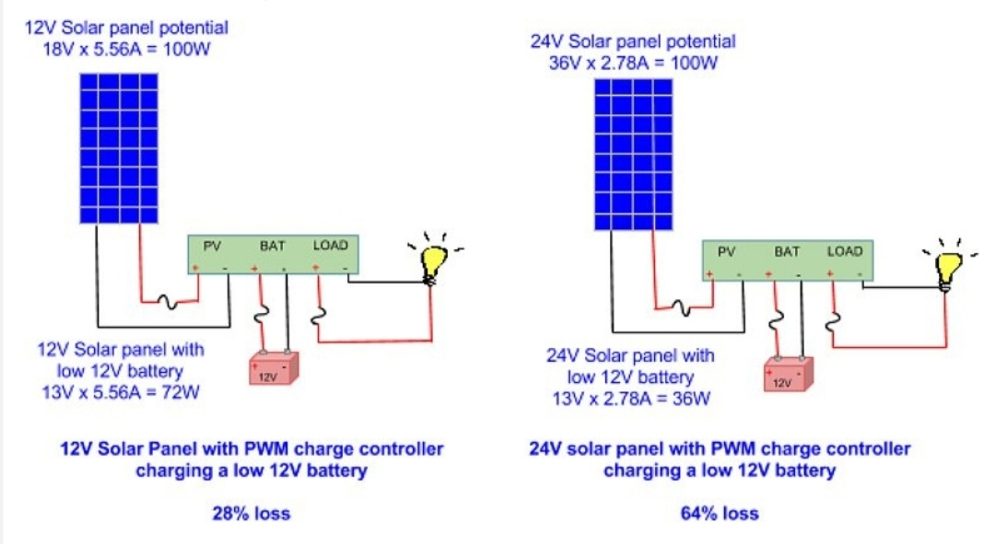
Photographs

Slide 6
Congratulations : MPPT
With a 20V solar panel, you can charge a 12V battery bank, or two in series can charge up to a 24V battery bank, and three in series can charge up to a 48V battery bank. This opens up a whole wide range of solar panels that now can be used for your off-grid solar system.

Slide 7
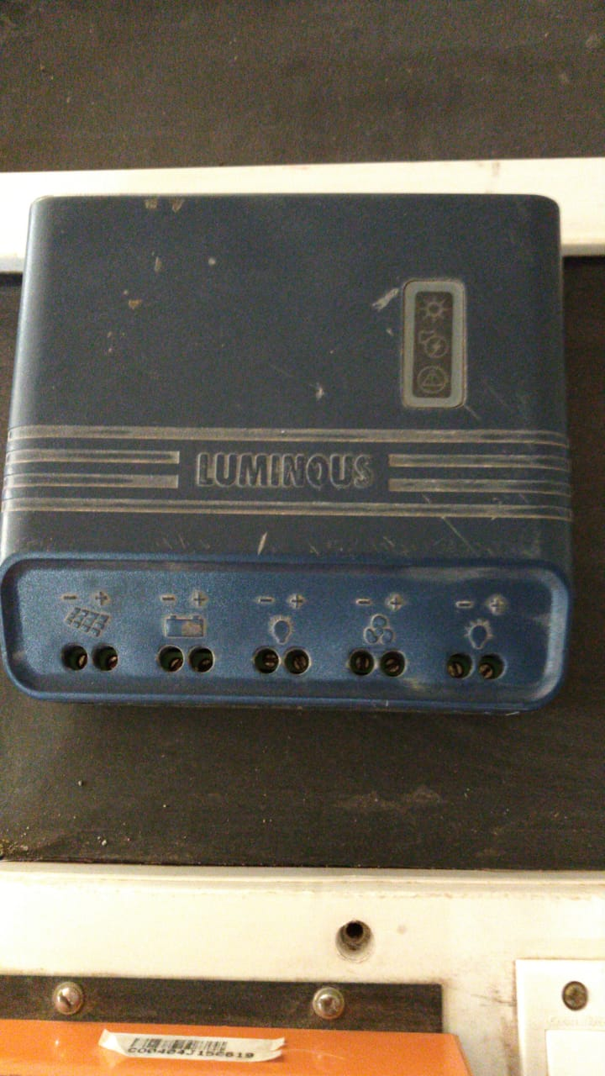
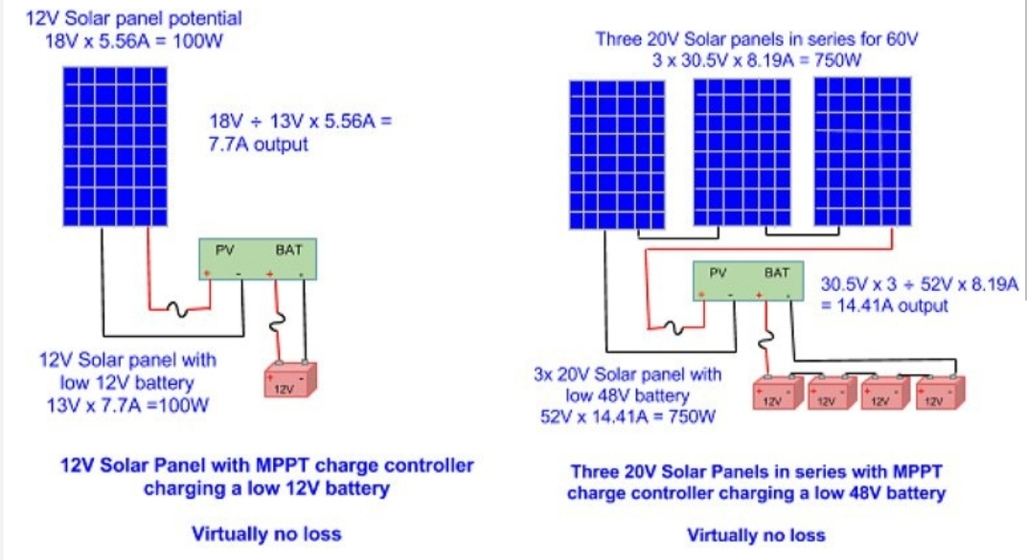
Photographs

