Slide 1
Work, Power & Energy
Presented by
Prof. Nimay Chandra Giri

Slide 2
Definition
Work: In physics, work is related to the amount of energy transferred to or from a system by a force. It is a scalar-valued quantity with SI units of Joule.
Power: Power is defined to be the rate at which work is performed, or the derivative of work over time or the ability or capacity to do something in a particular way. The SI unit for power is the watt.
Energy cannot be created or destroyed; it can only be converted from one form to another. It can only change its form. Energy (E): in physics, the ability to do work. (E = mc2). E is measured in joules (J) & Power (P) is measured in watts (W), 1 W = 1 J s-1

Slide 3
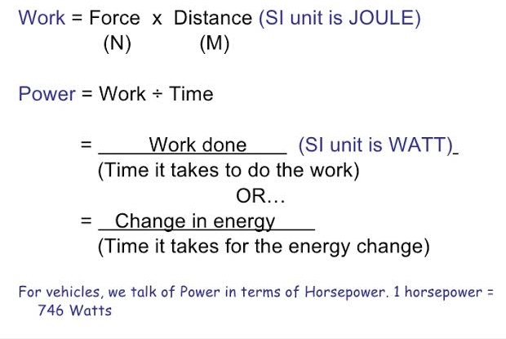
Calculation
Energy formula: Power x Time in Joule

Slide 4
Example
If a solar panel have Voltage - 12 V, Current - 2 A and avg hours of sunlight, find out the Power and Energy of the System.
Ans- Power = VxI =12*2=24 Watt
Energy=PxT=24*5=120 J
Output of a Solar Panel= panel watts x average hours of sunlight x 75% = daily watt-hours
As an example, let’s say you have 250-watt solar panels and live in a place where you get 5 hours of sunlight per day. What’s that 75 percent for? That’s to account for all those variables we've been going over.
250 watts x 5 hours x .75 = 937.5 daily watt hours,To round up and make it pretty, that’s 0.94 kilowatt-hours per solar panel.

