Slide 1

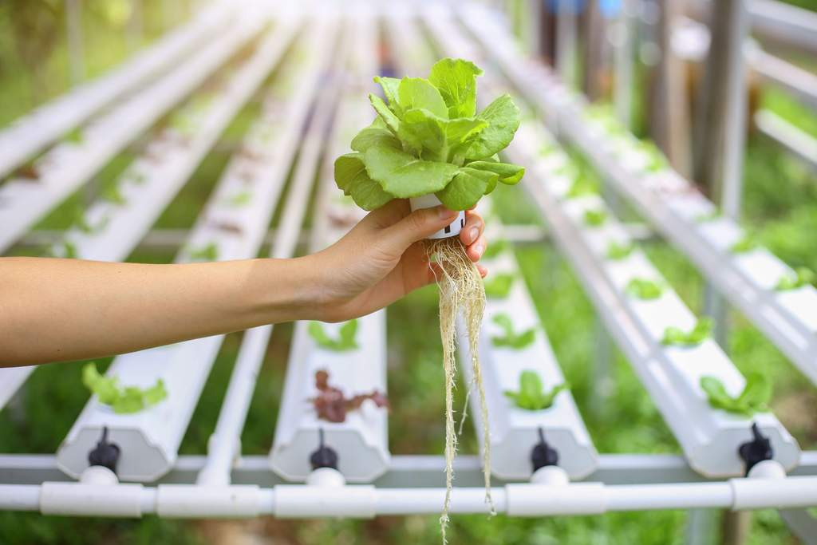

Lecture 1 Introduction, Scope and Importance of Hydroponics technology

Slide 2


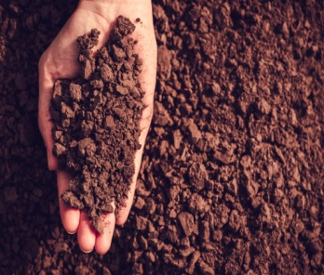


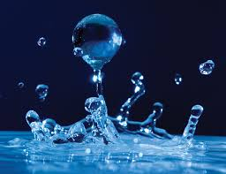
What does a plant need to grow ?
Soil
Sun light
Nutrient
Plant
Water
Soil is just a medium to provide nutrients to the plant.
Water is as good a medium as soil.

Slide 3

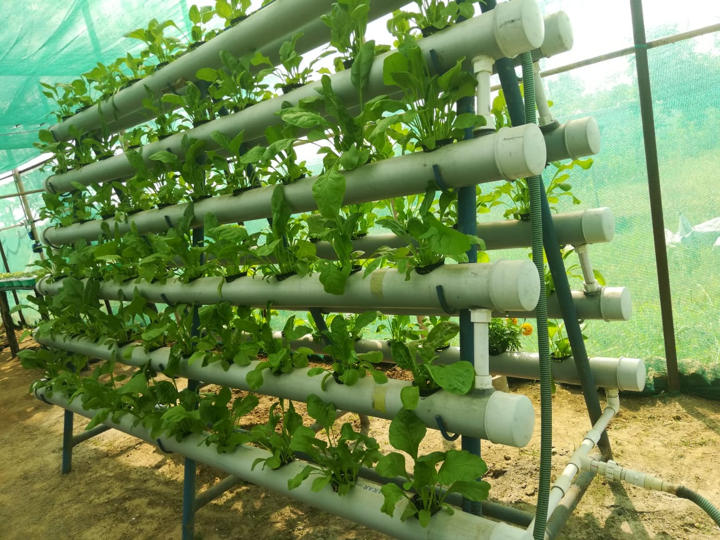
The word hydroponics has derived from combining the two Greek words, hydro, meaning water, and ponos, meaning labor (i.e., working water).
Hydroponics is a method of growing plants using a solution of suitable nutrients instead of soil and the plants need some type of inert medium to support the root system.

Slide 4
Historical background of hydroponics
The classic work on growing terrestrial plants without soil was published by Sir Francis Bacon in 1627, the book named ‘Sylva Sylvarum’.
It was Professor William Frederick Gericke (1937), who finally introduced the term hydroponics and wrote the book named ‘Complete Guide to Soilless Gardening’.
Hydroponics did not reach India until 1946. The first research studies were started at the Government of Bengal’s Experimental Farm at Kalimpong in the Darjeeling district. Initially a number of problems were faced but later on after a careful appraisal of salient problems, during 1946-47, the Bengal System of hydroponics was developed representing the efforts to meet Indian requirements.

Slide 5
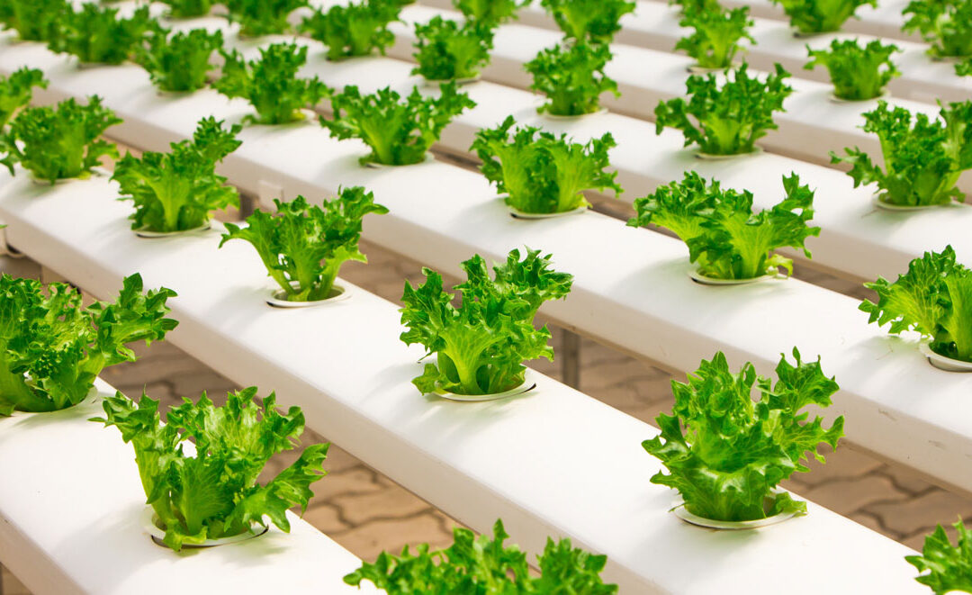
No soil needed
Saves water
Greater control of nutrients
Better utilization of space
Advantages
Plants grow faster and larger
Off season production
No tillage, Weeds, less pests
Controlled climate
Ease of harvesting
Less labor intensive

Slide 6
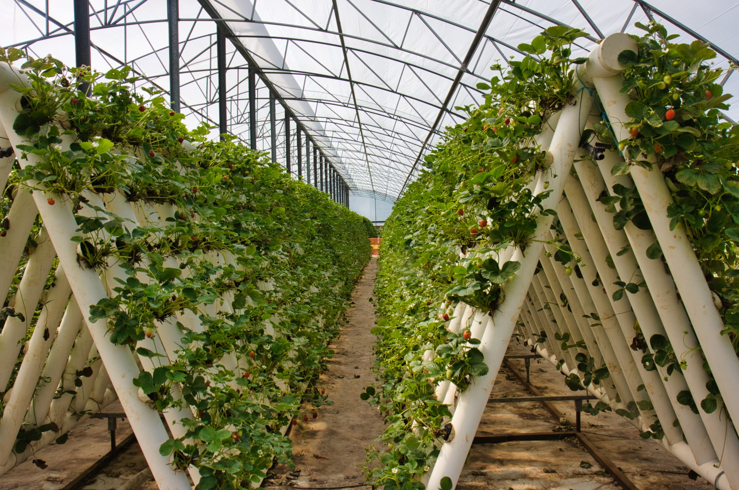

Insect and disease infestation
Water and electricity risk
Formulated soluble nutrient required
System failure threats
Disadvantages
Daily monitoring required
Expertise required
High initial investment

Slide 7
Scope and Importance of hydroponics
Hydroponics scope is very good especially in India as most of the vegetable supplies available are with residual chemicals and harmful to our health. No matter how rich or poor we are, these vegetable supplies are same for all of us and affect to us and our children.
Entrepreneurs with visions could enter into commercial farming and flood hydroponic vegetables to the super market stores on big margin and earn tax free, market slump free regular income.

Slide 8


