Slide 1

Lecture 11
Seeding and establishment

Slide 2
Propagation
Propagation is simply the creation of new plants. Many growers propagate using hydroponic techniques to benefit from early rooting and faster growth rates. This is possible because hydroponic growing media provides the root zone with easy access to water, nutrient and oxygen.

Slide 3
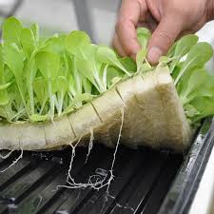

Slide 4
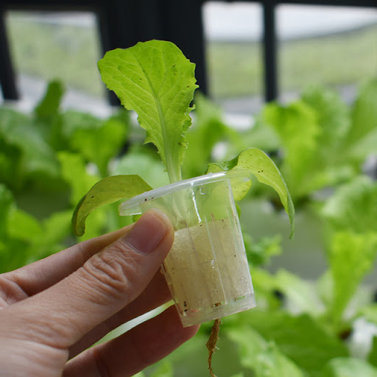

Slide 5
Propagation: Seed vs. cuttings
Firstly, as with any type of propagation, you need to decide whether you want to grow from seeds or cuttings. Generally, growers who propagate from seed do so because it gives them peace of mind that their plants will be disease and pest free. However, the main draw back with seeds is that the characteristics of plants you produce can be inconsistent. Whereas, with cuttings you are producing plants that are identical to their healthy parent, this is why cuttings are also referred to as ‘clones’.

Slide 6


