Slide 1

Lecture 12
Assessment of water quality, principal factors involving EC and pH

Slide 2
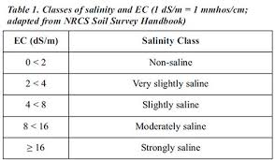
Total Dissolved Solids (TDS)or Electrical Conductivity (EC)in Hydroponics
Conductivity is really a measure of the nutrients in the solution.
Low conductivity implies a low nutrient concentration, which usually results in nutritional deficiencies and slow growth rates of plants.
However, Be careful of very high level as these can burn and or kill the plants.

Slide 3
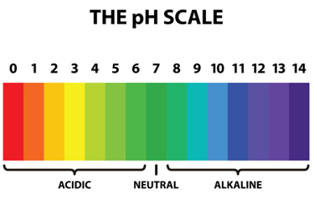
Importance of pH in Hydroponics
pH (hydrogen ion concentration)
It is a numeric scale used to specify the acidity or basicity of an aqueous solution.
pH is very important in hydroponics and organic as well as regular soil gardening.
pH is measured on the scale of 1 to 14 with 7 being neutral.

Slide 4
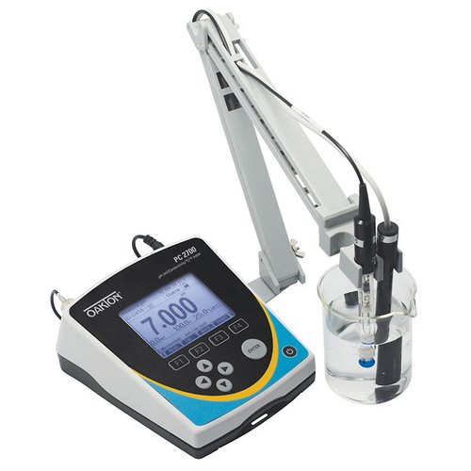
pH Meter

Slide 5
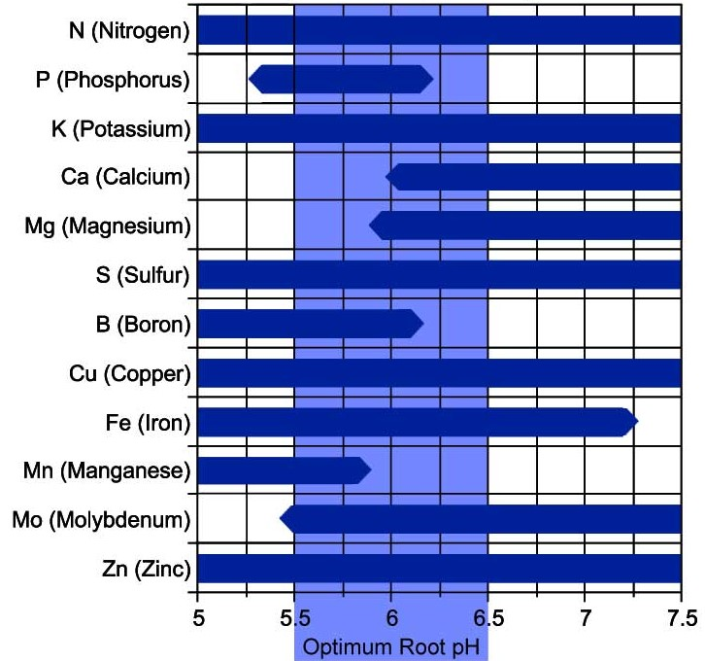

Slide 6
How to adjust PH…..?
pH can be adjusted by natural products like lemon or also with chemical like phosphoric acid or potassium hydroxide.
Preparing a phosphoric acid or potassium Hydroxide: add small quantity of these acids to a glass of warm water and stir well before adding it to the nutrient solution. Once in the solution, Stir well again, or leave for 75 minutes before testing pH.
In soft water areas very little pH adjustment (if any) will be needed but in hard water areas the pH will rise gradually.

Slide 7


