Slide 1

Lecture 14
Monitoring of plant health, hydroponic environment, nutrient solution, perform routine maintenance checks

Slide 2
During the plant cultivation, several steps including temperature, humidity,
light intensity, water nutrient solution level, pH and EC value, CO2 concentration, atomization time, and atomization interval
time require proper attention for flourishing plant growth. Therefore, the object of this review study was to provide significant
knowledge about early fault detection and diagnosis in aeroponics using intelligent techniques (wireless sensors). So, the farmer
could monitor several paraments without using laboratory instruments, and the farmer could control the entire system
remotely.

Slide 3
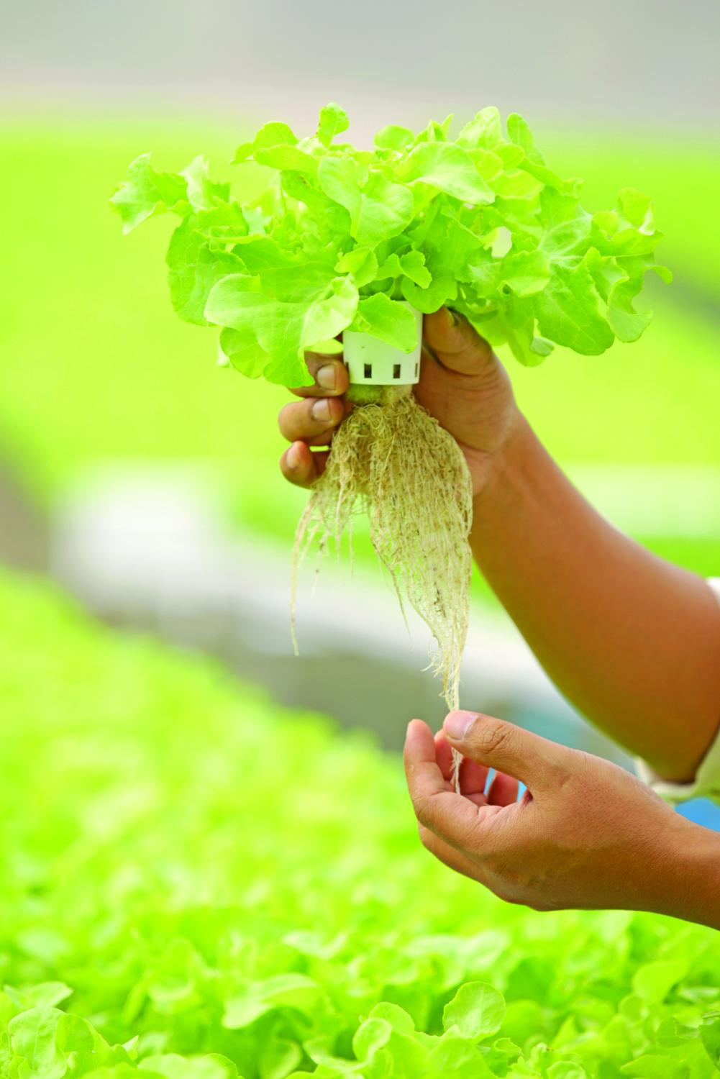

Slide 4
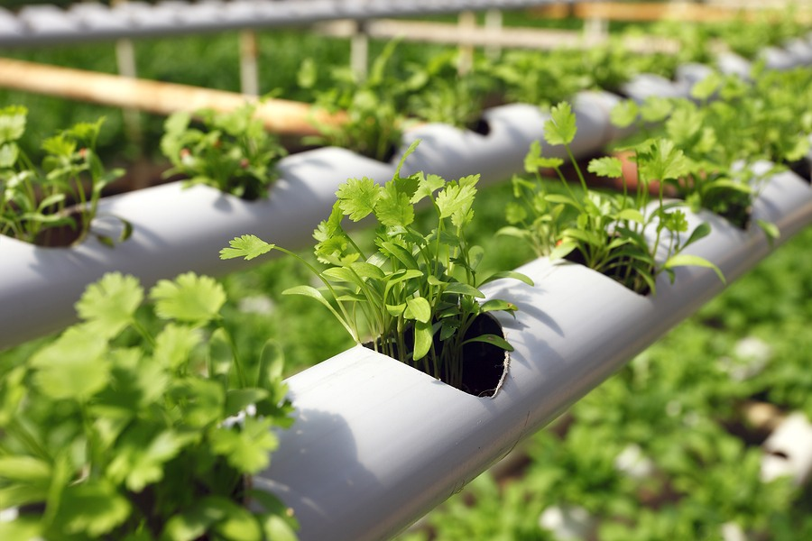

Slide 5


