Slide 1

Lecture 2
Plant Growth Requirements, Importance of light, temperature and humidity

Slide 2
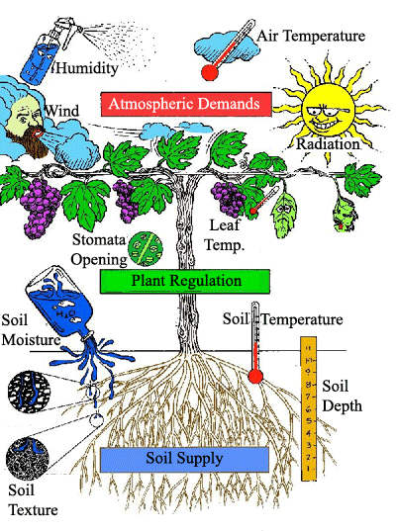

Slide 3
Importance of light to the plants
Light is an essential factor in maintaining plants.
The rate of growth and length of time a plant remains active is dependent on the amount of light it receives.
Light energy is used in photosynthesis, the plant’s most basic metabolic process.
When determining the effect of light on plant growth there are three areas to consider: intensity, duration and quality.

Slide 4
Importance of temperature on crop plants
Growth and development
Leaf production, expansion and flowering
Physical and chemical processes within the plants
Temperature
Enzymatic activities
Biochemical reactions in crops

Slide 5
Effects of humidity on crops
Keeping the stomata open
Humidity
Cooling of the plant
Reduce transpiration loss

Slide 6
Improving the microclimate
To improve the microclimate, you can keep extra humidity in the plants by providing good coverage.
In addition, the microclimate can also be improved by watering.
An irrigation pipe is the best option to moisten the top layer of the substrate than an irrigation tube.
Especially for countries with a warmer climate, it is therefore necessary to have an irrigation pipe to improve the microclimate.
By moistening the top layer of the substrate, water from the substrate can evaporate better, which improves the microclimate.
By irrigating more often with smaller quantities, the microclimate around the plant will be kept moister during the day

Slide 7


