Slide 1

Lecture 3
Nutrient requirements, deficiencies, toxicities

Slide 2

There are seventeen essential nutrients that are supplied to crops. Of these, three are available through water uptake and gas exchange (the air): Carbon through CO₂, hydrogen, and oxygen.
6 macronutrients are
N, P, K, Ca, Mg and S
Others are micronutrients
Lastly added essential micronutrient is Ni and it is essential for regulating N metabolism, grain filling and seed viability.

Slide 3
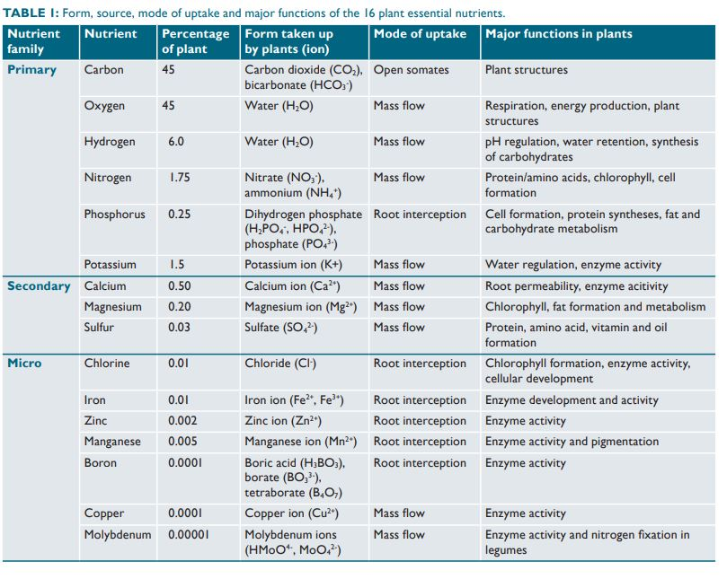
Role of different nutrients in plant growth

Slide 4

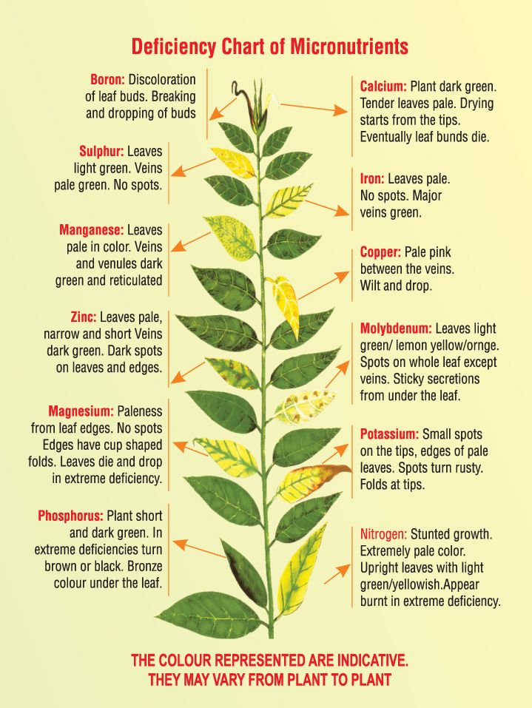
Deficiency Symptoms for Essential Elements

Slide 5
Toxicity Symptoms for Essential Elements
N: Restricted root system. Potatoes form only small tubers, and flowering and seed production can be retarded.
P: Sometimes copper and zinc deficiency occurs in the presence of excess phosphorus
K: Oranges develop coarse fruit at high potassium levels. Excess potassium may lead to magnesium deficiency and possible manganese, zinc, or iron deficiency
S: Reduction in growth and leaf size. Leaf symptoms often absent or poorly defined. Sometimes interveinal yellowing or leaf burning.

Slide 6
Mg: Very little information available on visual symptoms.
Ca: Usually associated with excess carbonate
Fe: It appears as necrotic spots.
Cl: Burning or firing of leaf tip or margins. Bronzing, yellowing, and leaf abscission and sometimes chlorosis. Reduced leaf size and lower growth rate
Mn: Sometimes chlorosis, uneven chlorophyll distribution, and iron deficiency (pineapple). Reduction in growth.
B: Yellowing of leaf tip followed by progressive necrosis of the leaf beginning at tip or margins and proceeding toward midrib.

Slide 7
Zn: Excess zinc commonly produces iron chlorosis in plants.
Cu: Reduced growth followed by symptoms of iron chlorosis, stunting, reduced branching, thickening, and abnormal darkening of rootlets.
Mo: Tomato leaves turn golden yellow

Slide 8


