Slide 1

Lecture 4 Plant structure, photosynthesis, characteristics of different root‐zone factors and their application

Slide 2
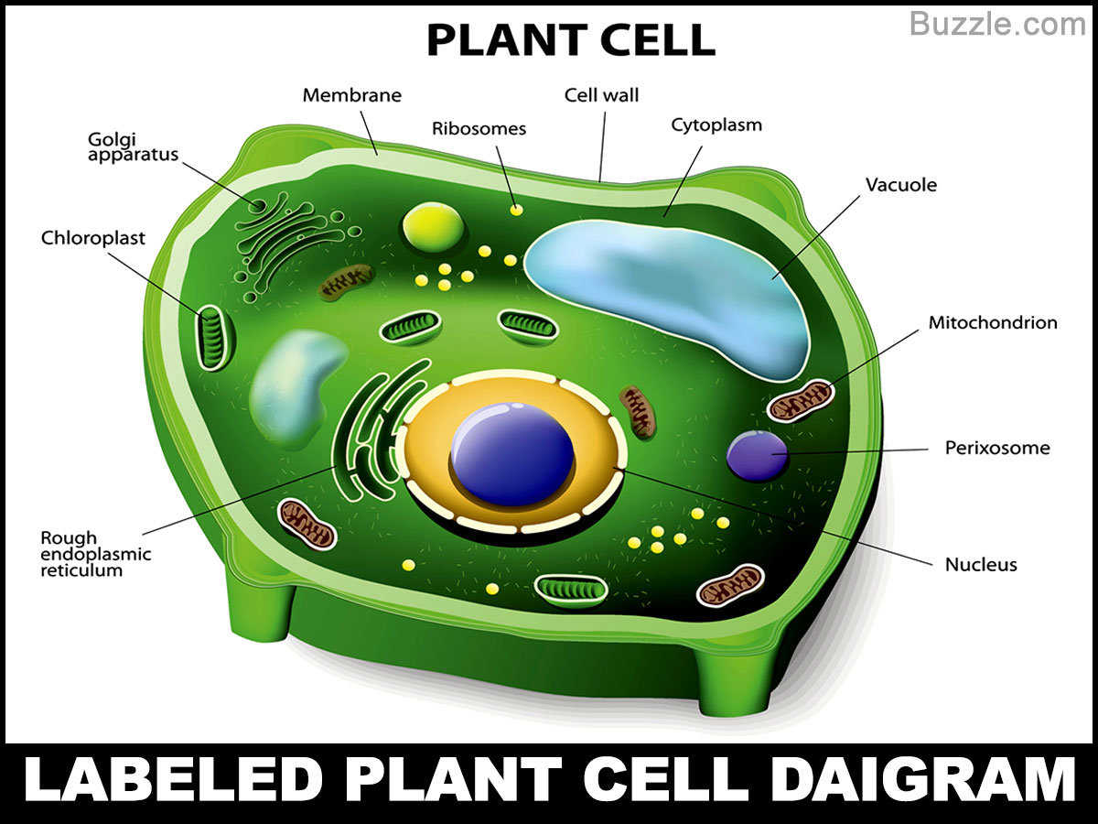
Plant Cell Structures
Structures found in plant cells but not animal cells include a large central vacuole, cell wall, and plastids such as chloroplasts.

Slide 3
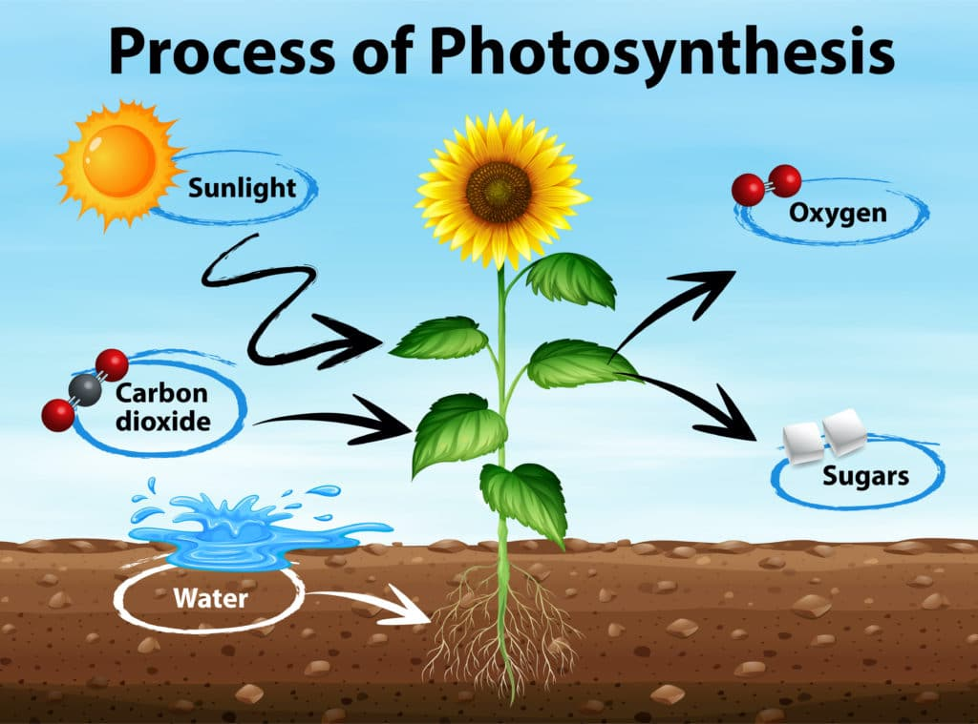

Photosynthesis

Slide 4
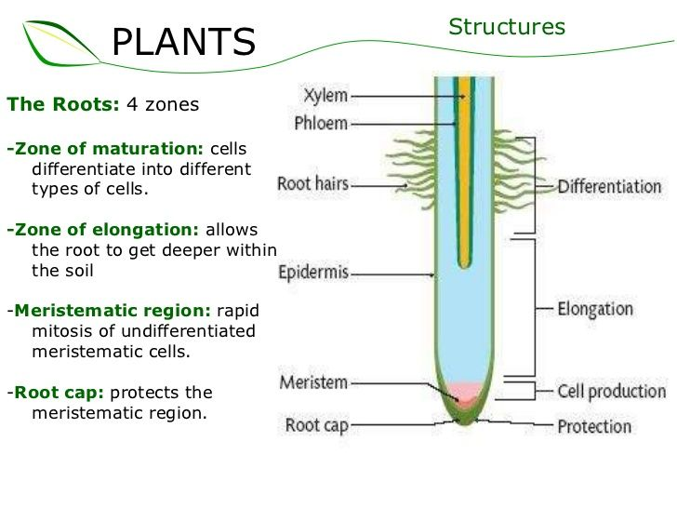
Root Zones

Slide 5


